Slide 1

What Can YOU Do to Improve the
Air We Breathe?

Slide 2

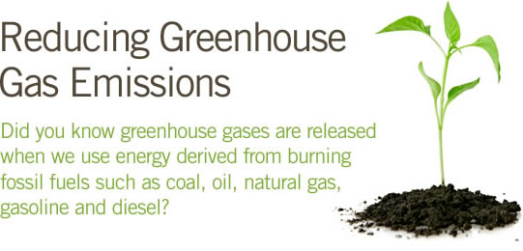
As A Community:
Build greener using materials that are recycled
Reduce green house gases by using electricity from a renewable source
Ride the bus more often, ride a bike or car pool; the less cars on the road the less emissions
Insist that public transportation is fueled by alternative fuels like CNG
Our RTA buses are almost all run on compressed natural gas

Slide 3

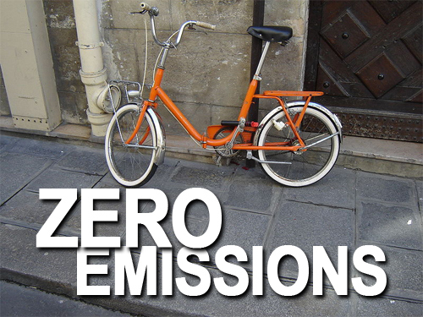
As An Individual:
Combine errands to save gas and reduce exhaust; better yet, park and walk!
Don’t Idle! Idling is running vehicle instead of turning it off.
Make the switch to cleaner fuels!
Slow down when you drive!
Don’t overfill your tank! This will help prevent leaks and evaporation.
Keep up with your vehicles engine….the better it runs the better it is on gas.
Check the air pressure in your tires regularly
Do not fill your tank on O-zone action days

Slide 4

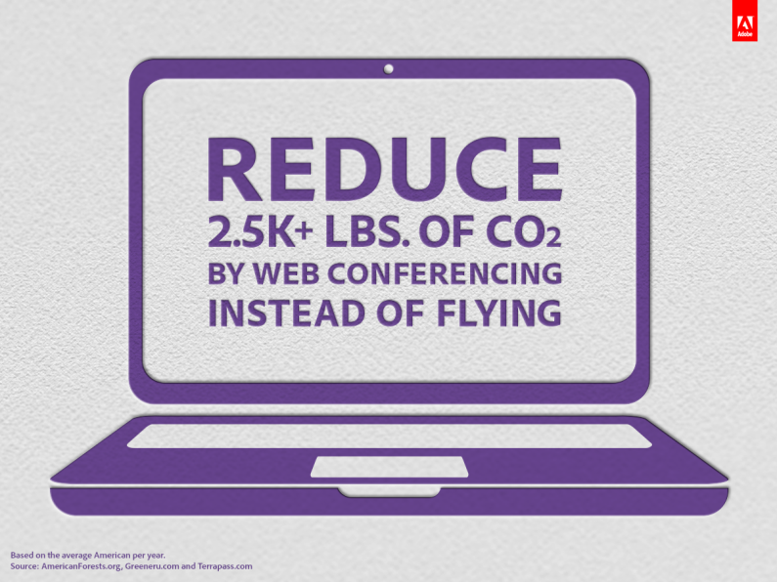
As A Business:
When replacing fleet---go alternative fuel!
Don’t Idle!
Support air shed planning
Have us do free fleet emissions testing for your fleet!
Do your part to conserve electricity

Slide 5
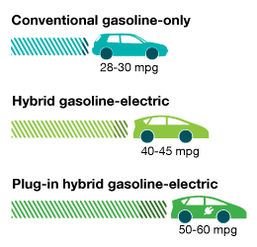
Alternative fuel vehicles
Though the sticker price of alternative fuel vehicles may look more expensive….you have to look at the cost savings in the long run on fuel and the saving to the environment in emissions!

Slide 6
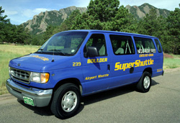
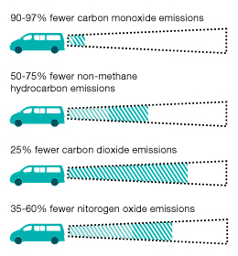
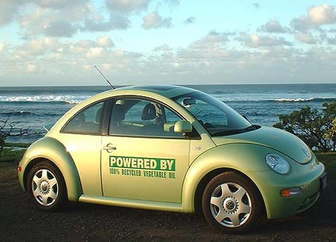
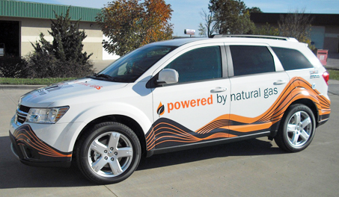
Alternative Fuel Vehicles

Slide 7







Make clean air a part of YOUR Routine!

Slide 8

For more information or to schedule emissions testing please call 361-825-3070

