Slide 1



Pollution Prevention Partnership
Reducing ground level ozone in Nueces and San Patricio counties since 1995

Slide 2
Why Care About Air Pollution?
Ecology
Health
Economy
Major Toxic Pollutants in Vehicle Exhaust:
  VOC— Volatile Organic Compounds, ingredients for ozone
      Unburned Fuels in Exhaust, Evaporated Fuels and Solvents
  NOx—Oxides of Nitrogen, ingredient for ozone
  PM—Particulate Matter, lodges in the lungs
  CO—Carbon Monoxide, a colorless, odorless, poisonous gas
  HCHO—Formaldehyde, a lung irritant and carcinogen
Some Economic Costs of EPA Non-Attainment
(Ozone averages >70 ppb Oct. 2015)
  Possible loss of industry and economic development
  Possible loss of federal highway and transit funding
  Restrictive permitting requirements not applied in attainment areas
  Technical and Formula Changes for product manufacturing
Notes:
Pick a reason !

Slide 3
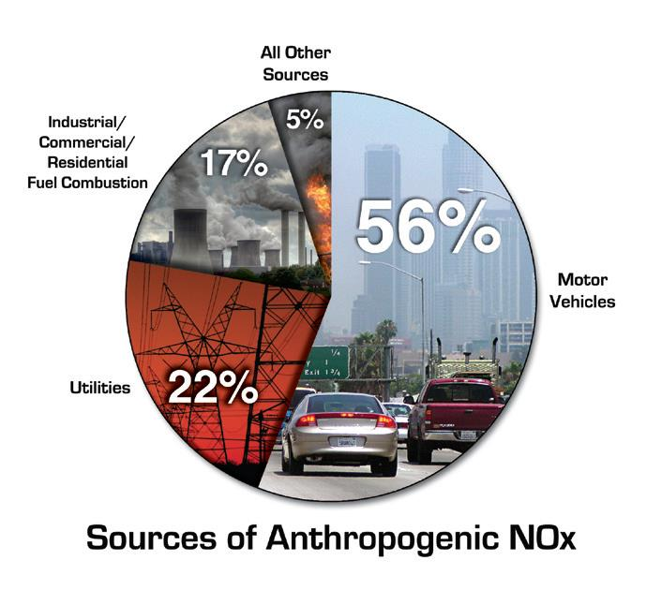
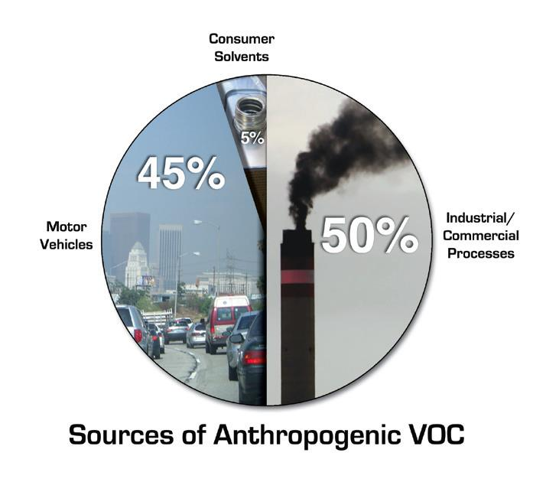

Sources of Primary Pollutants
From EPA brochure OZONE

Slide 4
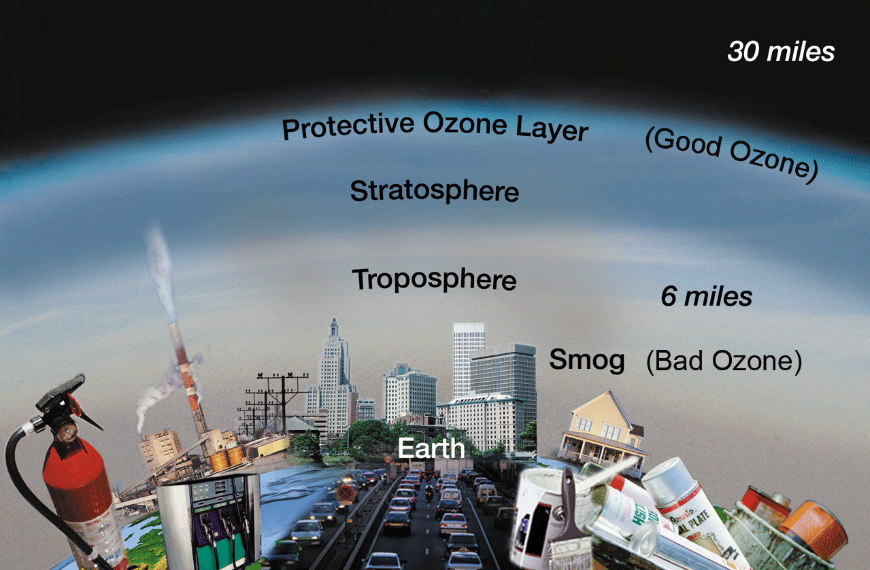
Focus on Ozone
Ozone Good Up High
Ozone Bad Nearby

Slide 5
Ground Level Ozone Formation
NO_{X}
Oxides of Nitrogen
UV
Sunlight
Ozone
VOC
Volatile Organic Compounds
Corpus Christi Region Ozone Season:
April 1 to October 31
VOC’s - Unburned Fuels in Exhaust, Evaporated Fuels, Solvents and

Slide 6
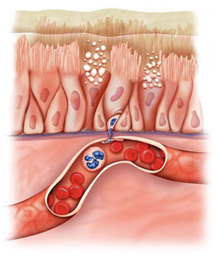

Health Effects
Difficulty breathing deeply and vigorously
Shortness of breath and pain when taking deep breaths
Coughing and sore or scratchy throat
Inflammation and damaged airways
Aggravated lung diseases: asthma, emphysema, and chronic bronchitis.
Increased the frequency of asthma attacks.
Lungs more susceptible to infection.
Continued lung damage even when the symptoms have disappeared.
With airway inflammation, there is an influx of white blood cells, increased mucous production, and fluid accumulation and retention. This causes the death and shedding of cells that line the airways and has been compared to the skin caused by sunburn.
Most at Risk
Children
Adults who are active outdoors.
People with respiratory diseases, such as asthma
People with unusual susceptibility to ozone
http://www3.epa.gov/ozonepollution/health.html

Slide 7

The Fix
Reduce Emissions!
Find and Fix Gross Polluters
Reduce Normal Emissions
Change Habits
Alternative Fuels
Emission Controls
High MPG Vehicles
Check
Fix
Maintain
Ozone Actions
Cycling, walking
Mass transit
Carpool
Combine trips

Slide 8
Alternative Fuels: Moving Forward
Choosing a Fuel Technology for Health, Ecology and Economy

Slide 9
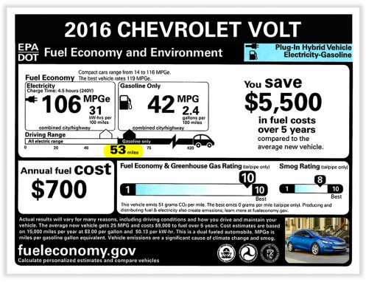
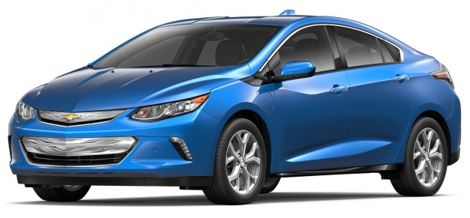
Common Alternative Fuel Vehicles (AFV)
CNG- Compressed Natural Gas
E85- 85% ethanol and 15% gasoline
LPG- Propane
HEV-Gasoline Hybrid Electric Vehicle
PHEV- Gasoline Plug-in Hybrid Electric Vehicle
EREV- Gasoline Extended Range Electric Vehicle
EV- All Electric Vehicle
2016 Chevrolet VOLT - electric vehicle with gasoline powered range-extending capability (EREV).
https://www.fueleconomy.gov/feg/Find.do?action=sbs&id=34918
Notes:
Hybrids are not designed to travel extended distances in electric-only mode. Hybrids generally use battery power while stopped or at low speeds, and also cannot typically operate at high speeds while being powered by electricity alone.
EREV (Volt) is designed to travel longer distances and at all speeds (up to 100 mph on a test track) in EV mode. Once the battery is depleted, Volt uses the gas-powered, range-extending generator to drive hundreds of miles more.

Slide 10
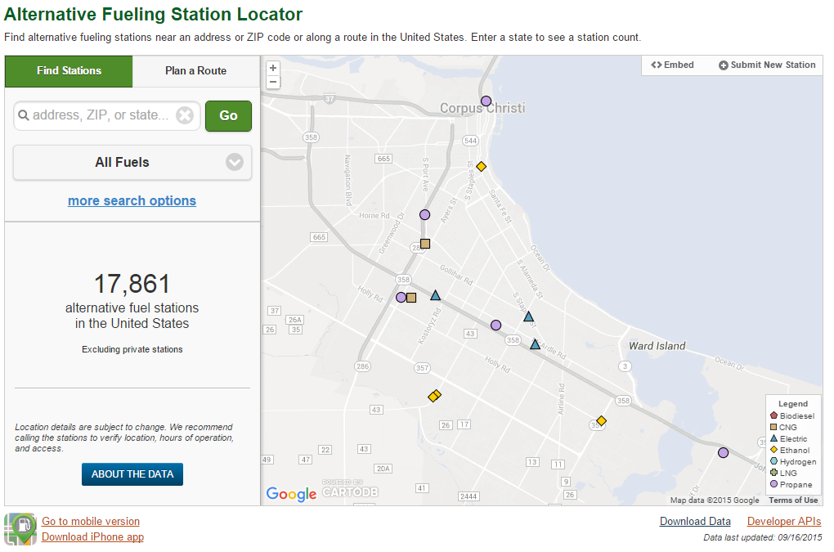
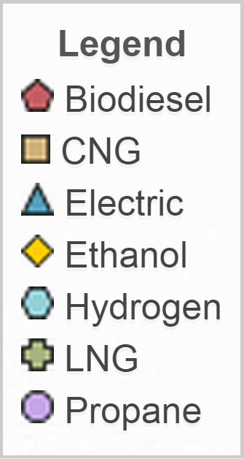
http://www.afdc.energy.gov/locator/stations/

Slide 11
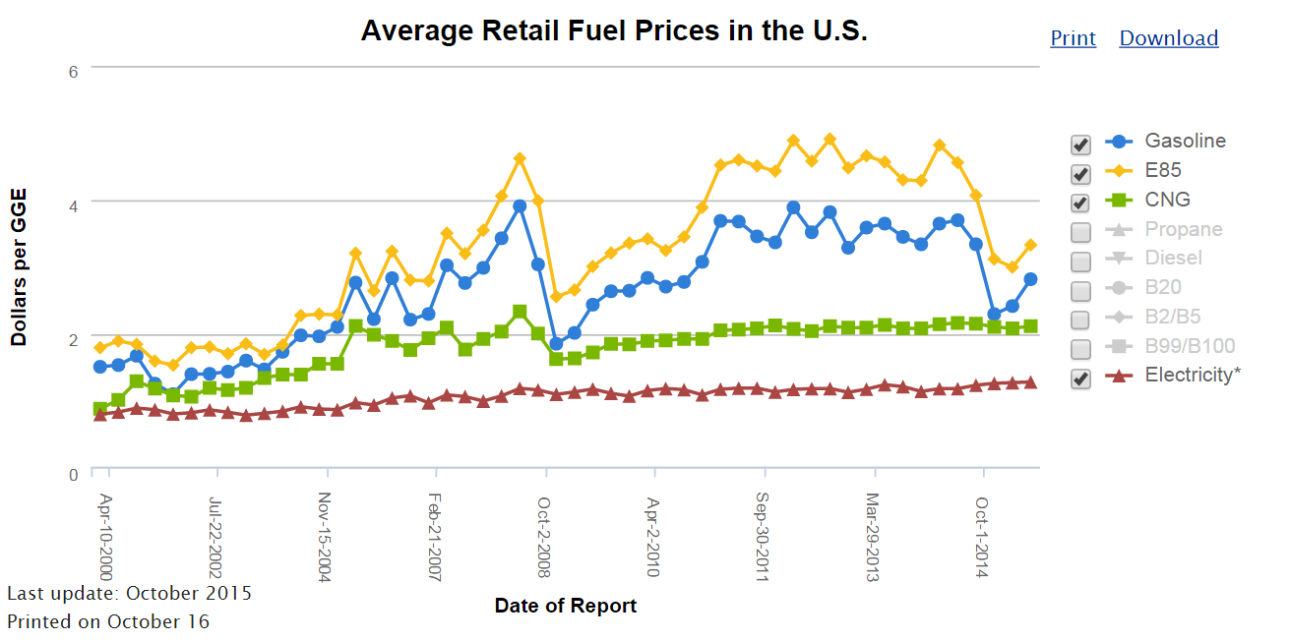
July-1-2015
http://www.afdc.energy.gov/fuels/prices.html

Slide 12
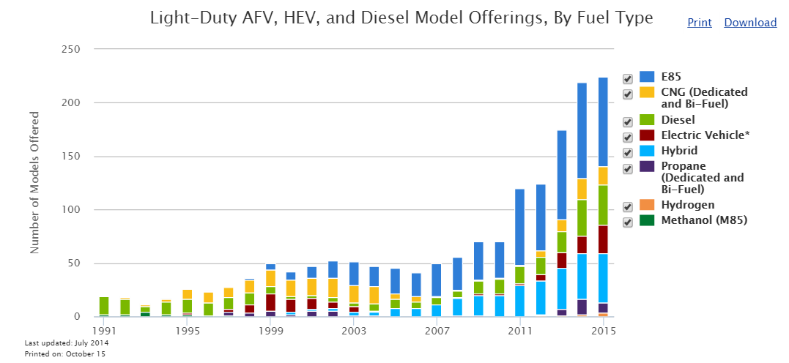
http://afdc.energy.gov/data/10303

Slide 13
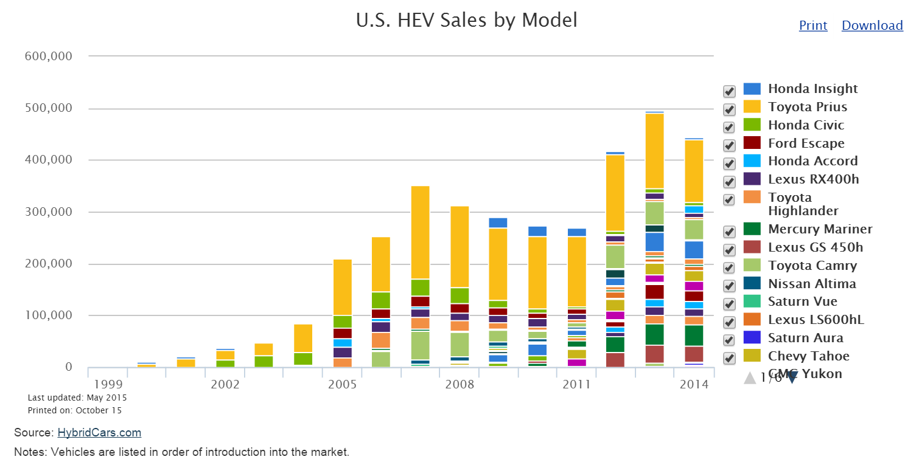

http://afdc.energy.gov/data/10301

Slide 14
Emissions Charts
Pollution Comparison by Fuel Technology

Slide 17
Local Vehicle Stock
Nueces and San Patricio Counties (CY 2014)

Slide 18
Total count 186,477

Slide 21
Total Annual Pounds of NO_{X} Emissions All passenger cars and trucks
San Patricio and Nueces Counties
973,676
NO_{X} Reductions with % Change form Gasoline to Alternative Fuels
Fuel Tech | 5% | 10% | 15% | 20% | 25% | 30%
CNG | (8,181) | (16,363) | (24,544) | (32,725) | (40,906) | (49,088)
E85 | (17,239) | (34,478) | (51,716) | (68,955) | (86,194) | (103,433)
HEV | (36,062) | (72,124) | (108,185) | (144,247) | (180,309) | (216,371)
EV | (49,888) | (99,776) | (149,664) | (199,552) | (249,440) | (299,329)

Slide 23
Total Annual Pounds of VOC Emissions All passenger cars and trucks
San Patricio and Nueces Counties
914,562
VOC Reductions with % Change form Gasoline to Alternative Fuels
Fuel Tech | 5% | 10% | 15% | 20% | 25% | 30%
CNG | (20,630) | (41,260) | (61,890) | (82,521) | (103,151) | (123,781)
E85 | (4,290) | (8,579) | (12,869) | (17,159) | (21,448) | (25,738)
HEV | (23,450) | (46,899) | (70,349) | (93,799) | (117,249) | (140,698)
EV | (46,382) | (92,764) | (139,146) | (185,529) | (231,911) | (278,293)
VOC Reductions with % Change form Gasoline to Alternative Fuels
Fuel Tech | 5% | 10% | 15% | 20% | 25% | 30%
CNG | (20,630) | (41,260) | (61,890) | (82,521) | (103,151) | (123,781)
E85 | (4,290) | (8,579) | (12,869) | (17,159) | (21,448) | (25,738)
HEV | (23,450) | (46,899) | (70,349) | (93,799) | (117,249) | (140,698)
EV | (46,382) | (92,764) | (139,146) | (185,529) | (231,911) | (278,293)

Slide 24
VW Offending Vehicles
313
Cars registered locally (.1% of local cars) ➔
NO_{X} released above certified ➔
Exhaust equivalent of adding cars ➔
% of NO_{X} from offending cars➔
10X to 40X
2,817 to 12,207
2-7 % of NO_{X} from cars

Slide 25
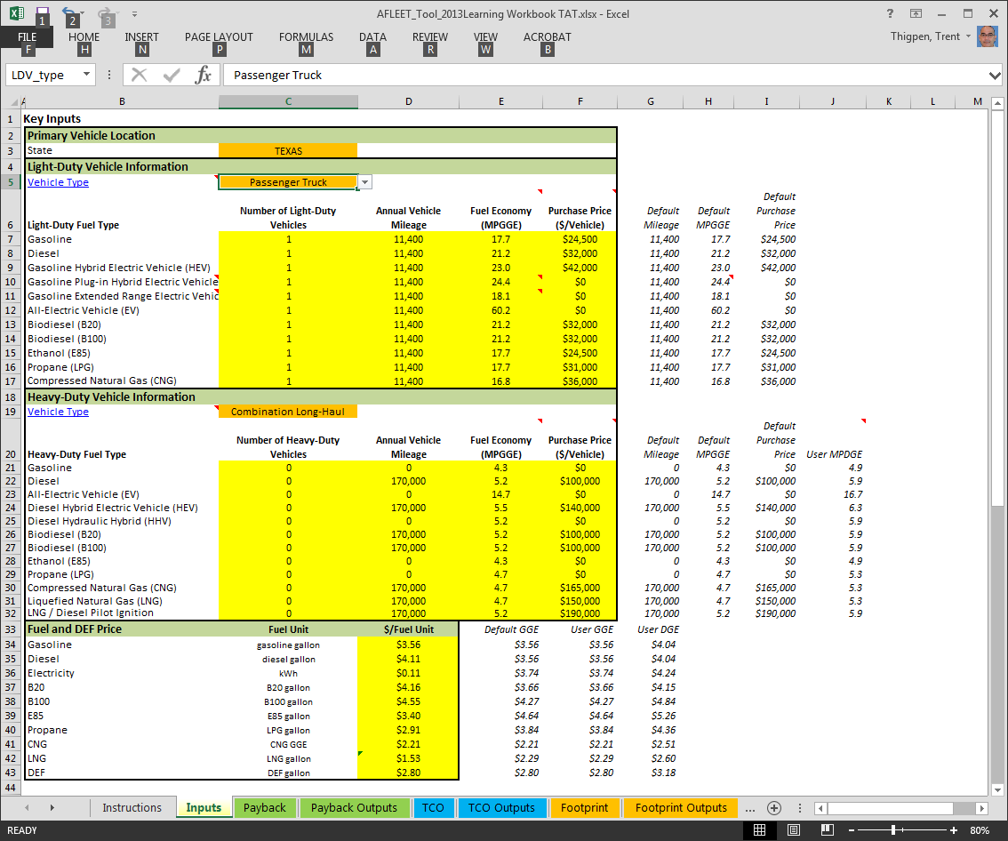
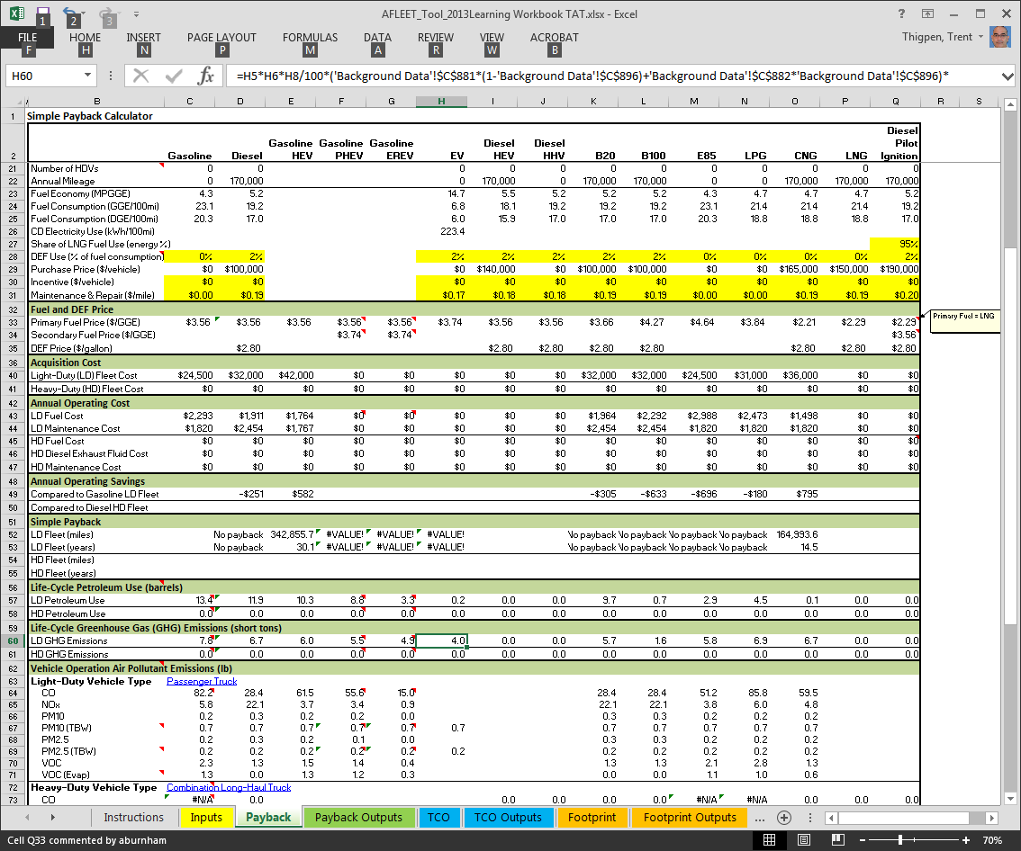
AFLEET Tool -Argonne National Laboratory

Slide 26

Sources and Resources
AutoCheck.cc
http://www.afdc.energy.gov/
http://www.hybridcars.com/
https://greet.es.anl.gov/afleet
http://www.eia.gov/forecasts/aeo/tables_ref.cfm

