Slide 1


3 Minute THESIS
Information
AND Training

Slide 2
The Event
When? April 10, 5pm-8pm
Where? University Center
Competition will begin promptly at 5pm followed by an awards ceremony at 6:30pm

Slide 3
  The Concept
  Three Minute Thesis (3MT™) is a research communication competition developed by The University of Queensland in Australia in 2008.
  The premise of the competition is to develop academic, presentation, and research communication skills. It supports the development of students’ capacities to effectively explain their research in language appropriate to an intelligent but nonspecialist audience.

Slide 4
The Concept
Students have three minutes to present compelling orations on their topics and their significance. 3MT™ is not an exercise in “watering down” research but forces students to consolidate their ideas and concisely explain their research discoveries.

Slide 5
The Rules
A single static PowerPoint slide is permitted. No slide transitions, animations or 'movement' of any description are allowed. The slide is to be presented from the beginning of the oration.
No additional electronic media (e.g. sound and video files) are permitted.
No additional props (e.g. costumes, musical instruments, laboratory equipment) are permitted.
Presentations are limited to 3 minutes maximum and competitors exceeding 3 minutes are disqualified.
Presentations are to be spoken word (e.g. no poems, raps or songs).
Presentations are to commence from the stage.
Presentations are considered to have commenced when a presenter starts their presentation through either movement or speech.

Slide 6
Rules
  Can I use notes?
No

Slide 7
Judging Criteria
Comprehension and content
Presentation provided clear motivation, background and significance to the research question
Presentation clearly described the research strategy/design and the results/findings of the research
Presentation clearly described the conclusions, outcomes and impact of the research
Engagement and communication
The oration was delivered clearly, and the language was appropriate for a non-specialist audience
The PowerPoint slide was well-defined and enhanced the presentation
The presenter conveyed enthusiasm for their research and captured and maintained the audience’s attention

Slide 8
Write for your Audience
Avoid jargon and academic language.
Explain concepts and people important to your research - you may know all about Professor Smith’s theories but your audience may not.
Highlight the outcomes of your research, and the desired outcome.
Imagine that you are explaining your research to a close friend or fellow student from another field.
Convey your excitement and enthusiasm for your subject.

Slide 9
Tell a story
You may like to present your 3MT as a narrative, with a beginning, middle and end.
It’s not easy to condense your research into three minutes, so you may find it easier to break your presentation down into smaller sections.
Try writing an opener to catch the attention of the audience, then highlight your different points, and finally have a summary to restate the importance of your work.

Slide 10
Have a clear outcome in mind
Know what you want your audience to take away from your presentation.
Try to leave the audience with an understanding of what you’re doing, why it is important, and what you hope to achieve.

Slide 11
Revise
Proof your 3MT presentation by reading it aloud, to yourself and to an audience of friends and family.
Ask for feedback.
Ask your audience if your presentation clearly highlights what your research is about and why it is important.

Slide 12
The PowerPoint Slide
The slide must be STATIC!
This means no animation or sound of any kind.

Slide 13
Effective 3MT Slides
Remember that the slide must be STATIC! No Animation or Sound
The Slide should be Simple, Clear, and Engaging.
It should support your spoken presentation and not distract from it.

Slide 14
Effective 3MT Slides
Minimal Text:
  Avoid full sentences or paragraphs.
  Use key phrases or keywords (5-10 words max).
Strong Visuals:
  Use high-quality images, diagrams, or infographics. Avoid clutter.
Consistent & Readable Fonts:
  Sans-serif fonts (e.g., Arial, Calibri) are best.
  Minimum font size: 24pt for readability.
Use Colors Wisely:
  Stick to 2-3 complementary colors.
  Ensure high contrast between text and background.

Slide 15
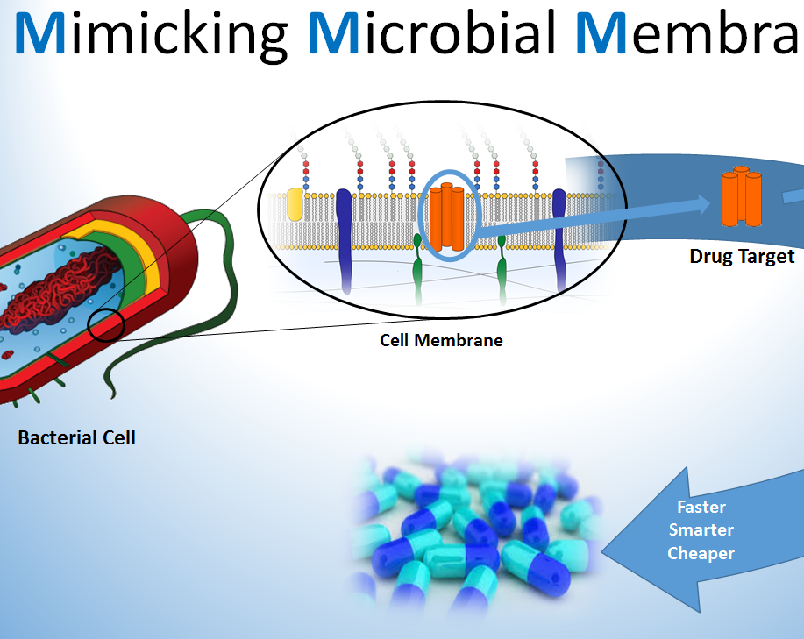

Slide 16
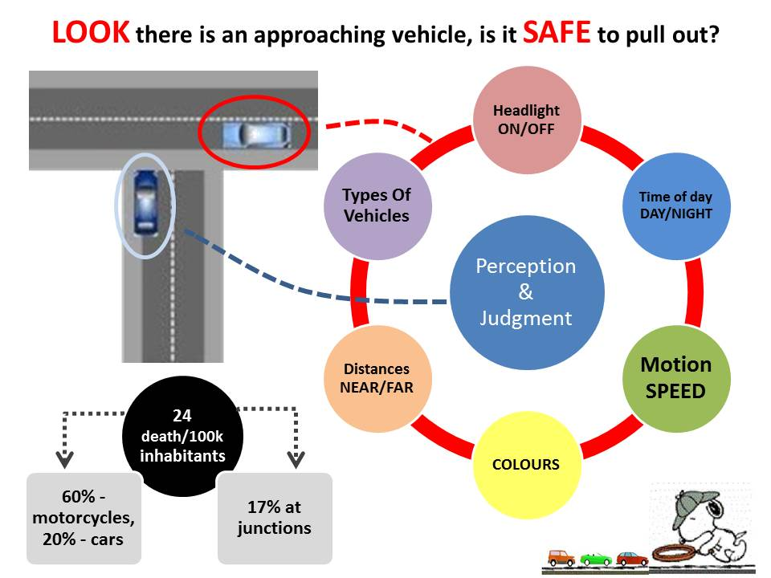

Slide 17
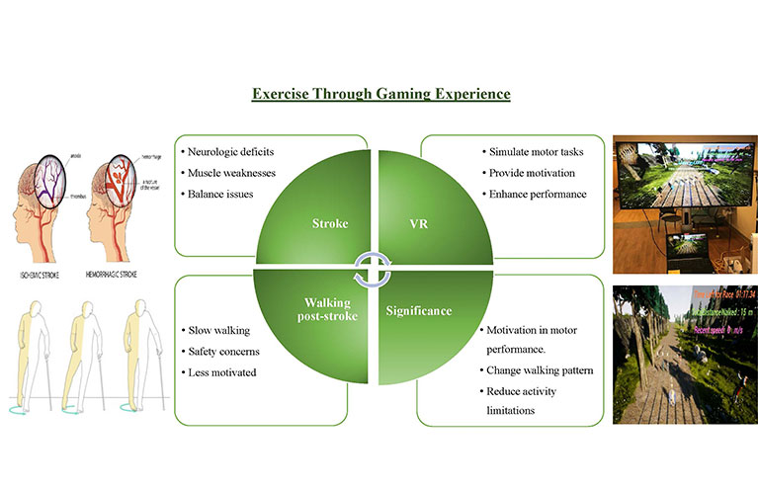

Slide 18
Effective 3MT Slides
Align with your speech – Your slide should reinforce your message, not replace it.
Test readability – Ensure it looks good on different screen sizes.
Practice with it – Get feedback from peers and refine as needed.
Remember: A great 3MT slide enhances your storytelling and makes your research memorable!

Slide 19
The SLIDE: Suggestions
Less is more: text and complicated graphics can distract your audience – you don’t want them to read your slide instead of listening to your 3MT.
Personal touches: personal touches can allow your audience to understand the impact of your research.
Creativity drives interest: do not rely on your slide to convey your message – it should simply complement your oration.
Work your message: think about how your slide might be able to assist with the format and delivery of your presentation – is there a metaphor that helps explain your research?
An engaging visual presentation can make or break any oration, so make sure your slide is legible, clear and concise.

Slide 20
The presentation
Practice, practice, practice
Feeling nervous before you present is natural, and a little nervousness can even be beneficial to your overall speech. Nonetheless, it is important to practice so you can present with confidence and clarity. Practicing will also help you gauge the timing of your 3MT so that you keep within the time limit.

Slide 21
The presentation
Vocal range
Speak clearly and use variety in your voice (fast/slow, loud/ soft).
Do not rush – find your rhythm.
Remember to pause at key points as it gives the audience time to think about what you are saying.

Slide 22
The Presentation
Body language
Stand straight and confidently.
Hold your head up and make eye contact.
Never turn your back to the audience.
Practice how you will use your hands and move around the stage. It is okay to move around energetically if that is your personality, however it is also appropriate for a 3MT presentation to be delivered from a single spot on stage.
Do not make the common mistakes of rolling back and forth on your heels, pacing for no reason or playing with your hair as these habits are distracting for the audience.

Slide 23
The Presentation
Record yourself
Record and listen to your presentation to hear where you pause, speak too quickly or get it just right.
Then work on your weaknesses and exploit your strengths.
Look to the stars!
Watch your role models such as academics, politicians and journalists, and break down their strengths and weaknesses.
Analyse how they engage with their audience.
View presentations by previous 3MT finalists.

Slide 24
The Presentation
Dress
There is no dress code, if you are unsure of how to dress you may like to dress for a job interview or an important meeting. It is important that you feel comfortable so you can focus on your presentation.
If you are presenting on a stage that has a wooden floor, be aware of the noise your footwear might make.
Do not wear a costume of any kind as this is against the rules (as is the use of props).

Slide 25
Designing your 3MT Talk
3MT talks generally consist of 6 parts
I. The Hook – Introduce your topic of study (problem) in a way that grab’s the audience’s attention.
II. The Foundation – Convey the problem to the audience in terms they can understand and appreciate it’s importance.
III. The Research Question – your problem description should lead to an obvious statement of your research question.
IV. The Approach - Describe the approach used to answer the research question.
V. The Discovery – What did you find out? What conclusions can be made?
VI. The Big Picture - How will your research change the world?

Slide 26
I. The Hook
Grab the audience right from the start by starting with something that almost everyone is interested in to “hook” them into your presentation. Take a look at 3MT winning presentations on the internet and explore the wide range of “hooks” others have used effectively. The idea is to build a bridge between the everyday experience of your audience and the more academic material you plan to present.

Slide 27
II. The RESEARCH Foundation
After hooking the audience, you will be ready to provide the reader with the foundation underlying the research question. It is important to convey where the idea came from and why it is IMPORTANT. More specifically, why it should be important to the audience. If there is terminology that needs to be defined for your research question, it should be done here. But avoid the use of jargon that your audience will not understand.

Slide 28
III. The Research Question
Now that the audience understands the problem and its importance, its time to tell them where YOU come into the story. What research question is being answered by the work? Be sure that you state this in a way that is understandable to the audience. Any terms that needed to be defined should have already been defined while describing the foundation. This will likely be a very short piece of your presentation, but it is critical because it marks the transition between Foundation and Approach. A clearly stated question makes your presentation much easier to follow for the audience.

Slide 29
IV. Approach
You just stated your research question. The audience is begging to hear what you chose to do to answer this question. Don’t forget who you are talking to at this point. Keep the description of your approach/methods as simple as possible (watch your time). After hearing your approach, the audience should be able to foresee possible outcomes.

Slide 30
V. Discovery
Time to tell the audience what insights you found and what conclusions you made. You won’t have time to tell them all the details, so stick to major ideas here which should include the most interesting ones. When you consider an idea interesting, make sure you explain why it is interesting. Be excited about this section. Your passion should peak with discoveries!

Slide 31
VI. The Big Picture
You are now in the homestretch. Bring your talk full circle by returning the hook you started with (circular writing) and end with a grand statement of how your approach may or will change the world! Slow your speech and move close to your audience here.

Slide 32
EXAMPLE 3MT TALKS
For the following presentation, try to identify the 6 parts of the presentation.
EXAMPLE 1 - Karthik Sukumar - Purdue University

Slide 33
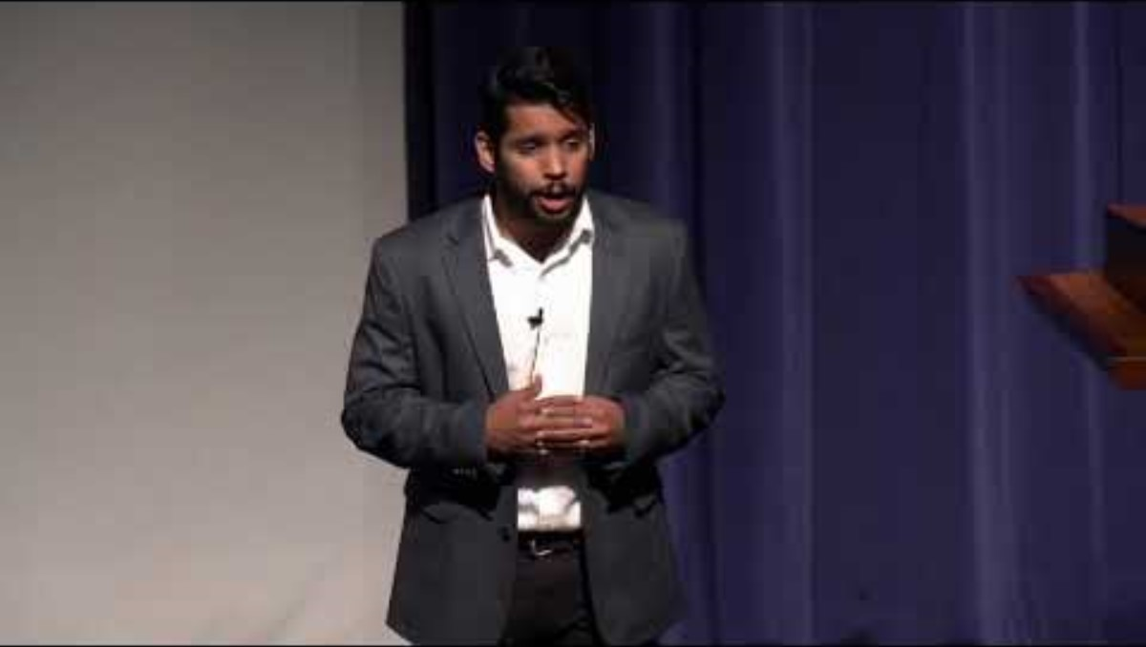

Slide 34
The Secret Ingredient: Presence
Speak with an awareness of how your audience is responding.
Use body language consistent with your presentational goals. Move with authority and purpose.
Maximize vocal expressiveness. Speak slowly and deeply.
Develop the content of your speech so that it will lead your audience to respond the way you would like them too.
Become comfortable with being in the spotlight.

Slide 35
Passionate
Confident
Enthusiastic
Presence
Authentic
  Captivating
Comfortable

Slide 36
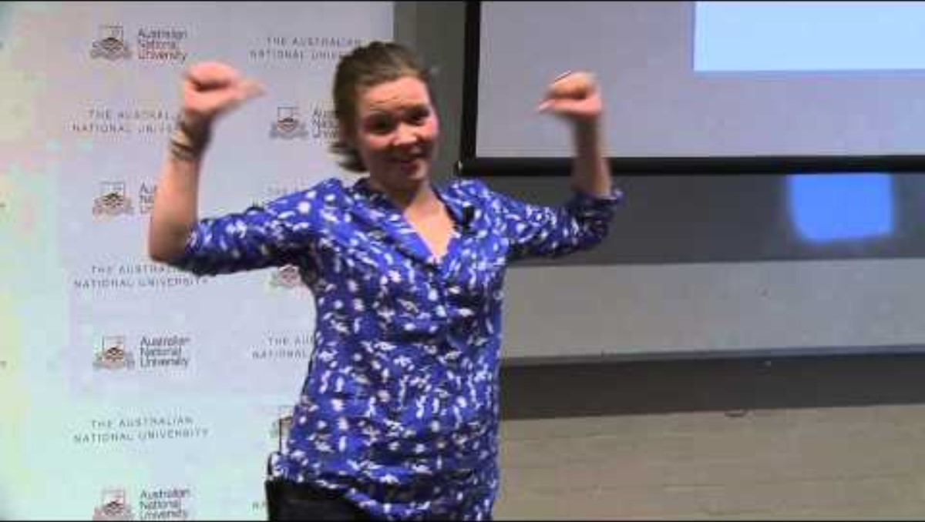
An Example of Presence
EXAMPLE 3 – Rosanna Stevens, Australian National University
Some Tips from Rosanna Stevens

Slide 37
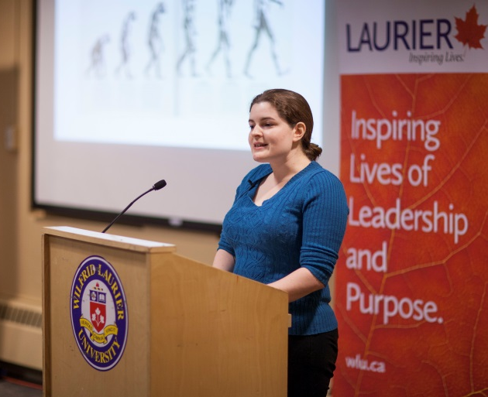

3MT® Winner Videos
Check out 3MT® videos from around the world!
3MT District winners - Search Videos
Many universities in the U.S. also have their own competitions – you can find their winner videos online too!
  Youtube or Googling “3MT® winner videos” will help.

Slide 38
GOOD LUCK!!!

