Slide 1
Tips for Making a 3 Minute Presentations

Slide 2
The Concept
Three Minute Thesis (3MT™) is a research communication competition developed by The University of Queensland in Australia in 2008.
The premise of the competition is to develop academic, presentation, and research communication skills. It supports the development of students’ capacities to effectively explain their research in language appropriate to an intelligent but nonspecialist audience.

Slide 3
The Concept
Students have three minutes to present compelling orations on their topics and their significance. 3MT™ is not an exercise in “watering down” research but forces students to consolidate their ideas and concisely explain their research discoveries.

Slide 4
Rules
A single static PowerPoint slide is permitted. No slide transitions, animations or 'movement' of any description are allowed. The slide is to be presented from the beginning of the oration.
No additional electronic media (e.g. sound and video files) are permitted.
No additional props (e.g. costumes, musical instruments, laboratory equipment) are permitted.
Presentations are limited to 3 minutes maximum and competitors exceeding 3 minutes are disqualified.
Presentations are to be spoken word (e.g. no poems, raps or songs).
Presentations are to commence from the stage.
Presentations are considered to have commenced when a presenter starts their presentation through either movement or speech.

Slide 5
Rules
To be clear……
NO NOTES ARE PERMITTED!!!
This will only apply to your final project in this class.

Slide 6
Judging Criteria
Comprehension & Content
Did the presentation provide an understanding of the background to the research question being addressed and its significance?
Did the presentation clearly describe the key results of the research including conclusions and outcomes?
Did the presentation follow a clear and logical sequence?
Was the topic, key ideas and research significance and outcomes communicated in language appropriate to a non-specialist audience?
Did the speaker avoid scientific jargon, explain terminology and provide adequate background information to illustrate points?
Did the presenter spend adequate time on each element of their presentation - or did they elaborate for too long on one aspect or was the presentation rushed?
Engagement & Communication
Did the oration make the audience want to know more?
Was the presenter careful not to trivialize or generalize their research?
Did the presenter convey enthusiasm for their work?
Did the presenter capture and maintain their audience's attention?
Did the speaker have sufficient stage presence, eye contact and vocal range; maintain a steady pace, and have a confident stance?
Did the PowerPoint slide enhance the presentation - was it clear, legible, and concise?

Slide 7
Designing your 3MT Talk
3MT talks generally consist of 6 parts
I. The Hook – Introduce your topic of study in a way that grab’s the audience’s attention. II. The Problem – Convey the problem to the audience in terms they can understand and appreciate it’s importance. III. The Research Question – your problem description should lead to an obvious statement of your research question.
IV. Your Approach - Describe your approach to answering the research question.
V. Discovery – What did you find out? What conclusions did you make? VI. The Big Picture - How will your research change the world?

Slide 8
I. The Hook
Grab the audience right from the start by starting with something that almost everyone is interested in to “hook” them into your presentation. Take a look at 3MT winning presentations on the internet and explore the wide range of “hooks” others have used effectively. The idea is to build a bridge between the everyday experience of your audience and the more academic material you plan to present.
Visit the following site to view dozens of winning presentations:
https://threeminutethesis.uq.edu.au/

Slide 9
II. The RESEARCH Problem
After hooking the audience, you will be ready to describe the problem you chose to tackle. Note that this is not your research question but is the BIG PICTURE version of it. It is important to convey why this problem is IMPORTANT. More specifically, why it should be important to the audience. If there is terminology that needs to be defined for your research question, it should be done here. But avoid the use of jargon that your audience will not understand.

Slide 10
III. The Research Question
Now that the audience understands the problem and its importance, its time to tell them where YOU come into the story. What research question are you trying to answer through your work? Be sure that you state this in a way that is understandable to the audience. Any terms that needed to be defined should have already been defined while describing the problem. This will likely be a very short piece of your presentation but it is critical because it marks the transition between Problem and Approach. A clearly stated question makes your presentation much easier to follow for the audience.

Slide 11
IV. Approach (Application of Theory)
You just stated your research question. The audience is begging to hear what you chose to do to answer this question. Don’t forget who you are talking to at this point. Keep the description of your approach/methods as simple as possible. After hearing your approach, the audience should be able to foresee the possible value of your ideas.

Slide 12
V. Discovery
Time to tell the audience what insights you found and what conclusions you made. You won’t have time to tell them all the details, so stick to major ideas here which should include the most interesting ones. When you consider an idea interesting, make sure you explain why it is interesting. Be excited about this section. Your passion should peak with discoveries!

Slide 13
VI. The Big Picture
You are now in the homestretch. Bring your talk full circle by returning the BIG PICTURE problem you started with (circular writing) and end with a grand statement of how your approach may or will change the world!

Slide 14
Most Common Mistakes Made
1. Student failed to connect their research to the big picture. 2. Student did not work hard enough to engage the audience’s curiosity about their ideas.
3. Student neglected the visual component of the presentation.
4. Student did not leave enough room to practice the presentation. 5. Student failed to demonstrate their enthusiasm for their topic.

Slide 15
EXAMPLE 3MT TALKS
…..Let’s look at a few examples of winning presentations. Understand, however, that you will not be reporting any data since you have not collected any. For each of these presentations, try to identify the 6 parts of the presentation.
EXAMPLE 1 - Karthik Sukumar - Purdue University
In the second example, note how the speaker grabs the audience’s attention by acting out various characters (note the wide range of vocal inflection)
EXAMPLE 2 - Megan Pozzi, University of Queensland, Australia

Slide 16
The Secret Ingredient: Presence
Speak with an awareness of how your audience is responding.
Use body language consistent with your presentational goals. Move with authority and purpose.
Maximize vocal expressiveness. Speak slowly and deeply.
Develop the content of your speech so that it will lead your audience to respond the way you would like them too.
Become comfortable with being in the spotlight.

Slide 17
Passionate
Confident
Enthusiastic
Presence
Authentic
Captivating
Comfortable

Slide 18
EXAMPLE TALKS
In the third example, I have chosen a competitor with wonderful presence, Rosanna Stevens. Notice how she engages the audience and captures their attention throughout the entire talk. Although the talk is well planned out, she appears to just be having a comfortable ”conversation” with the audience rather than performing as a character in a “performance.”
EXAMPLE 3 – Rosanna Stevens, Australian National University
Some Tips from Rosanna Stevens

Slide 19
Good Presentations
Engage the audience! (Remember, they vote for “People’s Choice” award!)
Explicitly connect research to “the real world”
Speak clearly and comprehensively
Remember, the audience does not speak your discipline’s language
No “academic” language
Choose words wisely
Active verbs, shorter words & sentences
No jargon or acronyms
Pace yourself and find your own rhythm
Consciously slow your talking speed
Practice your material and delivery often! Familiarity with your script (and topic) will help the presentation flow more naturally and easily.

Slide 20
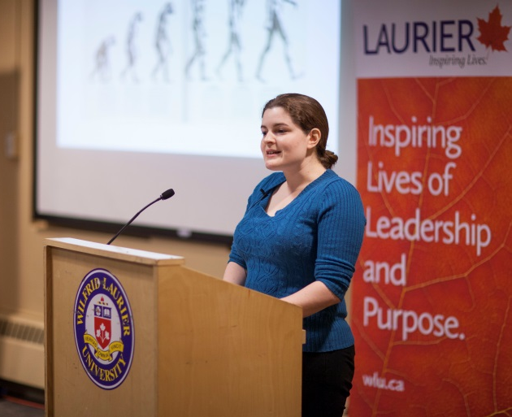
3MT® Winner Videos
Need a visual for good presentations?
Check out 3MT® videos
from around the world!
http://threeminutethesis.org/3mt-showcase
Many universities in the U.S. also have their own competitions – you can find their winner videos online too!
Youtube or Googling “3MT® winner videos” will help.

Slide 21
GOOD LUCK!!!

