Slide 1
iRIS for the Study Contact
Rebecca Ballard, JD, MA, CIP April 23, 2021
Director, Research Compliance

Slide 2
Did you know?
The Office of Research Compliance has implemented research compliance software called iRIS.
What does research compliance software have to do with me?
I’m not a researcher.

Slide 3
We know.
But behind every good PI, is a good business manager.

Slide 4
iRIS Features for the Study Contact
We have some software features that might be useful to you.

Slide 5
Welcome!
I’ll be guiding you through today’s course objectives.
What is iRIS?
What can iRIS do for me?
What do I need to know to help my investigators in the transition into iRIS?

Slide 6
What is iRIS?
iRIS is short for Integrated Research Information Systems.
It is a web-based system that enables online application submission, real-time submission tracking, review, post-approval compliance activities, and data management.
Learn more about iRIS features at:
https://research.tamucc.edu/compliance/home/index.html

Slide 7
What is iRIS?
iRIS will be used to submit all research compliance applications, including IRB, IBC (coming soon), IACUC (coming soon) and Dive Operations (coming soon). The system also functions as a document repository, providing investigators with easy access to submission records and study documents.
Investigators can use the system anywhere they have Internet access, helping to connect faculty, researchers, students and partners around the world in one portal.

Slide 8
Do investigators have to use iRIS?
Yes. Research Compliance Committees will ONLY accept research applications through iRIS.
When will investigators have to start using iRIS?
Starting June 1, 2021 for IRB.
Other committees are coming soon. Additional announcements on the timeline will be sent via research news listserve.
All committees are expected to be live in iRIS by end of 2021.

Slide 9
How do I get access to iRIS to take advantage of these features?
Getting an iRIS Account
First, you will need an iRIS account.
An iRIS account is automatically created for you when you logon for the first time through SSO.
You can access the iRIS login page on our website at:
https://research.tamucc.edu/compliance/home/index.html

Slide 10
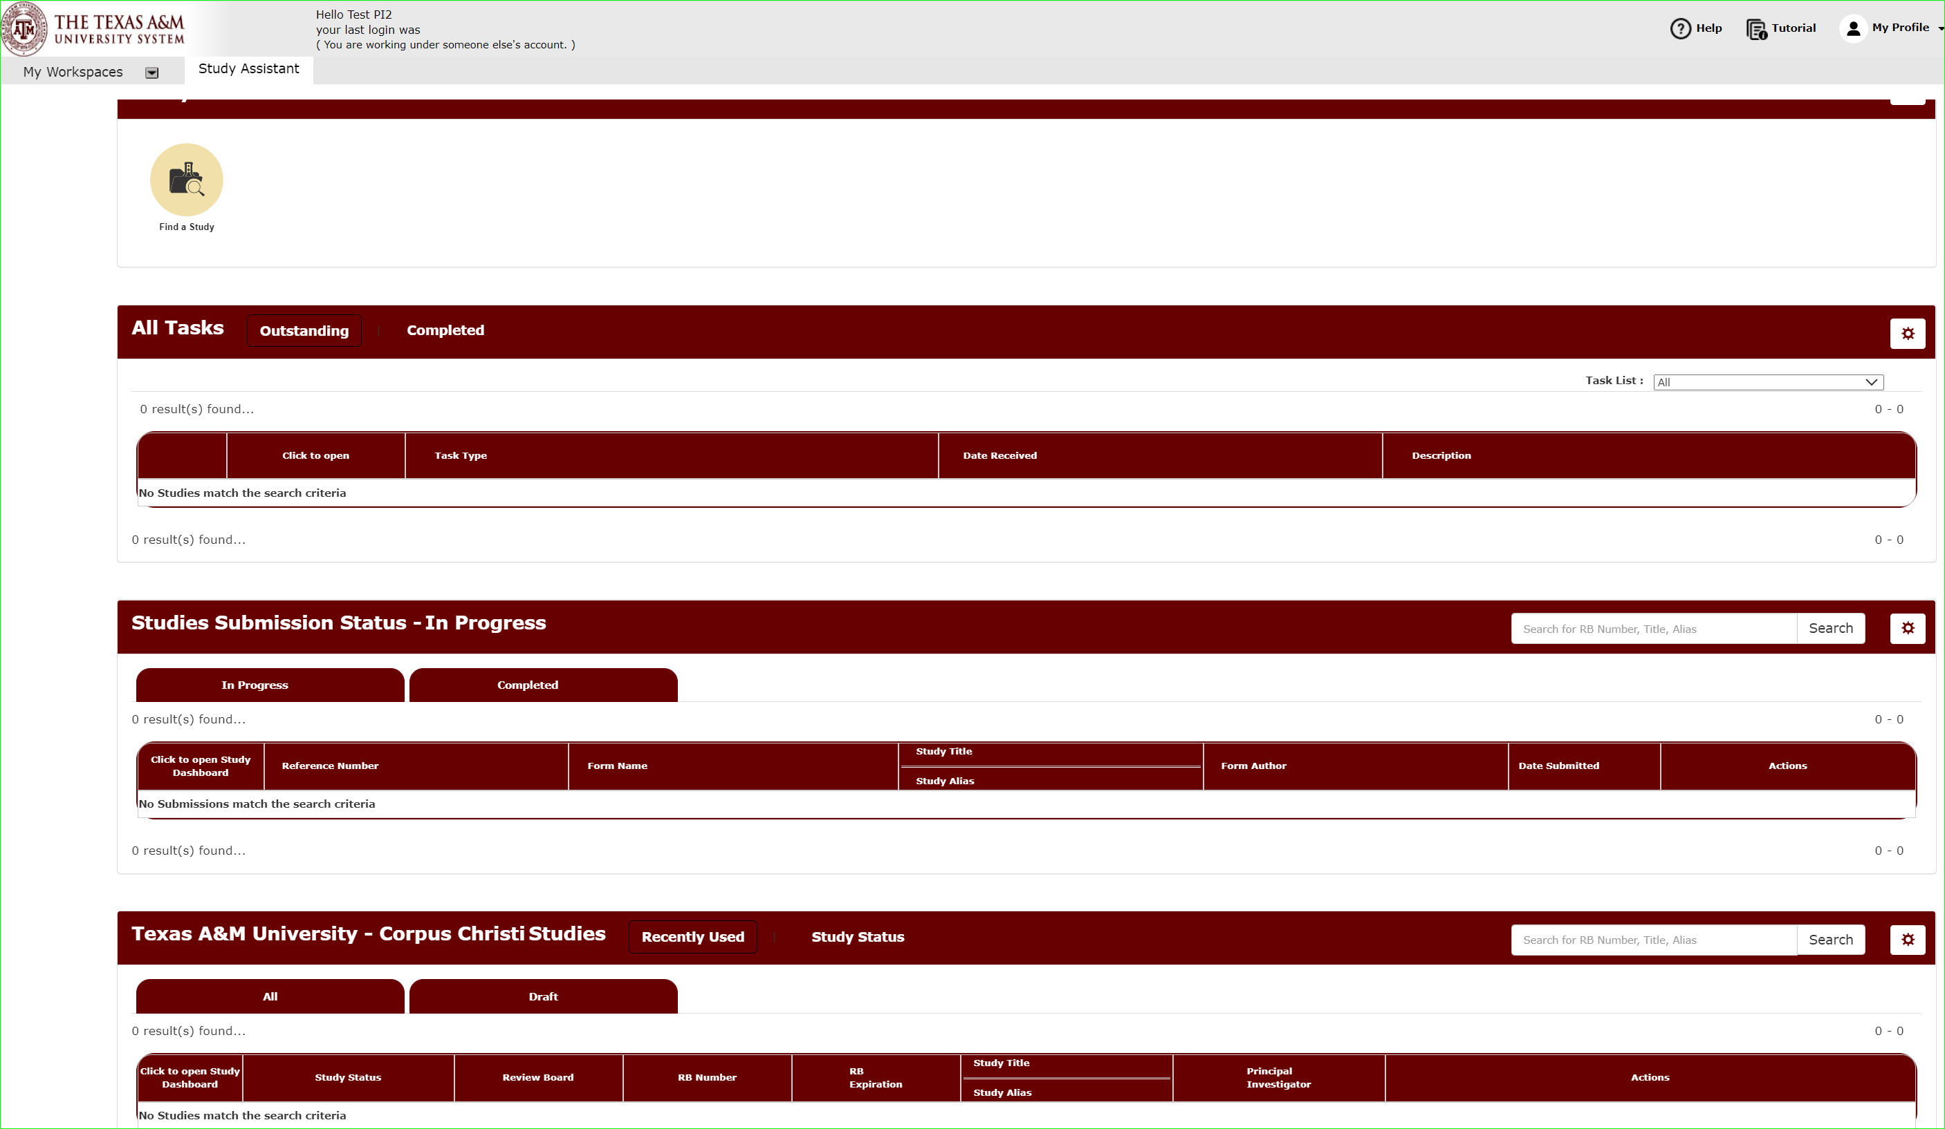
How do I get access to iRIS to take advantage of these features?
Getting access to studies
When you login for the first time your dashboard will likely be empty.
That’s because we only had listed study personnel in our files.

Slide 11
How do I get access to iRIS to take advantage of these features?
Associating your account to the study
We need to associate you as the study contact to your PI’s studies.
How do I get associated to the individual studies?
During our investigator training, we will point out this feature. The PI will have an opportunity to add you to their studies as study contacts during implementation.
You can also be added through the amendment process as a personnel change.

Slide 12
How do I get access to iRIS to take advantage of these features?
Grant Key Personnel Access to the Study
In the application under “Grant Key Personnel Access to the Study,” the submitting party sets who will have access to the submission.

Slide 13
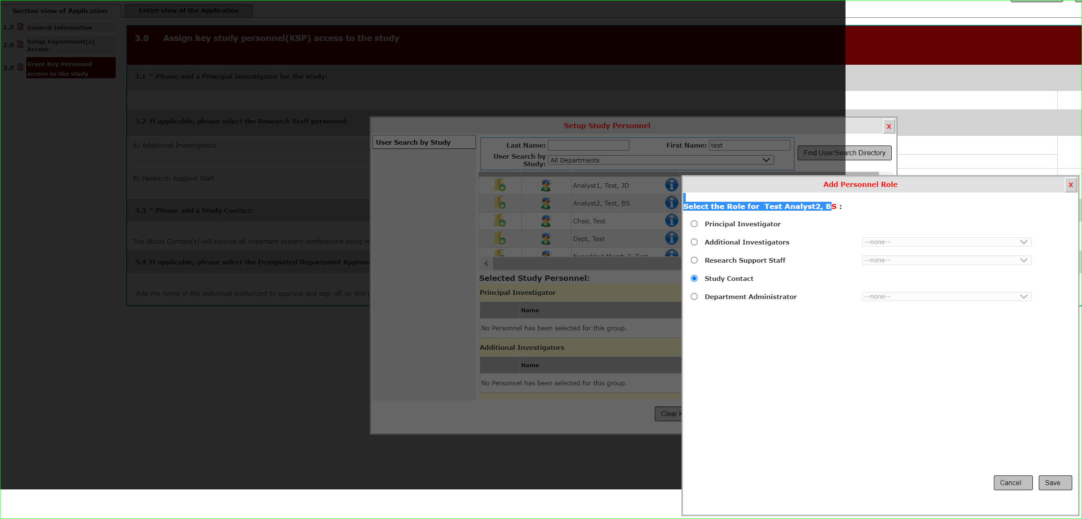
How do I get access to iRIS to take advantage of these features?
Setting Study Contacts
After selecting your name from the Find User Search Directory, the submitting party can select your role.
Selecting “Study Contact” role gives you access to the study.

Slide 14
Does this mean I’ll be treated a study team member?
No.
Selecting “Study Contact” role here gives you access to the study.
But if that is the ONLY role selected, like shown here, you are NOT considered a study team member.
This means you do not have training requirements.

Slide 15
What does the Study Contact role allow me to do?
1
Track the approval status of the submission.
2
Access all notifications that are sent to the Principal Investigator.
3
Assist the Principal Investigator in submitting their application.

Slide 16
What does the Study Contact role allow me to do?
1
Track the approval status of the submission.
As the submission progresses through review, the study status will be updated.

Slide 17
What does the Study Contact role allow me to do?
1
Track the approval status of the submission.
A detailed breakdown can be viewed in the History.

Slide 18
What does the Study Contact role allow me to do?
2
Access all notifications that are sent to the Principal Investigator.
Study contacts will be cc’d on all notifications sent by iRIS to the PI, such as continuing review reminders.
Study contacts can also access the submission study correspondence page to see notifications sent.

Slide 19
What does the Study Contact role allow me to do?
3
Assist the Principal Investigator in submitting their application.
You can assist by filling out the submission, such as uploading documents in the submission packet.
Once you are done, you will get to this page to send the draft to the PI for review, edits, and final sign-off.

Slide 20
What do I need to know to help my investigators in the transition into iRIS?
1
IRB will not accept submissions via REDCap after May 31, 2021.
The REDCap link will be replaced with the link to iRIS on June 1, 2021.
2
Training sessions
Encourage your investigators to attend one of the iRIS training sessions, or contact us for a small group training session in your department.

