Slide 1
iRIS My Profile
Rebecca Ballard, JD, MA, CIP March 19, 2021
Director, Research Compliance

Slide 2
Welcome!
I’ll be guiding you through today’s course objectives.
How to update your iRIS My Profile.

Slide 3
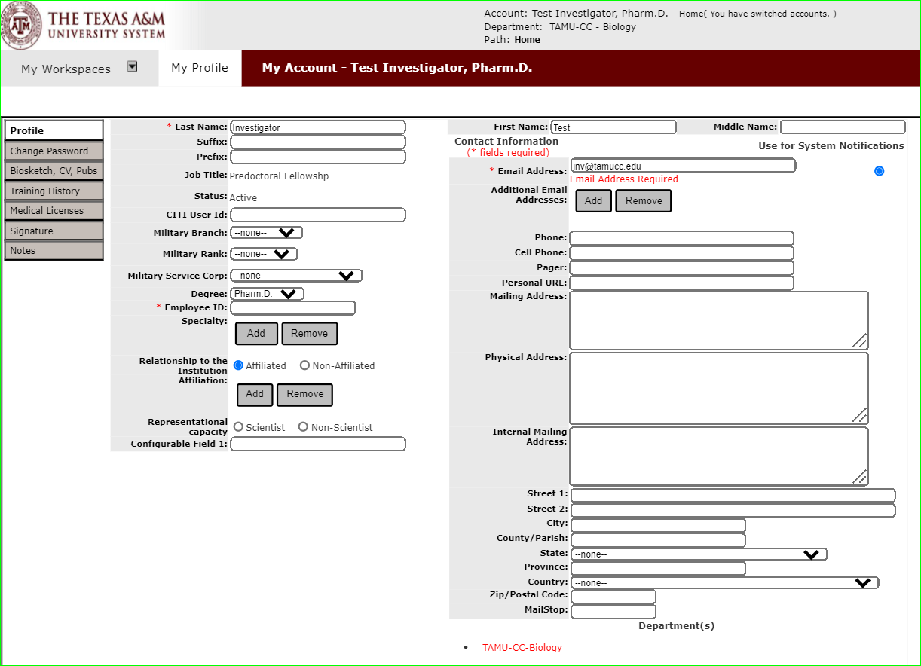
What is an iRIS My Profile?
Once an iRIS account is created for you, your iRIS profile collects information about you independent of your studies.

Slide 4
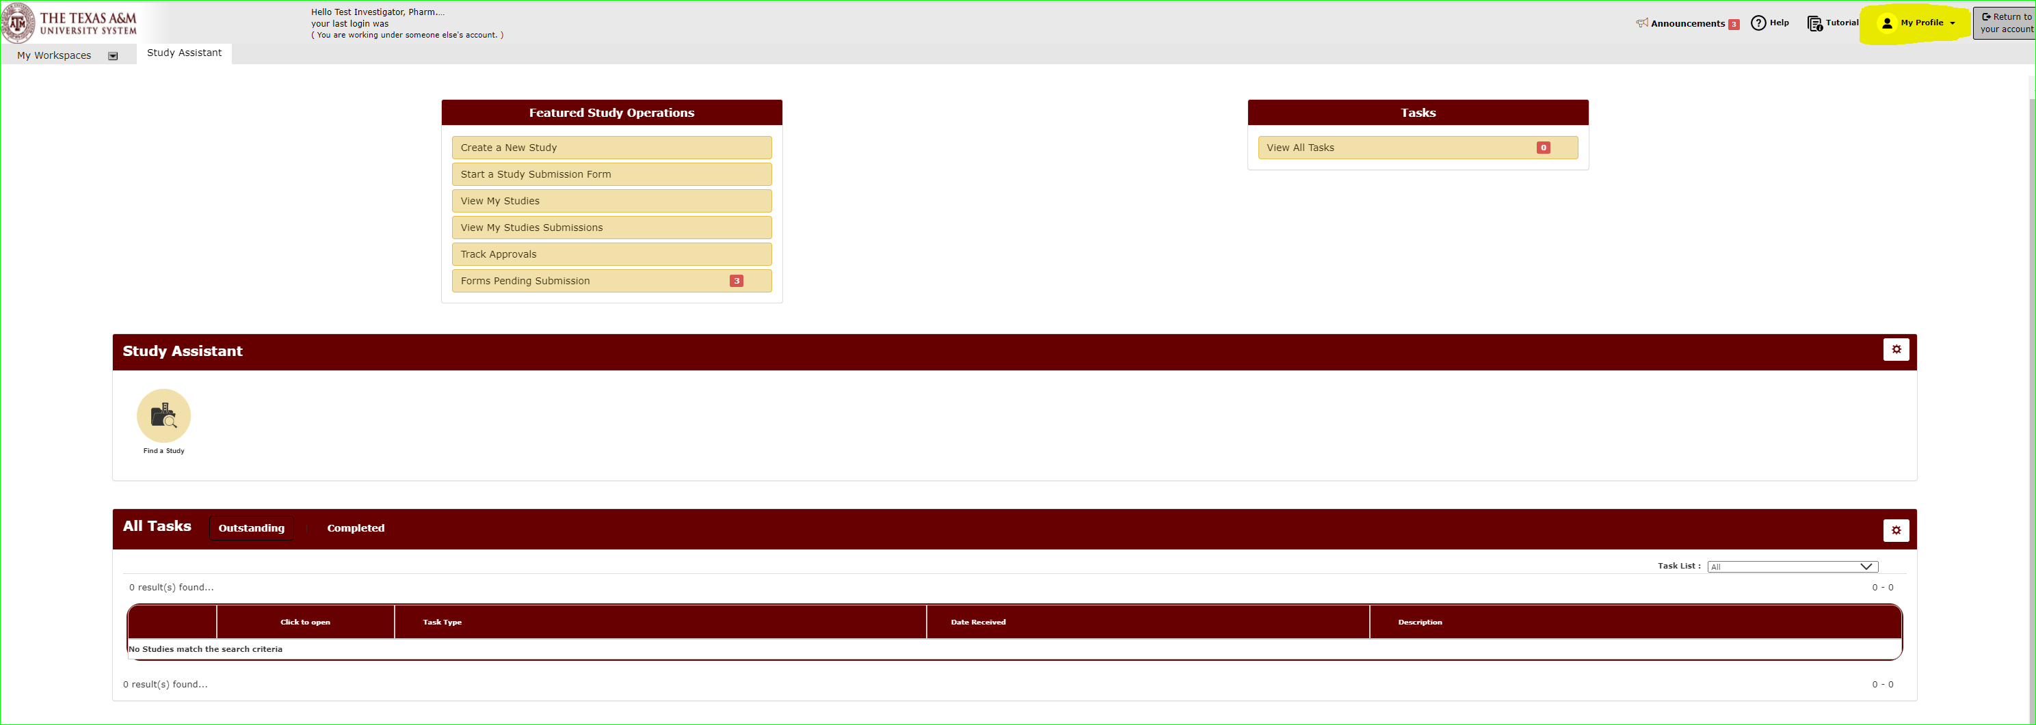
How do I view my iRIS My Profile?
On the Study Assistant Workspace, you can access your profile in the upper-right hand corner of the screen. Click “My Profile” to open.

Slide 5
How do I update information in My Profile?
Select “My Account”.

Slide 6
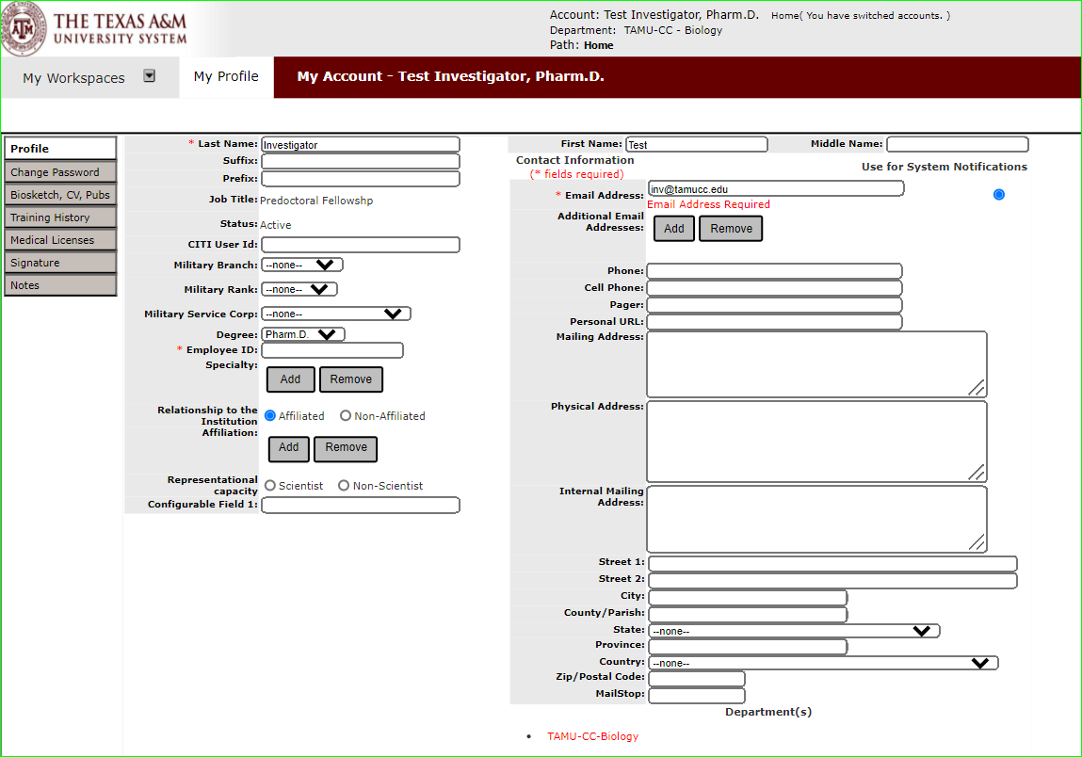
How do I update information in My Profile?
This opens a window where you can edit your profile.
Click the tabs to the left to access various parts of your profile to make any changes.

