Slide 1
Setting Alternate Emails for iRIS Notifications
Rebecca Ballard, JD, MA, CIP 4/19/2021
Director, Research Compliance

Slide 2
Welcome!
I’ll be guiding you through today’s course objectives.
How to add an additional email to My Profile.

Slide 3
Email settings are found in “My Profile”.
Under “My Profile” select “My Account”.

Slide 4
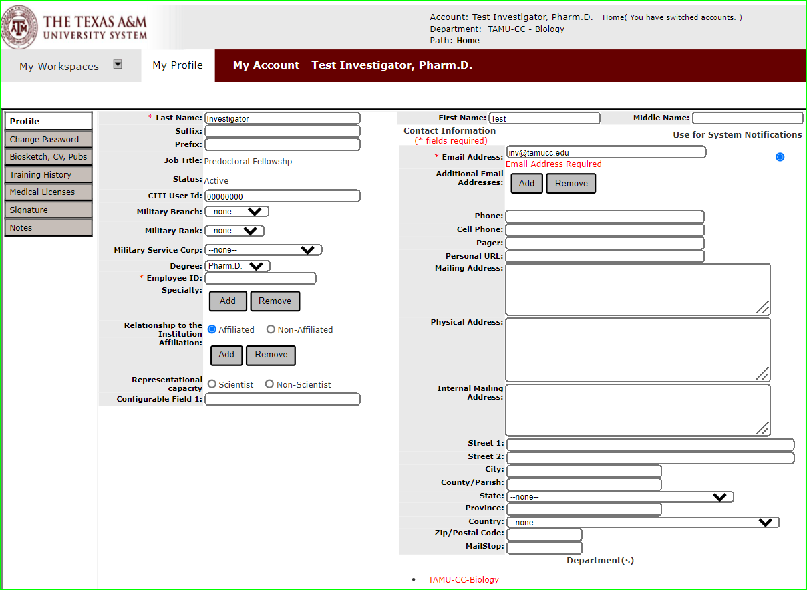
Email setting
When your account is set, your TAMU-CC email is entered as your email and set as the email to use for system notifications.
Sets the email to send system notifications to.

Slide 5
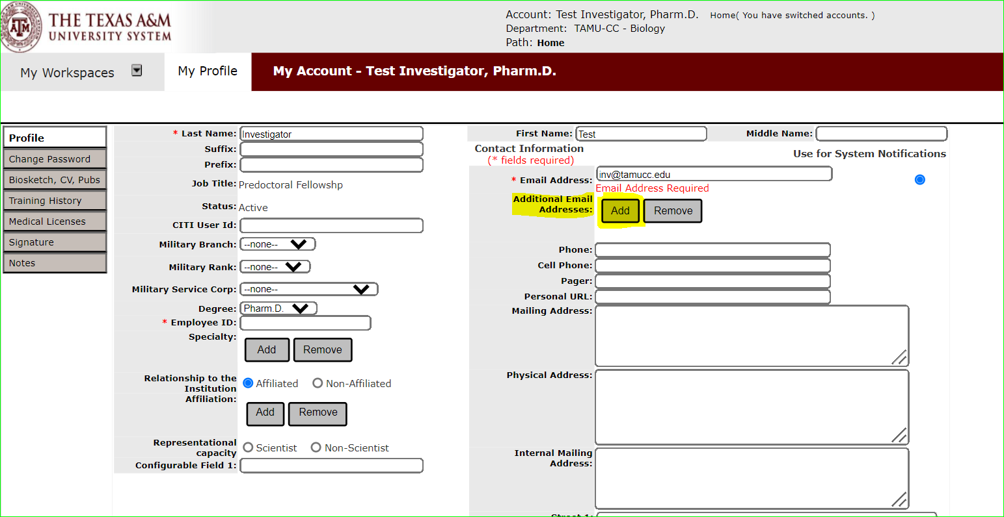
Add Additional Email Addresses
Click Add next to “Additional Email Addresses”.

Slide 6
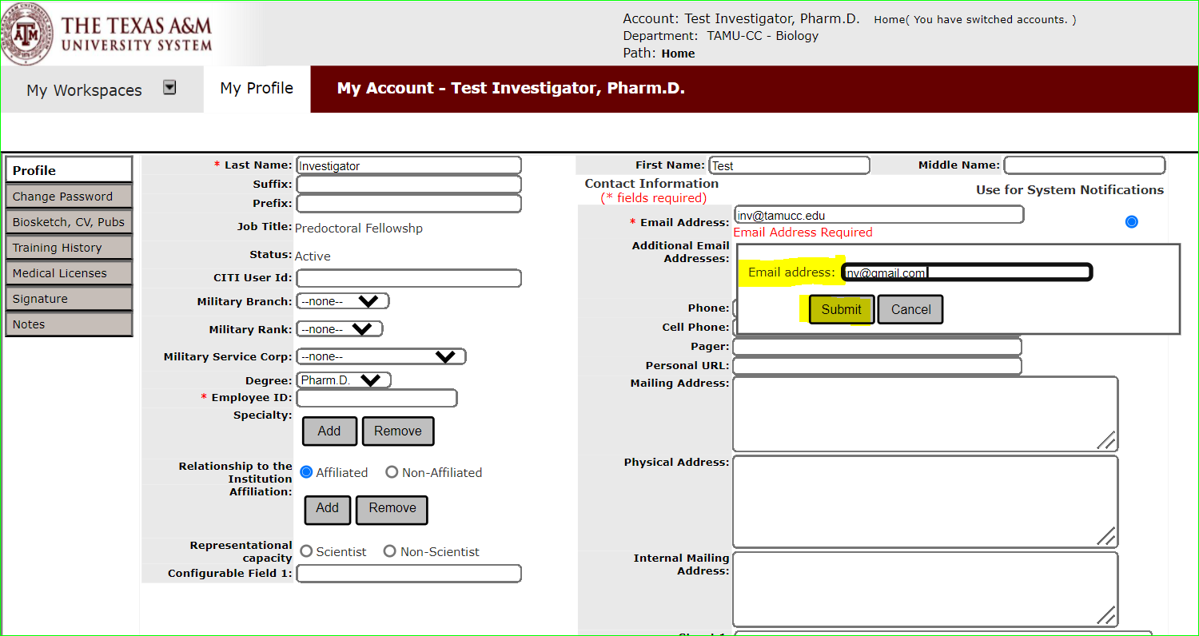
Add Additional Email Addresses
Enter the email address and hit “Submit”.

Slide 7
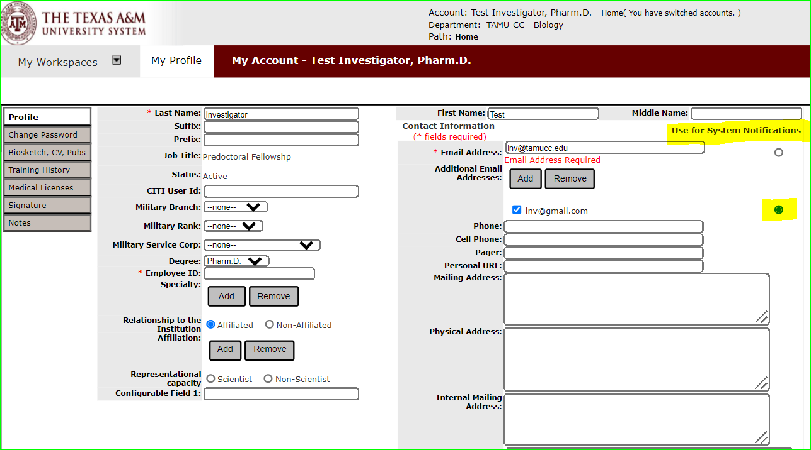
Set New Email for Use as System Notification
Change the radial button to the added email address to set the new email for system notifications.

Slide 8
Set New Email for Use as System Notification
Change the radial button to the added email address to set the new email for system notifications.
NOTE: Email Firewalls
Non-TAMUCC emails may have a firewall preventing automatic notifications. This may prevent you receiving system notifications.
You must work with IT to resolve these issues.

