Slide 1
iRIS My Profile
Rebecca Ballard, JD, MA, CIP March 19, 2021
Director, Research Compliance

Slide 2
Welcome!
I’ll be guiding you through today’s course objectives.
What is an iRIS My Profile?

Slide 3
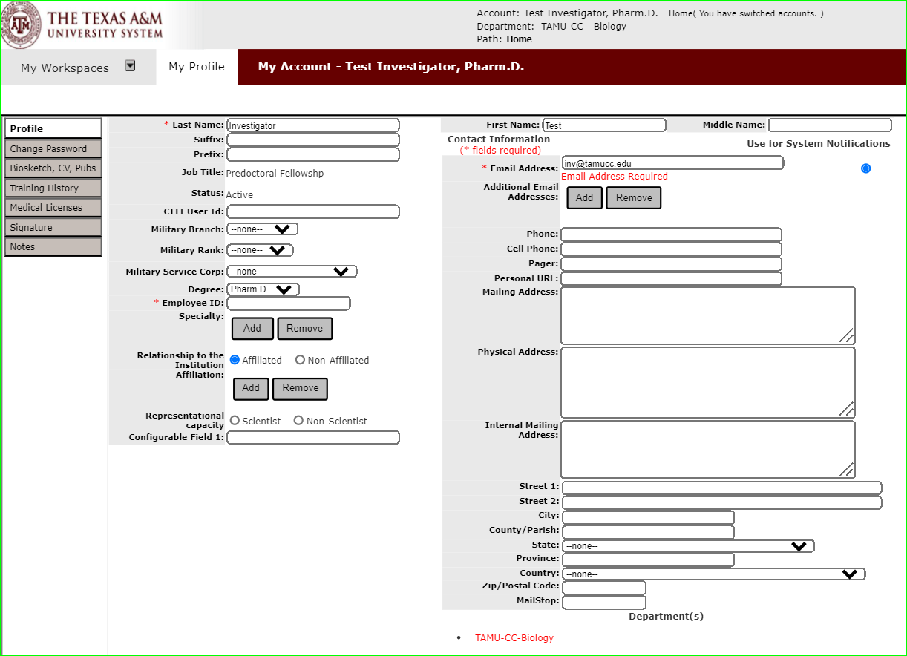
What is an iRIS My Profile?
Once an iRIS account is created for you, your iRIS profile collects information about you independent of your studies.

Slide 4
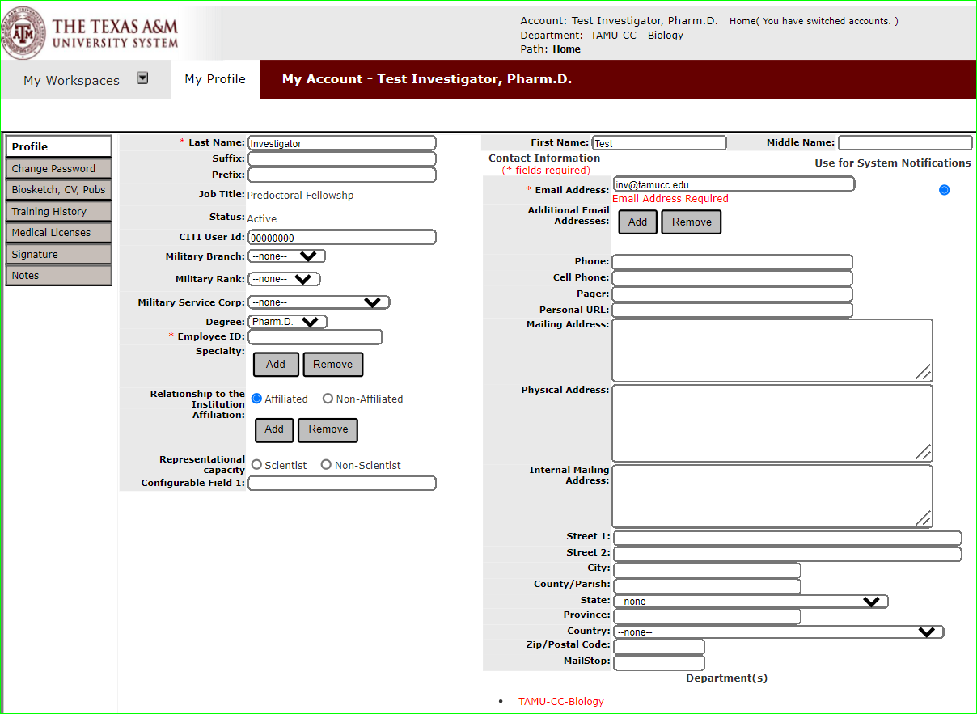
What does the iRIS My Profile do?
Information in your profile can help you easily fill out study submissions.

Slide 5
What does the iRIS My Profile do?
Information in your profile can help you easily fill out study submissions.
Here are some examples.
Sets the email to send system notifications to.

Slide 6
What does the iRIS My Profile do?
Information in your profile can help you easily fill out study submissions.
Here are some examples.
Auto fills your department in study applications.

Slide 7
What does the iRIS My Profile do?
Information in your profile can help you easily fill out study submissions.
Here are some examples.
Connects your account to CITI to auto feed your training records from CITI

Slide 8
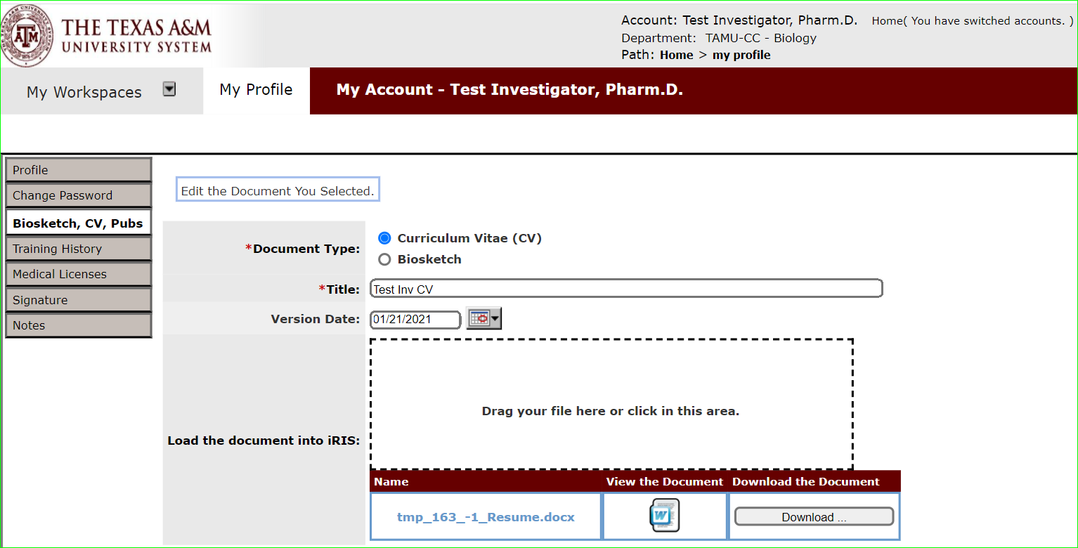
What does the iRIS My Profile do?
Information in your profile can help you easily fill out study submissions.
Here are some examples.
Allows you to upload your CV/biosketch once and auto fill into any study application.

Slide 9
What does the iRIS My Profile do?
Information in your profile can help you easily fill out study submissions.
Here are some examples.
Stores your training history. This allows the system to auto check your training when added to a submission.

Slide 10
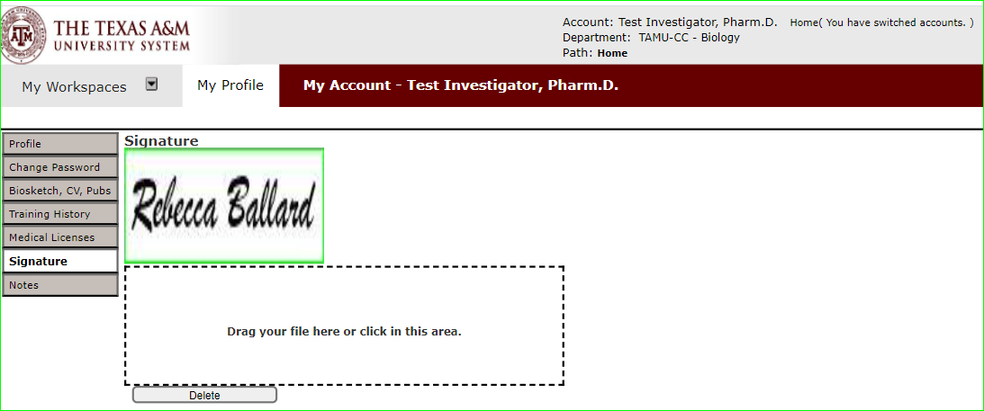
What does the iRIS My Profile do?
Information in your profile can help you easily fill out study submissions.
Here are some examples.
Create an electronic signature to apply when a signature is required.

Slide 11
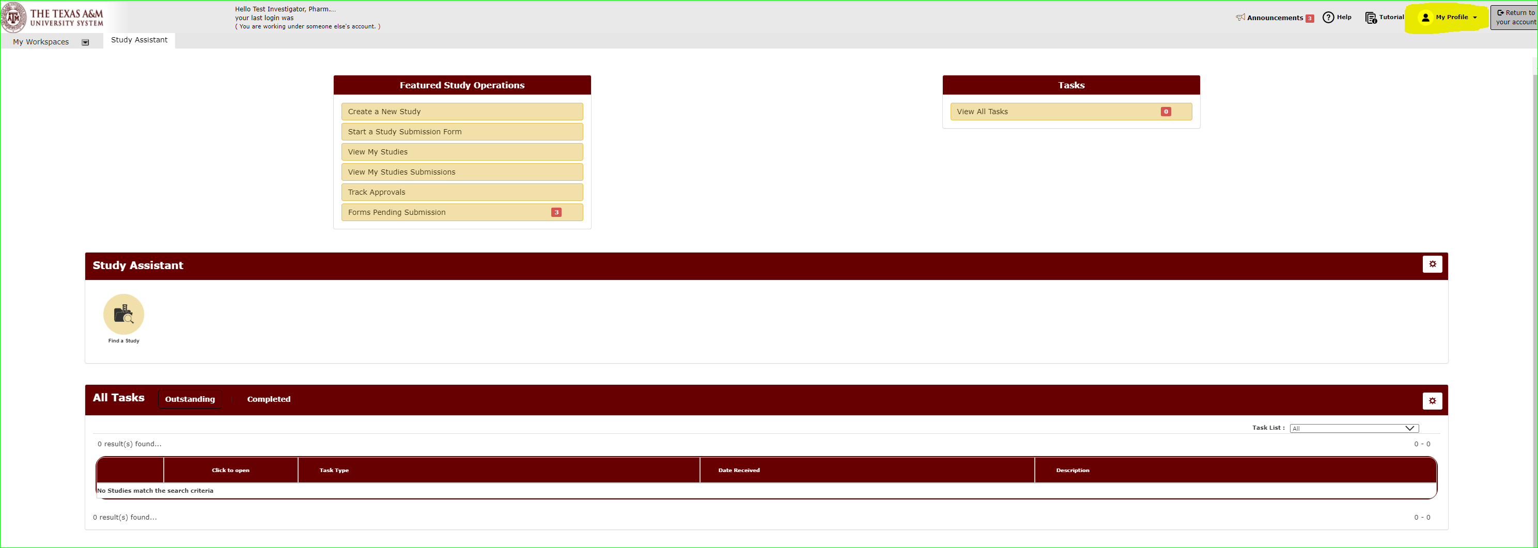
How do I view my iRIS My Profile?
On the Study Assistant Workspace, you can access your profile in the upper-right hand corner of the screen. Click “My Profile” to open.

Slide 12
How do I update information in My Profile?
Select “My Account”.

