Slide 1
Tracking the Submission Progress
Rebecca Ballard, JD, MA, CIP January 15, 2021
Director, Research Compliance

Slide 2
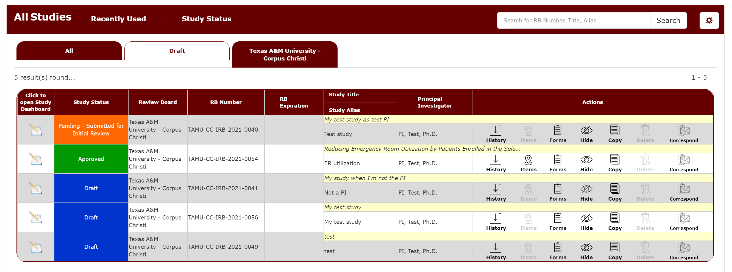
iRIS uses color coded “statuses” to classify where a submission is in the review process.
On the Study Assistant Dashboard, you will find a list of studies in which you are listed as study personnel.
In the column “study status” you can find where that protocol is in the review process.

Slide 3
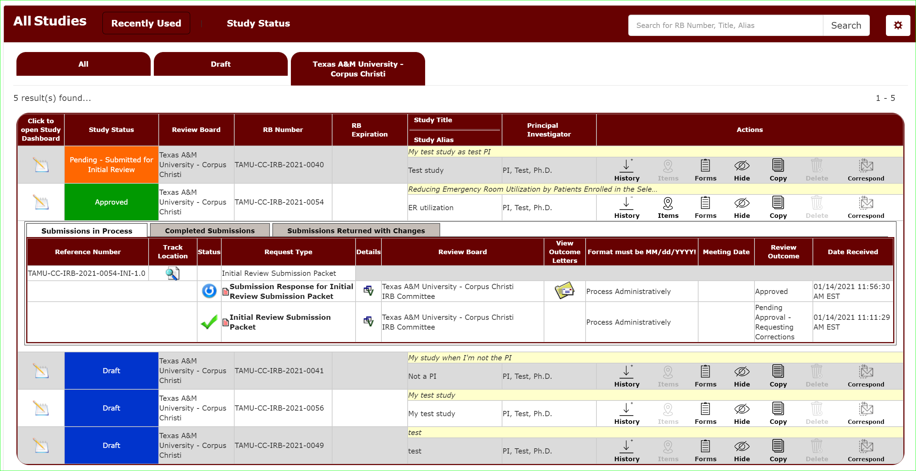
Study History
Click the History icon under the submission to open a quick view of the review process.

Slide 4
Submission Progress
Studies Submission Status – In progress will display all current submissions in the review process.

Slide 5
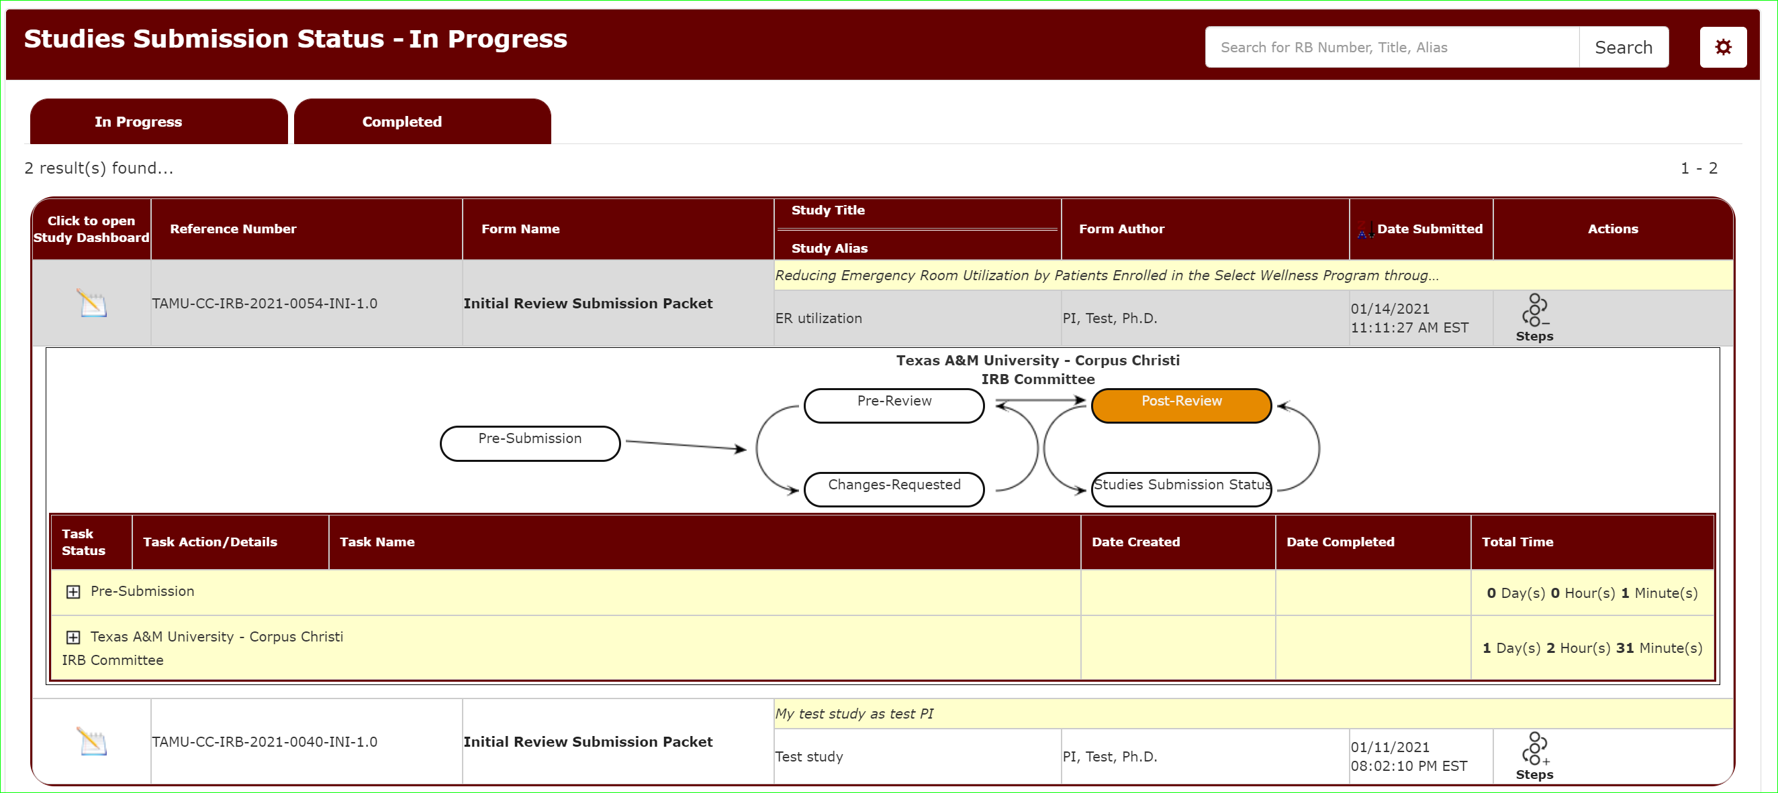
Submission Progress
Studies Submission Status – In progress will display all current submissions in the review process.
Clicking “Steps” will provide a visualization of where the submission is in the review process.
Click the + on each step to get more details.

