Slide 1
Starting a New Initial Submission
Rebecca Ballard, JD, MA, CIP May 13, 2021
Director, Research Compliance

Slide 2
Welcome!
I’ll be guiding you through today’s course objectives.
How to start a new initial submission form in iRIS.

Slide 3
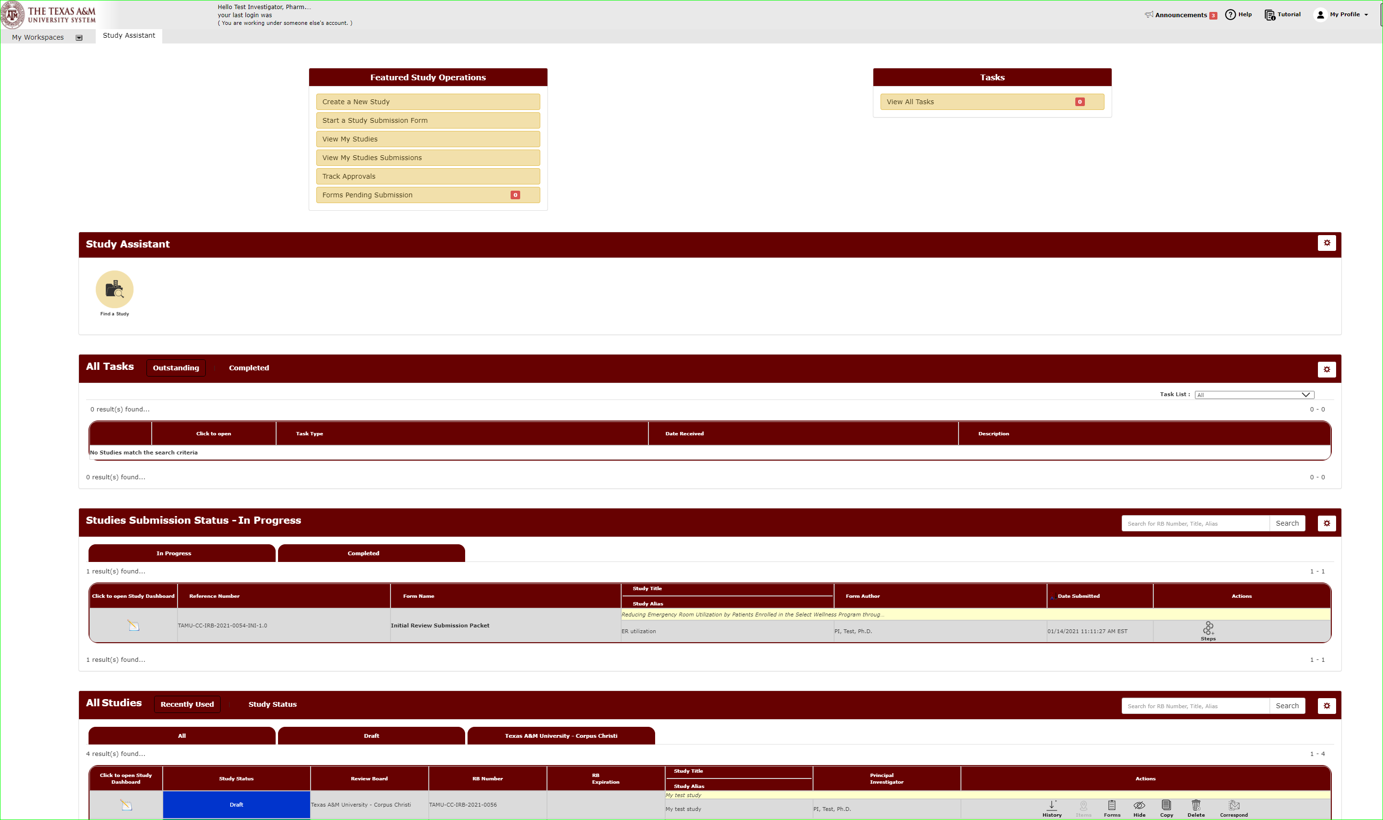
You will manage all your studies through the Study Assistant Workspace.
You will be taken to the Study Assistant Workspace once you login.

Slide 4
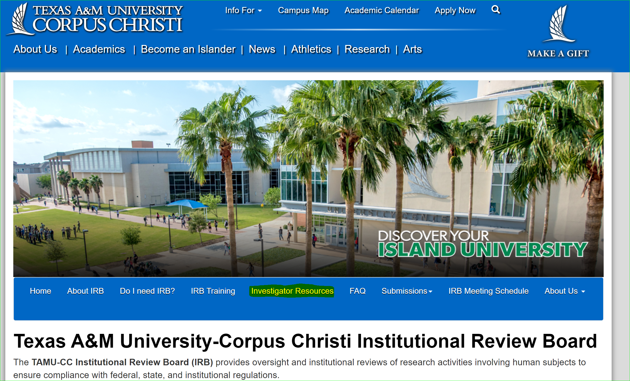
Submission Packet
The completed submission packet, and ultimately our approved protocol, consists of several parts:
You can find templates for study documents on our website under Investigator Resources.
The Study Application
Study Documents
  Consent forms
  Recruitment Materials
  Questionnaires
  Interview Questions

Slide 5
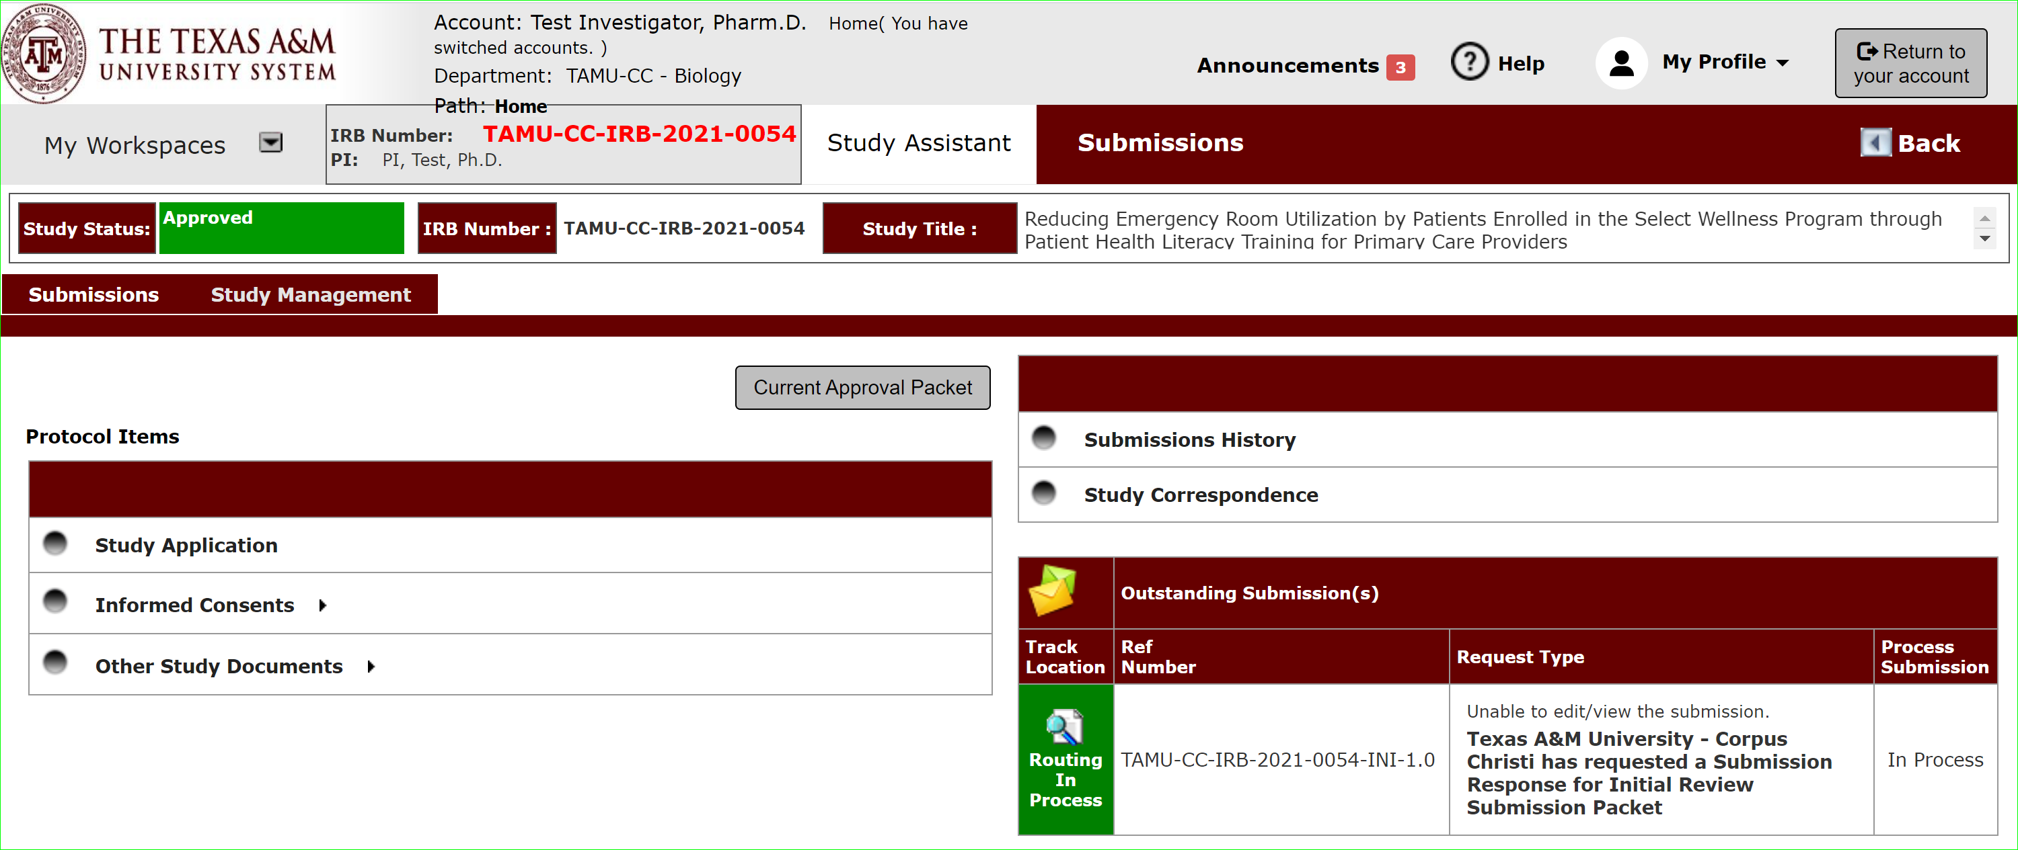
Submission Packet
The completed submission packet, and ultimately our approved protocol, consists of several parts.
Study Application
The study application is the guided form you will be prompted to fill out once you hit “Create New Study”.

Slide 6
Submission Packet
The completed submission packet, and ultimately our approved protocol, consists of several parts.
Consent Forms
After you finish the study application, then you will be taken to a submission packet page that allows you to attach consent forms.

Slide 7
Submission Packet
The completed submission packet, and ultimately our approved protocol, consists of several parts.
Study Documents
After you finish the study application, then you will be taken to a submission packet page that allows you to attach other study documents, such as recruitment flyers, letters of support, questionnaires, etc..

Slide 8
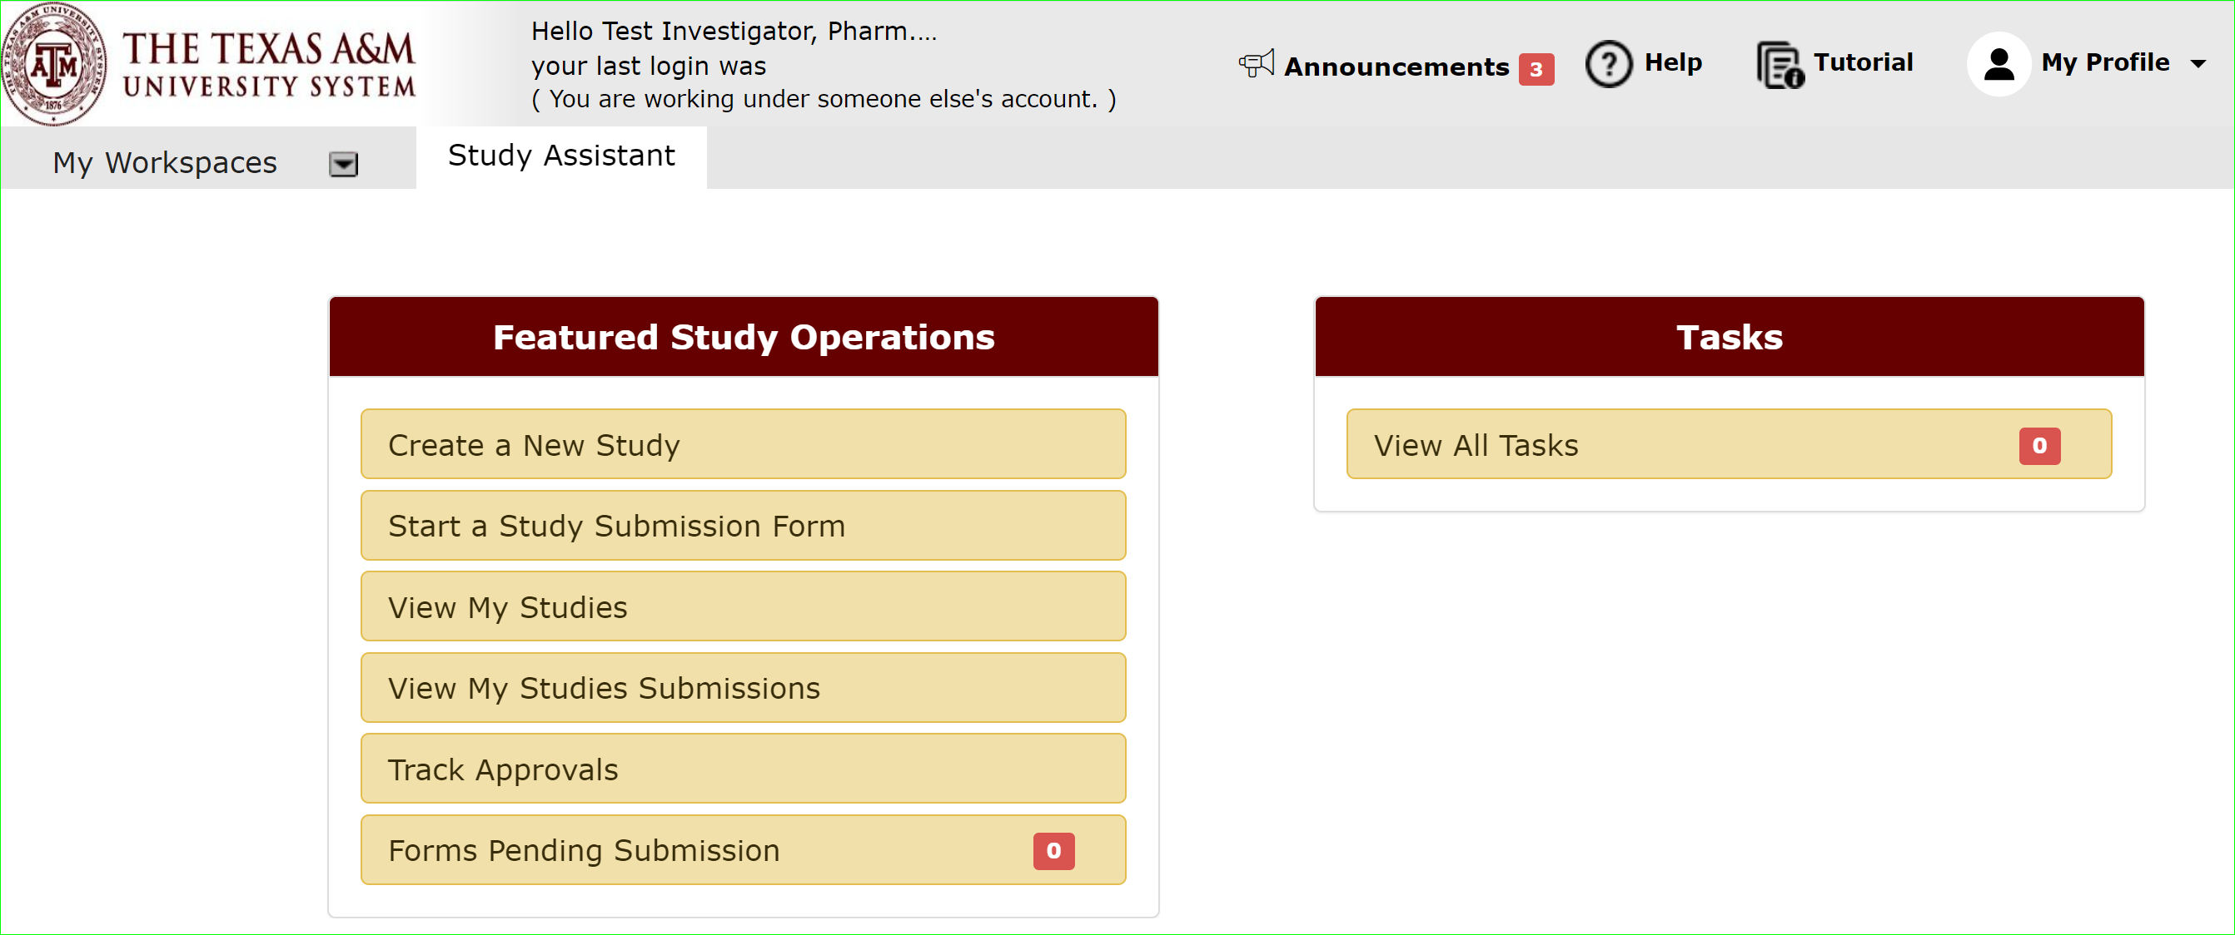
Let’s begin a new submission.
On the Study Assistant Workspace, Click “Create a New Study” to open the Study Application form.

Slide 9
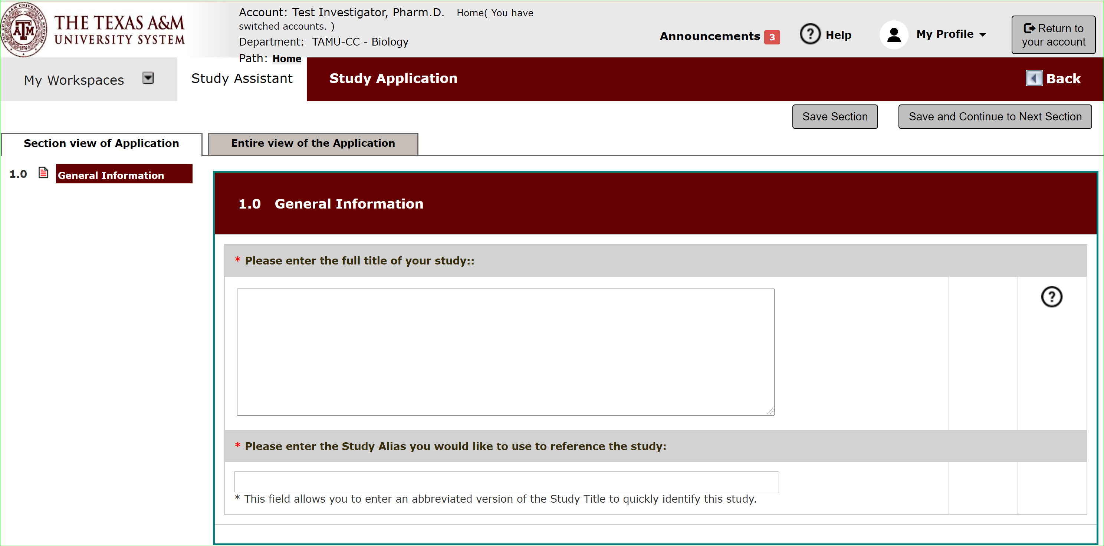
Begin filling out the form.
Hit save and continue to the next section to proceed through the form.

Slide 10
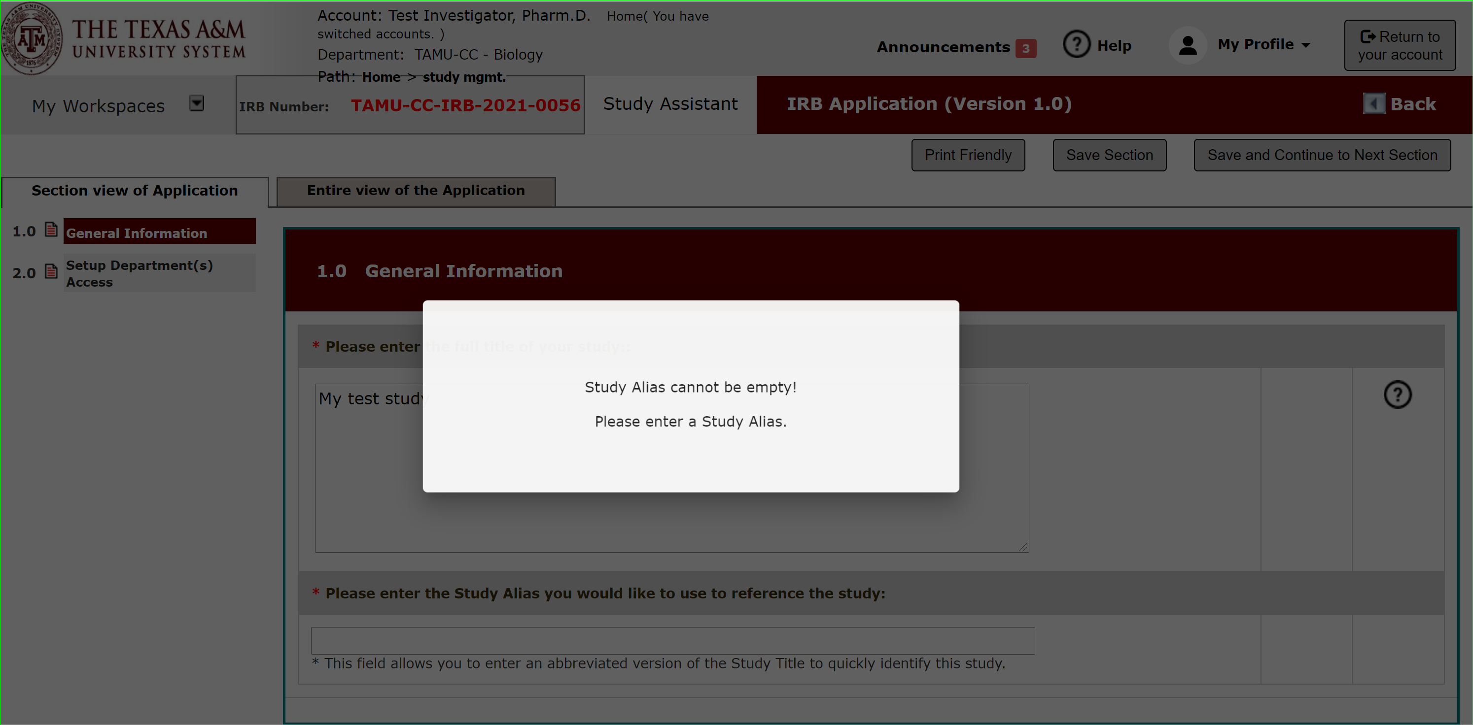
Begin filling out the form.
Fields with an asterisk are required fields.
An error message will appear if left blank.

Slide 11
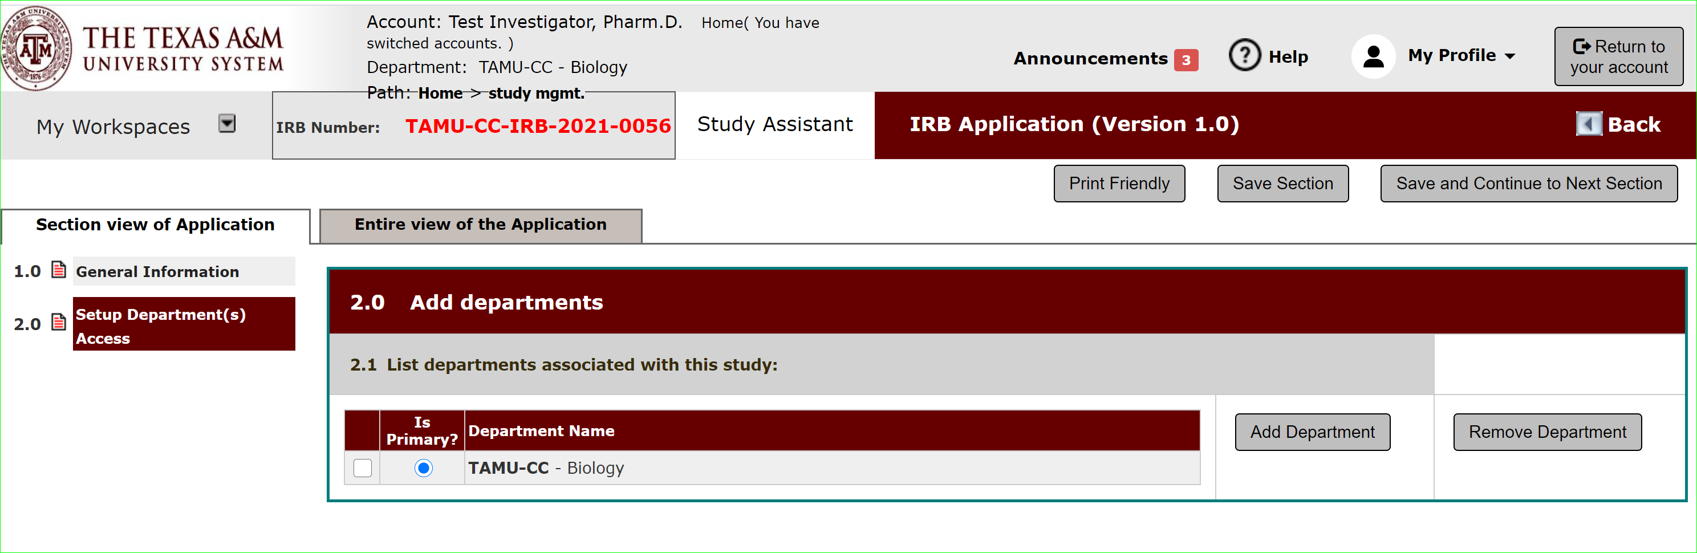


Section 2.0: Department Access
This section associates your study with your department.
This allows departments to run reports on studies within their area.
The department listed on the author’s profile will be added as a default department.
But the default can be changed, or additional departments added.

Slide 12
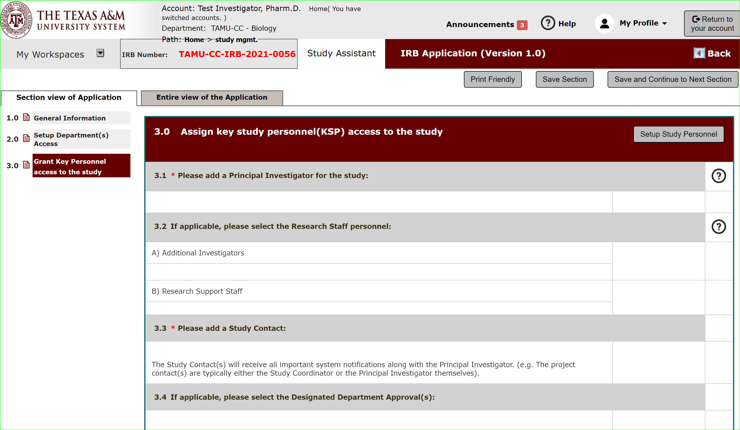
Section 3.0: Grant Key Personnel access
This section allows you to list study personnel and indicate what level of access you want them to have.

Slide 13
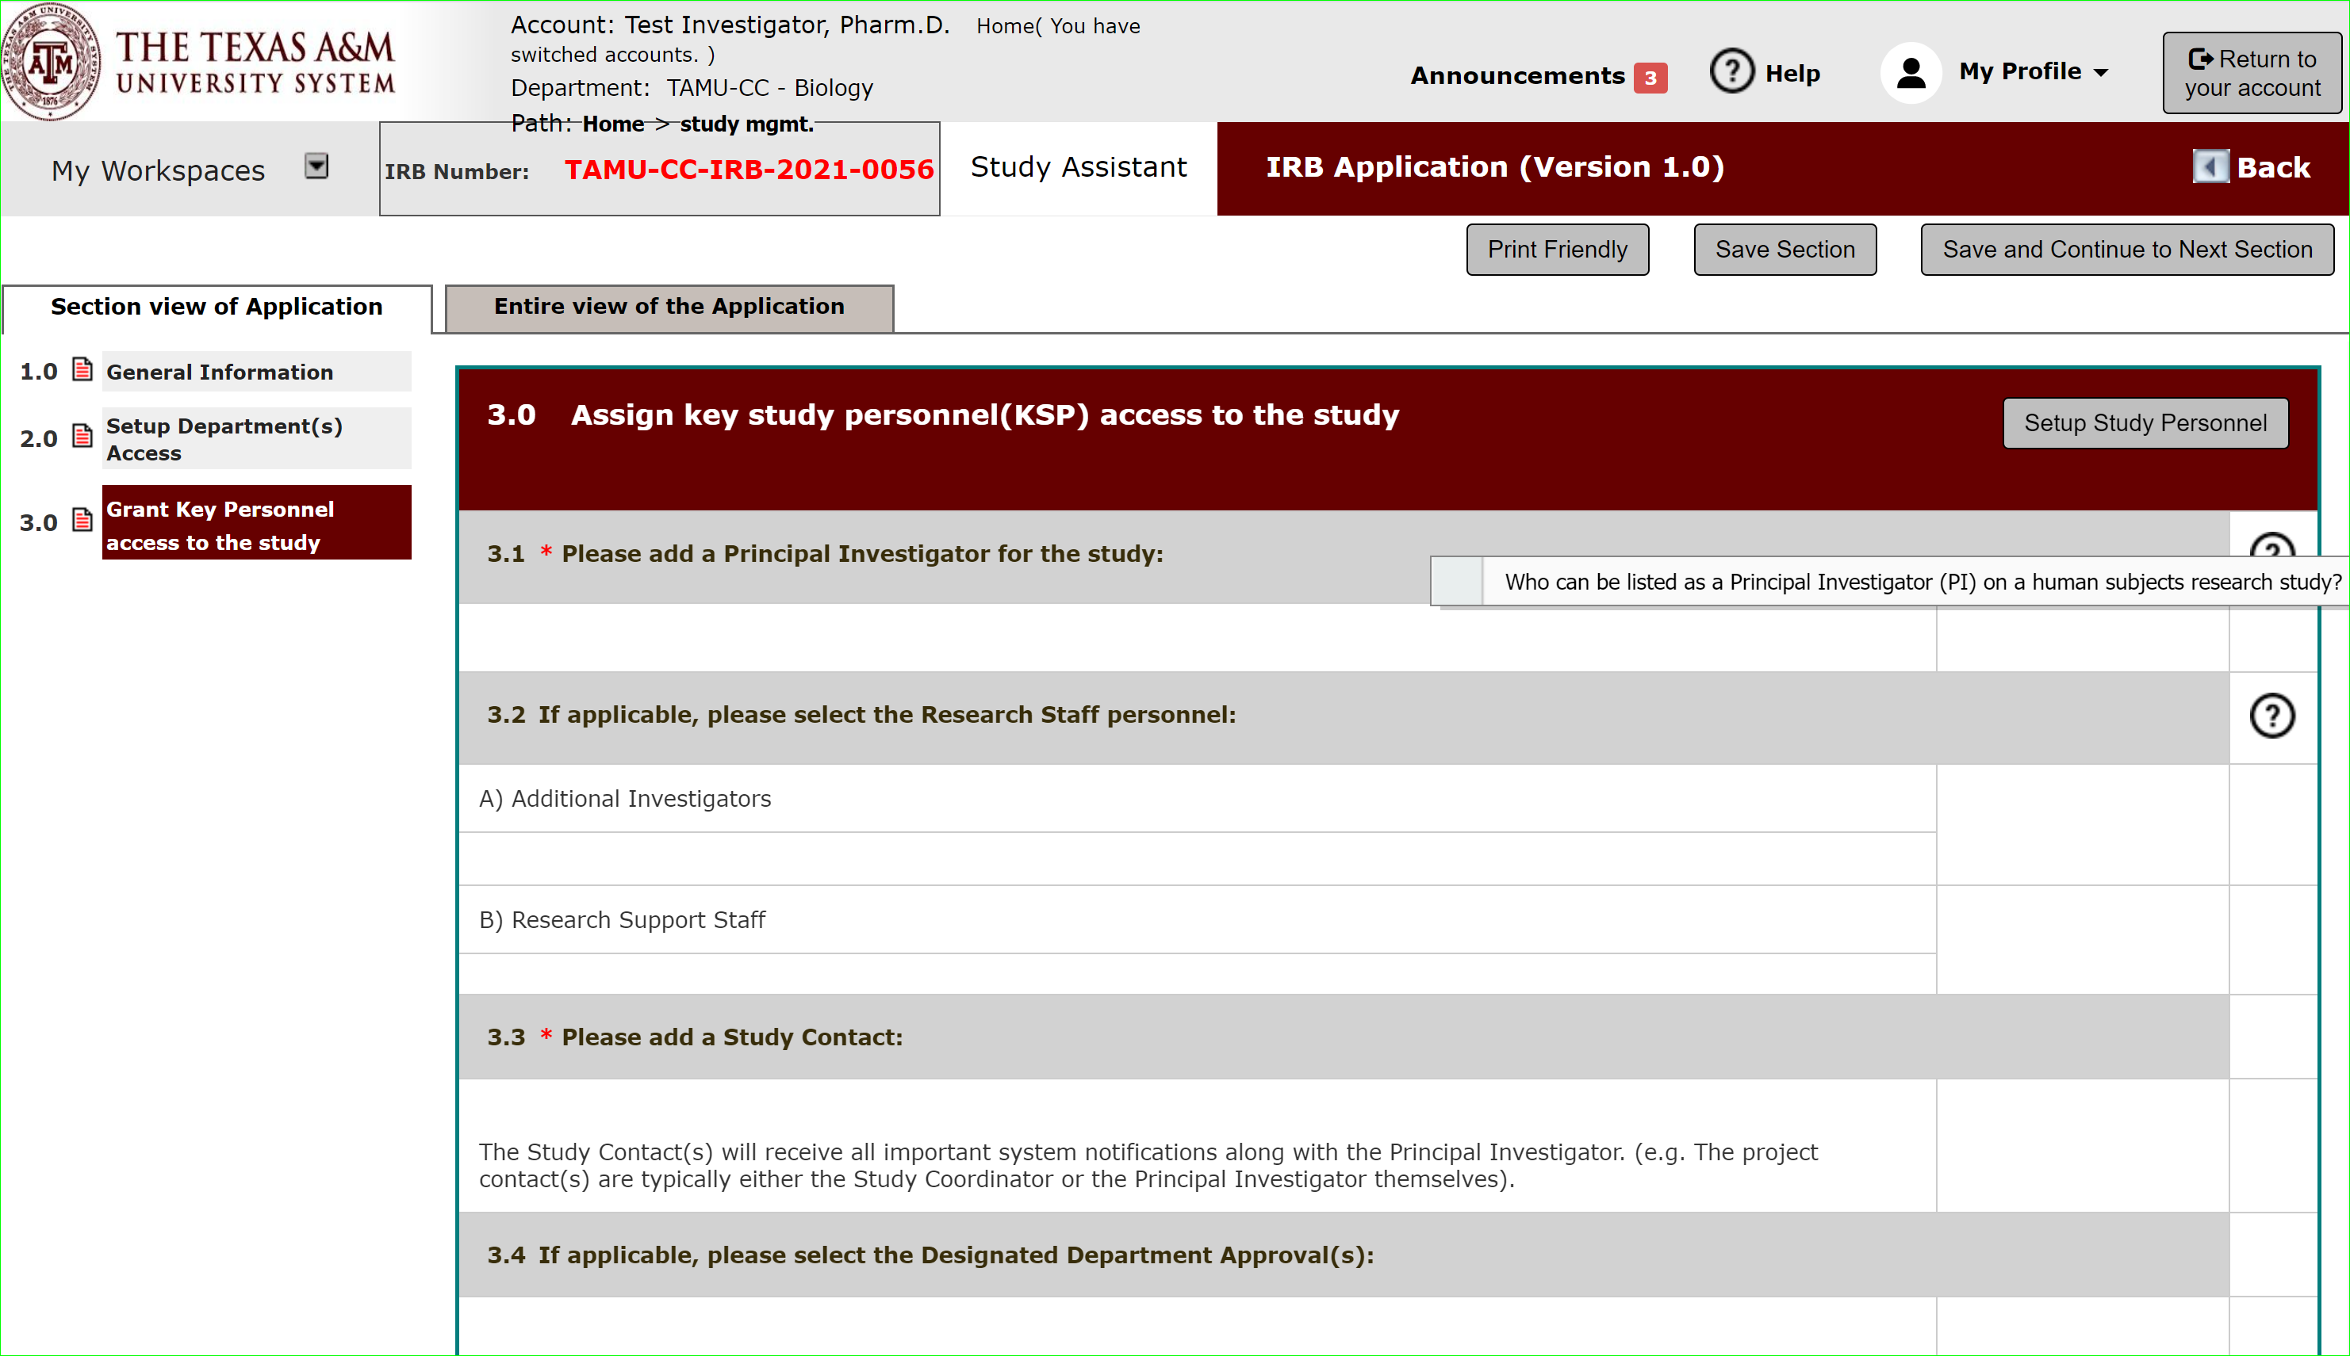
System Feature: Help Text
The application will feature help text to assist you in filling out the application form.
Click the ? Icon to open.

Slide 14
Section 3.0: Grant Key Personnel access
Click “Setup Study Personnel” to be able to add personnel to your application.

Slide 15
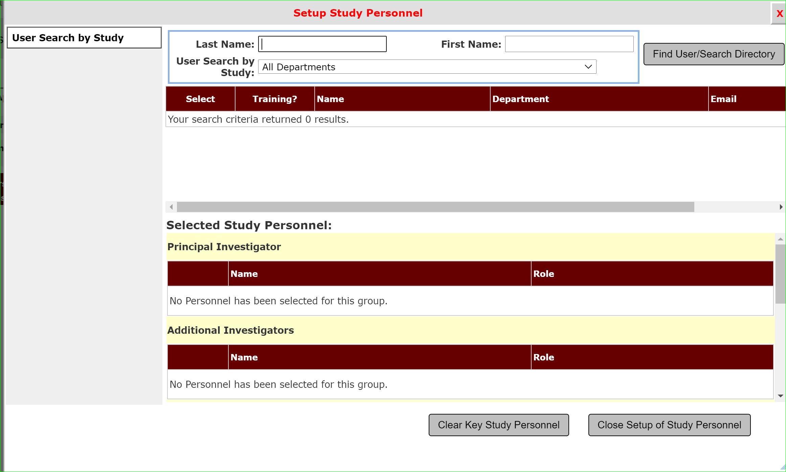
Section 3.0: Setup Study Personnel
Use the search feature to find personnel to add to your study.

Slide 16
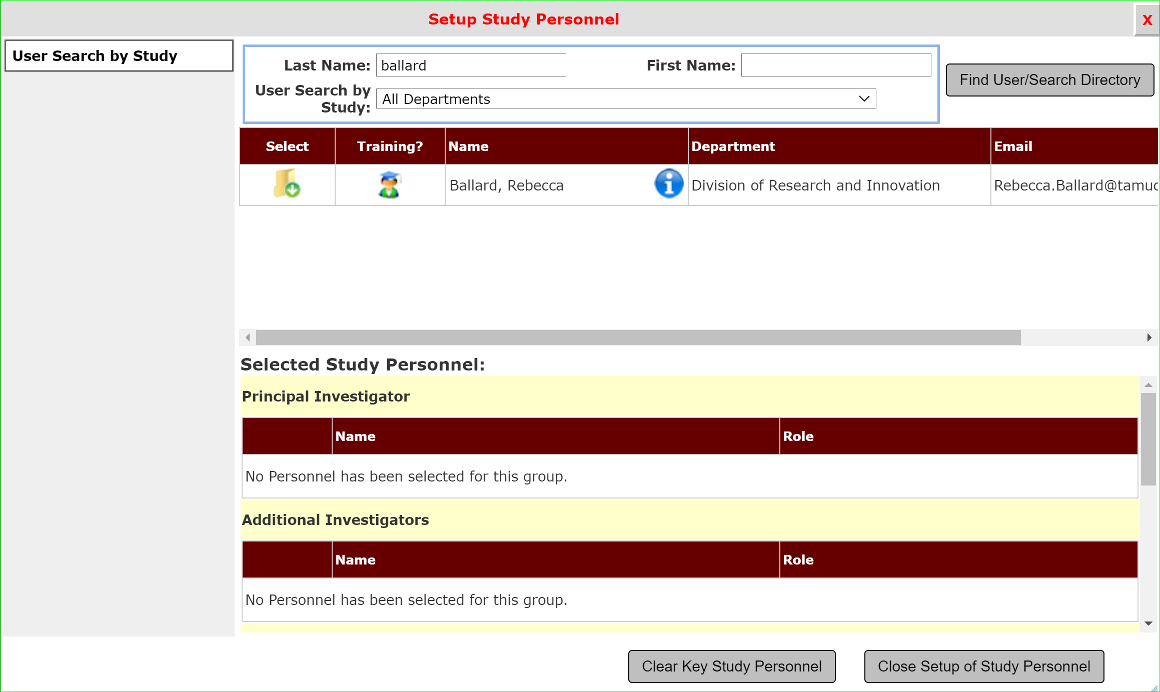
System Feature: Study Personnel Training Verification
iRIS is connected to CITI training.
CITI training records are updated nightly.
Click the person icon under Training to view the study personnel’s current training record to ensure the person has completed required training to be listed as study personnel.

Slide 17
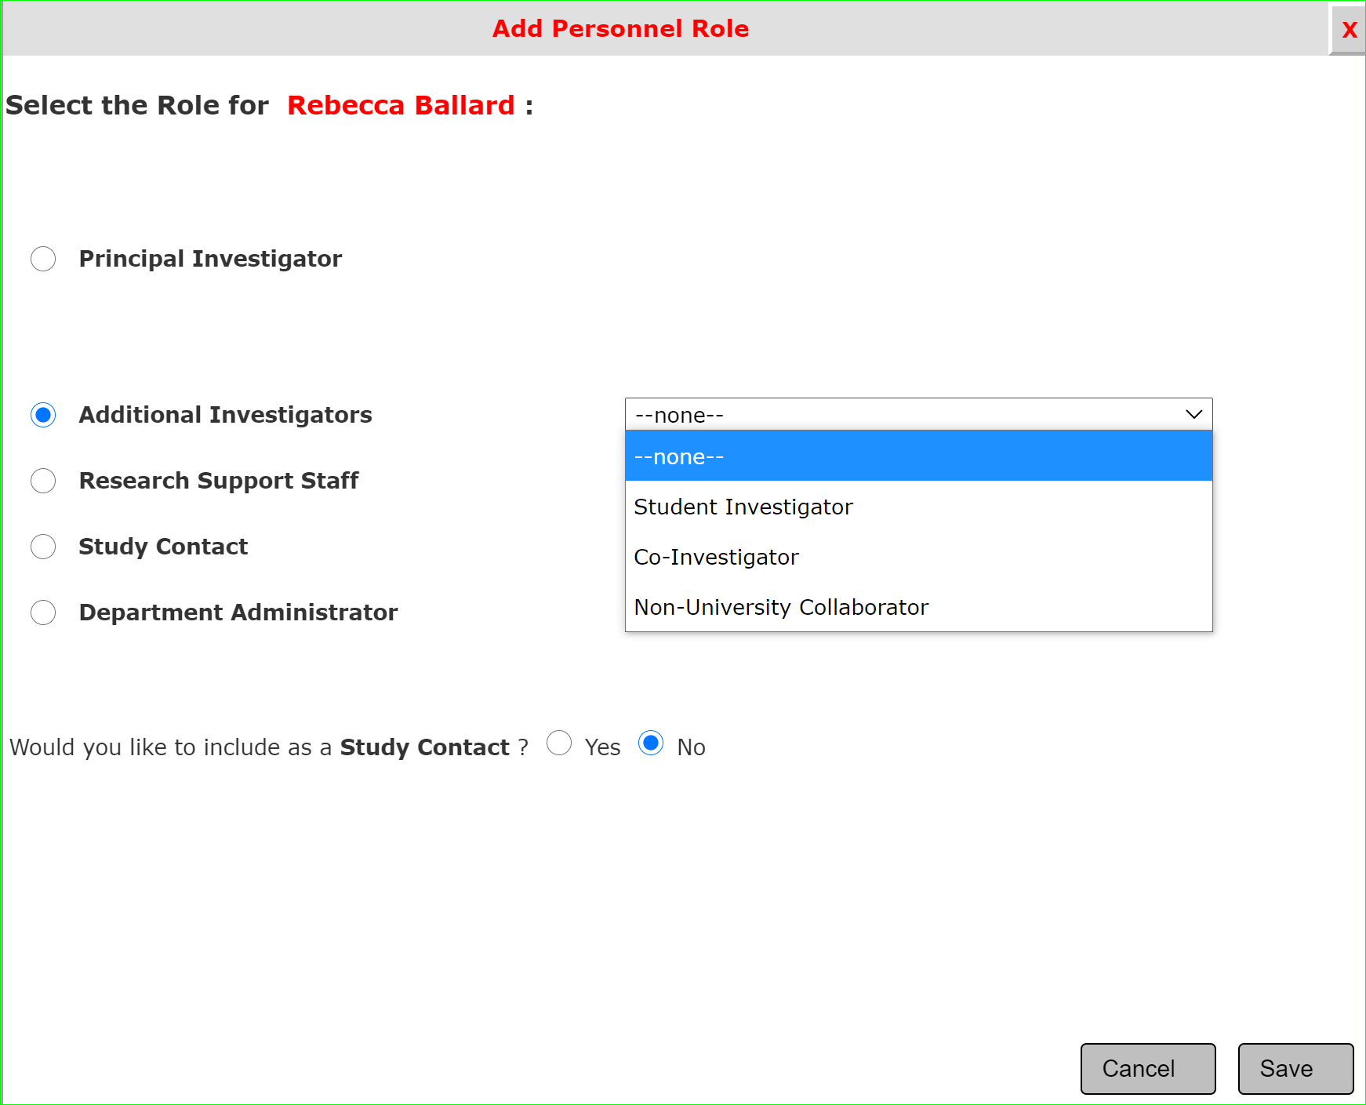

Section 3.0: Setup Study Personnel
Click “Select” to open the window to indicate the role of the individual.

Slide 18
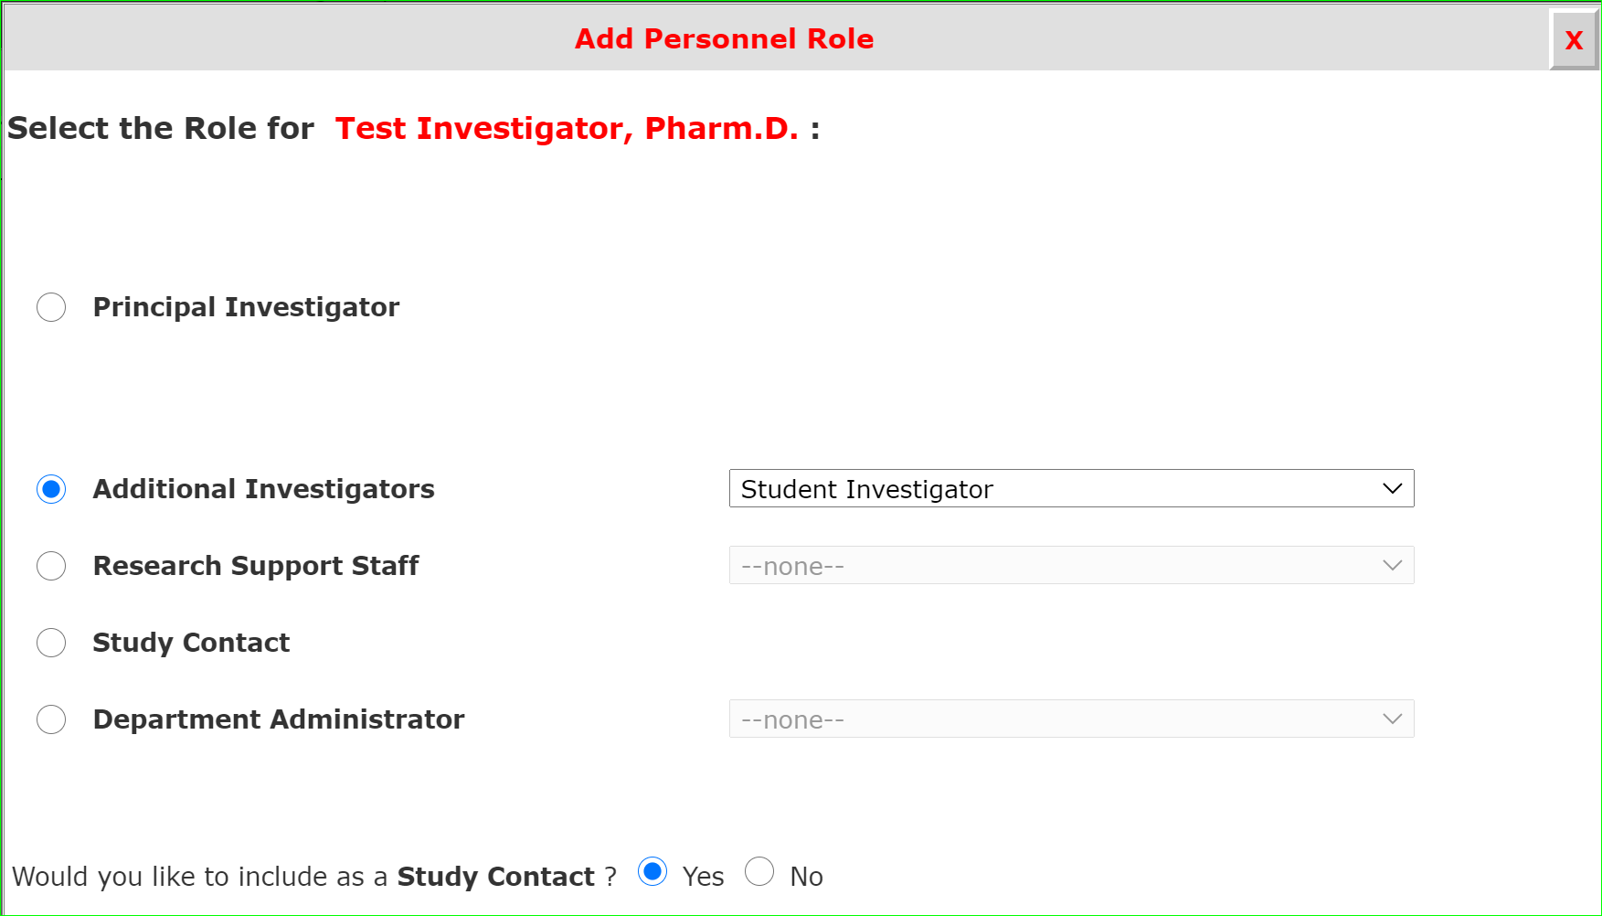
System Feature: Who Receives Study Notifications?
Who receives study notifications is in your control.
Study contacts will receive all study notifications just like the PI.
If you want the person to receive study notifications select “Yes” here.

Slide 19
What if I can’t find the person in the search directory?
To be in the directory the individual must have an iRIS account and profile.
How do I get an iRIS account?
Login to iRIS through SSO.
Go to: https://research.tamucc.edu/compliance/home/index.html to access the iRIS login page.

Slide 20
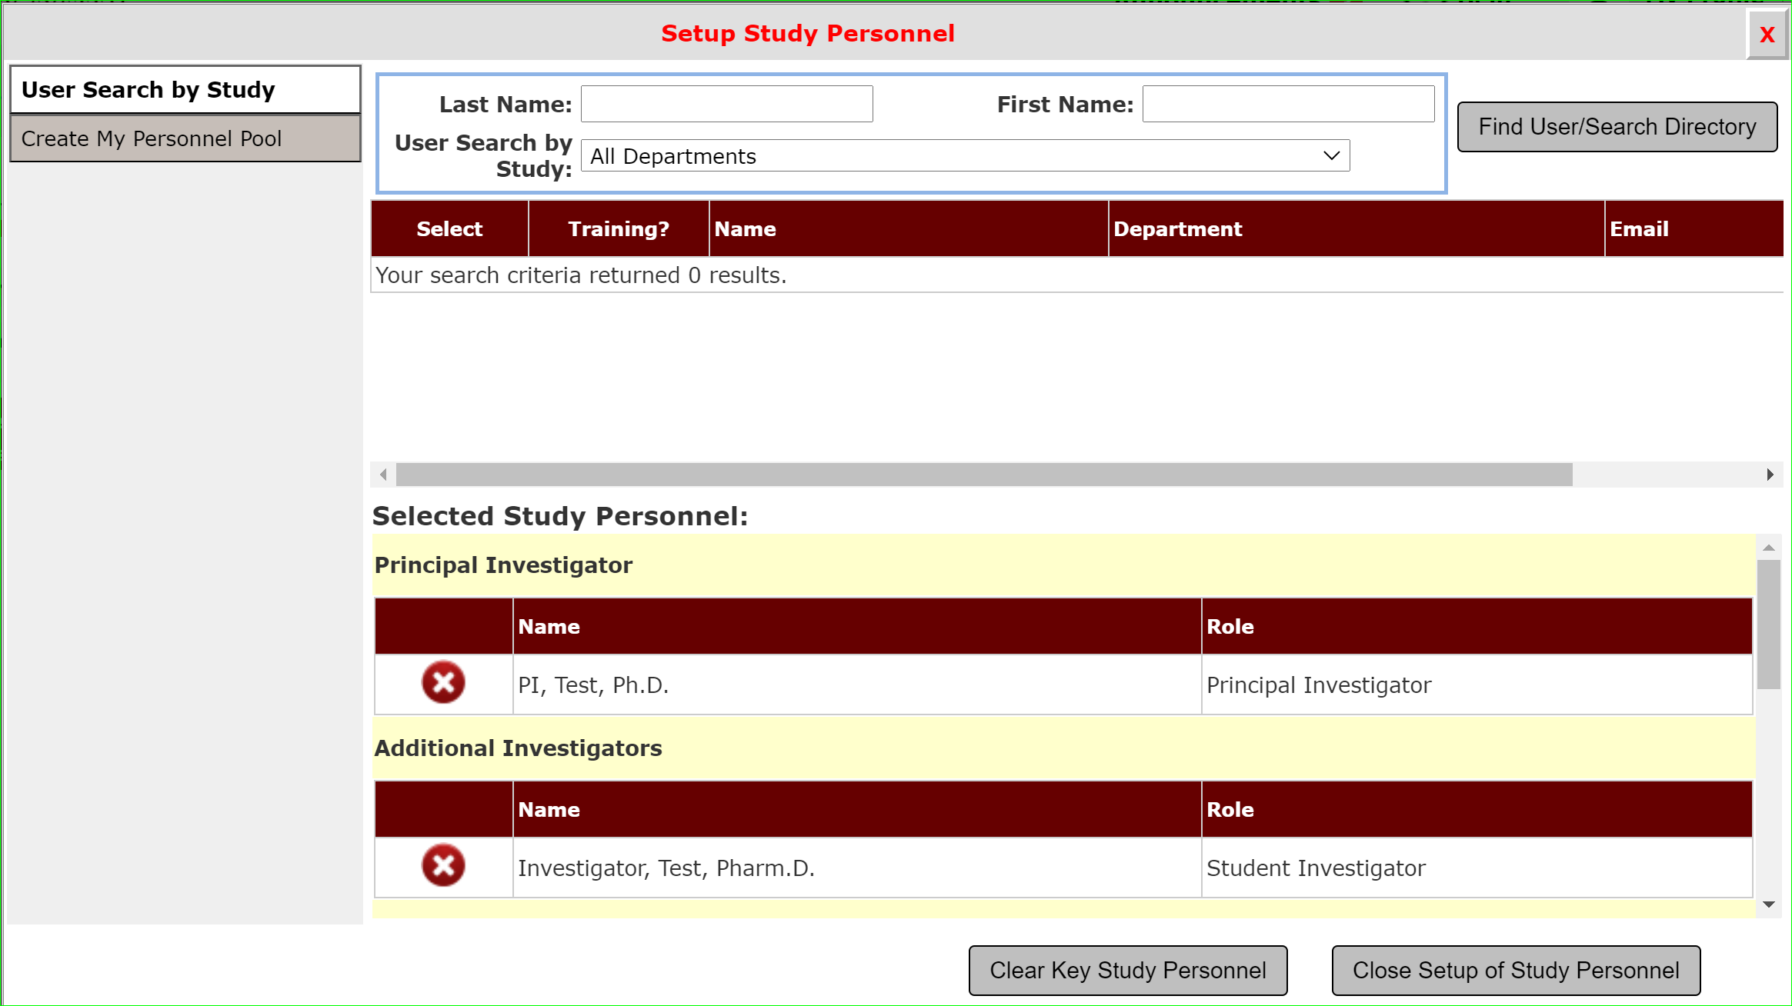
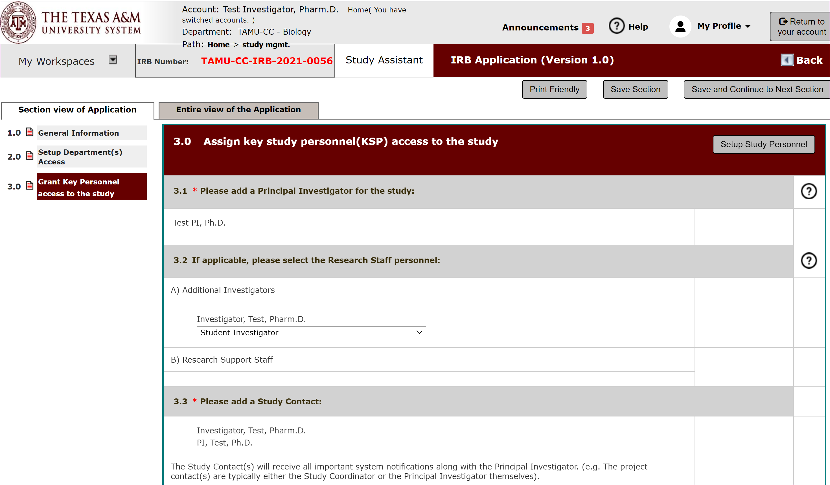
Section 3.0: Setup Study Personnel Completed
Once all individuals are set up as study personnel, select “Close setup of Study Personnel” to return to the application.

Slide 21

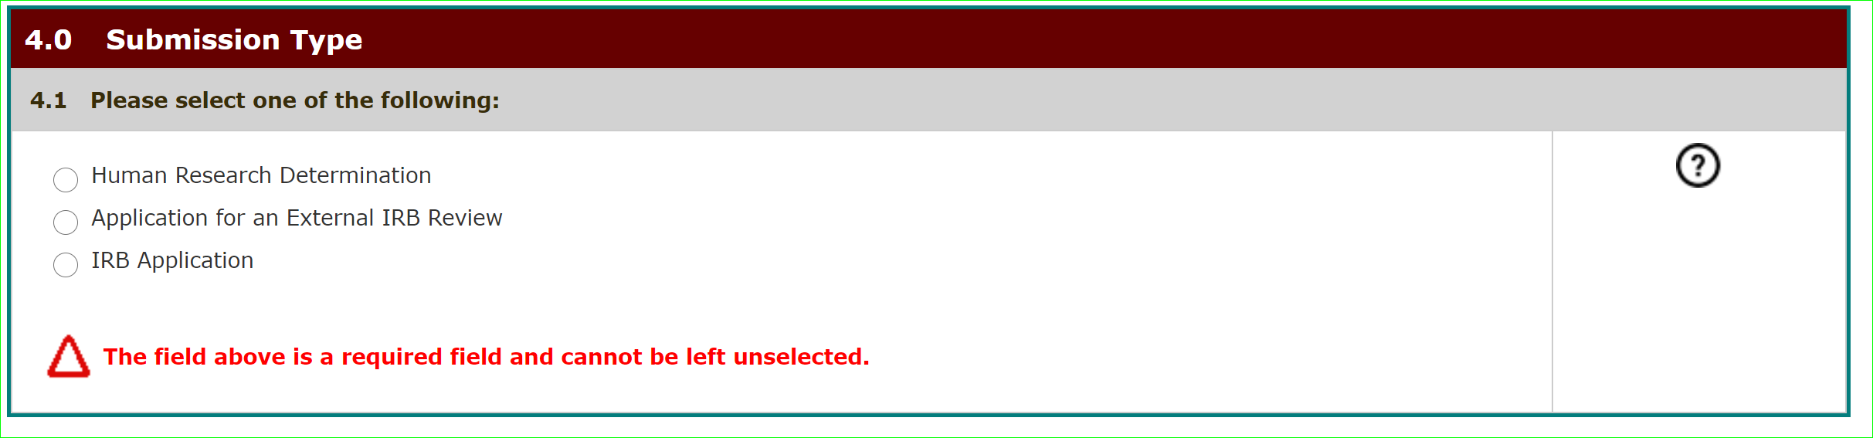
Remaining Application Sections
Continue through the application until all sections are completed.
The study application is composed of several sections.
iRIS uses smart form logic.
Questions with “branching” logic will trigger the hide/show feature that will hide or show additional questions or sections based on your answers.
Questions marked with an asterisk (*) must be answered. If they are not answered, you will receive an error message.
Help Text: Questions with an icon on the right have help text available to provide definitions of key terms, additional explanation on the question topic, suggestions or examples to assist you in responding to the questions.

Slide 22
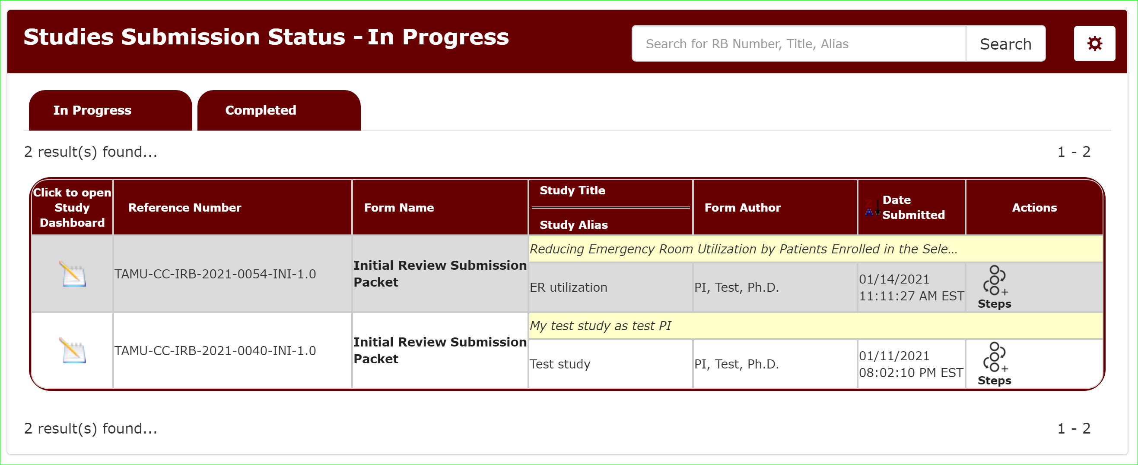
What if I need to finish my application later?
You can view your submissions in progress from the Study Assistant Dashboard.
Click the paper/pencil icon to open the study submission.

Slide 23
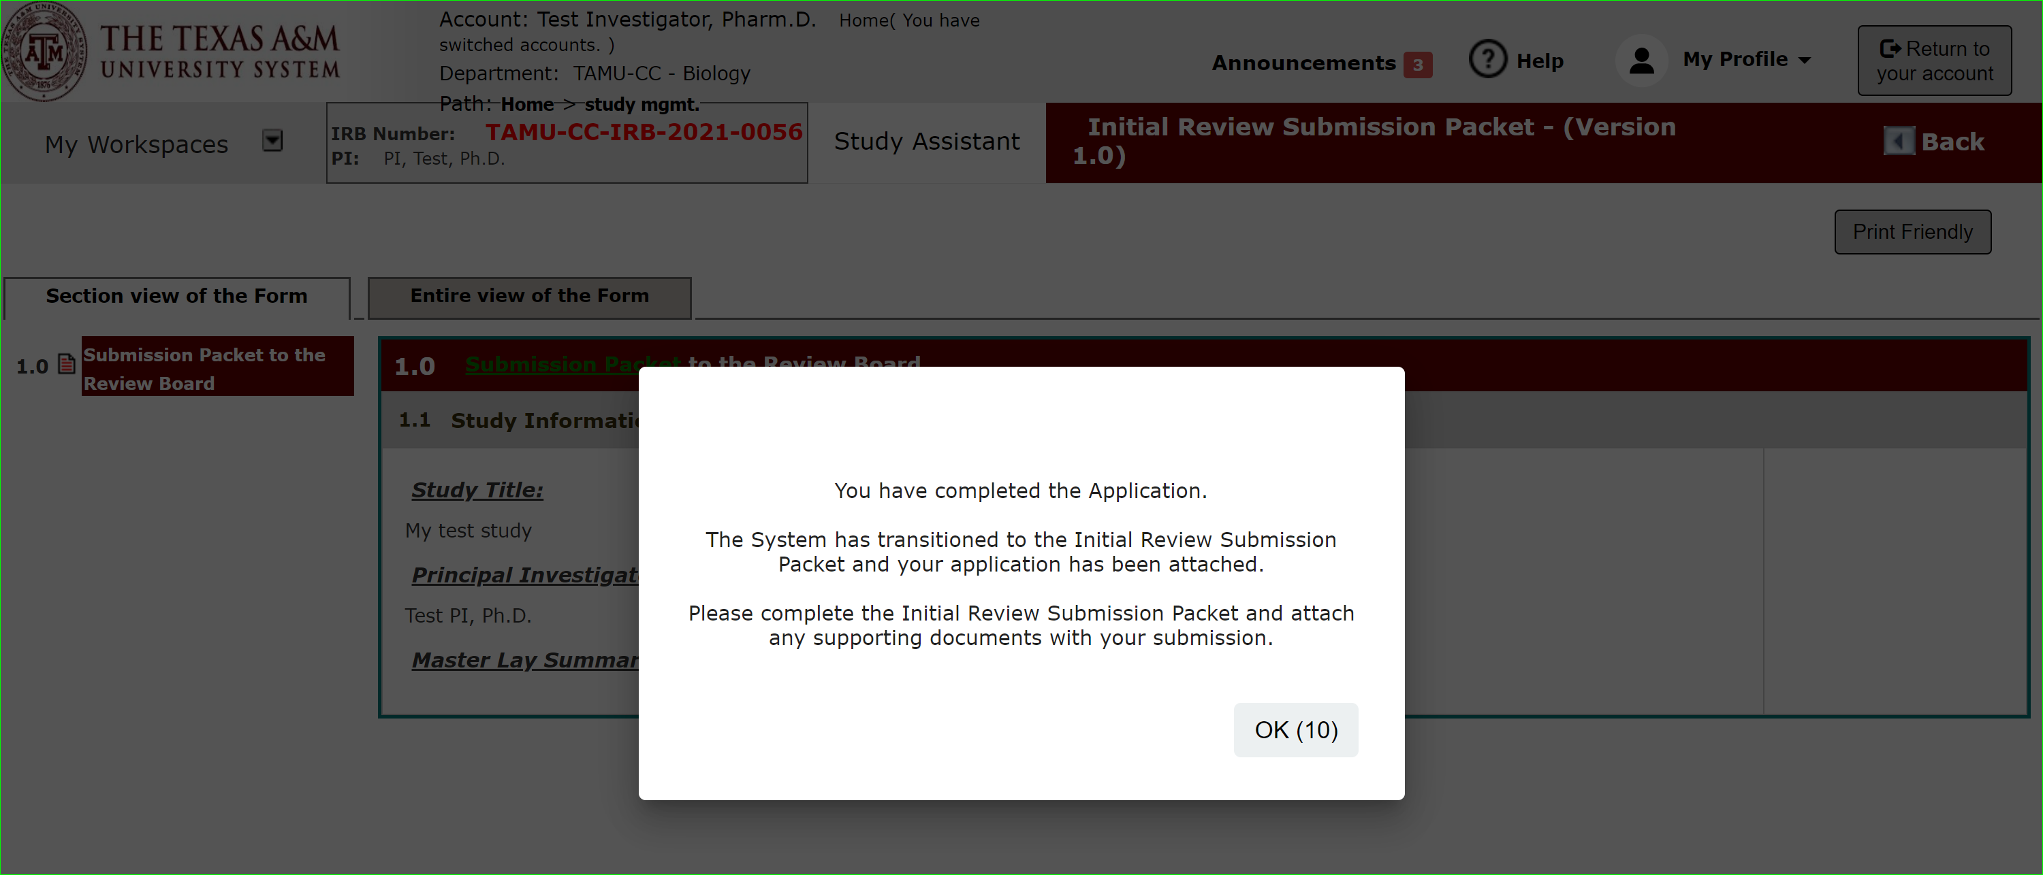
Application Complete
Once you have completed the application portion of the submission packet, you will see this message.

Slide 24
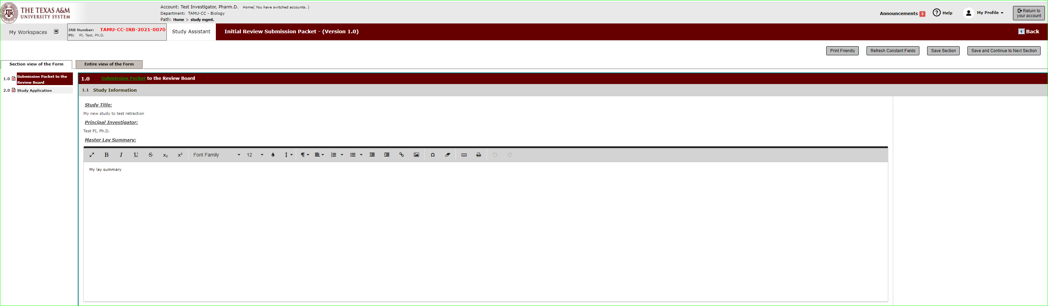
Submission Packet
You will automatically be taken to the submission packet to upload documents related to your application.
The Initial Review Submission Packet “packages” the Application and documents together for submission.

Slide 25
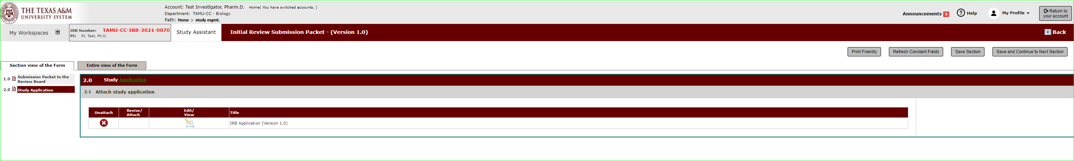
Submission Packet: Study Application
Section 2.0 Displays the Application form you just filled out.
You can view/edit the IRB Application form.
Or hit save and continue to the next section to upload your supporting documents.

Slide 26
Submission Packet: Upload Supporting Documents
As you progress through the submission packet you will see the IRB Application form you just filled out and then will be prompted to attach various study documents.
"Add a New Consent" in the Informed Consent section.
"Add New Document" or "Add Multiple Documents" in the "Study Documents" section.

Slide 27
Supporting Documents Templates
Supporting Document Templates are available.
Download on the IRB’s website under Investigator Resources: https://irb.tamucc.edu/investigator-resources.html.

Slide 28
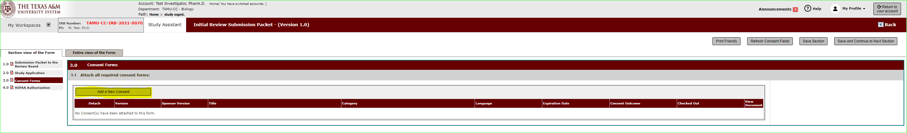
Submission Packet: Add a New Consent
The Initial Review Submission Packet select “Add a New consent” in the informed consent section.

Slide 29
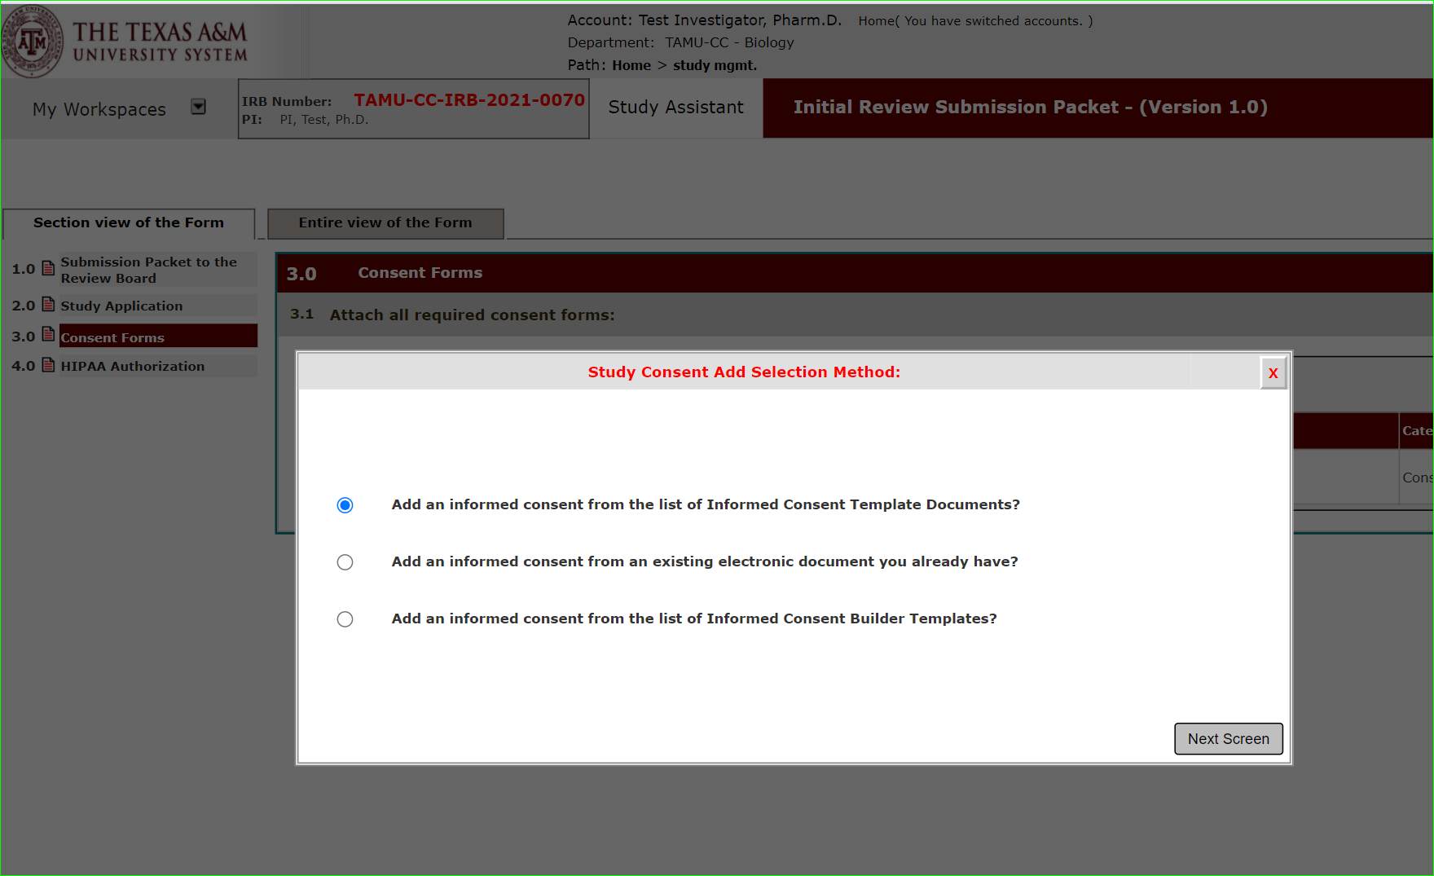
Add a New Consent: Consent Form Templates
There are three methods you can use to get started on your consent form.
Consent Templates
This option allows you to access the consent form templates from within iRIS.
Download. Edit the Document.
Upload final edited version for review.

Slide 30
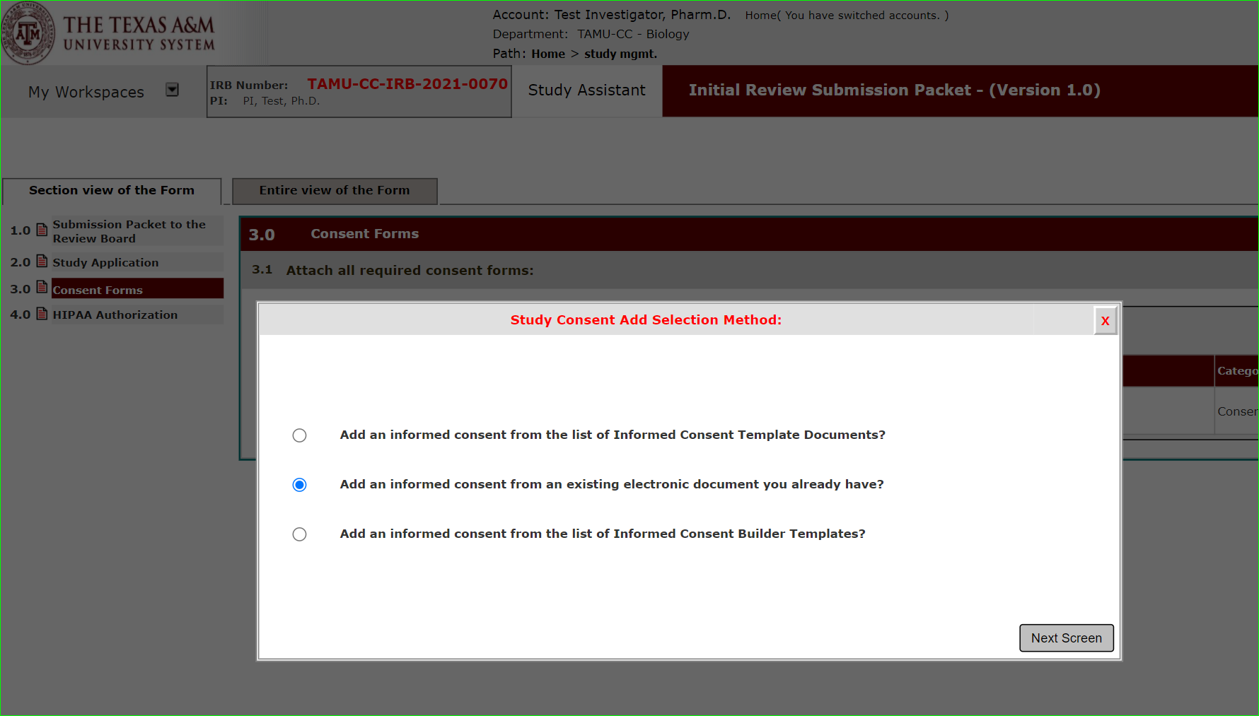
Add a New Consent: Consent Form Templates
There are three methods you can use to get started on your consent form.
Consent Upload
If you already accessed the templates from our website and have a final version ready for upload, this option allows you to upload the consent document.

Slide 31

Add a New Consent: Consent Form Templates
There are three methods you can use to get started on your consent form.
Consent Builder
This option allows you to select a consent template from within iRIS. Using merge code the system will prepopulate items for you, like study title, PI name.
Download. Edit the Document.
Upload final edited version for review.

Slide 32
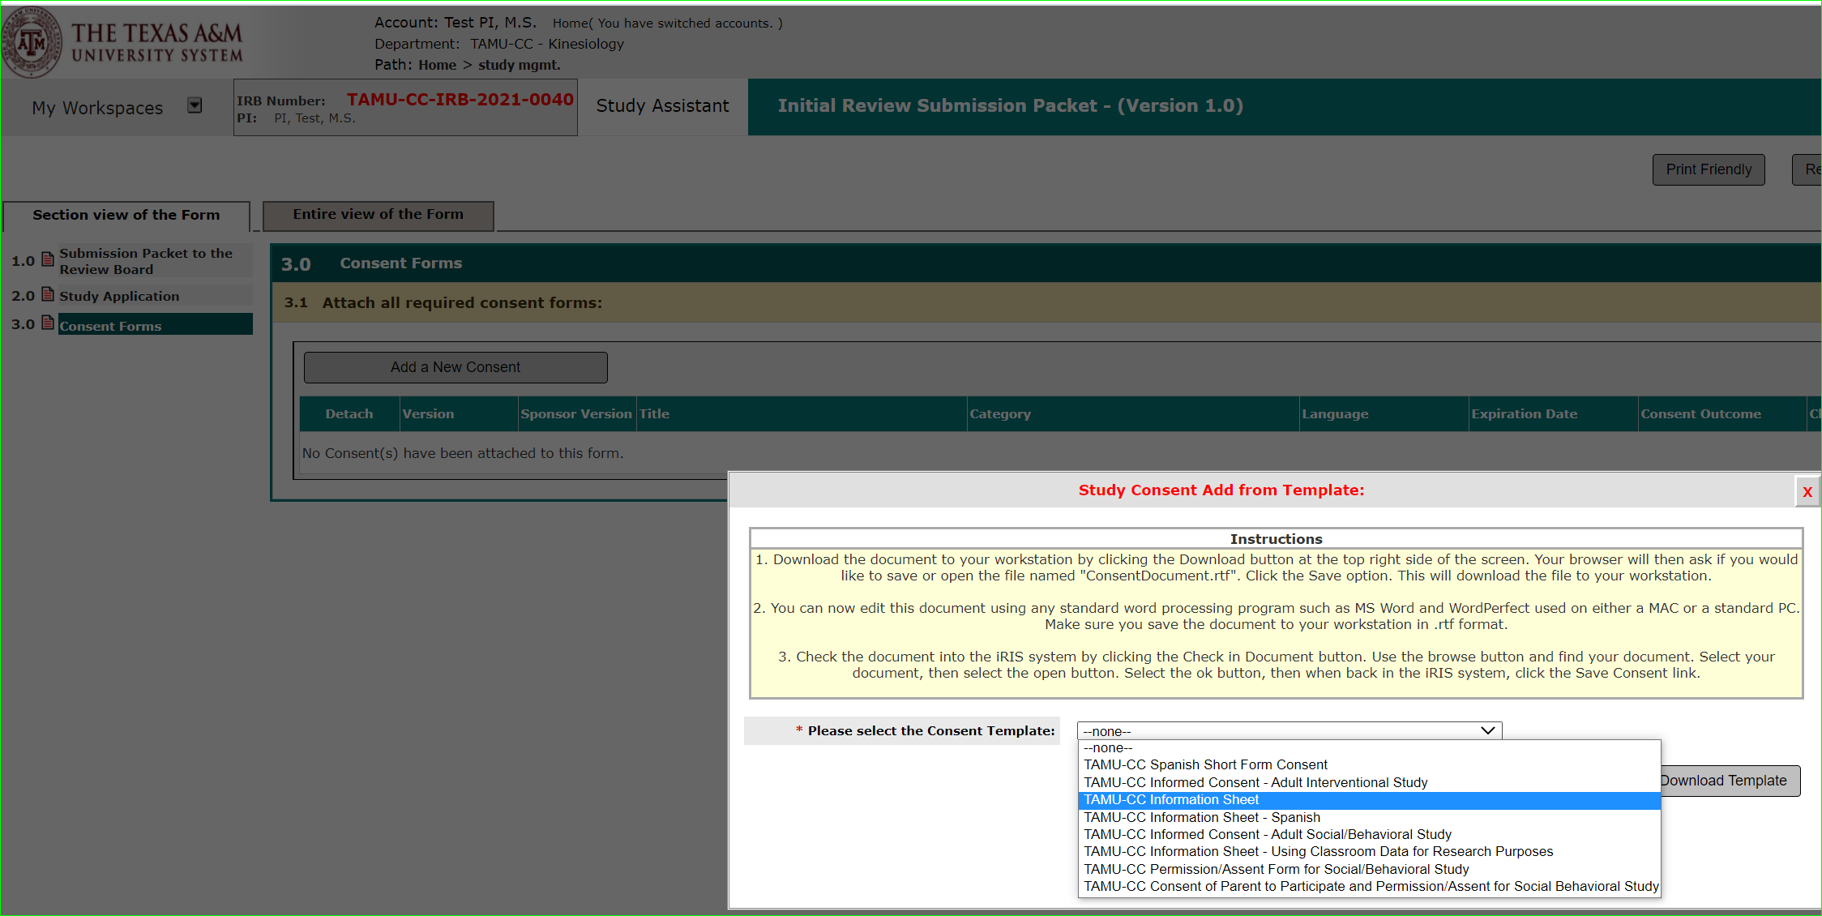
Add a New Consent: Consent Form Templates
To start from a template, select “add an informed consent from the list of Informed Consent Template Documents?”
A drop down of available informed consent templates are presented.
Select the template you wish to use.

Slide 33
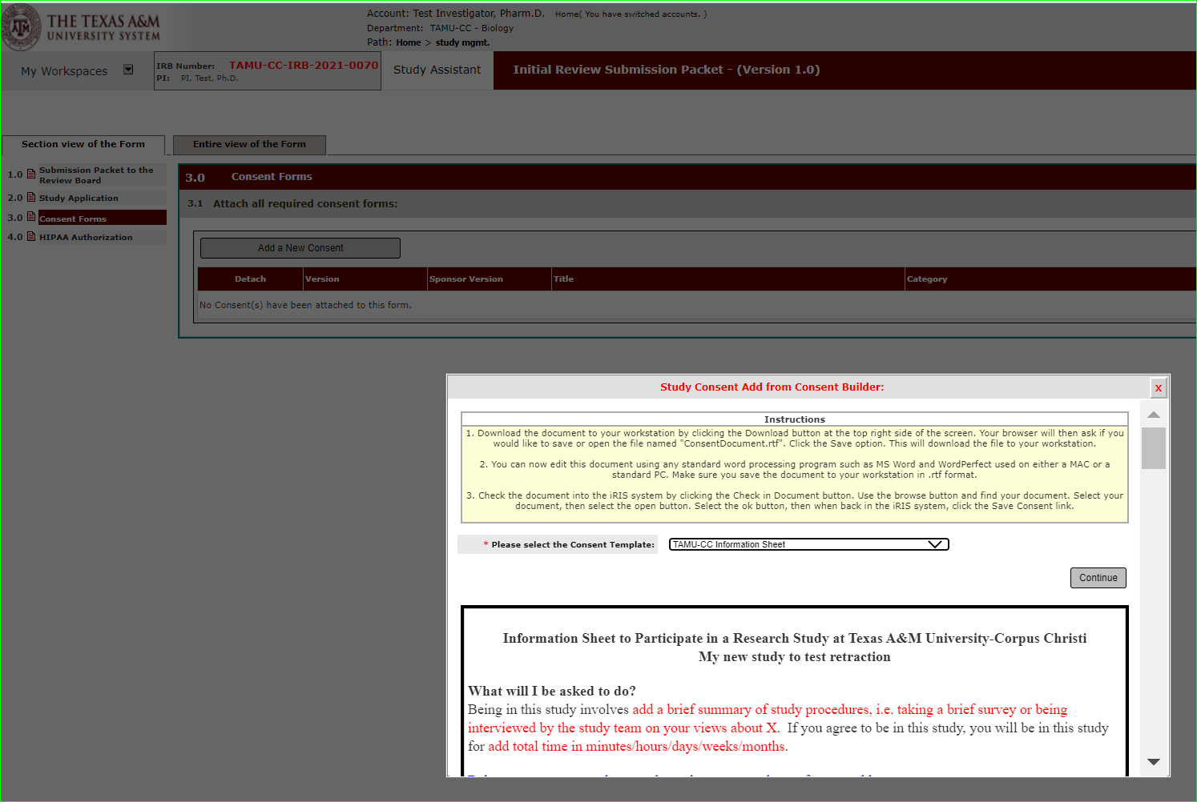
Add a New Consent: Consent Builder
To start from a template, select “add an informed consent from the list of Informed Consent Template Documents?”

Slide 34
Add a New Consent: Consent Builder
Select the template you want to start with. Merge code is used to fill in information found in your application to the consent template.

Slide 35
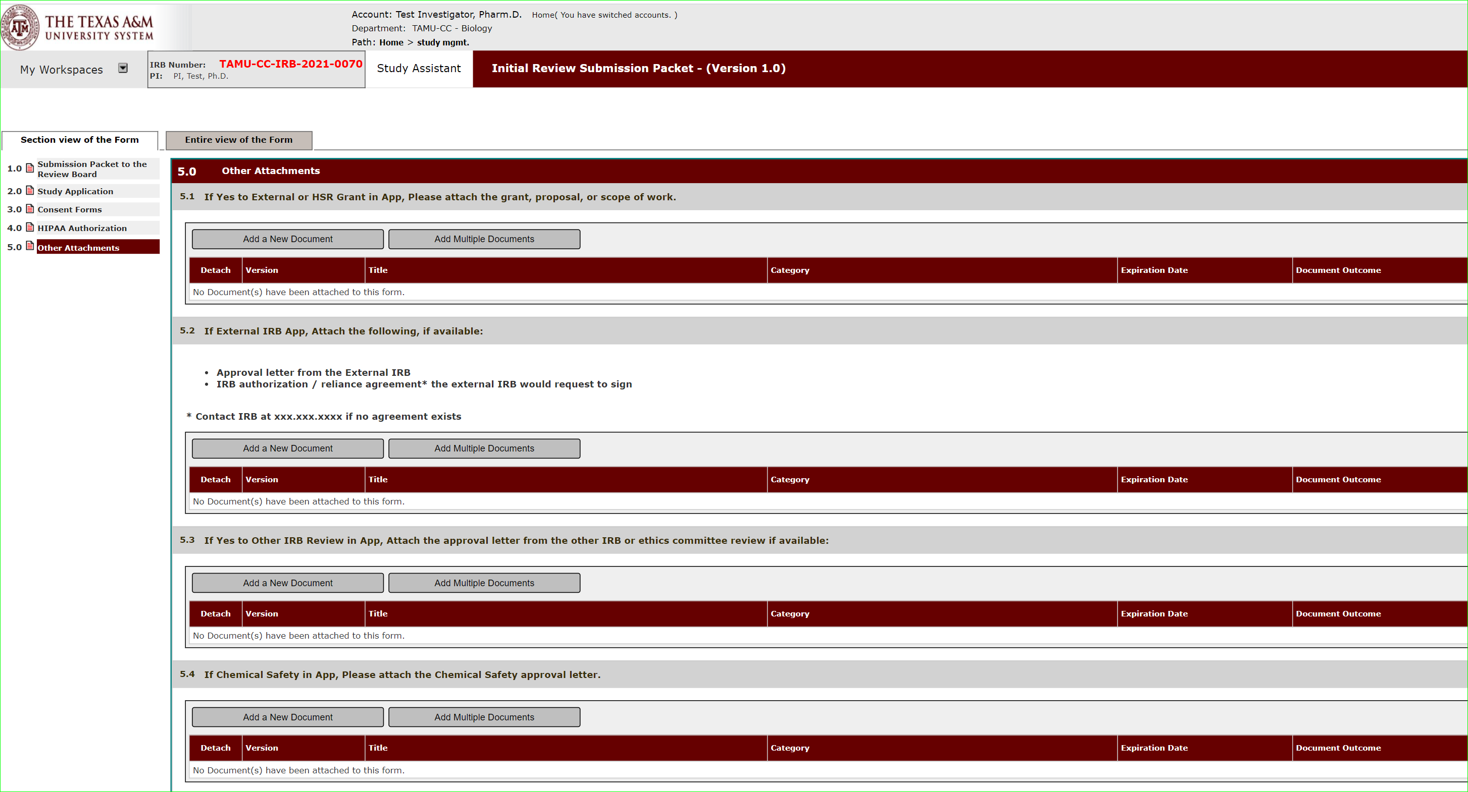
Add Study Documents
Upload supporting documents like surveys, recruitment materials, etc. in Other Attachments.

Slide 36
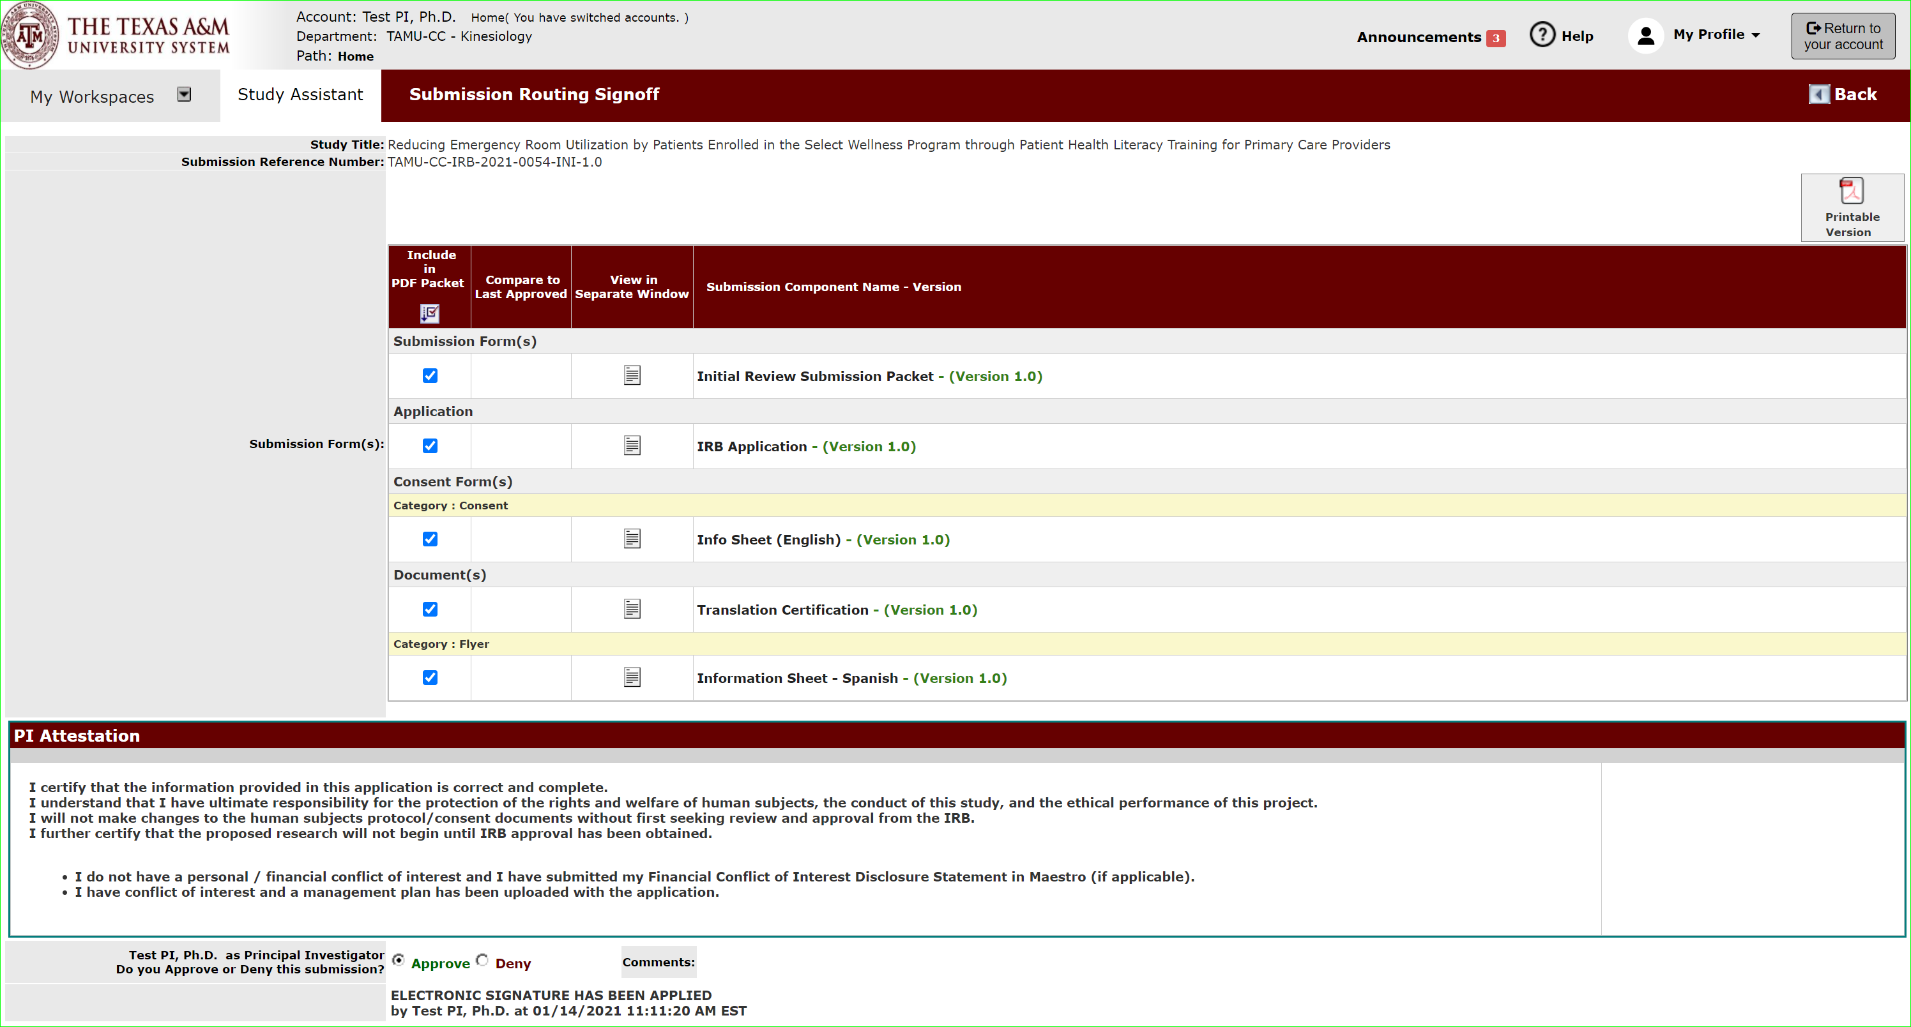
PI Sign-off and Submit
Once complete the PI will click “sign-off” and be presented with the attestation page for sign-off.

Slide 37
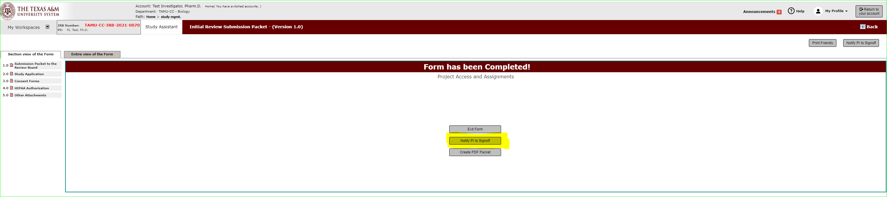
PI Sign-off and Submit
Only the Principal Investigator can execute the sign-off and submit action.
If you are not the PI, then select “notify PI to Signoff” once completed and ready for submission.

Slide 38
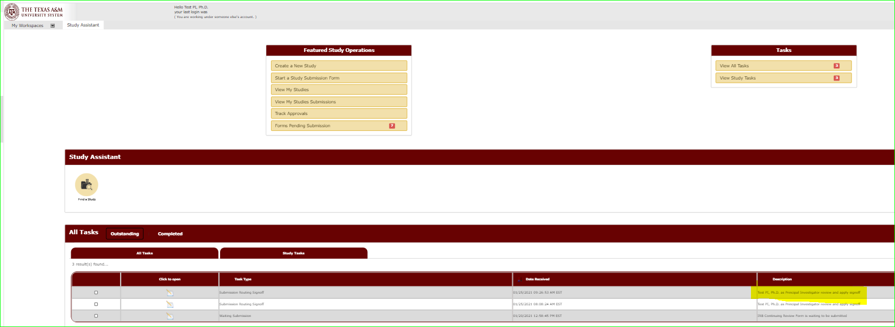
PI Sign-off Task
PI will receive a notification and a task will be on shown under outstanding tasks requesting sign-off.

Slide 39
PI Sign-off and Submit
Once the PI completes the attestation page below the submission is automatically submitted to the IRB Queue for processing.

Slide 40
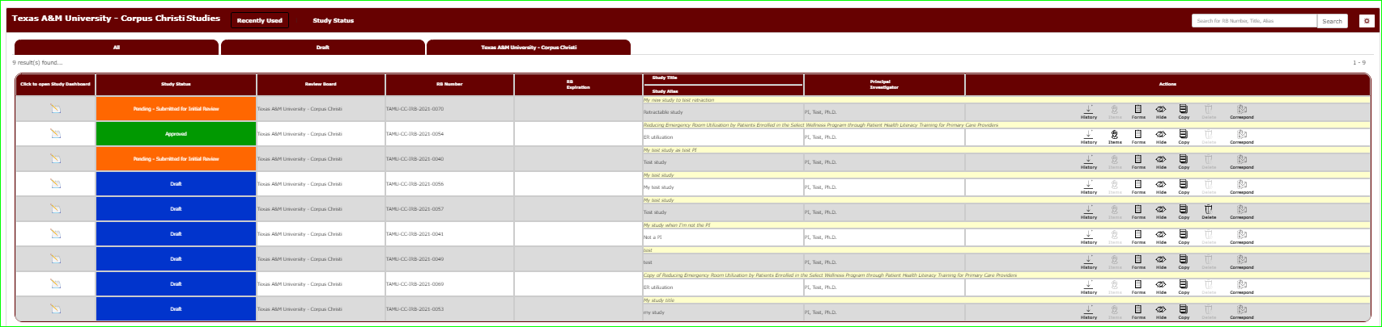
Application submitted
Once submitted, the application will move to study status “Pending – Submitted for Initial Review”.

