Slide 1
Continuing Review
Rebecca Ballard, JD, MA, CIP May 13, 2021
Director, Research Compliance

Slide 2
Welcome!
I’ll be guiding you through today’s course objectives.
How to submit a continuing review in iRIS.

Slide 3
How do I know when my study is due for continuing review?
A continuing review is conducted annually.
1
You are provided with your approval date and expiration date on the approval letter.
2
You will be provided with a reminder email from iRIS.
3
An outstanding task will be shown on your Study Assistant Dashboard.

Slide 4
What does my study have to go through a continuing review and not an annual check-in?
The Revised Common Rule changed when a continuing review would be required.
Studies NOT required to undergo continuing review are:
1
Exempt Studies
2
Expedited Studies
3
Full board studies where research has progress to the point that it only involves data analysis or accessing follow-up clinical data from procedures that subjects would undergo as part of clinical care.

Slide 5
What happens I don’t complete the continuing review or study closure by the due date?
Investigators are responsible for reviewing the checklist and either:
Submitting a study closure report if the study is no longer active or
Ensuring the protocol remains current and up-to-date.

Slide 6
What happens I don’t complete the continuing review or study closure by the due date?
Once the study hits the expiration date, the study status automatically goes to expired.
Expirations are reported to Office of Sponsored Research Administration (OSRA). This can impact your funding.
Research that continues beyond the expiration date is research conducted without IRB approval. This will be investigated as non-compliance.

Slide 7
Can’t I just get a short extension on the expiration date?
Sorry. This is not possible.
Federal regulations permit no grace period and no exceptions to the one-year requirement.
Extensions beyond the expiration date cannot be granted.

Slide 8
What happens if my study is now expired?
Once the study hits its expiration date the study status automatically goes to expired and the PI is notified.
If you need to continue study activities, you will be required to submit a new IRB submission.
No research activities involving human subjects can occur during this time.

Slide 9
How do I start the Continuing Review Form?
For studies with a study status as “Approved”, select under actions “Forms”.

Slide 10
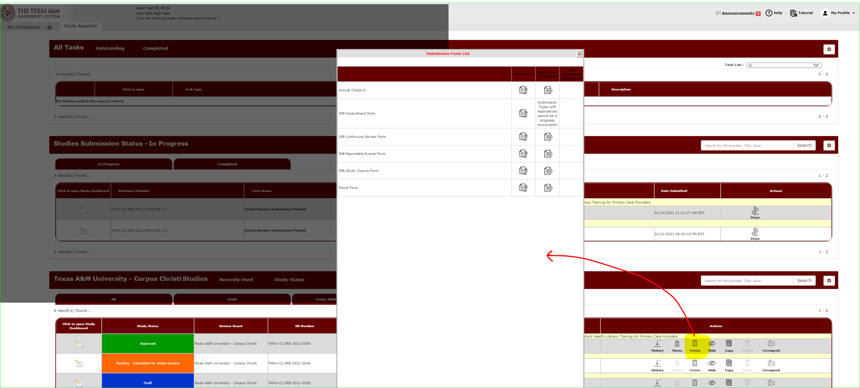
A list of submission forms you can submit will open.
Select “IRB Continuing Review Form” to begin this form.

Slide 11
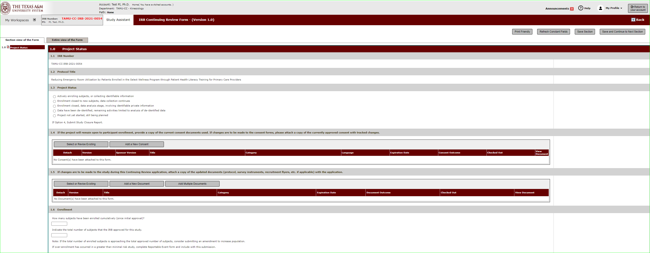
Begin filling out the form.
Hit save and continue to the next section to proceed through the form.

Slide 12
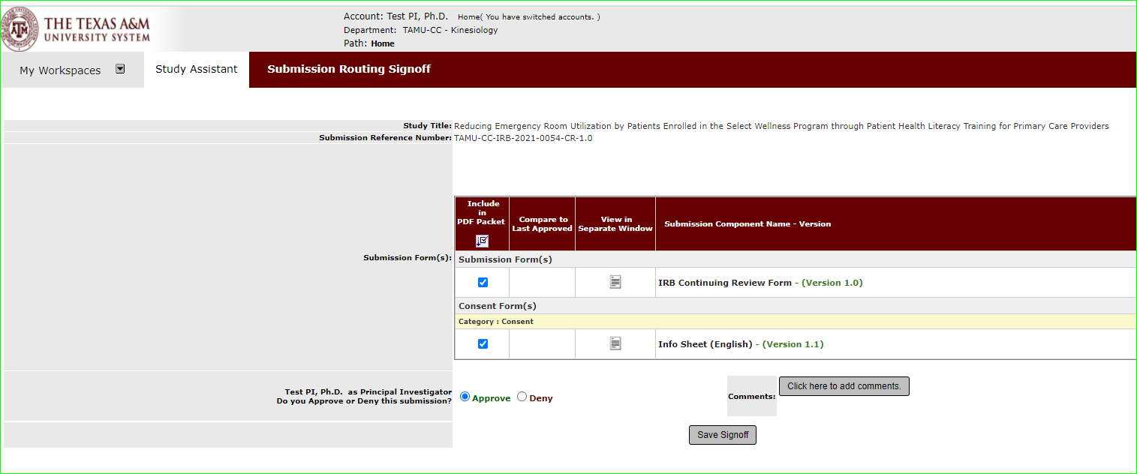
Sign-off and Submit
Once the form is complete, you will see the signoff and submit button.
Note: Only the Principal Investigator can execute the sign-off and submit action.

Slide 13
Sign-off and Submit
Click the submission form, “Approve”, and then save sign-off to approve and submit the continuing review.

Slide 14
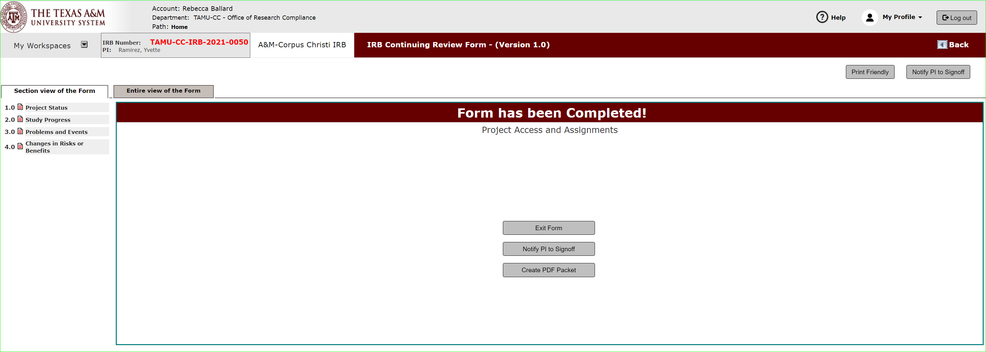
Sign-off and Submit: What if I am not the PI?
Click “notify PI to sign-off”.
This action will send a notification to the PI that the submission is ready for review to sign-off and submit.
The PI will be notified of the sign-off request.
An outstanding task will also show on the PI’s dashboard.

Slide 15
How do I track the submission’s review progress?
Submissions in progress will show on your dashboard under Studies Submission Status – In Progress.
A detailed look at the submission’s progress can be viewed under steps.

