Slide 1
Consent Builder
Rebecca Ballard, JD, MA, CIP May 25, 2021
Director, Research Compliance

Slide 2
Welcome!
I’ll be guiding you through today’s course objectives.
How to use the consent builder in iRIS.

Slide 3
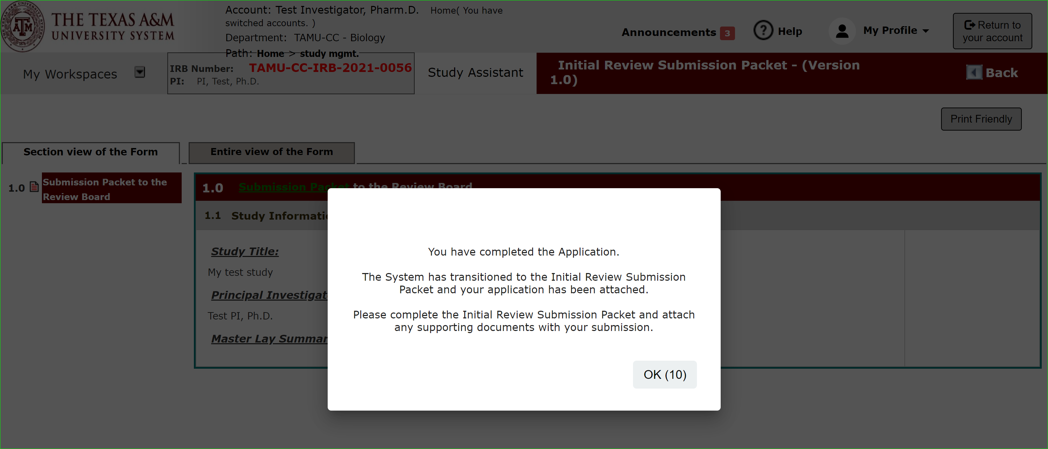
Application Complete
Once you have completed the application portion of the submission packet, you will see this message and be taken to the submission packet.

Slide 4
Submission Packet: Upload Supporting Documents
As you progress through the submission packet you will see the IRB Application form you just filled out and then will be prompted to attach various study documents.
"Add a New Consent" in the Informed Consent section.
"Add New Document" or "Add Multiple Documents" in the "Study Documents" section.

Slide 5
Submission Packet: Add a New Consent
The Initial Review Submission Packet select “Add a New consent” in the informed consent section.

Slide 6
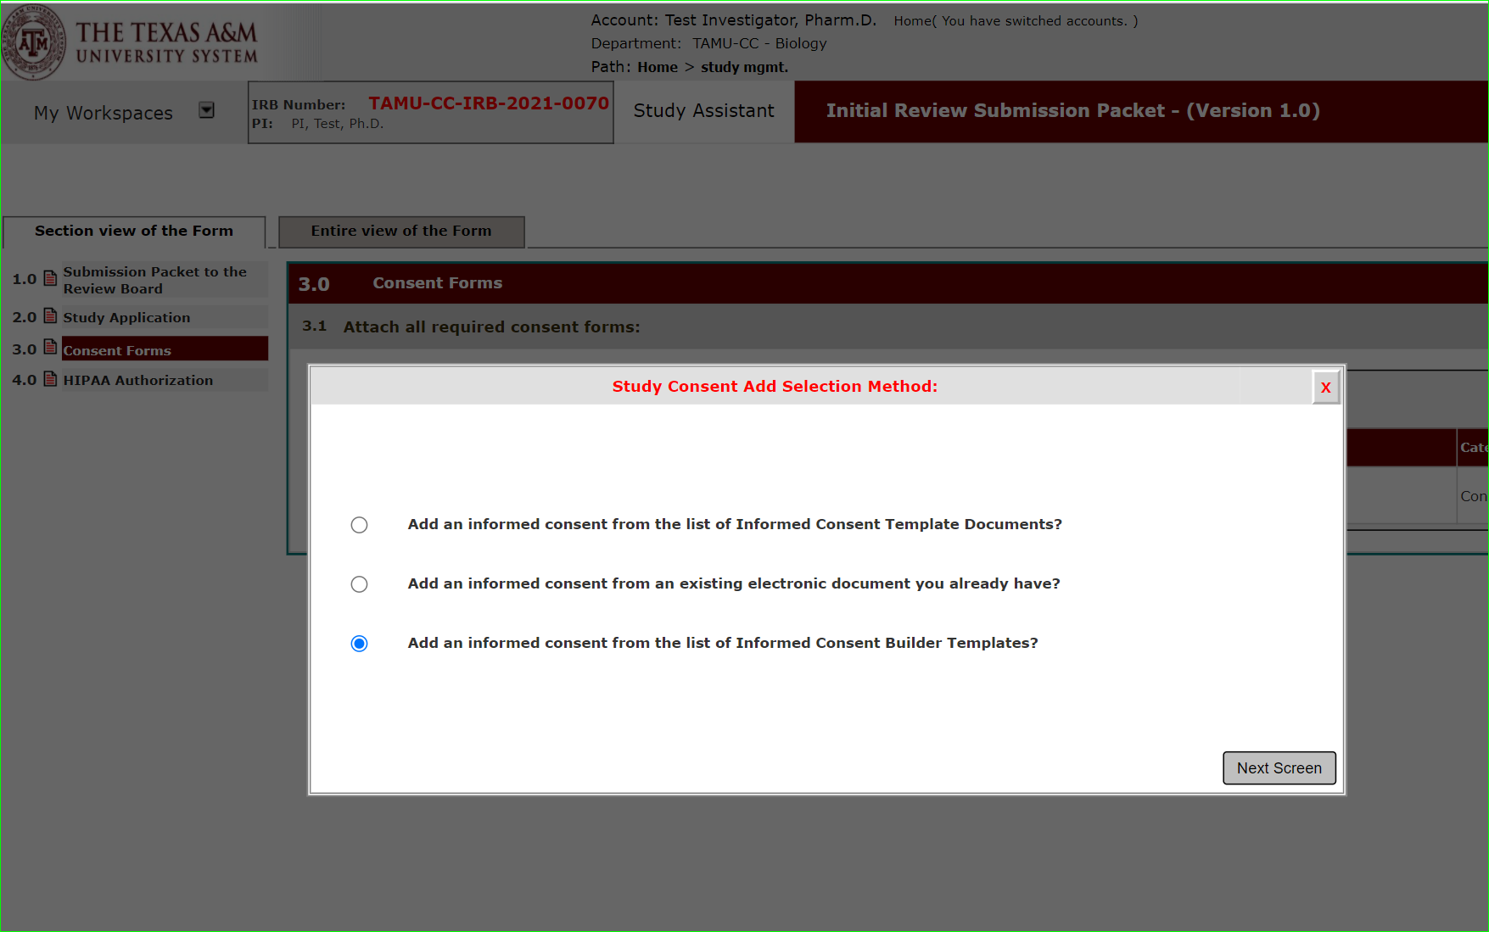
Add a New Consent
There are three methods you can use to get started on your consent form.
This lesson with focus on the 3rd option – The Informed Consent Builder
Consent Builder
This option allows you to select a consent template from within iRIS. Using merge code the system will prepopulate items for you, like study title, PI name.
Download. Edit the Document.
Upload final edited version for review.

Slide 7
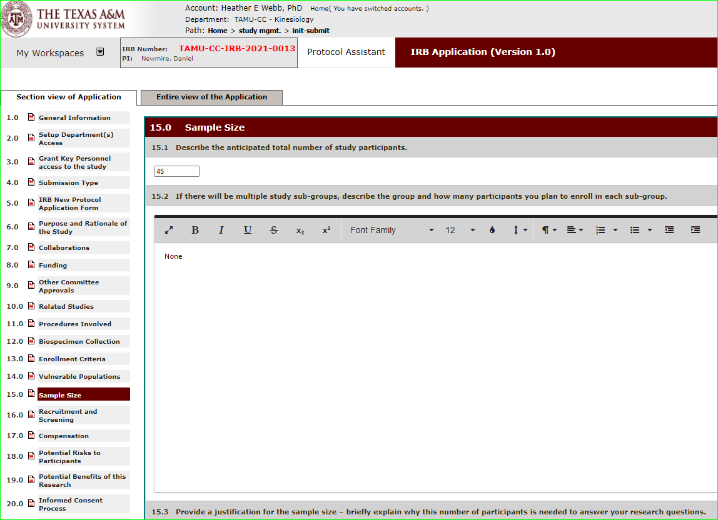
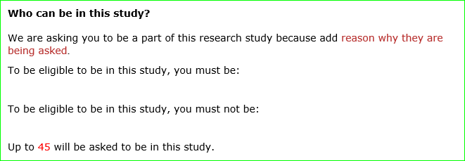
What does the Informed Consent Builder do?
The consent form builder uses merge code to add information you provided in the application form to the consent template you choose.

Slide 8
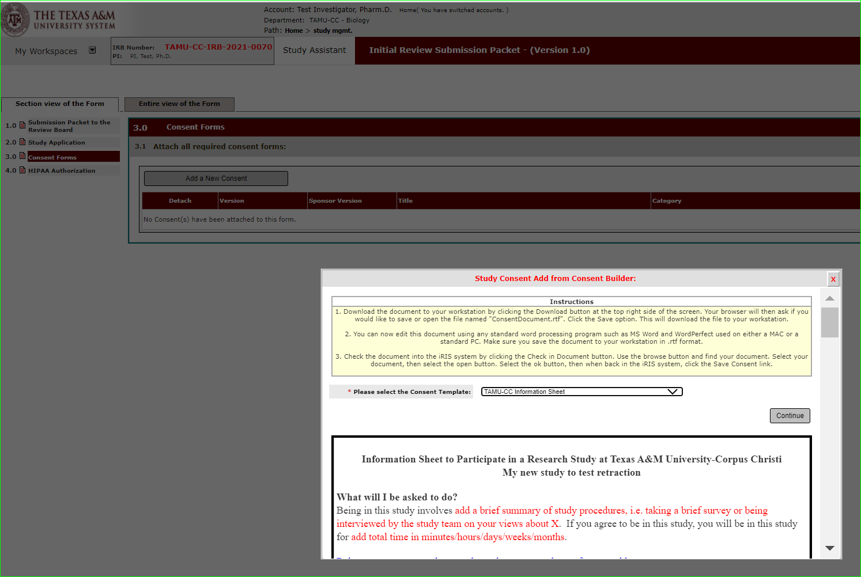
Add a New Consent: Consent Builder
To start from a template, select “add an informed consent from the list of Informed Consent Template Documents?”

Slide 9
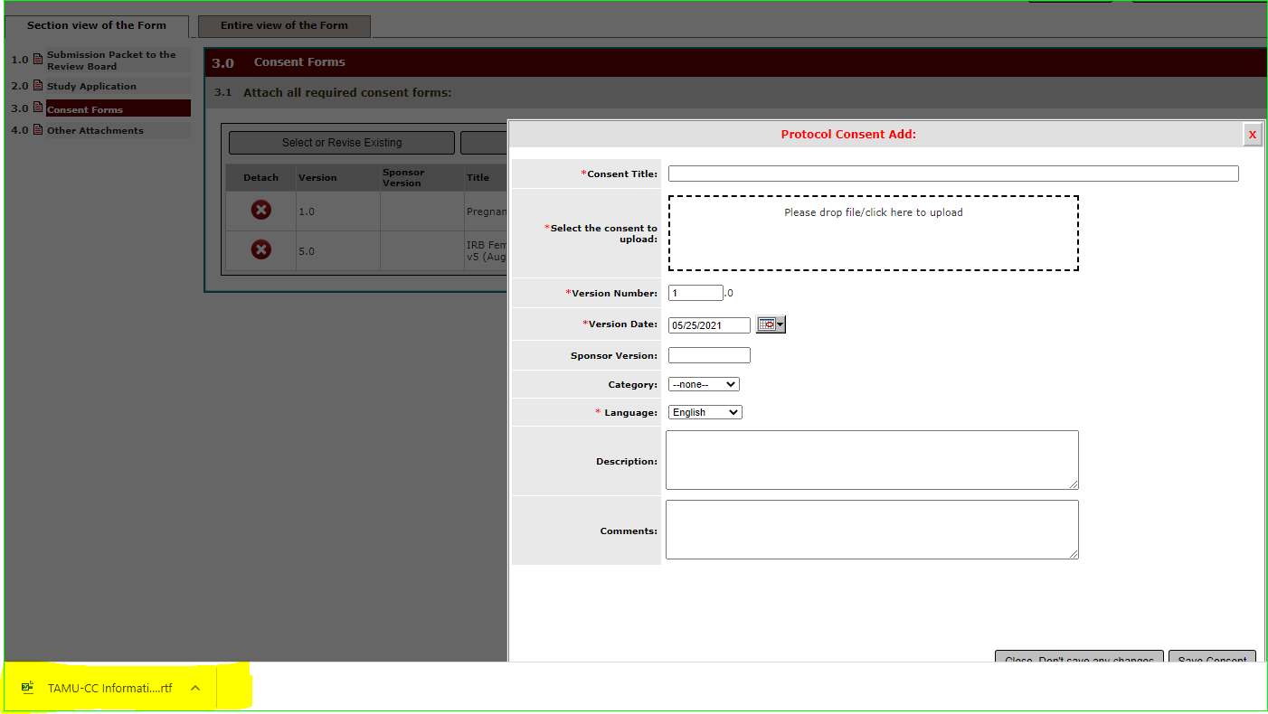
Edit Informed Consent
Once the merge is complete a Word document will be available for editing.

Slide 10
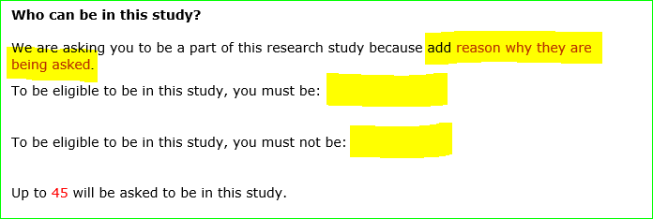
Do I have to edit the consent form built?
Yes! Edits are still required.
There are still sections that are not entered through merge code.

Slide 11
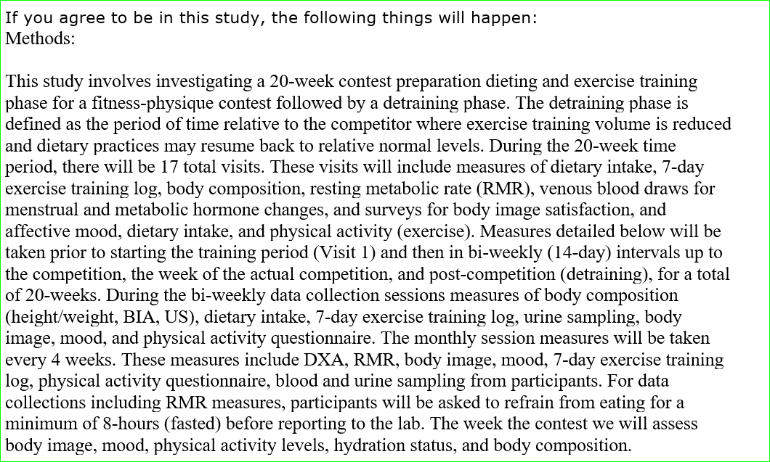
Do I have to edit the consent form built?
Yes! Edits are still required.
Also, the merge code will be exactly as you entered it into the application form. This may not be the same language you would use to describe the information to potential participants in lay language.
Example: Procedure section
This consent form will need to be revised to describe the procedures in lay language at an 8th grade level.

Slide 12
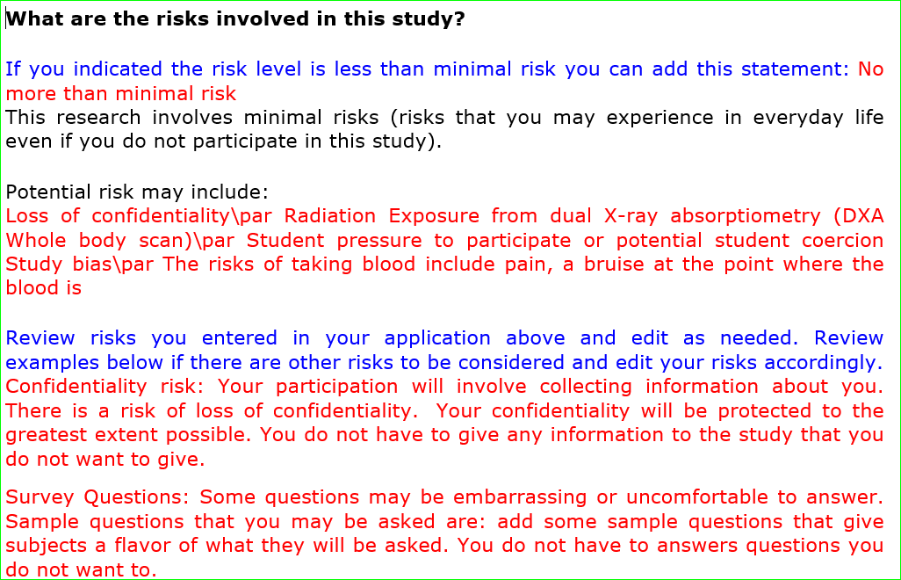
Do I have to edit the consent form built?
Yes! Edits are still required.
Some sections will display your answer in the application form, but you will need to detail out the information in the consent form for potential participants.
Example: Risk Section
The risk section will list the risks as a list.
This consent form will need to be revised to describe each risks for potential participants.

Slide 13
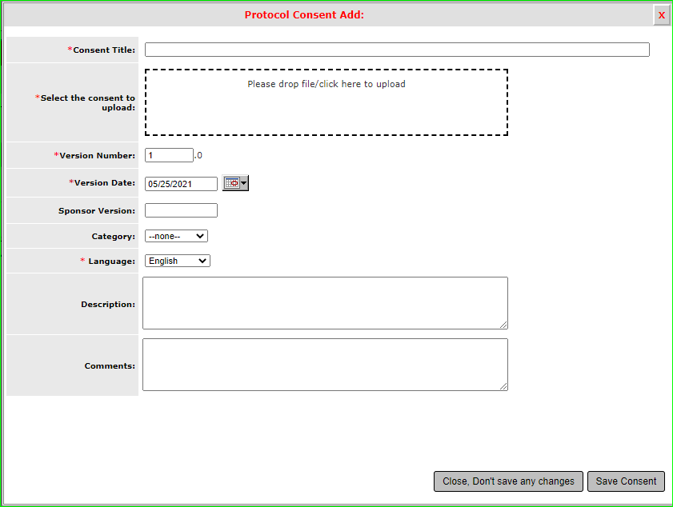
Upload Final Informed Consent Document
Once you have completed your informed consent document, then return to iRIS and upload the consent form.

Slide 14
Save and Continue
Continue to add a new consent until all consent forms are added.
Once complete then hit “save and continue to the next session” to finish the study application.

