Slide 1
Changes Requested
Rebecca Ballard, JD, MA, CIP June 1, 2021
Director, Research Compliance

Slide 2
Welcome!
I’ll be guiding you through today’s course objectives.
How to review and respond when changes are requested.

Slide 3
How will I know when changes are requested?
iRIS will notify you as soon as review has been completed and changes have been requested on your application.
1
You will receive a notification via email that changes have been requested on your submission.
2
The Protocol Status will also change to “Changes Requested”

Slide 4
Study Team Task
3
The submission will show on your outstanding tasks lists when you login on your dashboard.
Click the paper/pencil icon to open the submission.

Slide 5
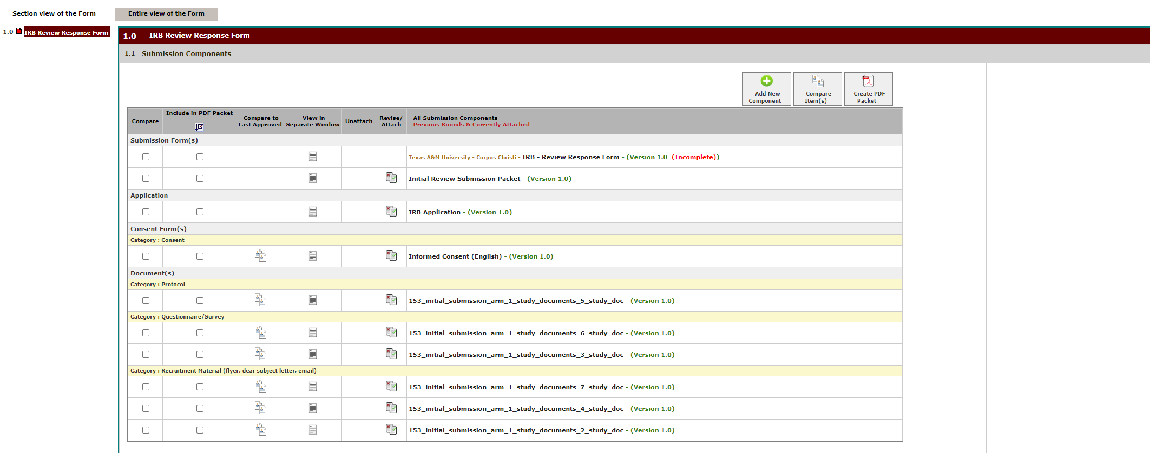
Submission Components
The first thing that will be displayed is the submission components. This includes the application and all attached forms.

Slide 6
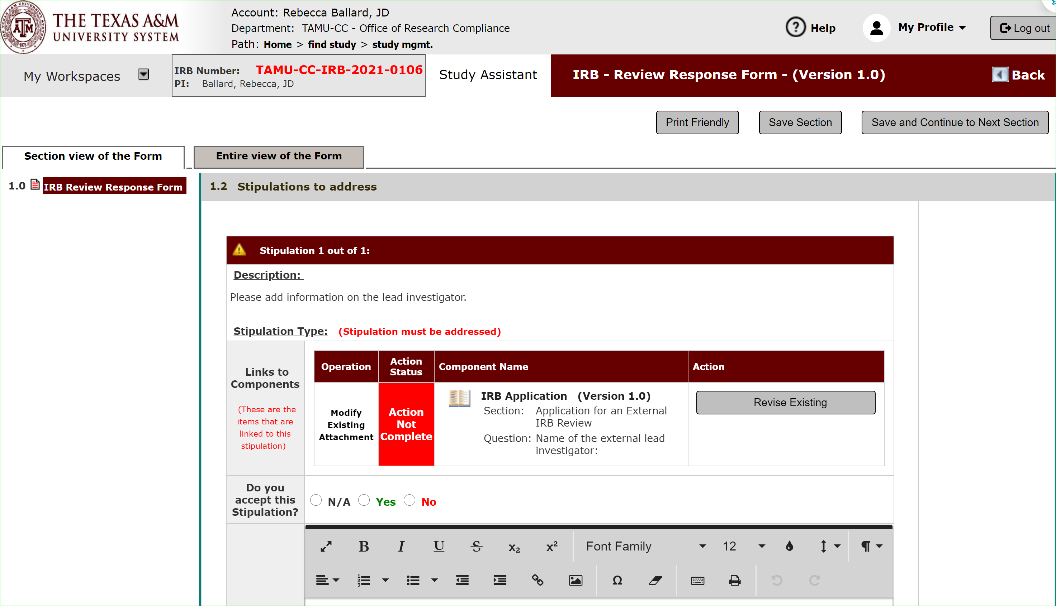
Where do I find what changes need to be addressed?
Scroll down to “Stipulations to address” to view the list of stipulations. Click on the actions to show the comment within the application.

Slide 7
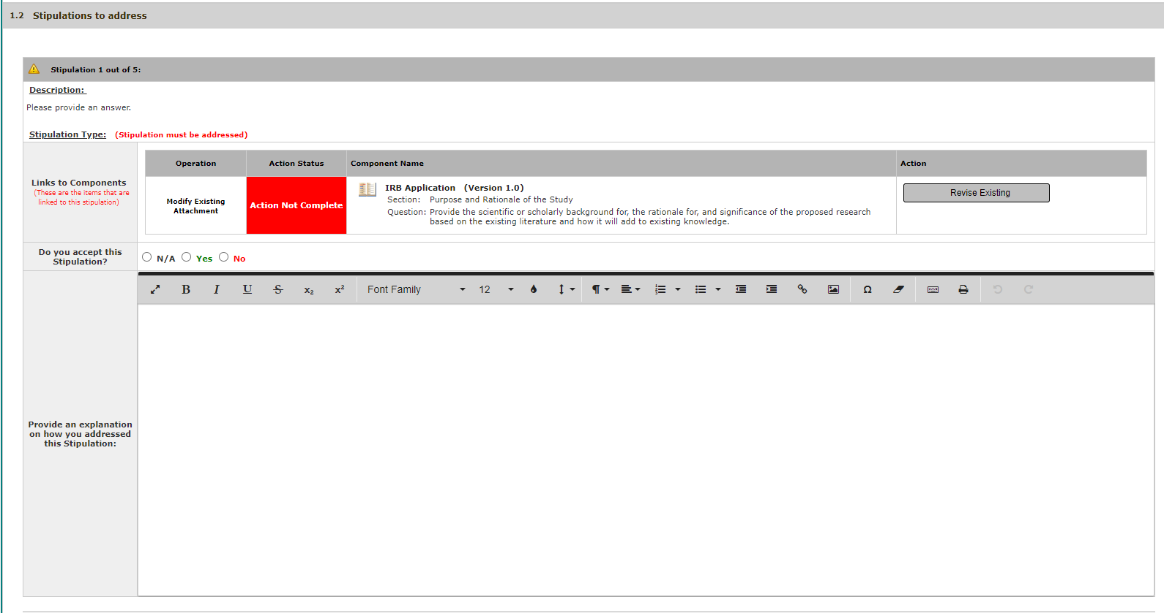
Where do I find what changes need to be addressed?
Under description will describe what needs to be changed.

Slide 8
Where do I make the changes?
The change requested will often be linked to components, meaning it is linked to the application question or document uploaded.

Slide 9
Where do I make the changes?
If you use the “revise existing” here, then this will take you right to the spot in the application to make the revision.

Slide 10
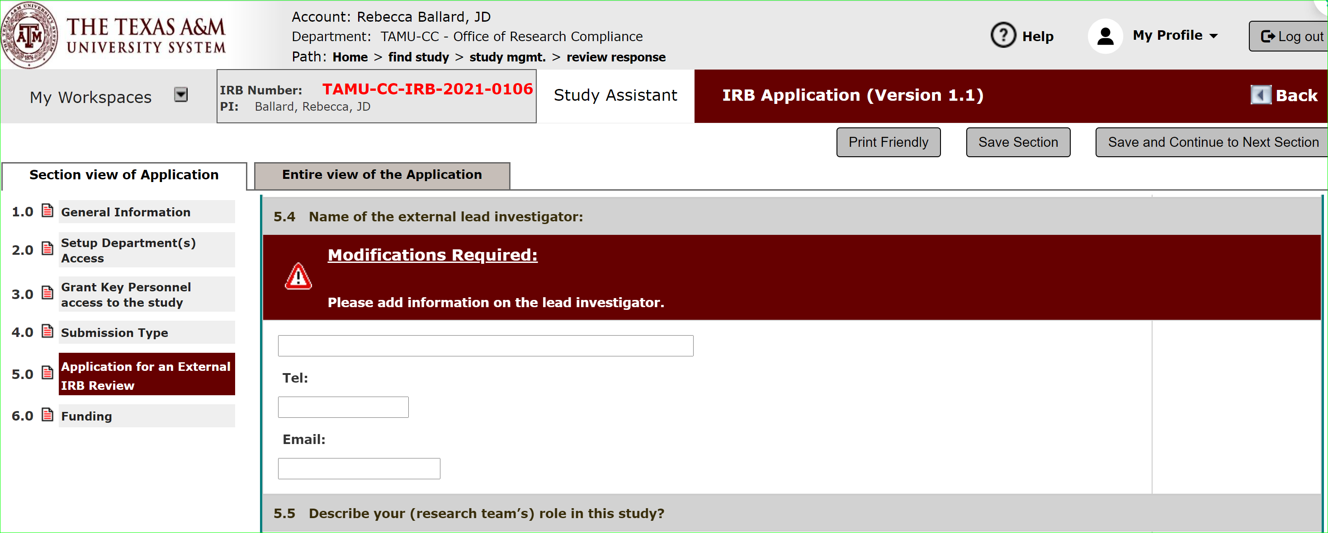
How do I make changes?
The link will take you to the question in the application related to the comment. You can edit the application.

Slide 11
How do I make changes?
Save and continue to next section until all comments have been addressed.

Slide 12
What do I do after I’ve revised the application in response to the change requested?
If you accept the stipulation, then select yes here.

Slide 13
What do I do after I’ve revised the application in response to the change requested?
The provide a quick explanation on how you addressed the stipulation.

Slide 14
What do I do after I’ve revised the application in response to the change requested?
The provide a quick explanation on how you addressed the stipulation.
In this section, do NOT make the changes to application.
In this section you will tell us steps taken to cure the issue, such as updating the application.
Example answers: Application updated to provide an answer.

Slide 15
What if I don’t agree with the stipulation?
Then select “No” to the question “Do you accept this stipulation?”
In this section, then describe why you disagree with the stipulation.

Slide 16
Version Control
The application and attached documents shows the document’s version number.

Slide 17
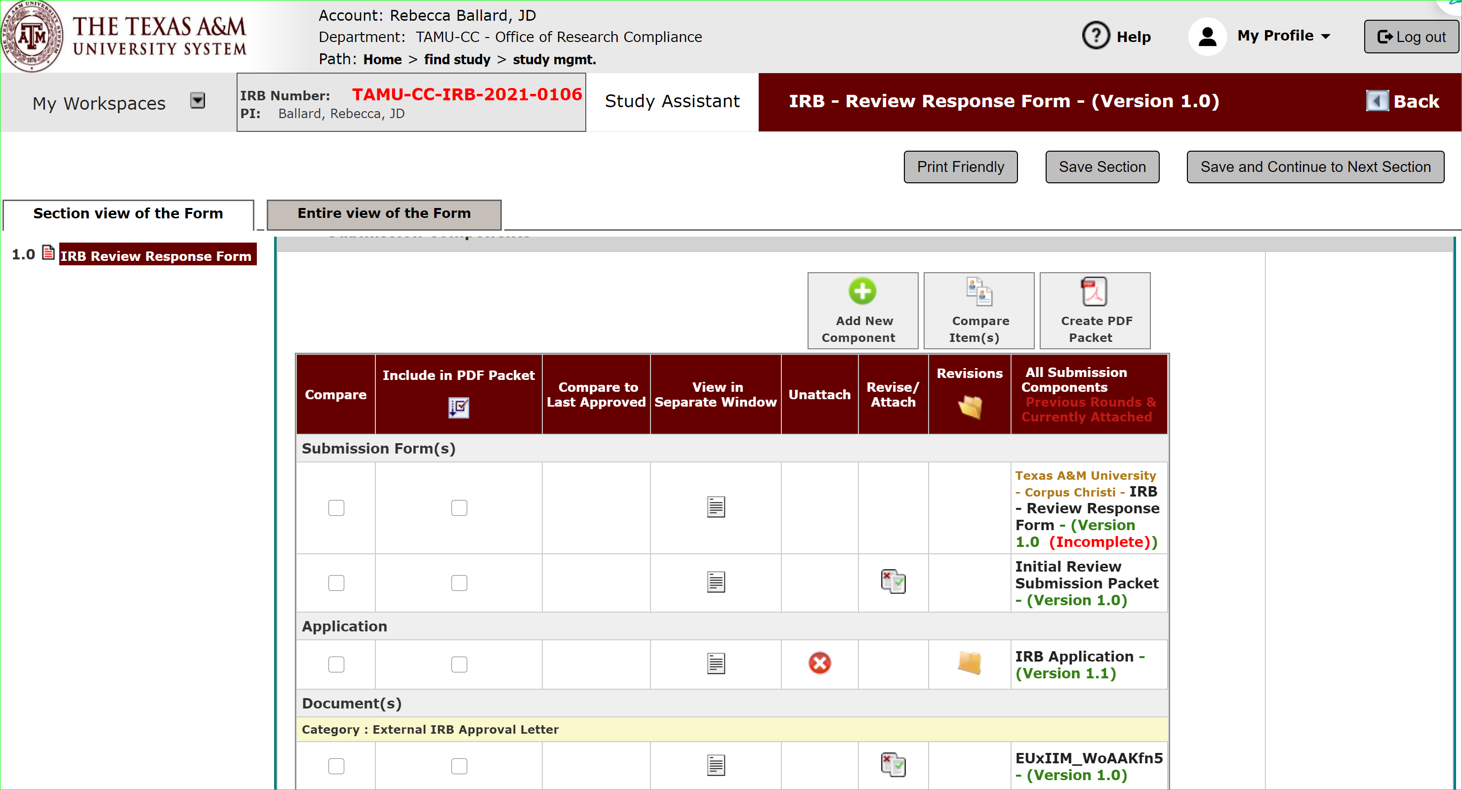
Version Control
Once you’ve made edits, the system will automatically update the application to new version.

Slide 18
Document Versions
There is also a compare feature that allows you to select two versions to do a comparison.

Slide 19
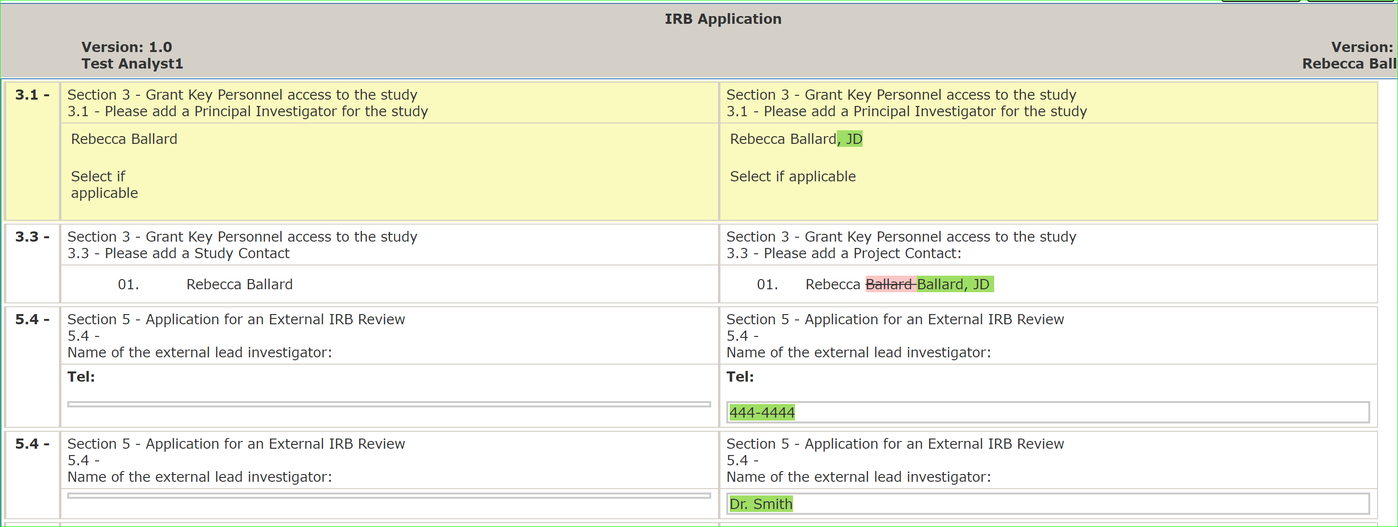
Version Control: Compare Versions
This will show information added and deleted.

Slide 20
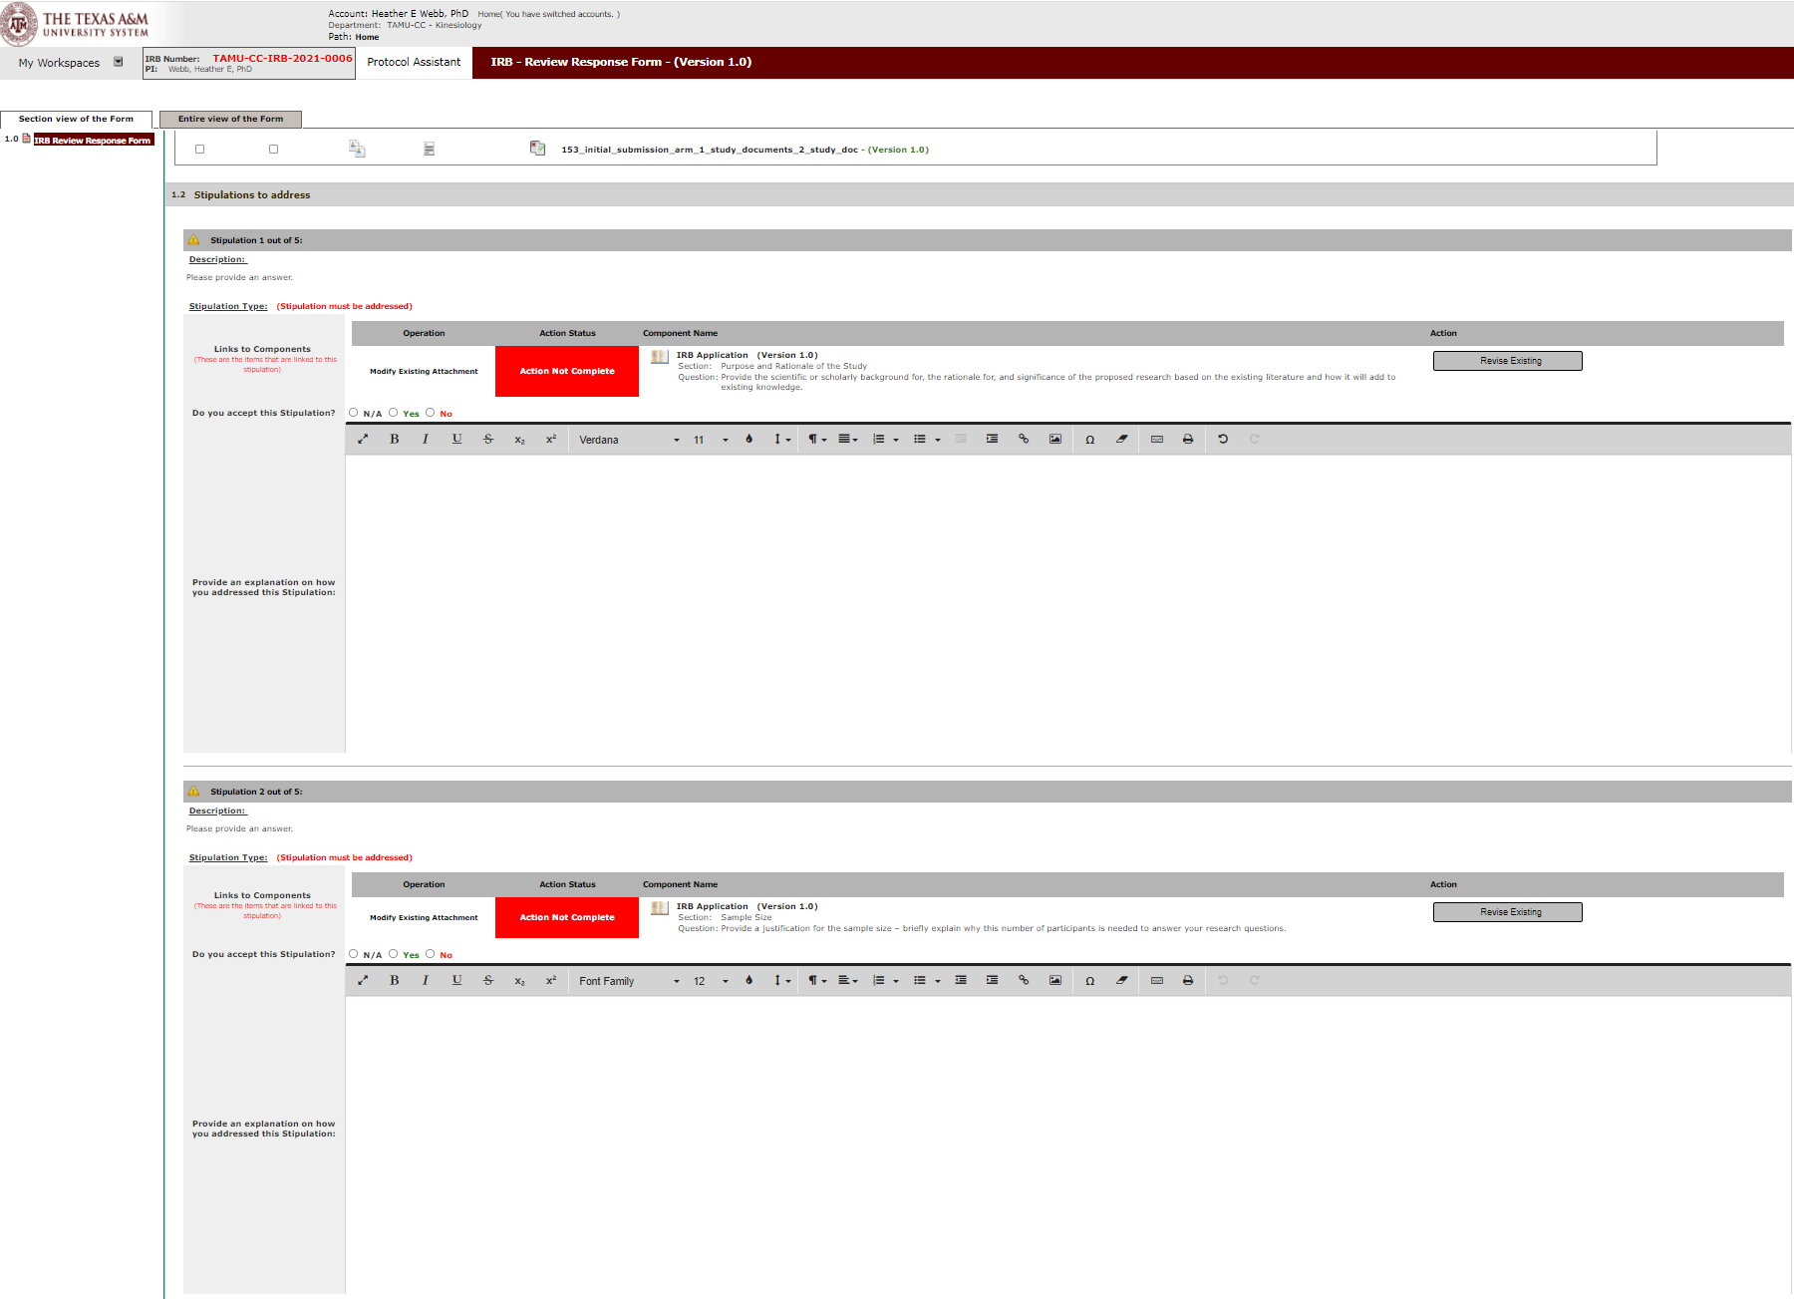
Continue until all stipulations have been addressed.

Slide 21
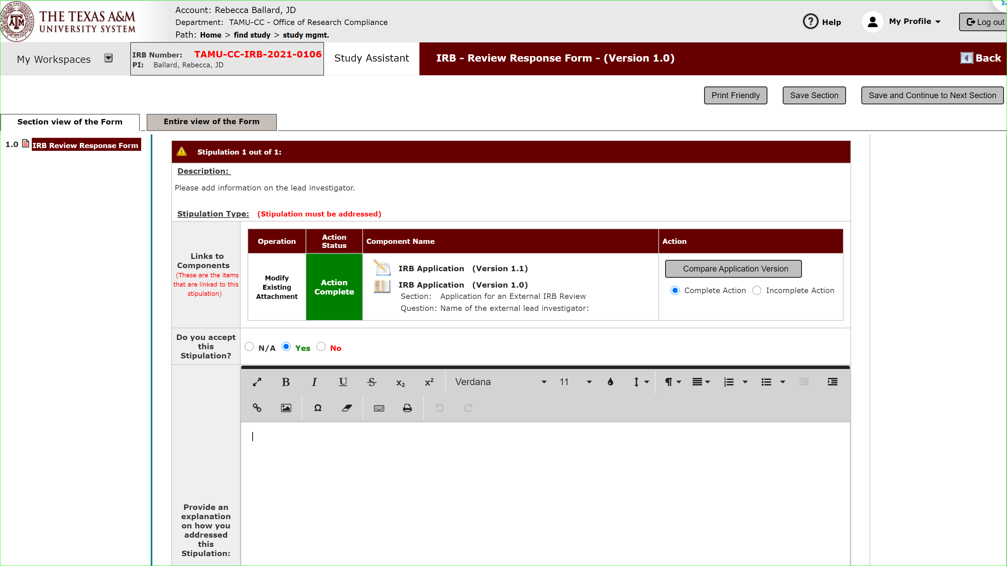
Sign-off and Submission
After addressing the stipulations, click Save and Continue to the Next Section to reach the sign-off page.

Slide 22
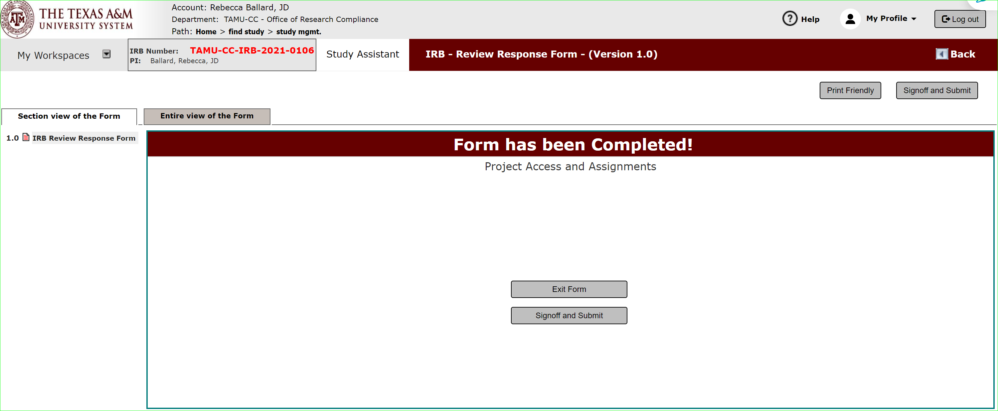
Sign-off and Submission
Click sign-off and submit.
Note: Only the PI can sign-off.

Slide 23
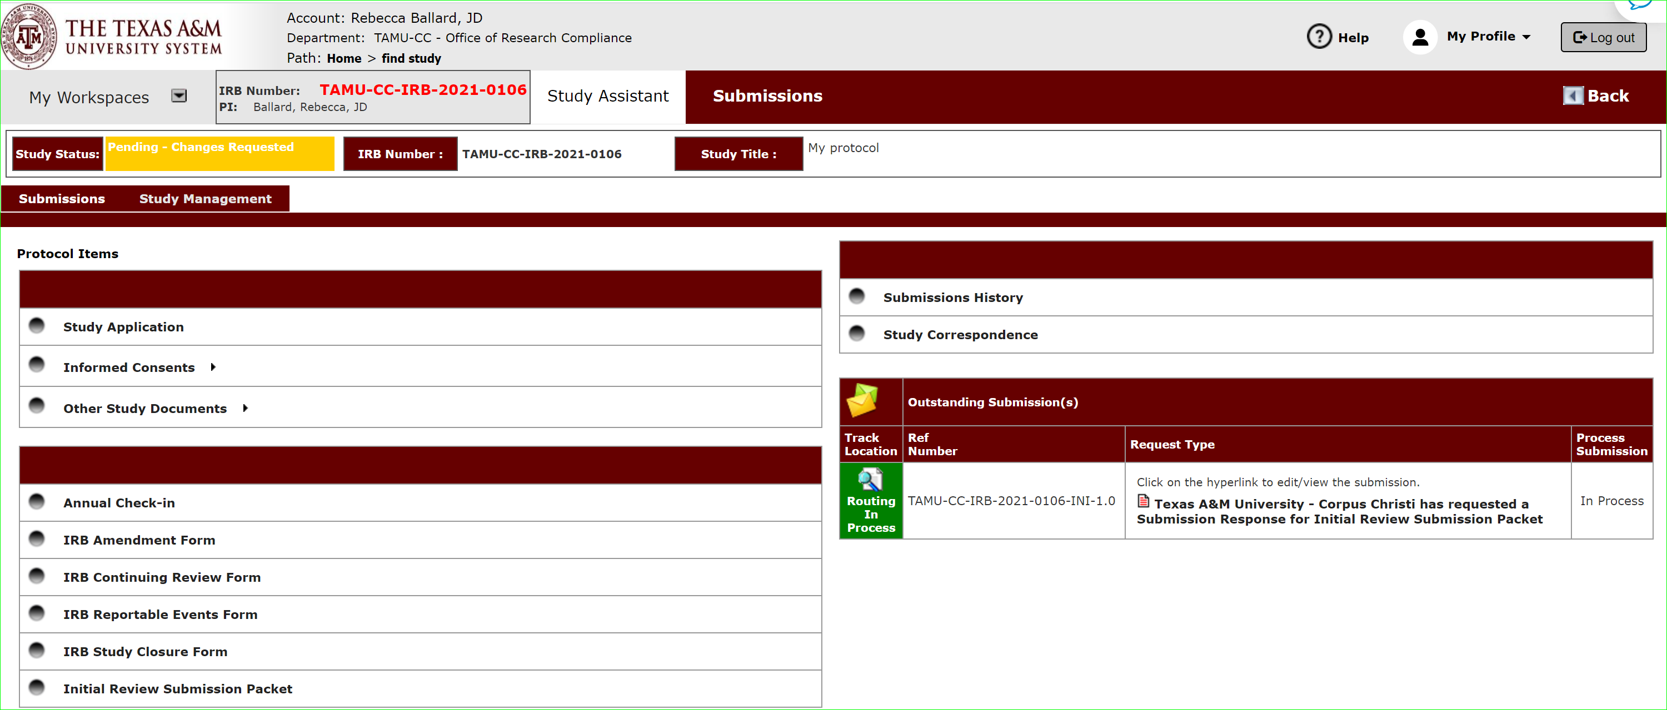
Submitted
Once submitted the application will be routed to the IRB office for review.

