Slide 1
Annual Check-In
Rebecca Ballard, JD, MA, CIP May 13, 2021
Director, Research Compliance

Slide 2
Welcome!
I’ll be guiding you through today’s course objectives.
How to submit an annual check-in in iRIS.

Slide 3
What is an annual check-in?
A process conducted annually to ensure investigator responsibilities for active studies remain met for studies not requiring continuing review.
Investigator Responsibilities for Active Studies:
1
Ensuring all study personnel remain compliant with human research educational requirements
2
Ensuring the study protocol remains current or submitting an amendment prior to implementing changes
3
Ensuring all reportable events are reported to the IRB

Slide 4
What studies can go through annual check-in process and not require a continuing review?
Studies NOT required to undergo continuing review are:
1
Expedited Studies
Full board studies where research has progress to the point that it only involves data analysis or accessing follow-up clinical data from procedures that subjects would undergo as part of clinical care.
2

Slide 5
How do I know when my study is due for annual check-in?
An annual review is conducted annually.
1
You are provided with your approval date on the approval letter.
2
You will be provided with a reminder email from iRIS.
3
An outstanding task will be shown on your Study Assistant Dashboard.

Slide 6
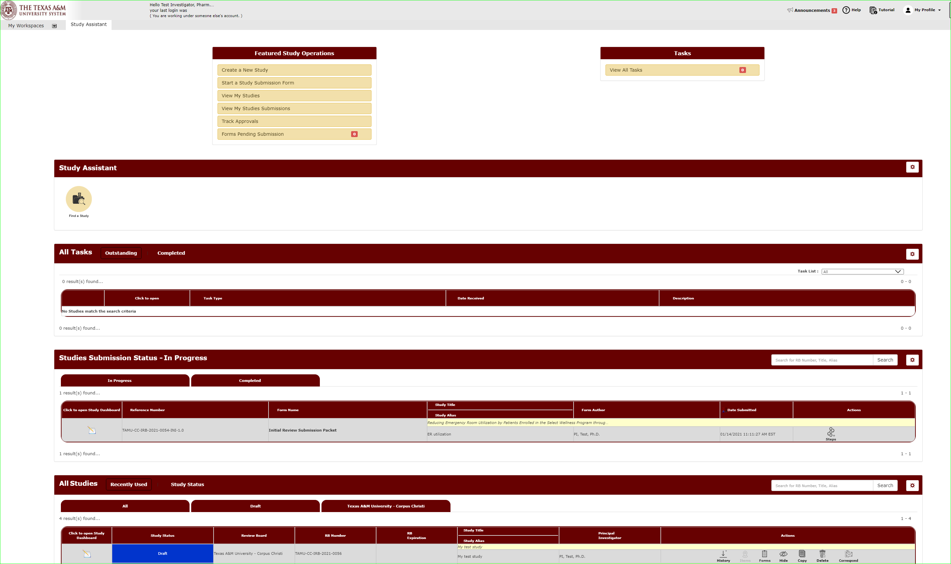
How will I know when my submission is due for an annual check-in?
A task will be available on your Study Assistant Workspace.
You will be taken to the Study Assistant Workspace once you login.

Slide 7
What happens I don’t complete the annual check-in or study closure by the due date?
Investigators are responsible for reviewing the checklist and either:
Submitting a study closure report if the study is no longer active or
Ensuring the protocol remains current and up-to-date.

Slide 8
How do I start the Annual Check-in Form?
For studies with a study status as “Approved”, select under actions “Forms”.

Slide 9
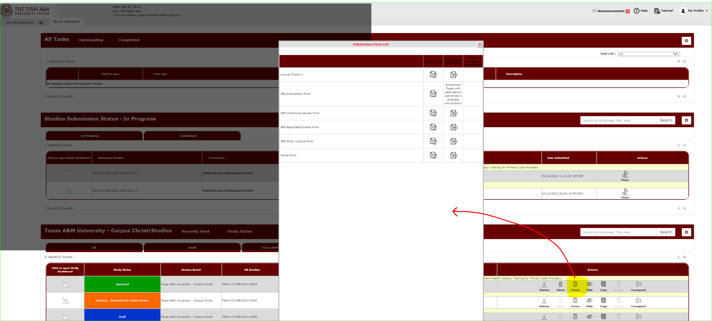
A list of submission forms you can submit will open.
Select “Annual Check-in” to begin this form.

Slide 10
Begin filling out the form.
Hit save and continue to the next section to proceed through the form.
Section 1.0: General Information
This section will display basic information from the protocol.

Slide 11
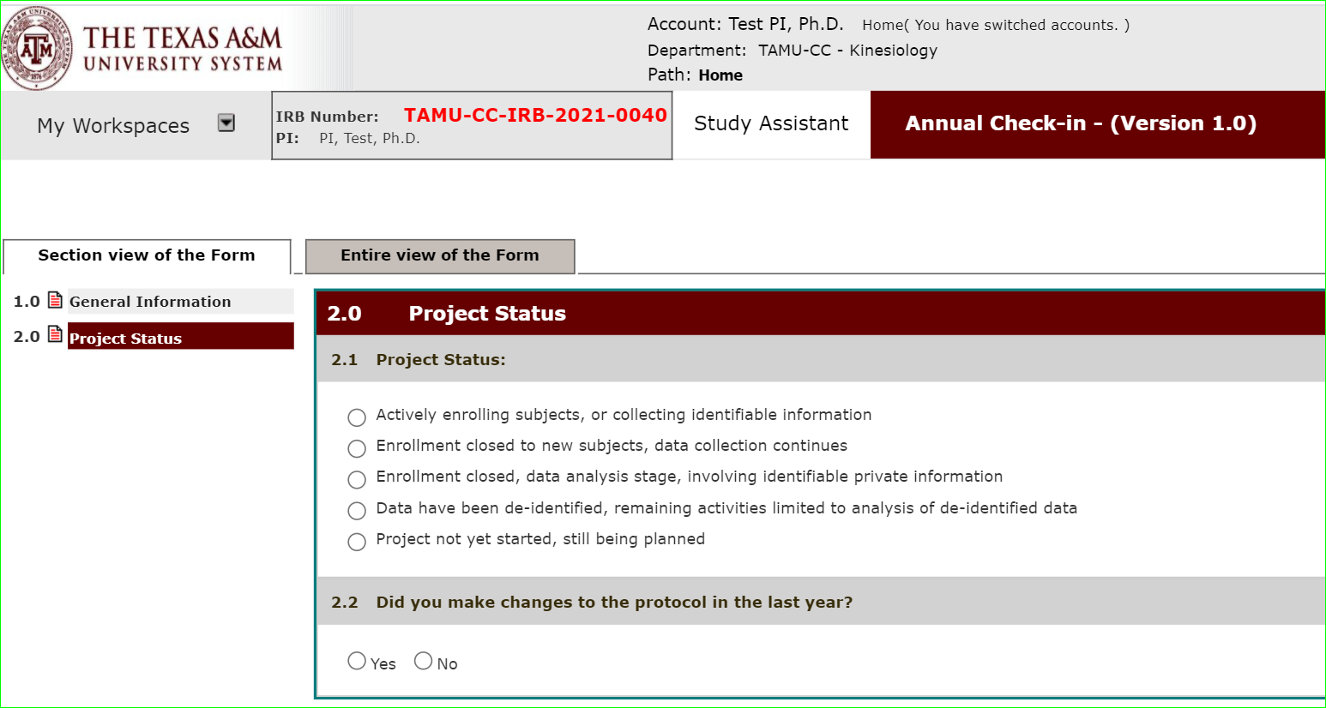
Section 2.0: Project Status
Select the project status that best applies to your project.

Slide 12
Sign-off and Submit
Once the form is complete, you will see the signoff and submit button.
Note: Only the Principal Investigator can execute the sign-off and submit action.

Slide 13
Sign-off and Submit
Click the submission form, “Approve”, and then save sign-off to approve and submit the annual checkin.

Slide 14
Sign-off and Submit: What if I am not the PI?
Click “notify PI to sign-off”.
This action will send a notification to the PI that the submission is ready for review to sign-off and submit.
An outstanding task will also show on the PI’s dashboard.

Slide 15
How do I track the submission’s review progress?
Submissions in progress will show on your dashboard under Studies Submission Status – In Progress.
A detailed look at the submission’s progress can be viewed under steps.

