Slide 1
Study Closure
Rebecca Ballard, JD, MA, CIP May 13, 2021
Director, Research Compliance

Slide 2
Welcome!
I’ll be guiding you through today’s course objectives.
How to submit a study closure in iRIS.

Slide 3
When can I close my study?
Studies can be closed when all the following occur:
1
Subject recruitment has concluded (i.e. no participant recruitment is in progress or anticipated)
2
All subject specimens, records, and data have been collected (i.e., no further collection of data/information from or about living individuals is needed)
3
All interactions or interventions with participants are completed (i.e., no further contact with the subject is necessary or anticipated)
4
Analyses of identifiable subject data, records, and specimens are finished (i.e., use of or access to identifiable subject data is no longer necessary).

Slide 4
How do I start the Study Closure Form?
For studies with a study status as “Approved”, select under actions “Forms”.

Slide 5
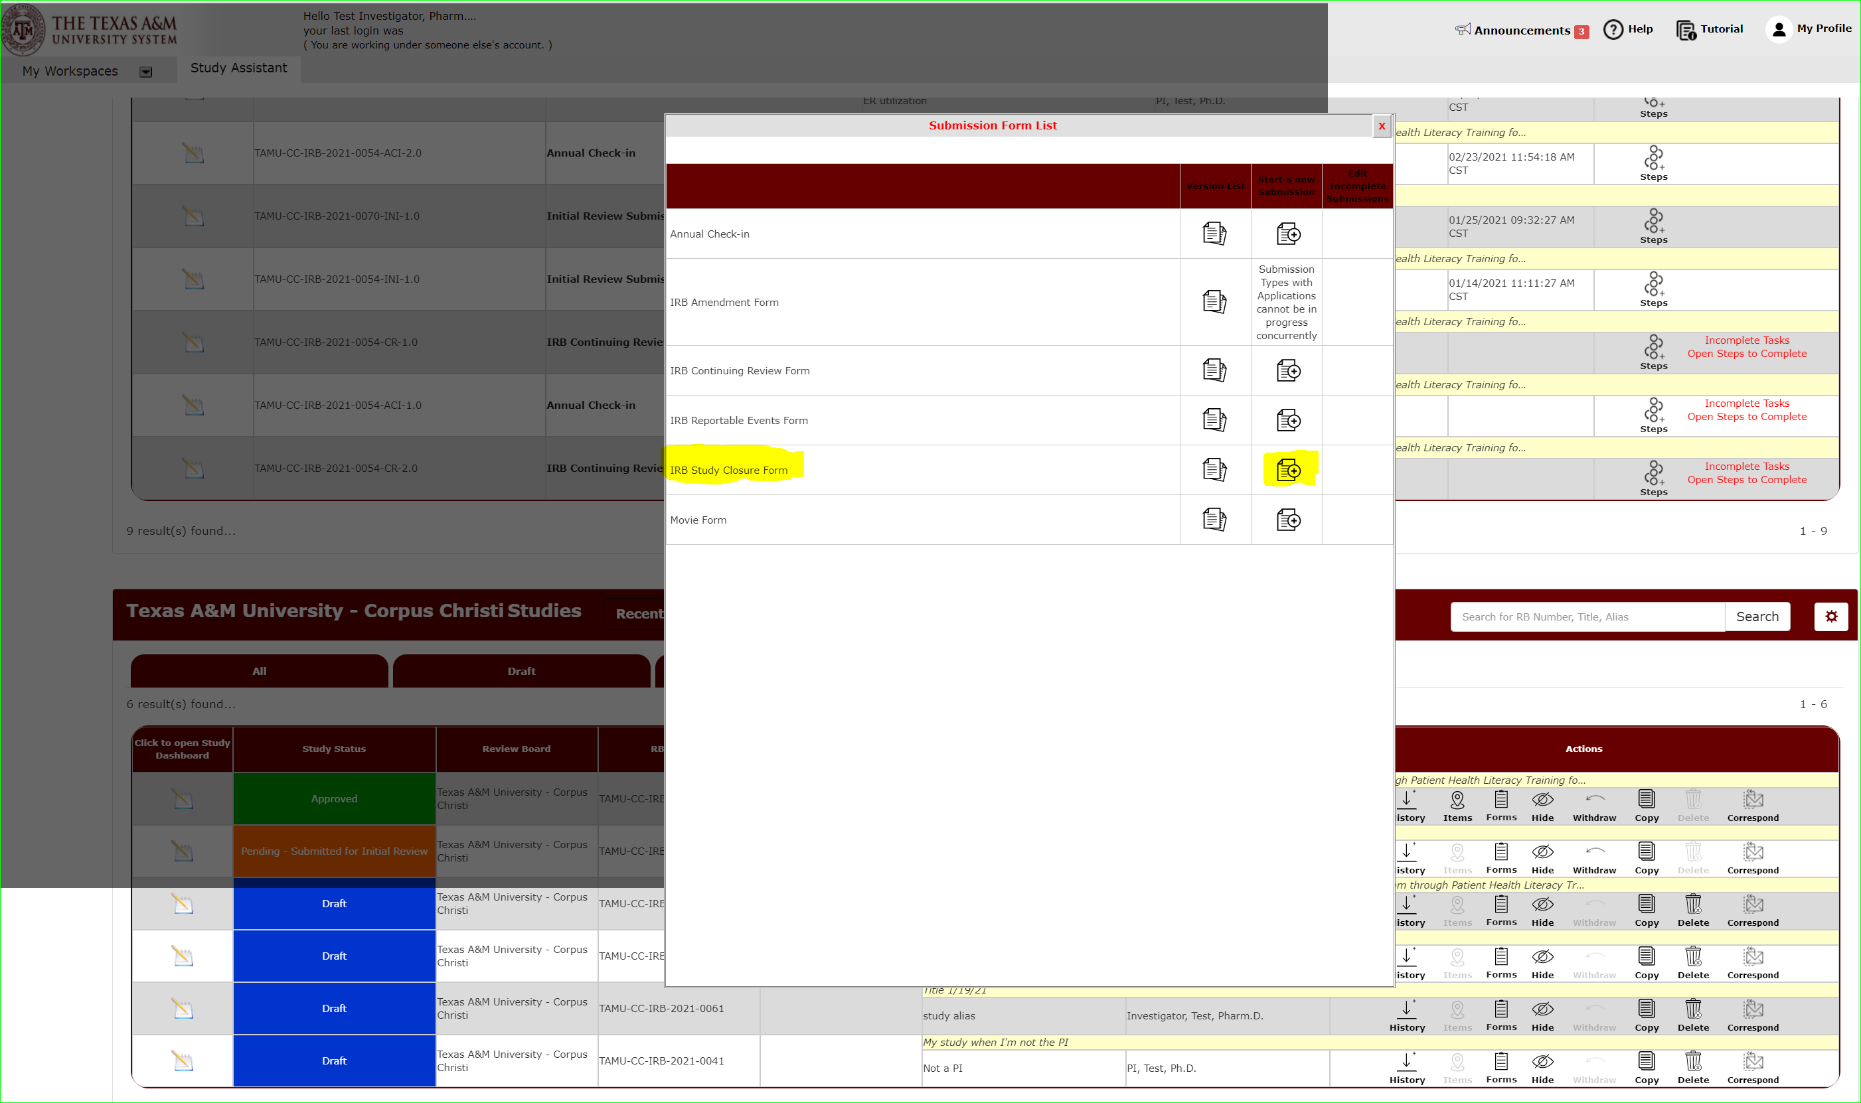
How do I start the Study Closure Form?
On the form list, select “IRB Study Closure Form” to open the study closure form.

Slide 6
Begin filling out the form.
Hit save and continue to the next section to proceed through the form.

Slide 7
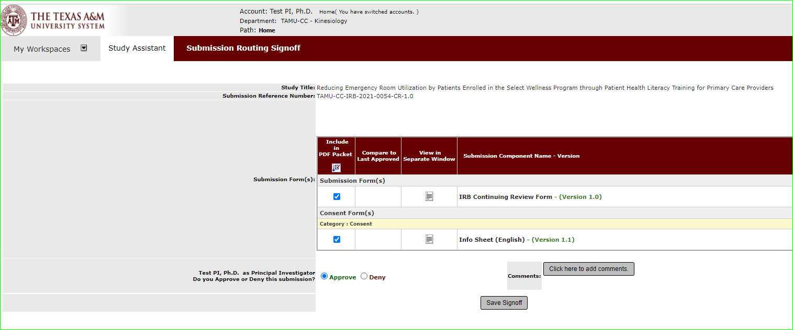
Sign-off and Submit
Once the form is complete, you will see the signoff and submit button.
Note: Only the Principal Investigator can execute the sign-off and submit action.

Slide 8
Sign-off and Submit: What if I am not the PI?
Click “notify PI to sign-off”.
This action will send a notification to the PI that the submission is ready for review to sign-off and submit.
The PI will be notified of the sign-off request.
An outstanding task will also show on the PI’s dashboard.

Slide 9
How do I track the submission’s review progress?
Submissions in progress will show on your dashboard under Studies Submission Status – In Progress.
A detailed look at the submission’s progress can be viewed under steps.

