Slide 1
Reportable Event
Rebecca Ballard, JD, MA, CIP May 13, 2021
Director, Research Compliance

Slide 2
Welcome!
I’ll be guiding you through today’s course objectives.
What to report
How to submit a reportable event in iRIS.

Slide 3
What do I need to report?
Federal regulations require institutions to ensure prompt reporting of unanticipated problems involving risk to research participants or others to the IRB, regulatory agencies, and appropriate officials.
In the conduct of their approved research, should unanticipated issues arise that may increase the level of risk or have other ethical implications, researchers shall report them in a timely manner.

Slide 4
What do I need to report?
Unanticipated Problems or Adverse Events
Unexpected events (not disclosed in consent form or described as risks in the protocol) or expected events that are determined to be occurring at a significantly higher frequency or severity than expected;
Being serious (physically or mentally (psychologically harmful) – whether observed or reported by participants; and/or
Is related or possibly related to participation in the research
Protocol Deviations
Any variation, intentional or unintentional, from an approved study protocol, or deviation from relevant federal regulations or IRB requirements, that may affect the subject’s rights, safety, or well-being and/or the completeness, accuracy, and reliability of the study data.
Complaints from Participants
Monitoring reports
Other events that, in the opinion of the PI, are unanticipated, related to study participation, and affect the welfare of current, previous, or future participants, such as equipment problems and unavailability of study-related material.

Slide 5
Now that we covered what to report,
let’s look at how to report.
What to report
How to submit a reportable event in iRIS.

Slide 6
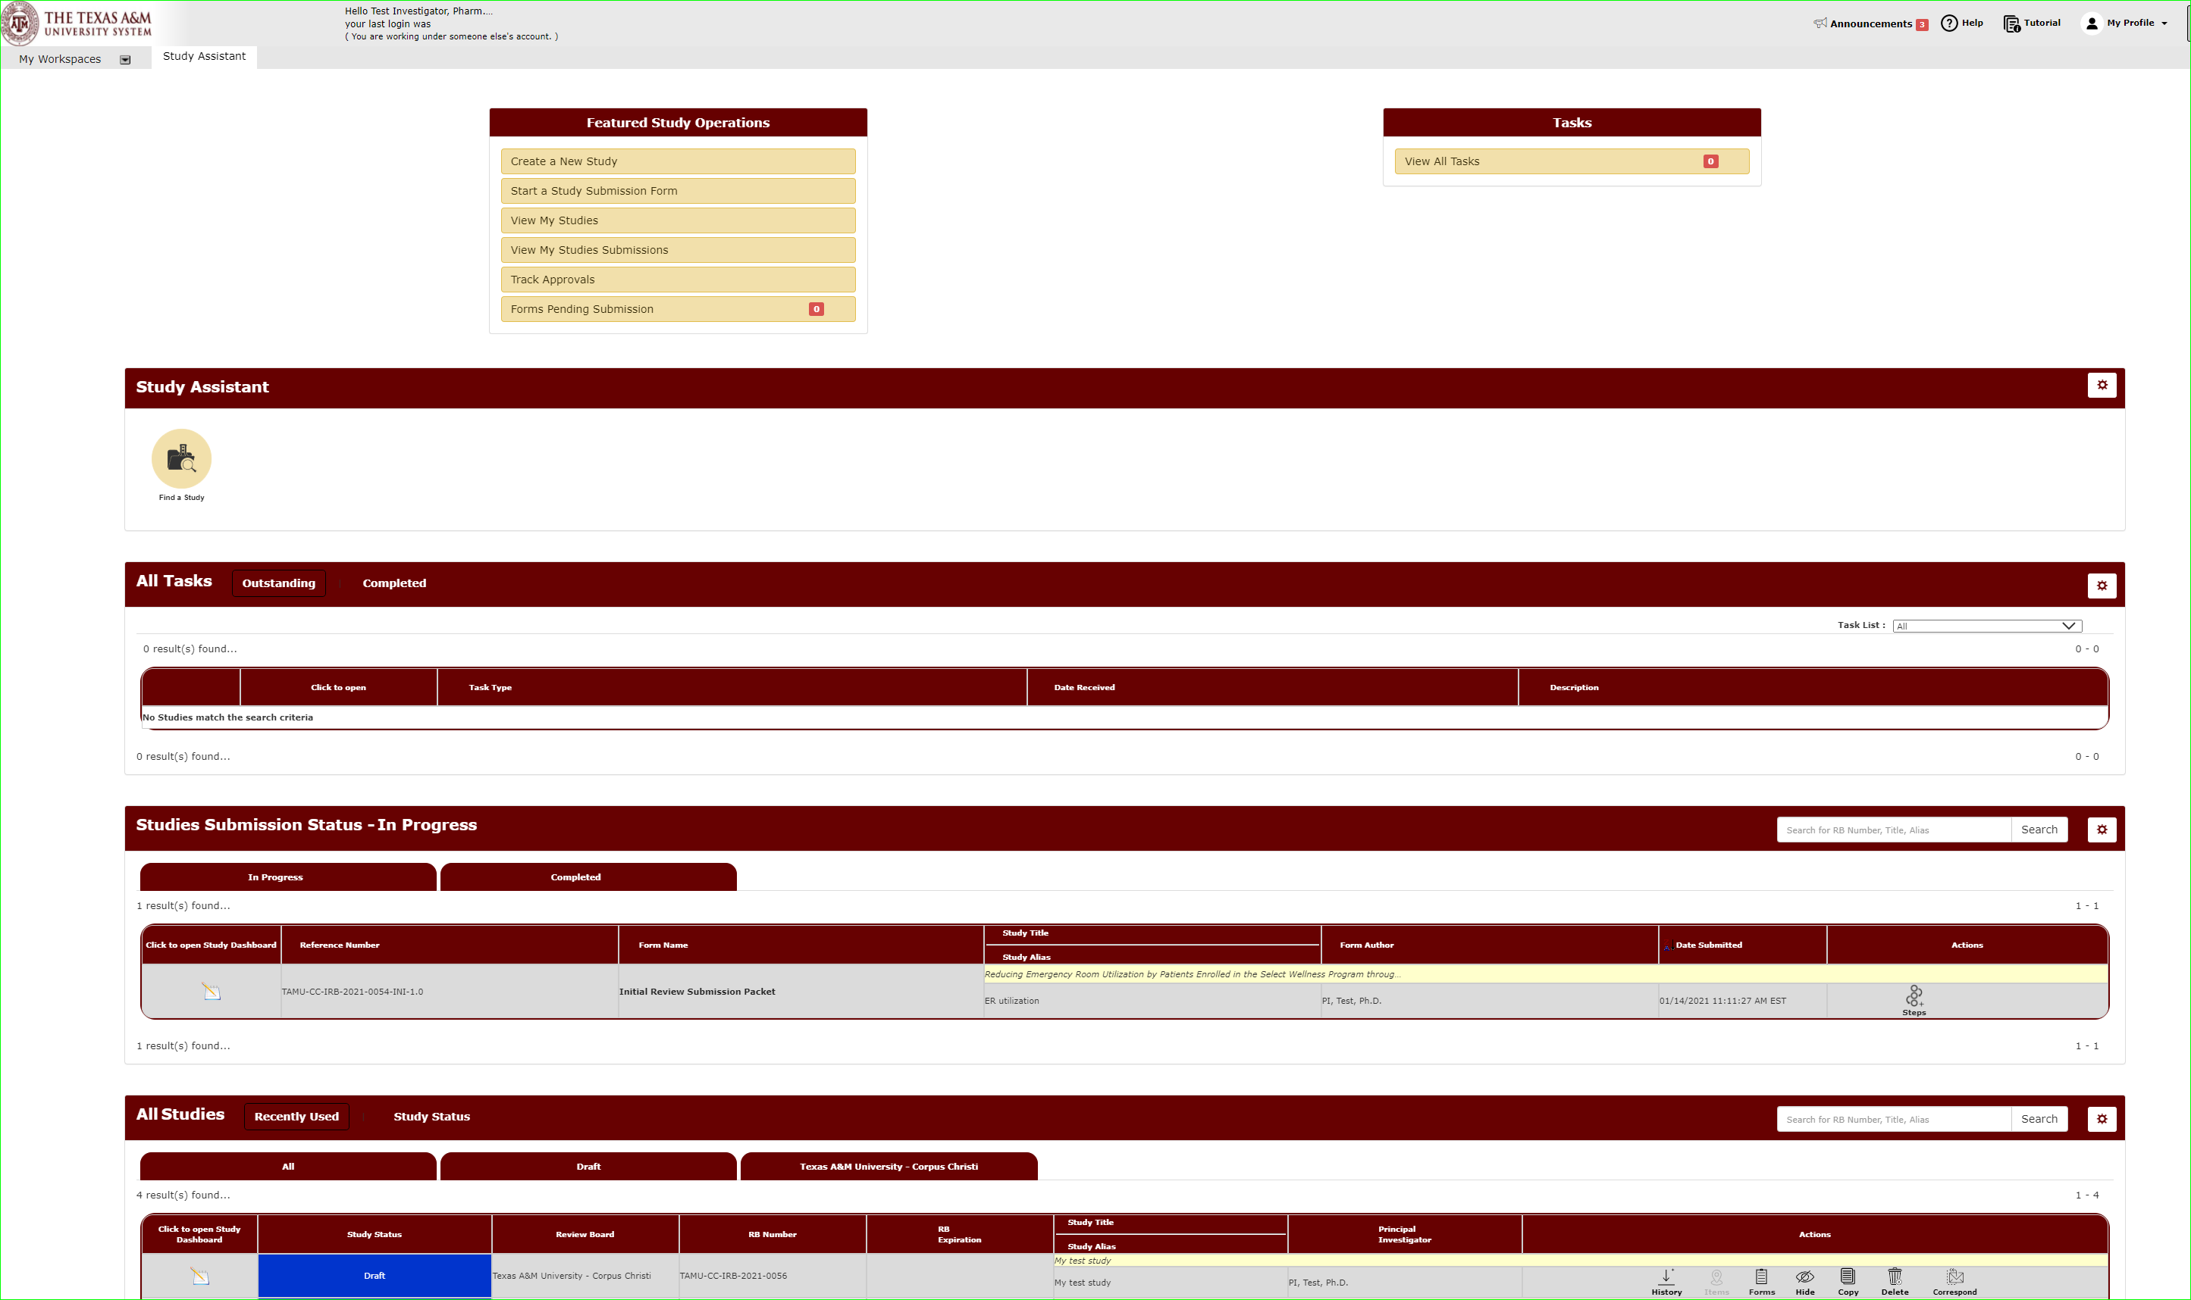
You will manage all your studies through the Study Assistant Workspace.
You will be taken to the Study Assistant Workspace once you login.

Slide 7
Locate the study you want to submit a report for.
You will be taken to the Study Assistant Workspace once you login.

Slide 8
For studies with a study status as “Approved”, select under actions “Forms”.

Slide 9
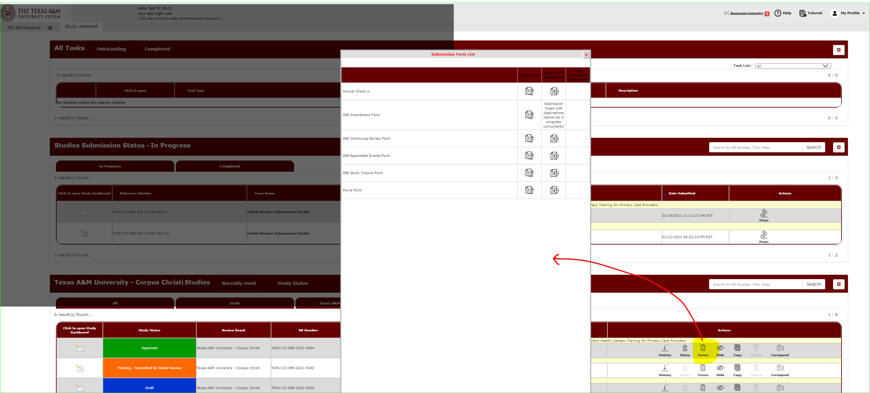
Select IRB Reportable Events Form to open the reportable event submission form.

Slide 10
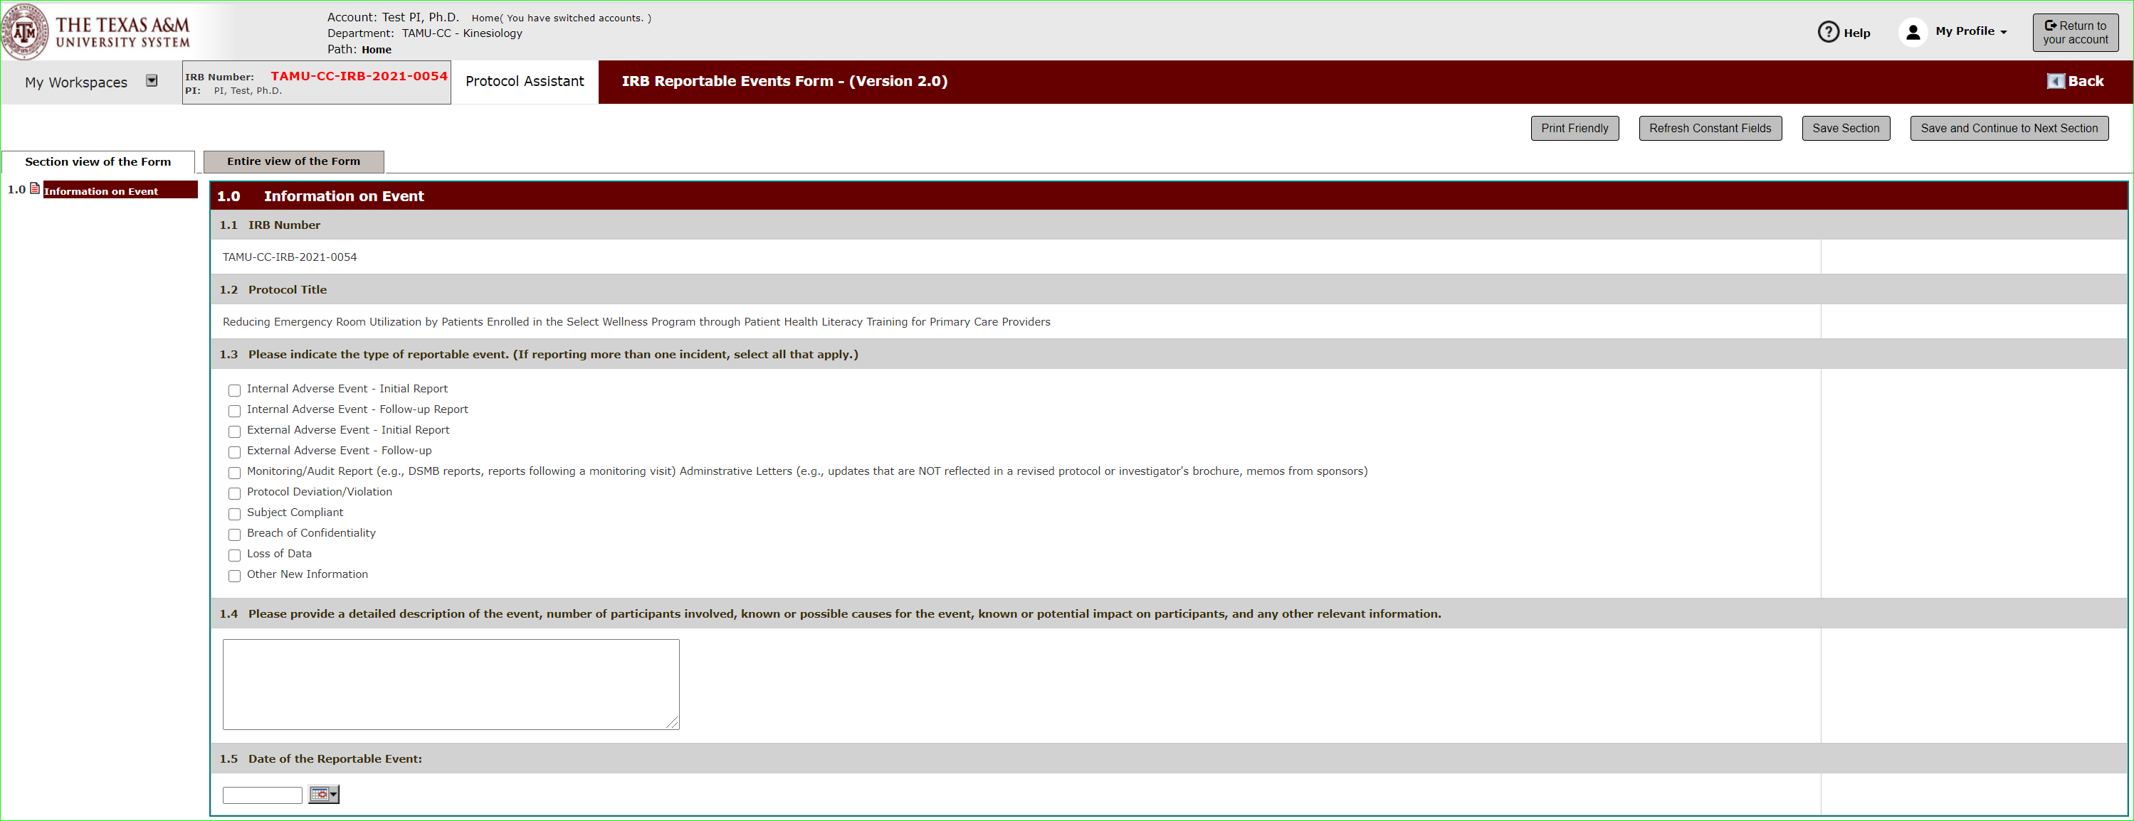
In Section 1.0 you will provide information about the event, such as event type, a description and a date it occurred.

Slide 11
Hit save and continue to the next section to move through the form.

Slide 12
Section 2.0 covers corrective actions taken to fix the immediate issue and those taken to help avoid future occurrences.

Slide 13
Sometimes events will require you modify the protocol or inform existing or future subjects.
In Section 3.0 select “Yes” if the event resulted in needing to change the protocol through an amendment or inform subjects of the event.

Slide 14
Sign-off and Submit
Once the form is complete, you will see the signoff and submit button.
Note: Only the Principal Investigator can execute the sign-off and submit action.

Slide 15
Sign-off and Submit
Click the submission form, “Approve”, and then save sign-off to approve and submit the reportable event.

Slide 16
Sign-off and Submit: What if I am not the PI?
Click “notify PI to sign-off”.
This action will send a notification to the PI that the submission is ready for review to sign-off and submit.
The PI will be notified of the sign-off request.
An outstanding task will also show on the PI’s dashboard.

Slide 17
How do I track the submission’s review progress?
Submissions in progress will show on your dashboard under Studies Submission Status – In Progress.
A detailed look at the submission’s progress can be viewed under steps.

