Slide 1
Amendment
Rebecca Ballard, JD, MA, CIP May 13, 2021
Director, Research Compliance

Slide 2
Welcome!
I’ll be guiding you through today’s course objectives.
How to submit an amendment in iRIS.

Slide 3
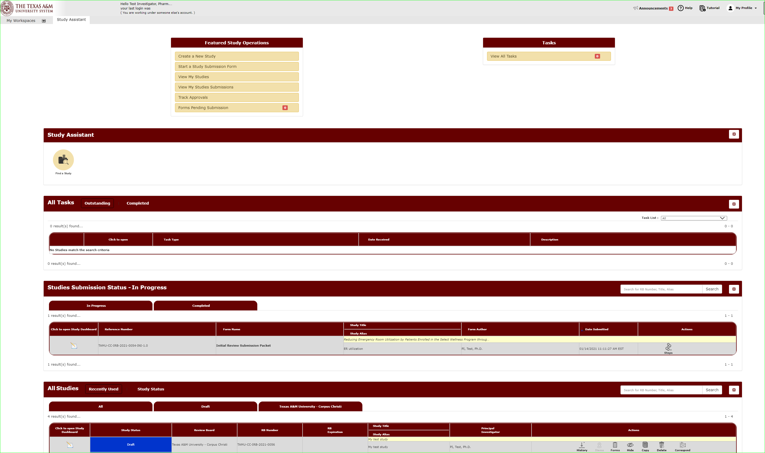
You will manage all your studies through the Study Assistant Workspace.
You will be taken to the Study Assistant Workspace once you login.

Slide 4
Locate the study you want to change.
You will be taken to the Study Assistant Workspace once you login.

Slide 5
For studies with a study status as “Approved”, select under actions “Forms”.

Slide 6
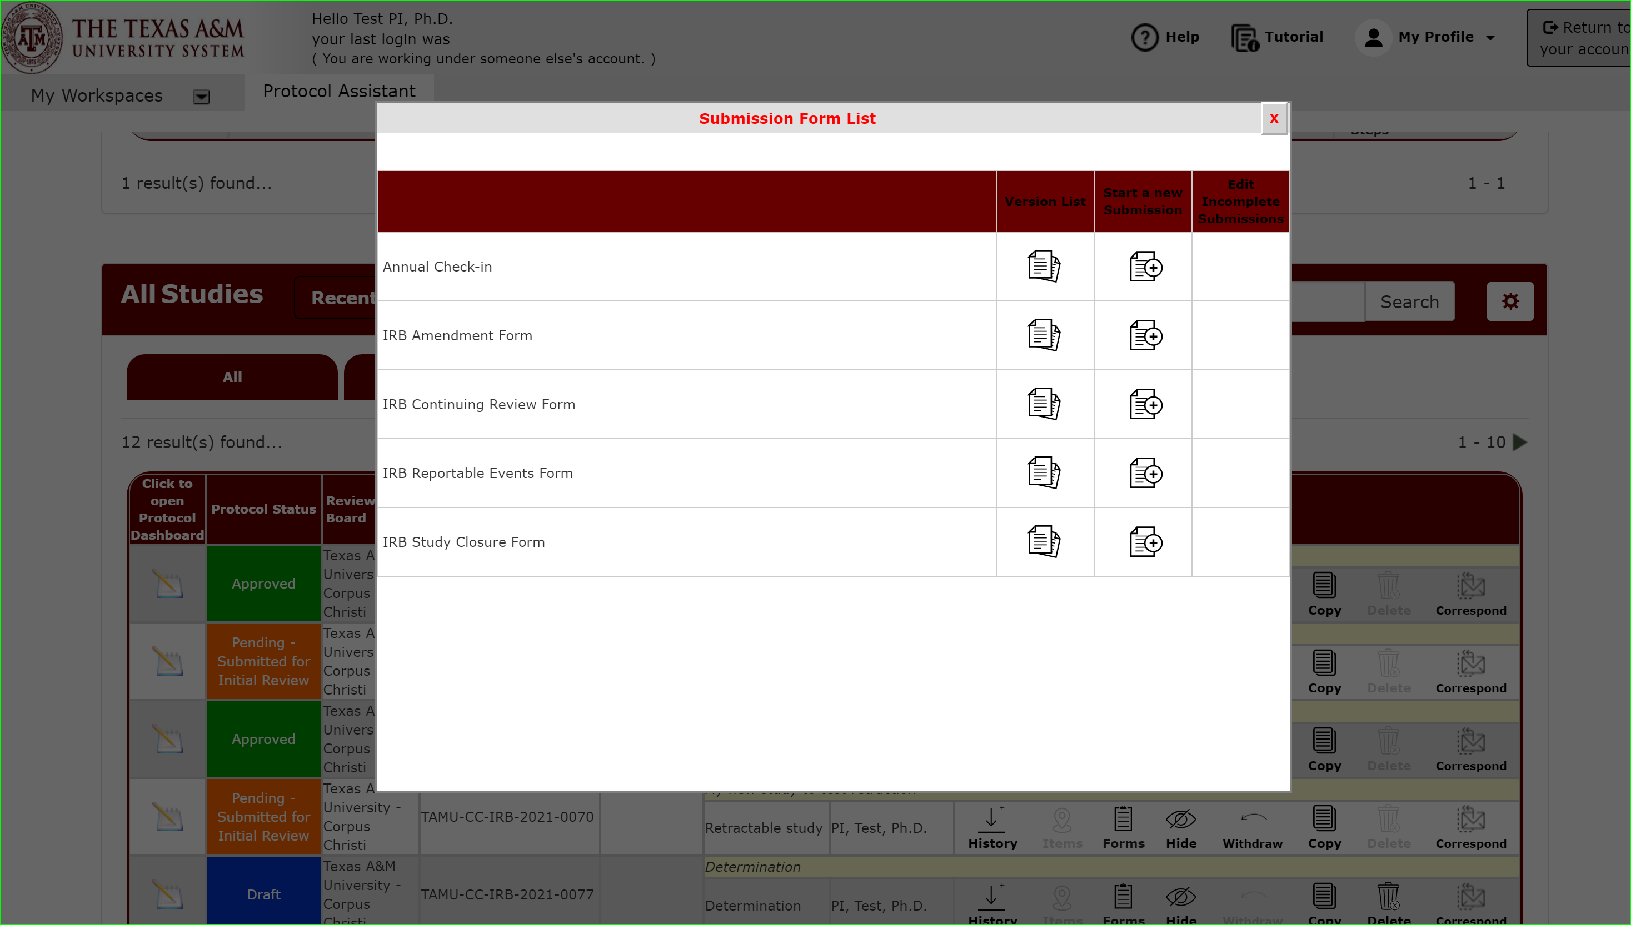
Locate the study you want to change.
Click next to IRB Amendment Form under Start a New Submission.

Slide 7
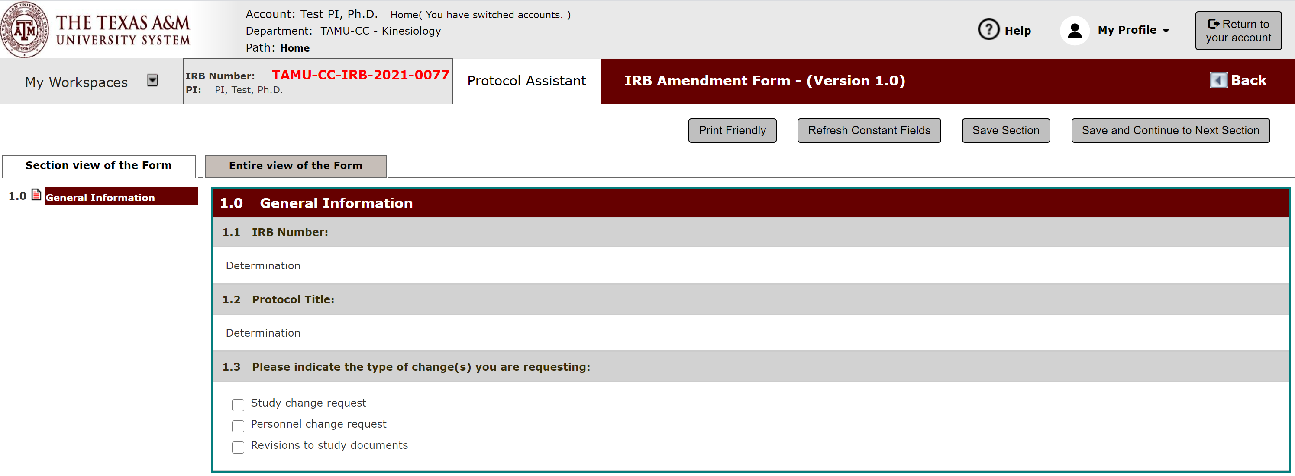
Amendment Form
You will be presented with the amendment form to tell us about the change you wish to make.

Slide 8
Amendment Form
You will be presented different questions based on the type of change you are performing

Slide 9
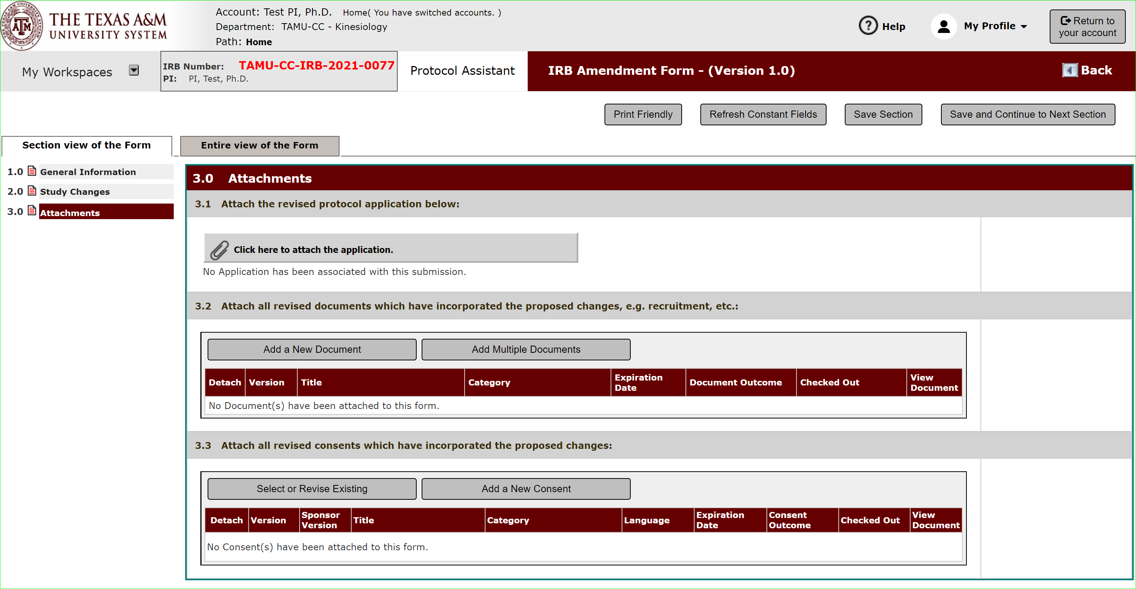
Making Changes
In the submission packet attachment section, is where you will attach the revised protocol and support documents.

Slide 10
Making Changes: The Application
To edit your protocol, click under the revised protocol application section.

Slide 11
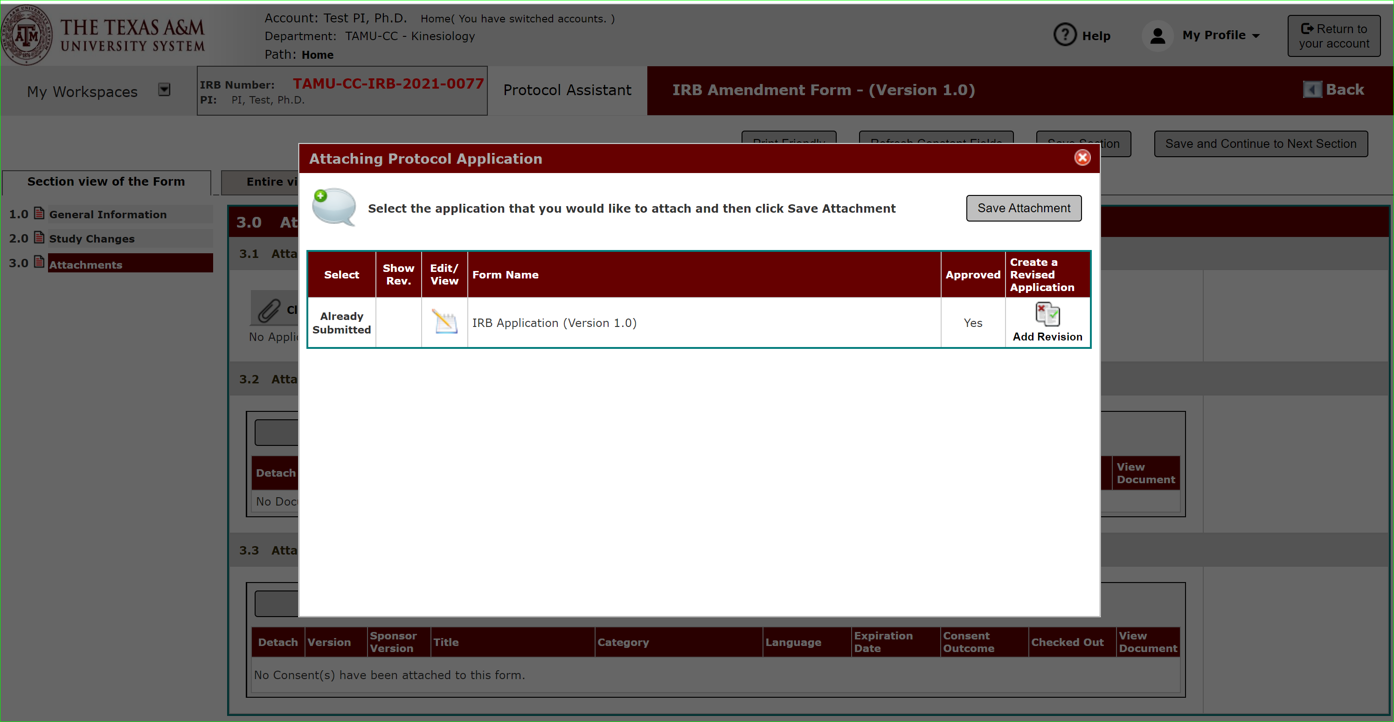
Making Changes: The Application
This will show the latest version of your IRB application.
Click “Add Revision”.

Slide 12
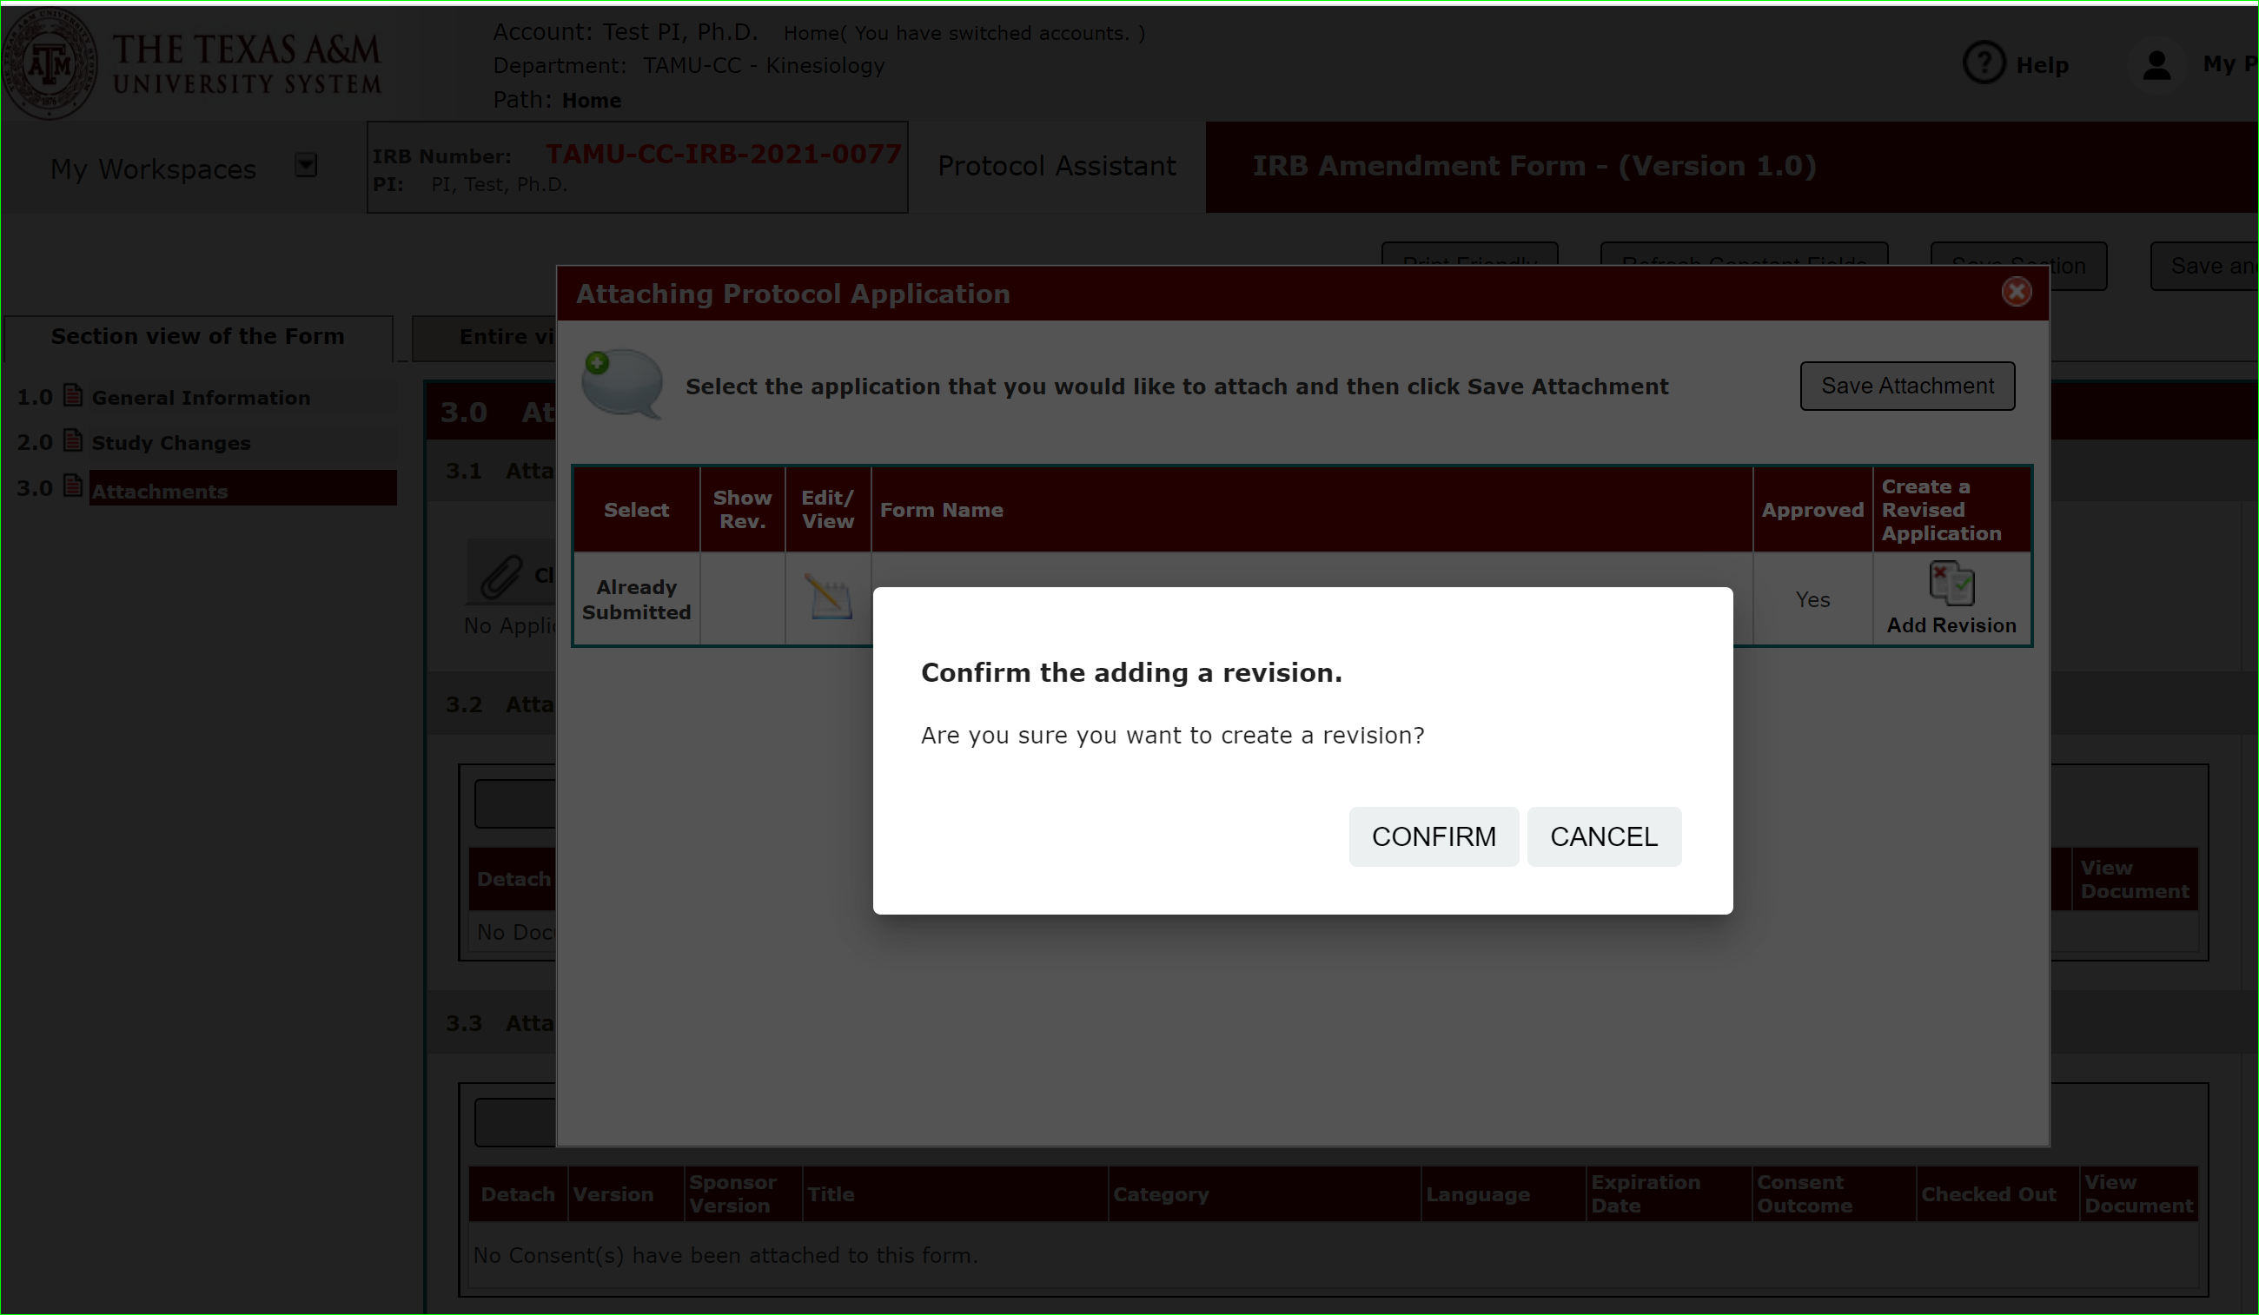
Making Changes: The Application
Click Confirm.

Slide 13
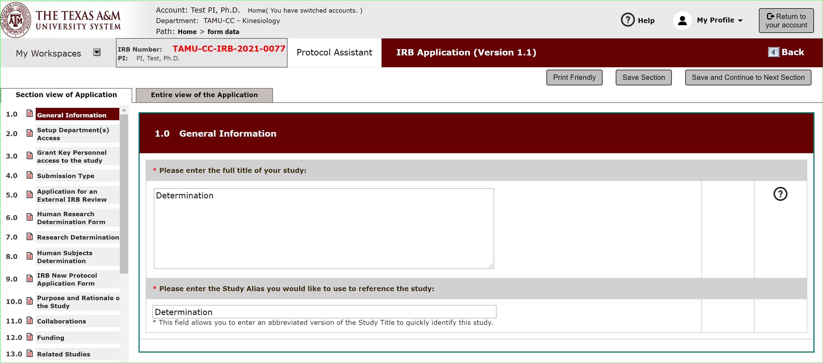
Making Changes: The Application
This will create a new version of your IRB application that is editable.

Slide 14
Making Changes: The Application
Click through the application and make the changes to the questions needed for your amendment.

Slide 15
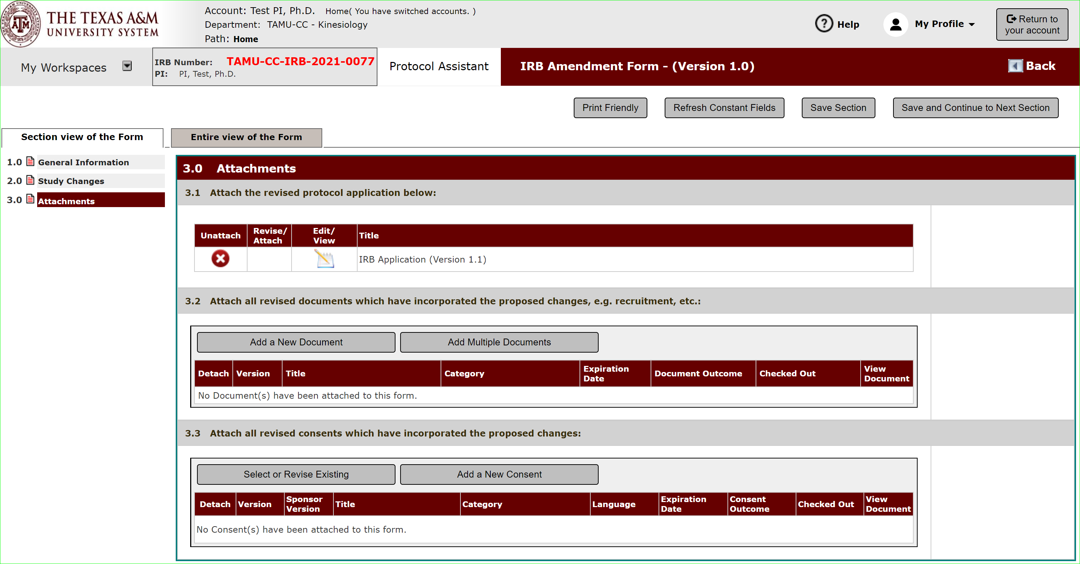
Making Changes: The Application
Save and continue the application and you will be returned to the attachment section of your amendment form.
The application version is changed from 1.0 to 1.1.

Slide 16
Making Changes: Adding New Supporting Documents
In 3.2 click Add a New Document if you need to add new documents not previously submitted.

Slide 17
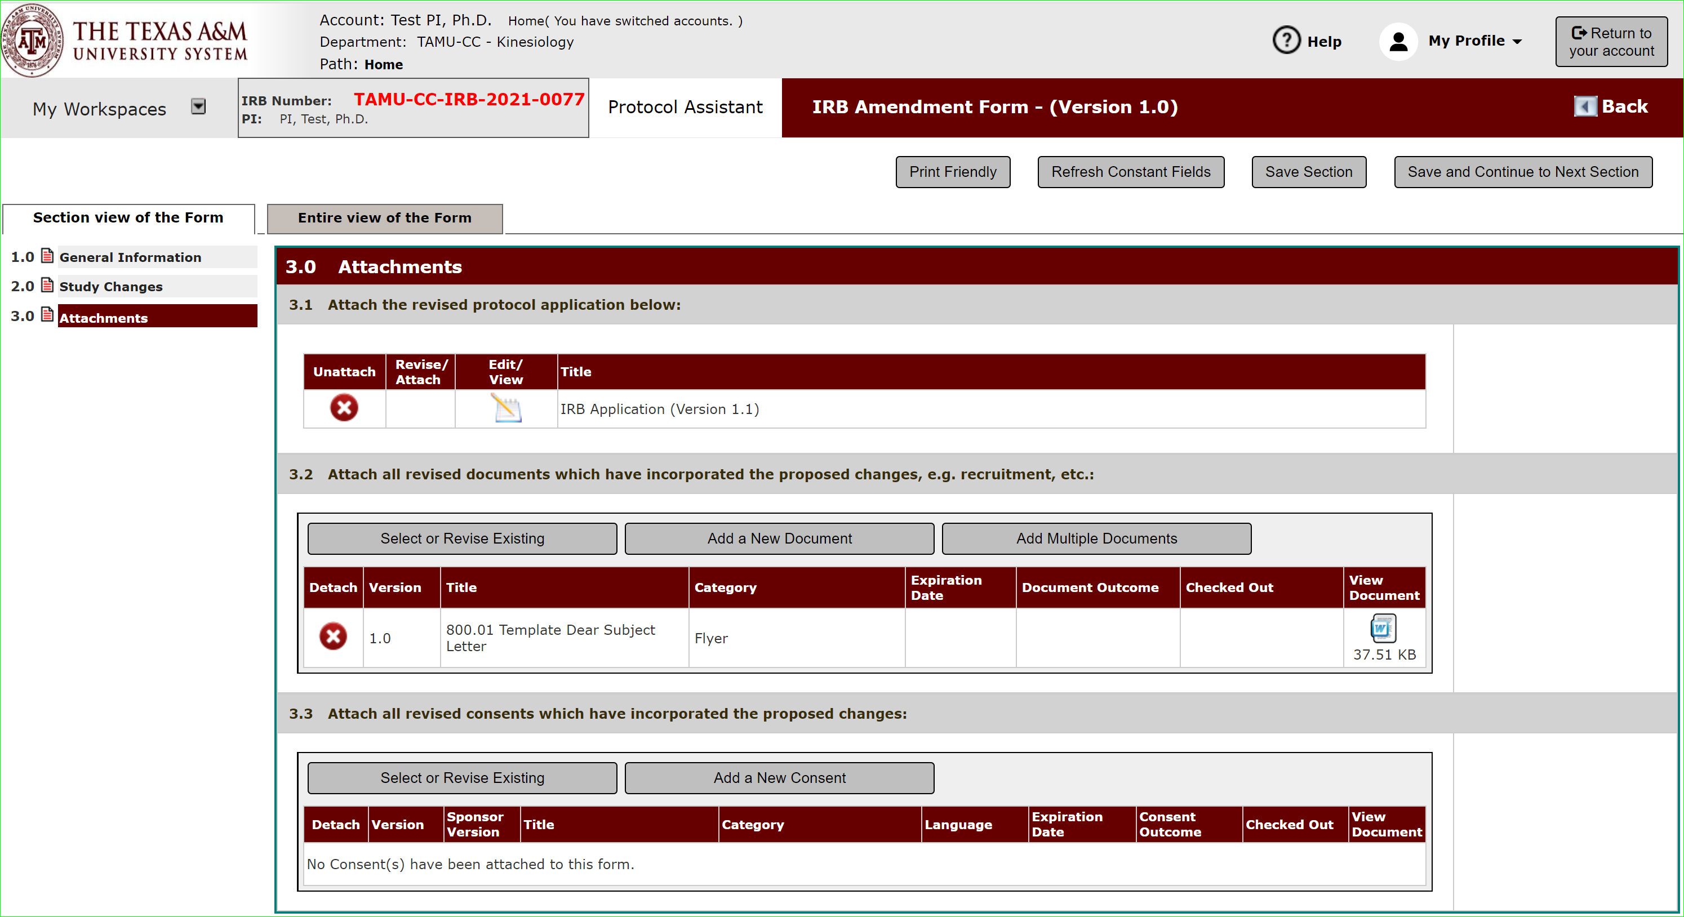
Making Changes: Revising Existing Supporting Documents
In 3.2 click Select or Revise Existing to revise a previously submitted Document.

Slide 18
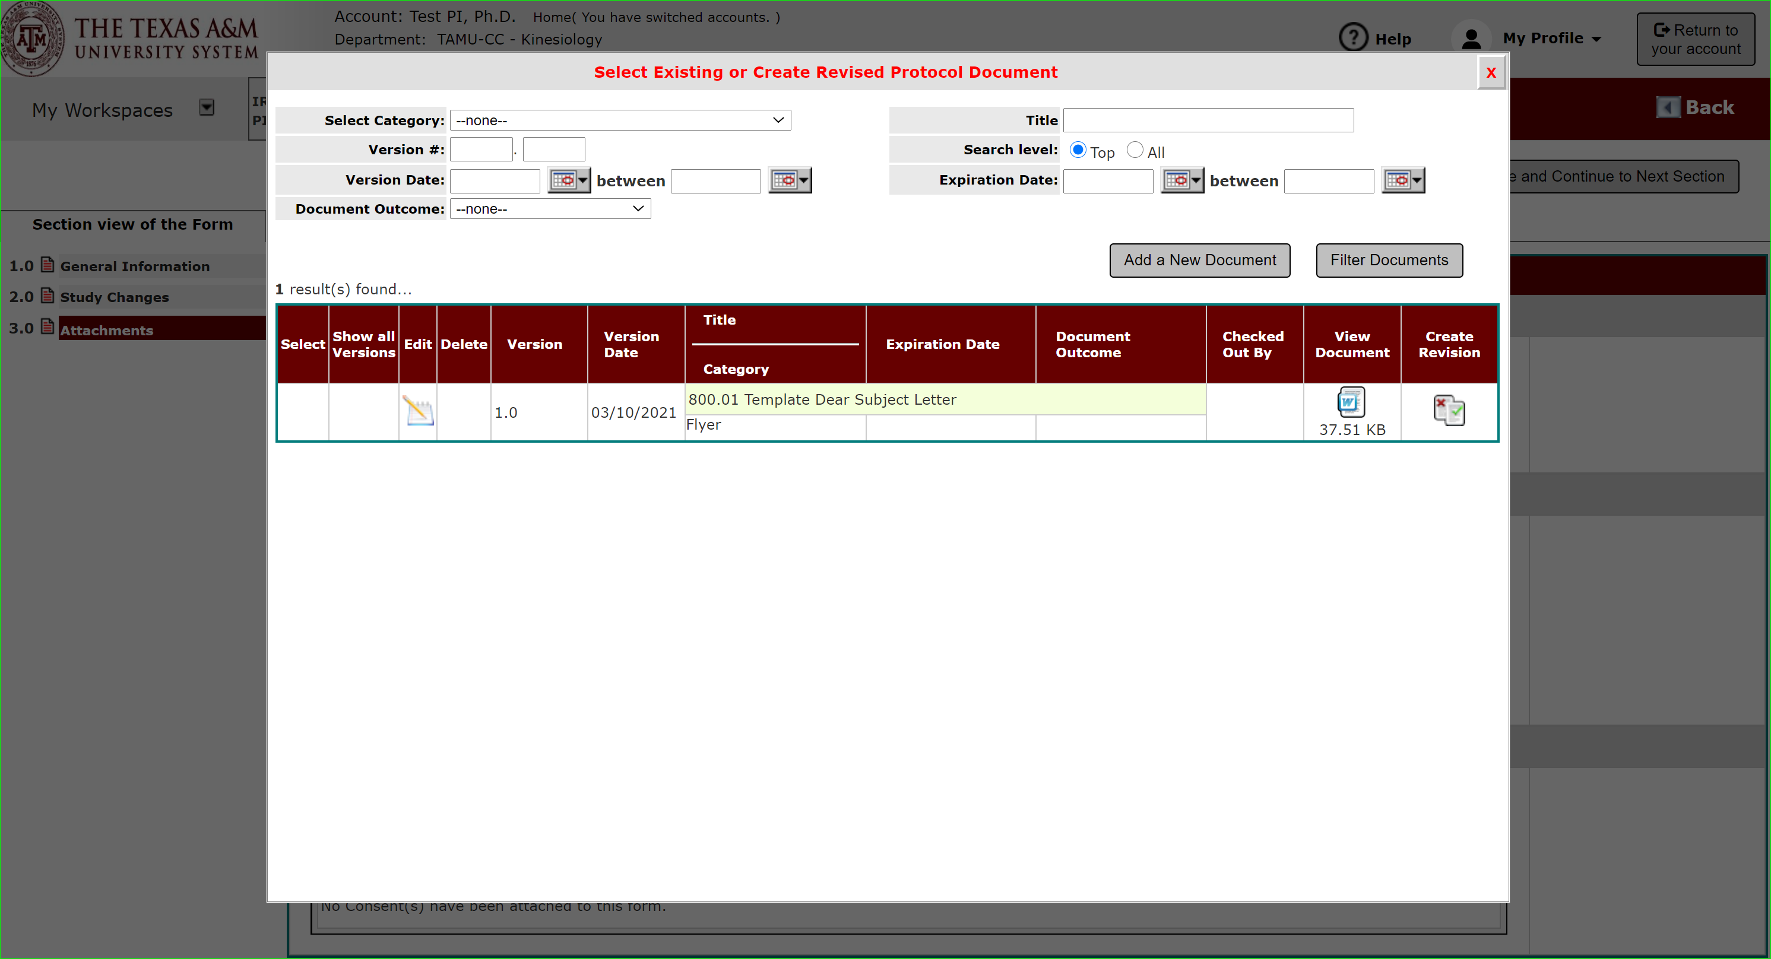
Making Changes: Revising Existing Supporting Documents
Click “Create Revision” to create a new version of this document to revise.

Slide 19
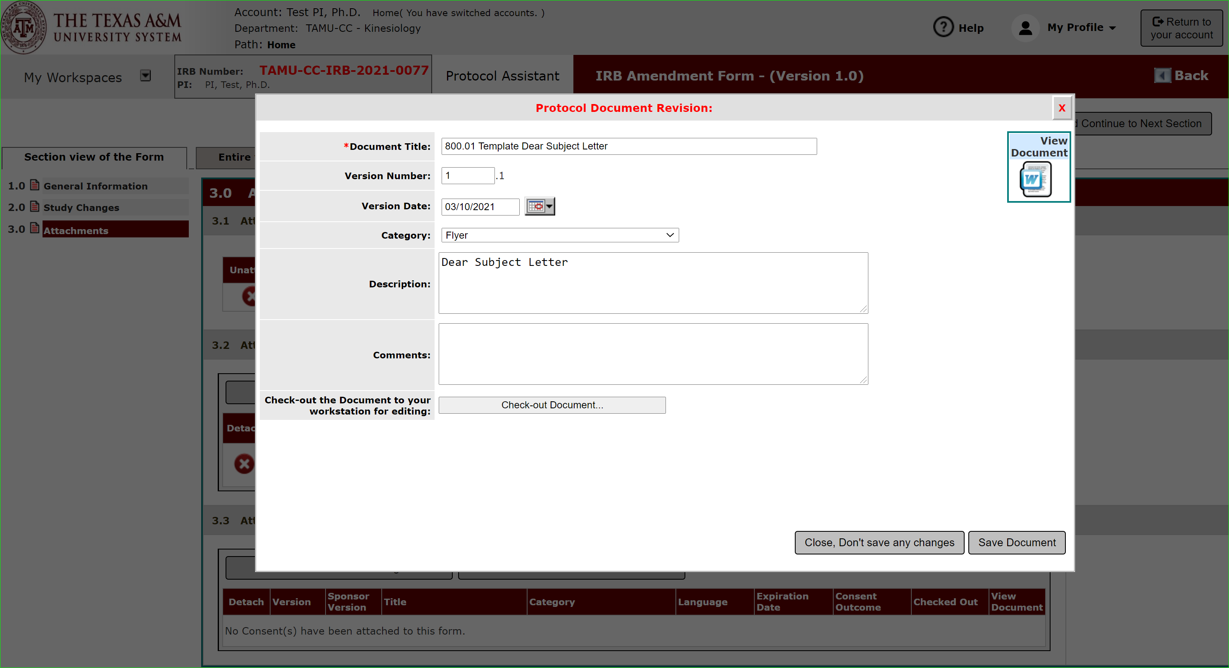
Making Changes: Revising Existing Supporting Documents
Check out the document to edit.

Slide 20
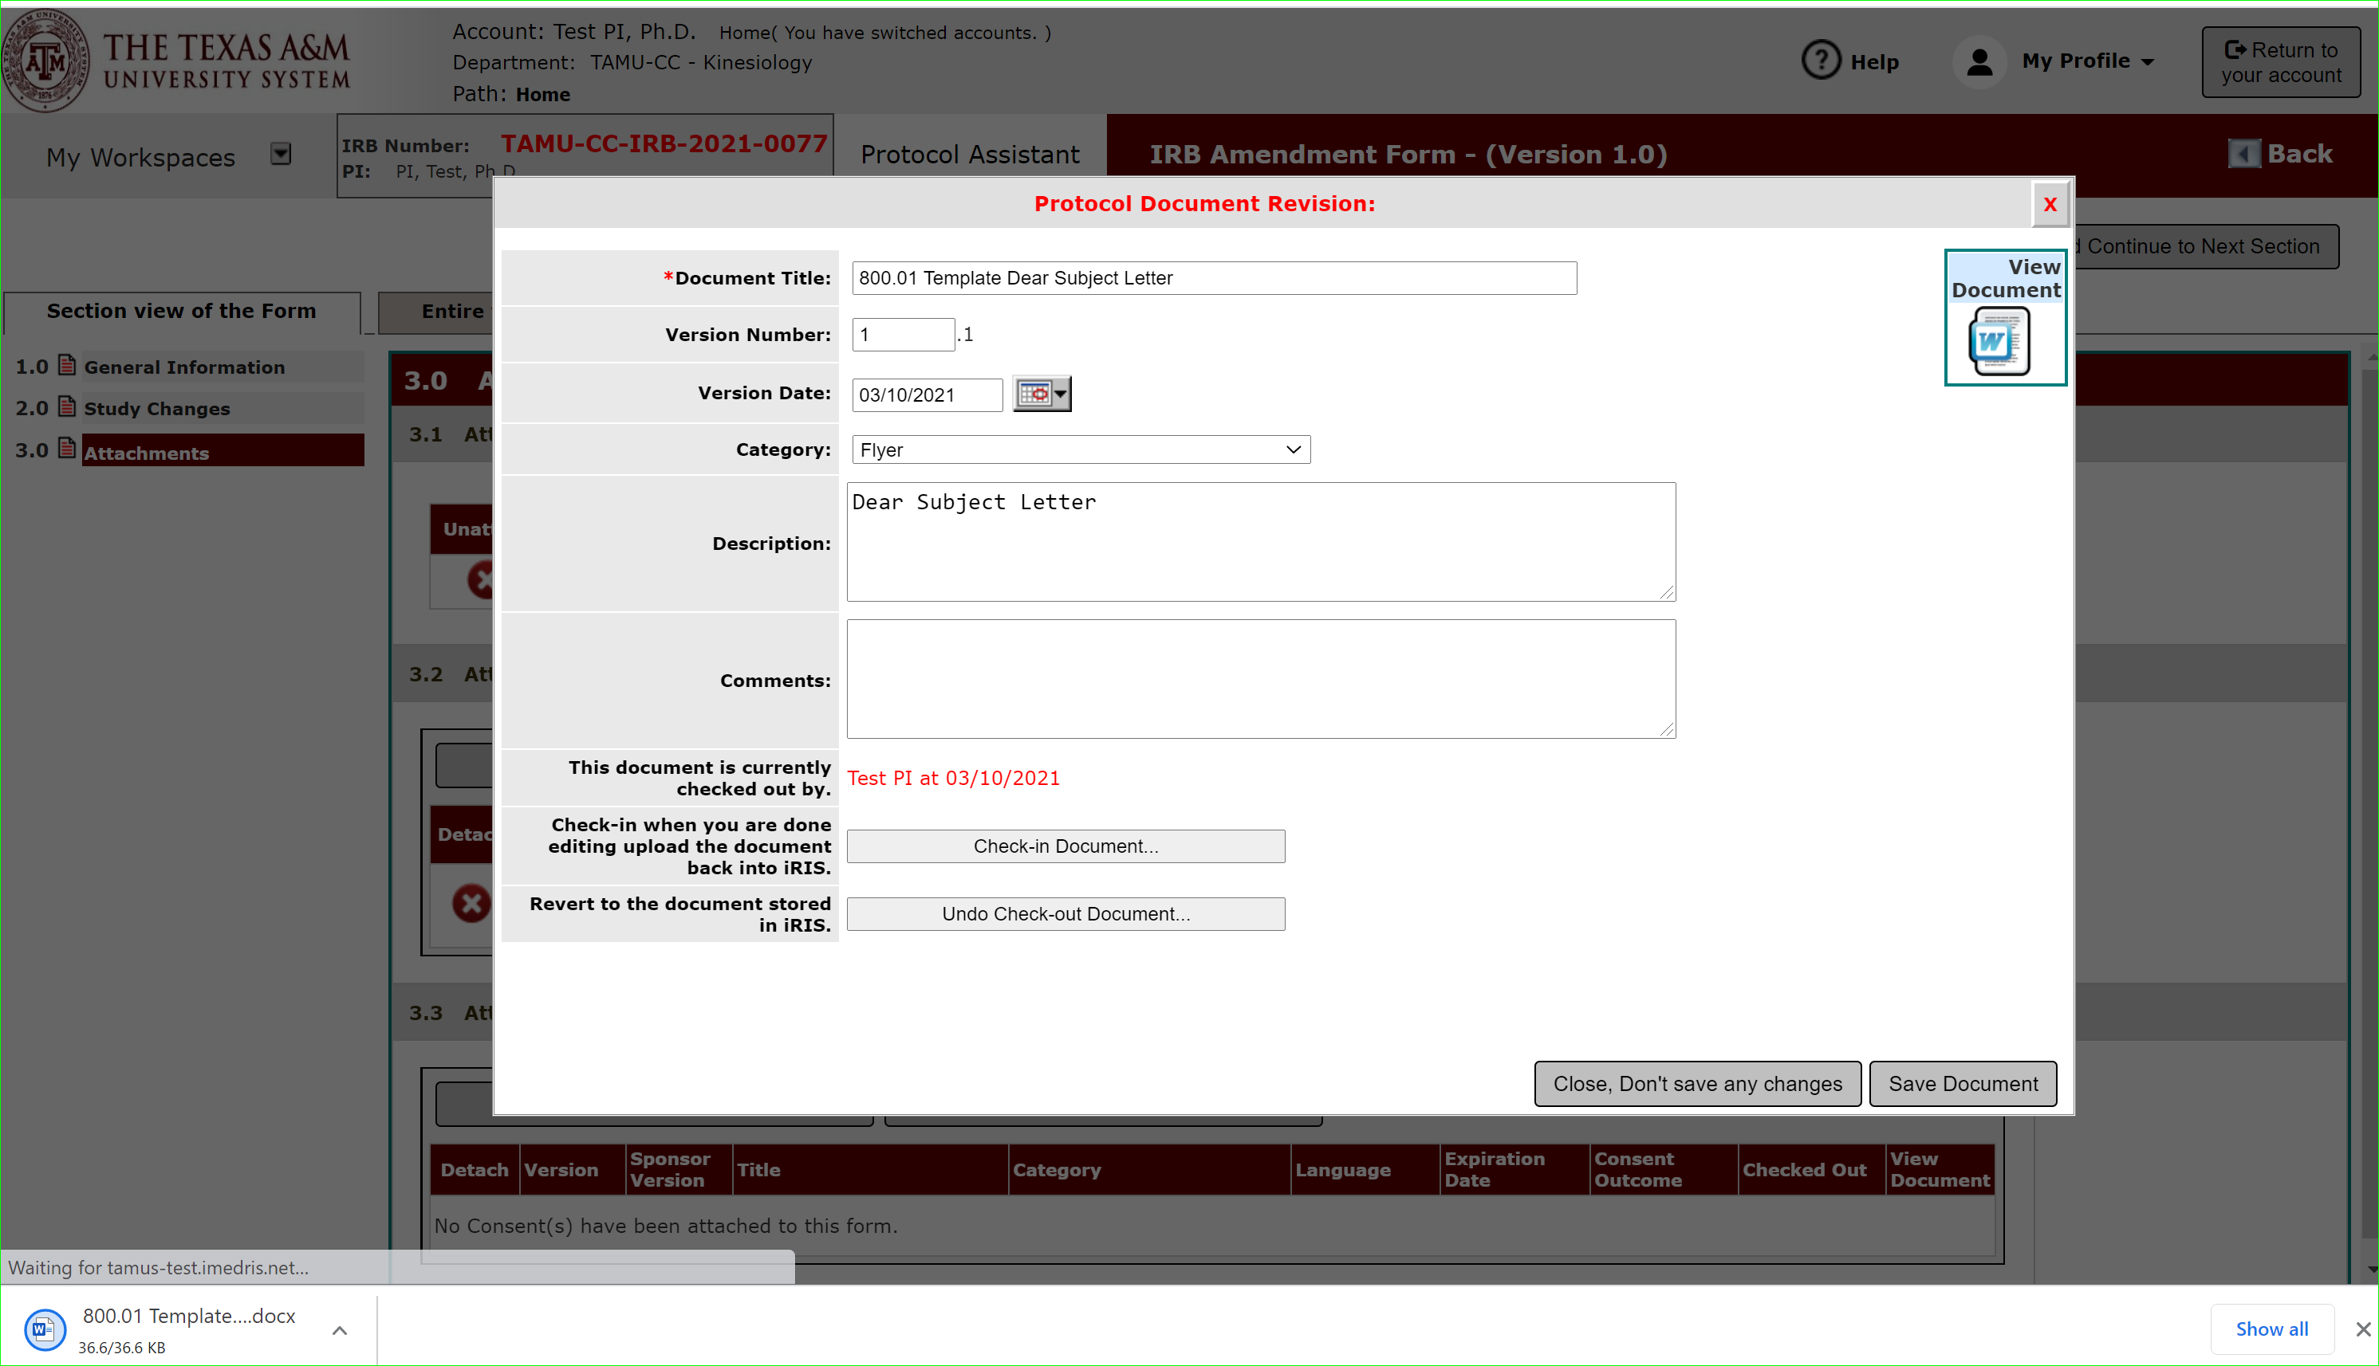
Making Changes: Revising Existing Supporting Documents
This will download a copy in Word for you to open and complete your edits within the document.

Slide 21
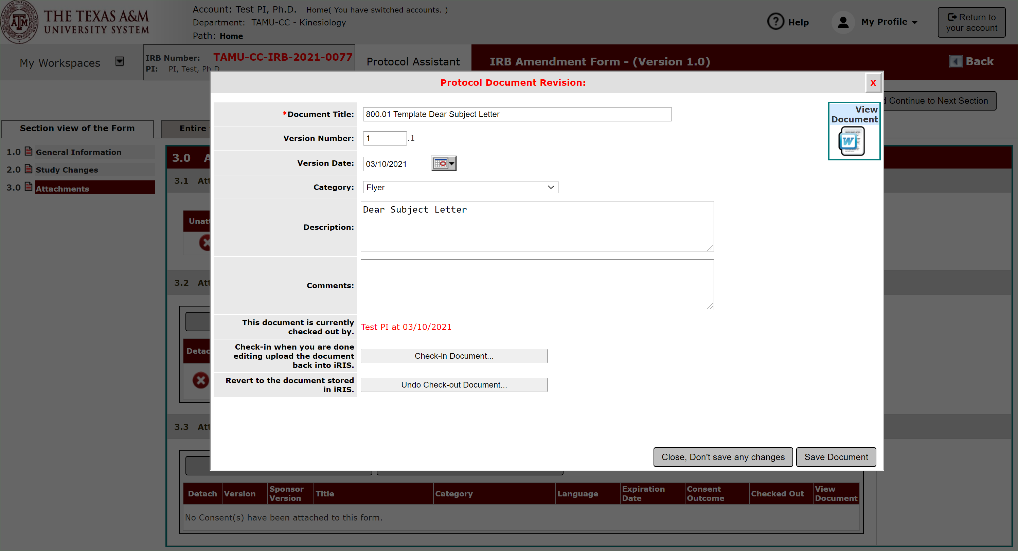
Making Changes: Revising Existing Supporting Documents
Once done making edits, check-in the document.

Slide 22
Making Changes: Revising Existing Supporting Documents
Once complete, the document version will be updated.

Slide 23
Making Changes: Consent Forms
Repeat the Add a New Consent or Select or Revise Existing in 3.3 for any revised consent forms.

Slide 24
Finalize Amendment
Once all revised documents are uploaded, hit “save and continue to next section”.

Slide 25
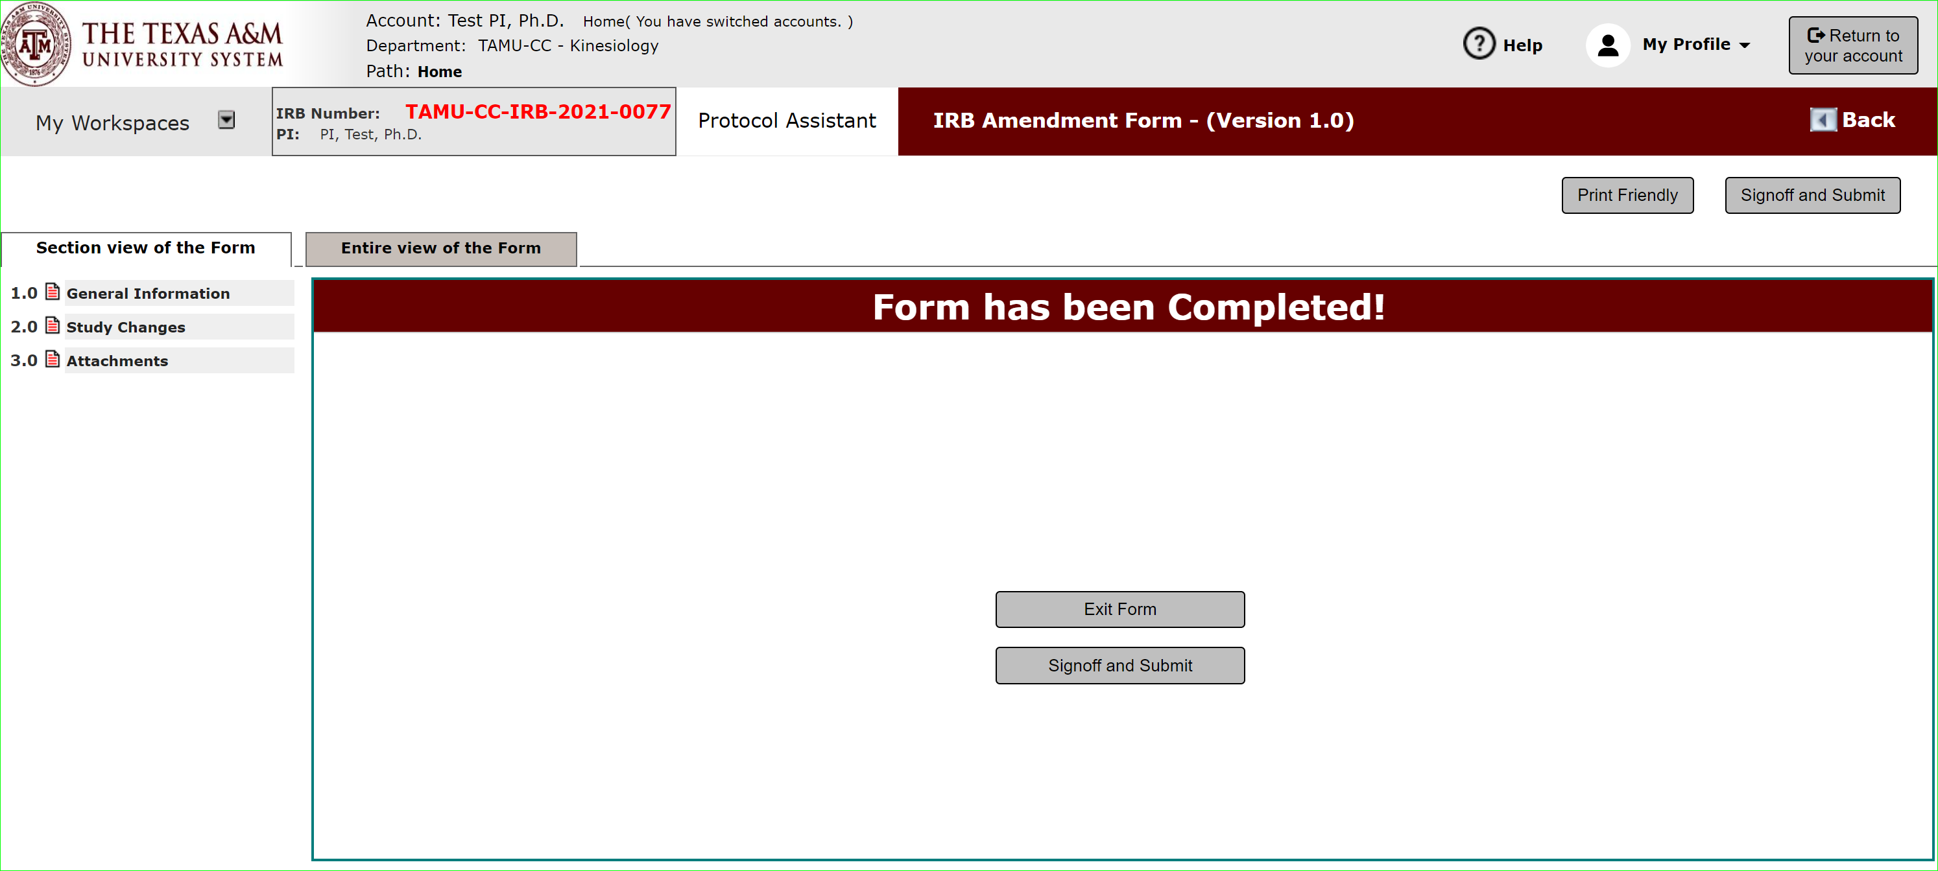
Finalize Amendment
Then signoff and submit.
Note: Only the PI can sign-off. If you are not the PI, you will get a Notify PI option just like for the initial submission.

Slide 26
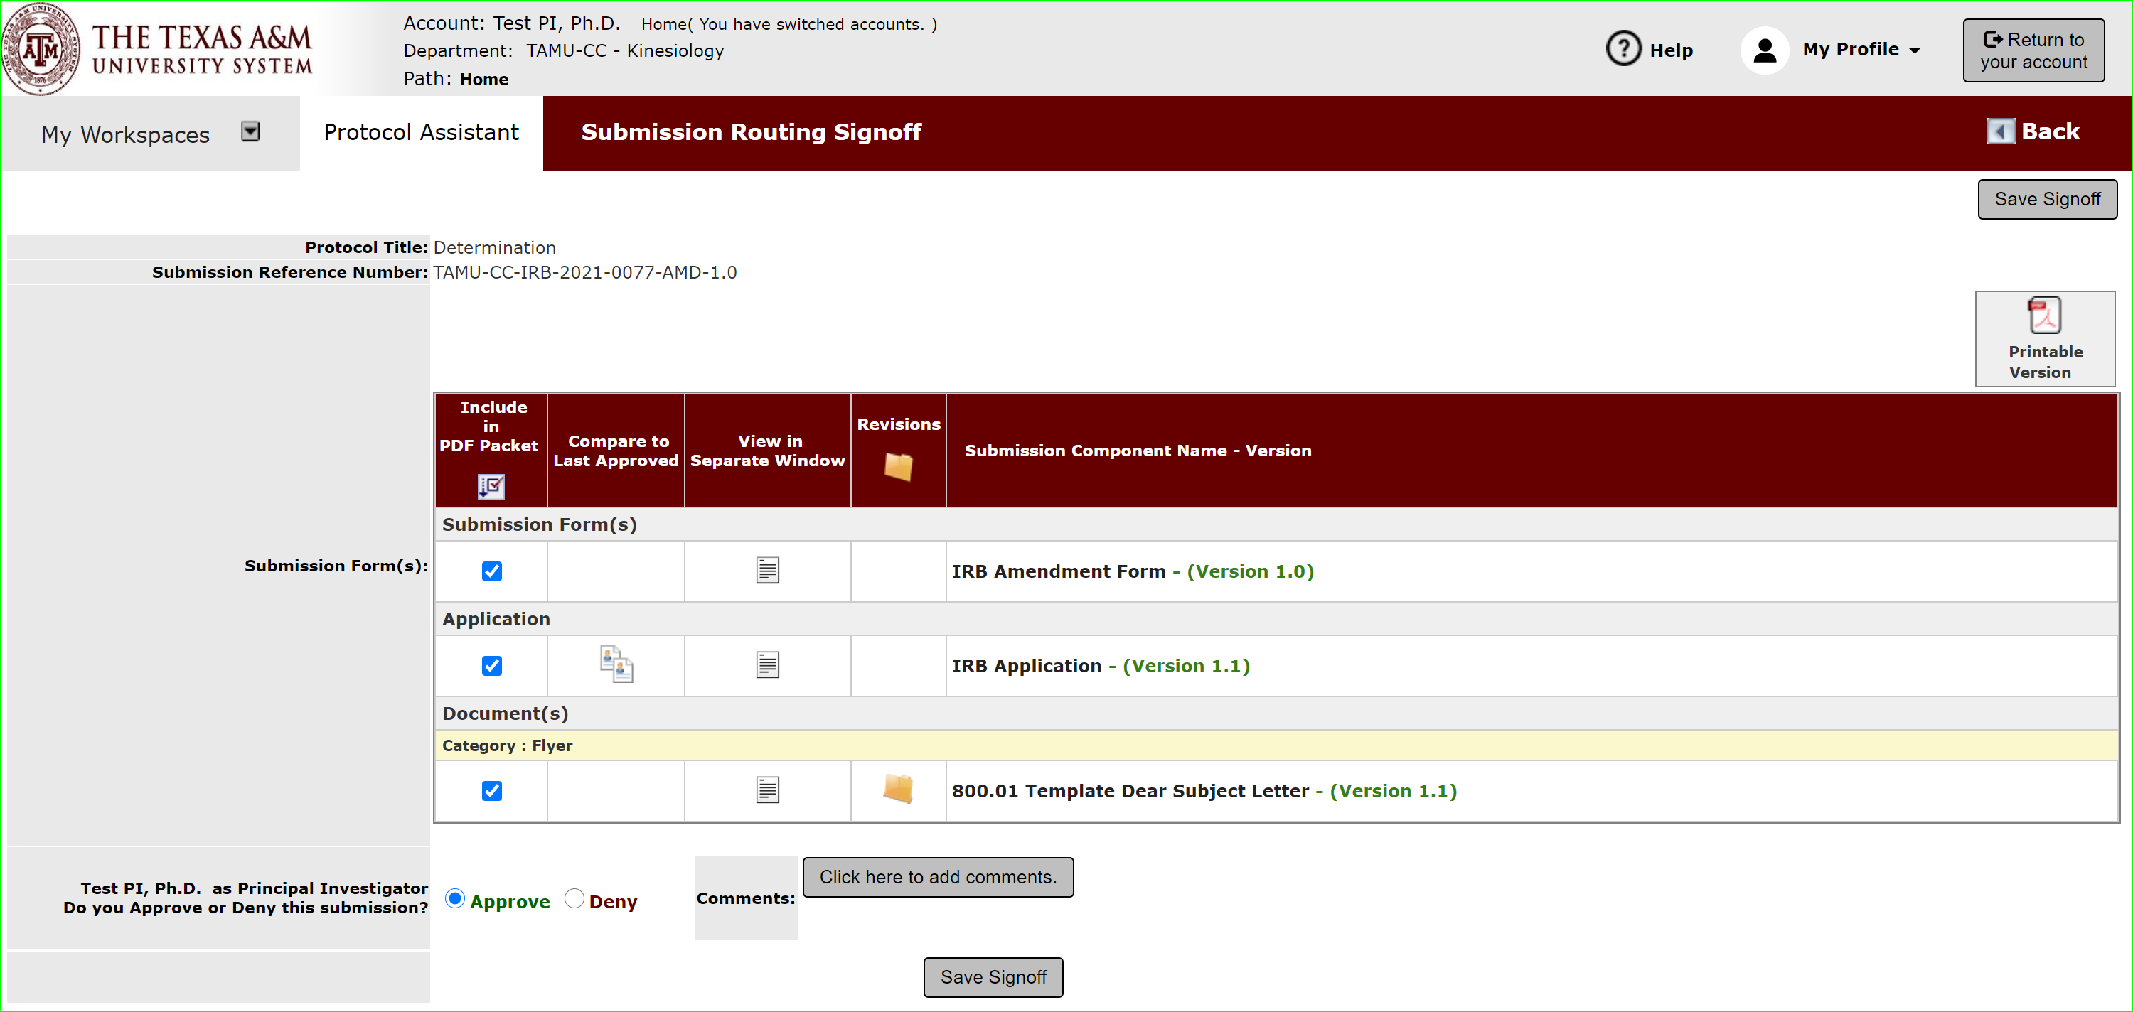
Finalize Amendment: PI Sign-off
The PI will review and sign-off on the amendment.

Slide 27
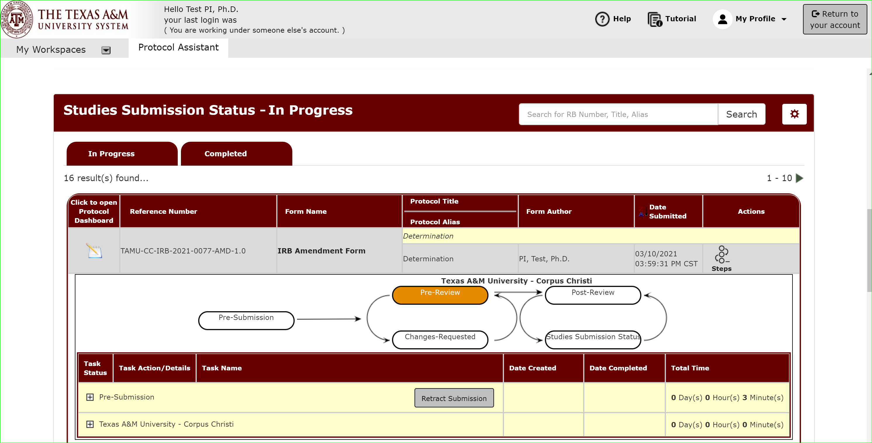
Amendment Submitted
Once submitted, you can track the review progress from your dashboard.

