Slide 1
Informed Consent
Revised Common Rule

Slide 2
In this session, we will review changes to informed consent.
Course Objectives :
General Overview of Informed Consent
Changes to the Informed Consent Form
Tiered Consent
New Elements to the Informed Consent Form
Broad Consent

Slide 3
Informed Consent Requirements
Regulations give several options on how to accomplish the informed consent requirements.
Informed Consent:
General
Informed Consent:
Use of Short Form
Informed Consent
Waiver of Documentation
Informed Consent
Waiver of Process

Slide 4
Informed Consent Requirements
The regulations start with the general position that informed consent is required, must be documented with required disclosures.
Before involving a human subject in research, an investigator shall obtain the legally effective informed consent of the subject or the subject’s legally authorized representative.
45 CFR 46.116 (pre-2018)/45 CFR 46.116(a)(1) (1/19/2017)
21 CFR 50.20
Informed consent shall be documented by the use of a written informed consent form approved by the IRB and signed (including in an electronic format) by the subjects or subject’s legally authorized representative.
45 CFR 46.117 (pre-2018)/45 CFR 46.116(a)(1) (1/19/2017)
21 CFR 50.20
In seeking informed consent the required information shall be provided to each subject or the legally authorized representative.
45 CFR 46.116 (pre-2018)/45 CFR 46.116(a)(1) (1/19/2017)
21 CFR 50.20

Slide 5
Consent is more than a Document
“Rather than an endpoint, the consent
document should be the basis for a
meaningful exchange between the
investigator and the subject.”
FDA IRB Information Sheets –“A Guide to Informed Consent”
Notes:
While the focus is on the document. It is important to understand it is the process that is equally, if not more, important.

Slide 6
Informed Consent Process
Investigator will obtain the legally effective informed consent of the subject or LAR.
1
Sufficient Opportunity to consider whether or not to participate
2
Obtained under circumstances that minimize possibility of coercion or undue influence
3
Information is in a language understandable to subject/LAR.
4
Subject/LAR has adequate opportunity to read the consent document before signing.
5
A copy of the signed and dated consent form is given to subject/LAR.

Slide 7
Informed Consent Process
Investigator will obtain the legally effective informed consent of the subject or LAR.
1
Sufficient Opportunity to consider whether or not to participate
The amount of time allotted to the process of consent is dependent upon the nature and complexity of the research and the need to minimize the possibility of coercion or undue influence.
If the study is cumbersome or the individual is uncomfortable or anxious about participating in the research they should be instructed to take the ICF home for further review and consideration before deciding whether or not to participate in the research.

Slide 8
Informed Consent Process
Investigator will obtain the legally effective informed consent of the subject or LAR.
1
Sufficient Opportunity to consider whether or not to participate
The amount of time allotted to the process of consent is dependent upon the nature and complexity of the research and the need to minimize the possibility of coercion or undue influence.
If the study is cumbersome or the individual is uncomfortable or anxious about participating in the research they should be instructed to take the ICF home for further review and consideration before deciding whether or not to participate in the research.
Notes:
There is no magic time frame on what would be a considered “sufficient”.

Slide 9
Informed Consent Process
Investigator will obtain the legally effective informed consent of the subject or LAR.
2
Obtained under circumstances that minimize possibility of coercion or undue influence

Slide 10
Undue Influence
Undue influence related to the inequity in power between parties that can make affect one’s ability to exercise free will.
Institutional
Vulnerability
Deferential
Vulnerability
An institutional vulnerability is when persons are within a system where they are subordinate to a formal authority, which could influence the subject’s participation in the study.
The coercion from subordination does not come from a formal hierarchy.
Subordination is based on informal relationships where there is a differential in power dynamics making the individual at a higher risk of exploitation due to the subordinate status.
Notes:
Deferential vulnerability is like institutional vulnerability except the coercion from subordination does not come from a formal hierarchy.

Slide 11
Undue Influence
Let’s look at some common relationships and choose which vulnerability that may be at play.
Institutional
Vulnerability
Deferential
Vulnerability
Employer-Employee

Slide 12
Undue Influence
Let’s look at some common relationships and choose which vulnerability that may be at play.
Institutional
Vulnerability
Deferential
Vulnerability
Great job.
The employee’s relationship with the supervisor is a formal hierarchy.
Employees recruited as research participants are vulnerable to undue influence because of the possibility that they may perceive employment or other benefits as dependent upon their participation in research.
Employer-Employee
Next >
Notes:
Employees
Employees recruited as research participants are vulnerable to undue influence because of the possibility that they may perceive employment or other benefits as dependent upon their participation in research.
Investigators recruiting employees show consider:
Reviewing the organization’s policy about employees participating in research on “company time”. Often employers have restrictions about when and how employees can participate in research. Investigators should ensure recruitment of employees follow the organization’s human resource policies.
Make sure that participants know that they may choose not to participate in the research and that their decision will not affect their employment or performance evaluation.
Make sure steps are taken to avoid identifying employees who decline participation.
Engage in recruitment and consent activities outside of the presence of the employee’s supervisors.
Be mindful and take steps to protect employee-participant’s identity, such as ensuring all data given to the employer is either in the aggregate or is stripped of all identifiers. Whenever possible the research procedures should be conducted out of sight of other employees. For example, surveys or questionnaires could be given to the employee participants to complete at home and be mailed back to the Investigators instead of asking all employee-participants to convene in a room on site.

Slide 13
Undue Influence
Let’s look at some common relationships and choose which vulnerability that may be at play.
Institutional
Vulnerability
Deferential
Vulnerability
Not quite.
The employee’s relationship with the supervisor is a formal hierarchy.
Employees recruited as research participants are vulnerable to undue influence because of the possibility that they may perceive employment or other benefits as dependent upon their participation in research.
Employer-Employee
Next >
Notes:
Employees
Employees recruited as research participants are vulnerable to undue influence because of the possibility that they may perceive employment or other benefits as dependent upon their participation in research.
Investigators recruiting employees show consider:
Reviewing the organization’s policy about employees participating in research on “company time”. Often employers have restrictions about when and how employees can participate in research. Investigators should ensure recruitment of employees follow the organization’s human resource policies.
Make sure that participants know that they may choose not to participate in the research and that their decision will not affect their employment or performance evaluation.
Make sure steps are taken to avoid identifying employees who decline participation.
Engage in recruitment and consent activities outside of the presence of the employee’s supervisors.
Be mindful and take steps to protect employee-participant’s identity, such as ensuring all data given to the employer is either in the aggregate or is stripped of all identifiers. Whenever possible the research procedures should be conducted out of sight of other employees. For example, surveys or questionnaires could be given to the employee participants to complete at home and be mailed back to the Investigators instead of asking all employee-participants to convene in a room on site.

Slide 14
Undue Influence
Let’s look at some common relationships and choose which vulnerability that may be at play.
Institutional
Vulnerability
Deferential
Vulnerability
Doctor-Patient

Slide 15
Undue Influence
Let’s look at some common relationships and choose which vulnerability that may be at play.
Institutional
Vulnerability
Deferential
Vulnerability
Great job.
This relationship is not part of a formal hierarchy. A patient can choose another doctor.
But a differential in power dynamics makes the individual at a higher risk of undue influence due to the subordinate status.
Doctor-Patient
Next >
Notes:
Deferential vulnerability is like institutional vulnerability except the coercion from subordination does not come from a formal hierarchy. Subordination is based on informal relationships where there is a differential in power dynamics making the individual at a higher risk of exploitation due to the subordinate status. This situation could occur when recruiting one’s own patients for research.

Slide 16
Undue Influence
Let’s look at some common relationships and choose which vulnerability that may be at play.
Institutional
Vulnerability
Deferential
Vulnerability
Nope.
This relationship is not part of a formal hierarchy. A patient can choose another doctor.
But a differential in power dynamics makes the individual at a higher risk of undue influence due to the subordinate status.
Doctor-Patient
Next >
Notes:
Deferential vulnerability is like institutional vulnerability except the coercion from subordination does not come from a formal hierarchy. Subordination is based on informal relationships where there is a differential in power dynamics making the individual at a higher risk of exploitation due to the subordinate status. This situation could occur when recruiting one’s own patients for research.

Slide 17
General Strategies for Recruitment
1
Persons with institutional or deferential vulnerability should not be used as the subject pool simply because they are a convenient and assessable to the study team
2
Design recruitment strategies so subject who are interested may approach the research team and initiate enrollment on their behalf.
3
Initiate contact with the research team outside the environment where subordination occurs.
4
Conduct the enrollment and consent process by someone on the research team who is at “arm’s length” to the potential subject.
5
Voluntary participation should be emphasized as all points of the recruitment and informed consent process.
Notes:
General strategies
Persons with the possibility of institutional or deferential vulnerability should not be used as the subject pool simply because they are a convenient and assessable to the study team.
Recruitment strategies may be designed so that the subject who is interested may approach the research team and initiate enrollment on their behalf. Where possible, the process to initiate contact with the research team should be done outside the environment where the source of subordination occurs. For example, a flyer about the possibility of participating in a research study posted in common areas, such as the cafeteria or student community center, is better than the professor/investigator asking for participation in the classroom and inviting students interested to approach the professor/investigator after class.
Where possible, it is recommended that the enrollment and consent process be conducted by someone on the research team who is at “arm’s length” to the potential subject. For example, employees should not be recruited or consented with their supervisor present or involved in the process.
Voluntary participation should be emphasized as all points of the recruitment and informed consent process. For example, a student may not be compelled to participate in instructor-initiated research as part of a course requirement. Similarly, an employee may not be required to participate in employer-initiated research as a condition of employment

Slide 18
Informed Consent Process
Investigator will obtain the legally effective informed consent of the subject or LAR.
3
Information is in a language understandable to subject/LAR.

Slide 19
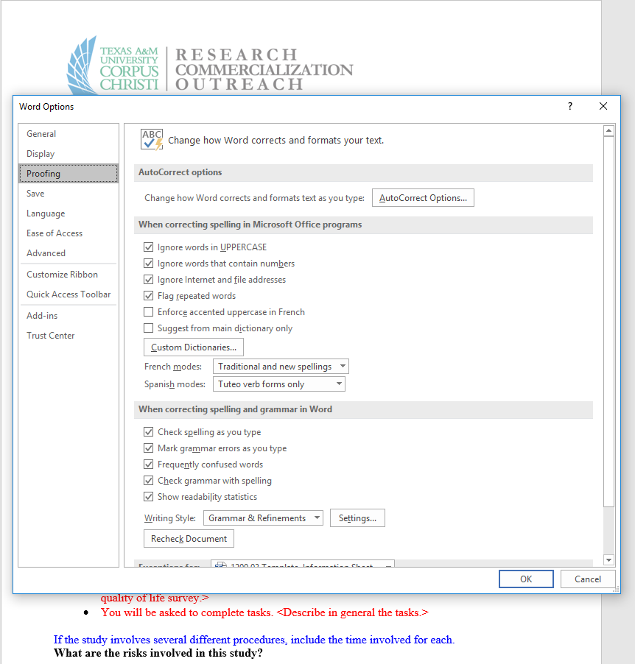
A Trick in Word: Check Readability Statistics
Under File, Go to the Options Menu
In the Options menu, Go to Proofing
Check “Show readability statistics”

Slide 20
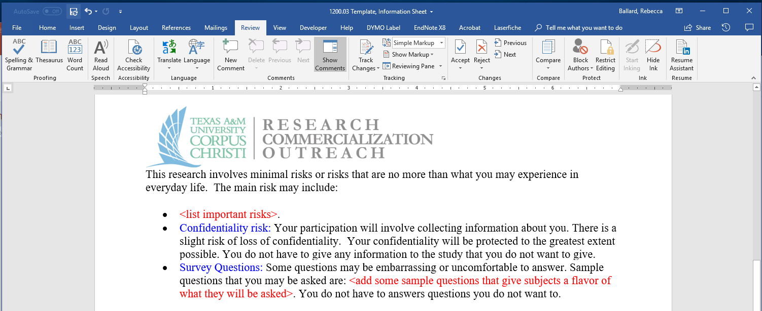
A Trick in Word: Check Readability Statistics
Under Review, Check Spelling.
Once the spell check is complete,
Word will provide readability statistics.
The grade level of your document is provided.

Slide 21
Informed Consent Process
Investigator will obtain the legally effective informed consent of the subject or LAR.
4
Subject/LAR has adequate opportunity to read the consent document before signing.
Notes:
More than just talking at them. Could miss key points.

Slide 22
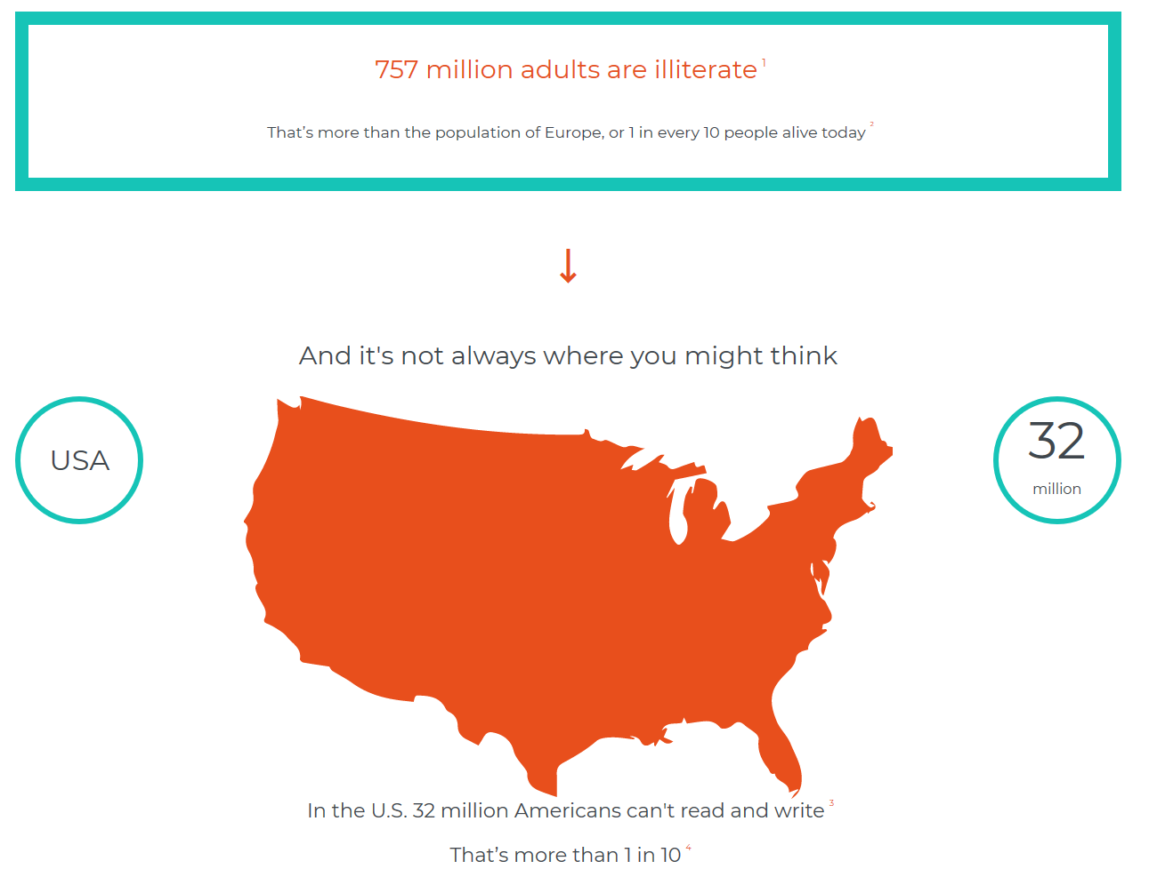
Literacy and Informed Consent
https://www.projectliteracy.com/you-wont-believe-how-many-people-cant-read-sentence
Notes:
https://www.youtube.com/watch?v=uLjniRfnbVk

Slide 23
Informed Consent Process
Investigator will obtain the legally effective informed consent of the subject or LAR.
5
A copy of the signed and dated consent form is given to subject/LAR.
Notes:
Why do you thing the regulations require a signed consent form be given? That seems very specific.
What is in the consent form?
Reminders of what the study is about.
Contact information of the investigators to call if something when wrong.
Also contact information of the IRB to report complaints.

Slide 24
Now that we have a good overview of the consent process, let’s take a look at the consent form.
Course Objectives :
General Overview of Informed Consent
Changes to the Informed Consent Form
Tiered Consent
New Elements to the Informed Consent Form
Broad Consent
Posting of Consent Forms

Slide 25
Revised Common Rule
Why the change?
1
Consent forms have evolved to protect institutions rather than to provide potential research subjects with the most important pieces of information
2
Growing body of literature that suggests informed consent forms
have grown too lengthy and complex, adversely affecting their ability to effectively convey the information needed for prospective participants to make an informed decision

Slide 26
Reasonable Person Standard
Subjects must be provided with the information that a “reasonable person” would want to have in order to make an informed decision and subjects must be provided an opportunity to discuss that information.
A
Reasonable
Person
45 CFR 46.116(a)(4) (1/19/2017)

Slide 27
Informed Consent Form
The revised Common Rule adds new elements to be included in the informed consent form.
A statement that the subject’s biospecimens (even if identifiers are removed) may be used for commercial profit and whether the subject will or will not share in this commercial profit (45 CFR 46.116(c)(7))
A statement regarding whether clinically relevant research results, including individual research results, will be disclosed to subjects, and if so, under what conditions (45 CFR 46.116(c)(8))
When appropriate for research involving biospecimens, subjects will be informed of whether the research will (if known) or might include whole genome sequencing (45 CFR 46.116(c)(9))
Notes:
added requirements to the informed consent process to increase
transparency so that potential subjects will have more information about how their biospecimens
or private information might be used.

Slide 28
Revised Common Rule Changes to Consent Form
Revised rule changes how information is presented. This new format has been described as “tiered consent”.
Information must be presented in sufficient detail, and must be organized and presented in a way that does not merely provide lists of isolated facts, but rather facilitates the prospective subject’s or legally authorized representative’s understanding of the reasons why one might or might not want to participate.
45 CFR 46.116(a)(1) (1/19/2017)
Informed consent begins with a concise and focused presentation of the key information that is most likely to assist a prospective subject or legally authorized representative in understanding the reasons why one might or might not want to participate in the research. This beginning portion must be organized and presented in a way that facilitates comprehension.
45 CFR 46.116(a)(1) (1/19/2017)
Notes:
recognition of complaints that consent
forms are too often complicated documents primarily used to protect sponsors from legal
liability, the NPRM proposed requiring that the information in these forms be organized and
presented in a way that does not merely provide lists of isolated facts, but rather facilitated the
prospective subject’s or representative’s understanding of the reasons why one might or might
not want to participate in the research.
41

Slide 29
Tiered Consent
Main Body
Appendix
Includes only the elements of informed consent that were required by the Common Rule
Any other information
Notes:
This change was intended to lead to substantially shorter “core” sections of consent
forms, with prospective subjects receiving the most important information in the body of these
relatively short forms, instead of that key information being buried in long and overly complex
documents. The final rule does not adopt a requirement that certain information be
included only in appendices.

Slide 30
Tiered Consent
Main Body
Appendix
A chart that shows study visits and the procedures that will occur at each study visit.
Notes:
The final rule does not adopt a requirement that certain information be
included only in appendices.

Slide 31
Tiered Consent
Main Body
Appendix
A chart that shows study visits and the procedures that will occur at each study visit.
Notes:
The final rule does not adopt a requirement that certain information be
included only in appendices.

Slide 32
Tiered Consent
Main Body
Appendix
A list of important risks that might be experienced if participating in the study
Notes:
The final rule does not adopt a requirement that certain information be
included only in appendices.

Slide 33
Tiered Consent
Main Body
Appendix
A list of important risks that might be experienced if participating in the study
Notes:
The final rule does not adopt a requirement that certain information be
included only in appendices.

Slide 34
Tiered Consent
Main Body
Appendix
A list of every possible risks that might be experienced if participating in the study
A list of every possible risks that might be experienced if participating in the study
Notes:
The final rule does not adopt a requirement that certain information be
included only in appendices.

Slide 35
Tiered Consent
Main Body
Appendix
A detailed description of how data will be protected
Notes:
The final rule does not adopt a requirement that certain information be
included only in appendices.

Slide 36
Tiered Consent
Main Body
Appendix
A detailed description of how data will be protected
Notes:
NPRM proposed that HIPAA was to be in the main body. Since the final rule did not adopt the specifics on what is required to be in the main body v. appendix, the final rule did not incorporate this requirement. Still unknown about HIPAA.

Slide 37
Tiered Consent
The final rule does not adopt a requirement that certain information be included only in appendices.
1
The fact that consent is being sought for research and that participation is voluntary.
2
The purposes of the research, the expected duration of the prospective subject’s participation, and the procedures to be followed in the research.
3
The reasonably foreseeable risks or discomforts to the prospective subject.
4
The benefits to the prospective subject or to others that may reasonably be expected from the research.
5
Appropriate alternative procedures or courses of treatment, if any, that might be
advantageous to the prospective subject.

Slide 38
What’s the guiding principle to decide?
The main body must encompass the key information most likely to assist a reasonable person (or legally authorized representative) in understanding the reasons why one might or might not want to participate in research.
A
Reasonable
Person
45 CFR 46.116(a)(4) (1/19/2017)

Slide 39
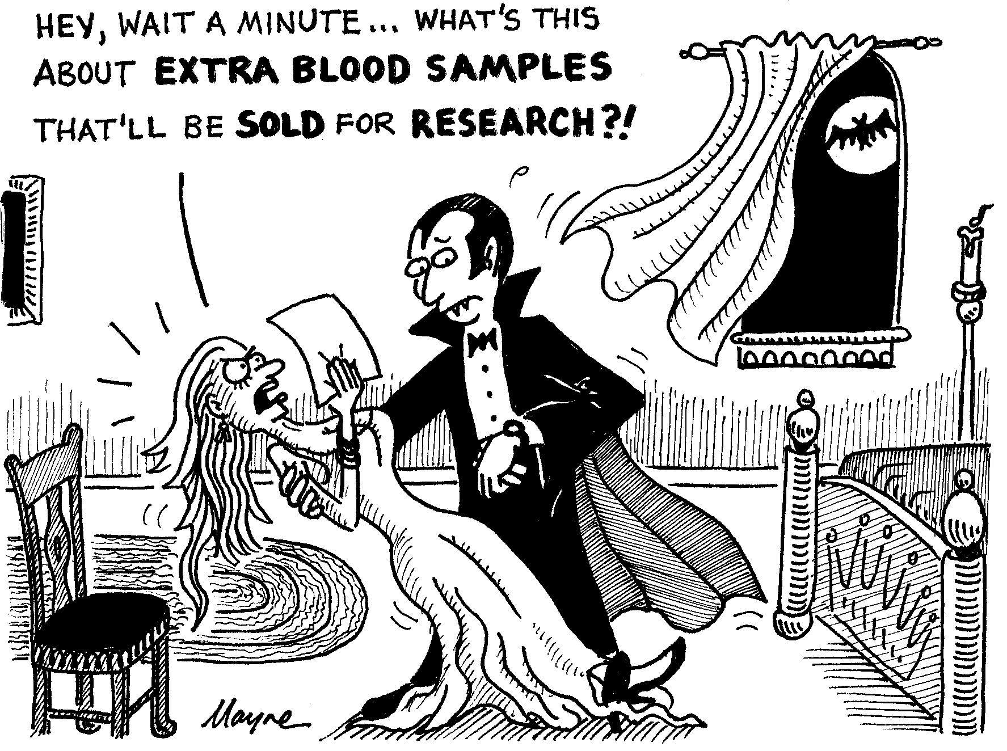
Broad Consent
The revised Common Rule also introduces a new concept for consent called “Broad Consent”.
Broad consent is permissible only for secondary research.
Revised Common Rule gives a set of required elements that must be included in the Broad Consent.
IRB is expected to determine whether the type of research to be conducted is within the scope of the broad consent obtained to permit secondary research.

Slide 40
In this session, we will review changes to informed consent.
Course Objectives :
General Overview of Informed Consent
Changes to the Informed Consent Form
Tiered Consent
New Elements to the Informed Consent Form
Broad Consent

