Slide 1








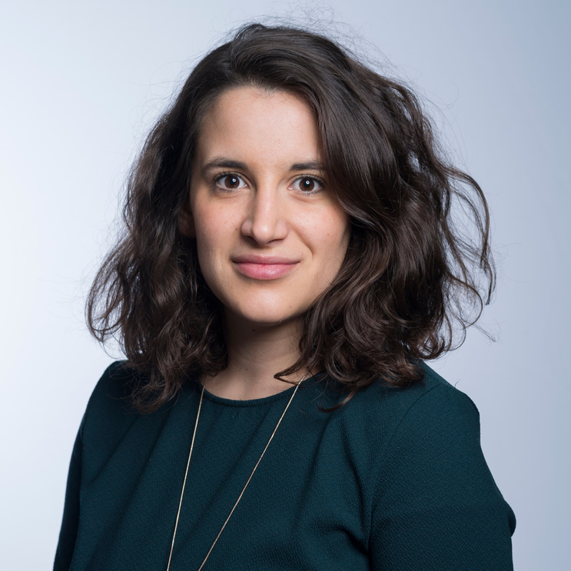


JOIN OUR
RESEARCH STUDY
You're Invited to Participate in a Research Study
STUDY TITLE
[study_title]
STUDY OBJECTIVES
TO PARTICIPATE
We invite you to participate in a research study aimed at [project_objectives].
To schedule your interview time: [link/QR code]
STUDY PROCEDURES
You will be interviewed by the study team.
To help us take notes, your interview will be recorded.
Once transcribed, the recording is deleted and your interview de-identified.
The interview will take approximately [project_duration]
QUESTIONS?
PARTICIPATION IS VOLUNTARY.
You can withdraw at any time.
[PI NAME]
Thank you in advance for considering participating. Your contributions make a difference!
Principal Investigator
Texas A&M University-Corpus Christi
6300 Ocean Drive
Corpus Christi, TX 78412
Email:
Phone:

