Slide 1
Do I need IRB Review?: Submitting a Human Research Determination Form
Rebecca Ballard, JD, MA, CIP April 27, 2021
Director, Research Compliance

Slide 2
Welcome!
I’ll be guiding you through today’s course objectives.
Understanding when IRB Review is Required
How to submit a request to determine if your project needs IRB review via iRIS.

Slide 3
Federal regulations gives us various levels of IRB review.
Labels are used to describe the review process the study will undergo.
Not Human Subjects Determination
Exempt
More extensive the review process
Limited IRB Review
(2018 Requirement)
Expedited
Full Committee

Slide 4
The further down the triangle, the greater the review required.
Not Human Subjects Determination
Can be reviewed by non-voting member
Exempt
More extensive the review process
Limited IRB Review
(2018 Requirement)
Reviewed by an experienced voting member
Expedited
Must be reviewed at a meeting with a majority of members
Full Committee

Slide 5
Do I need IRB review?
To require IRB review, the project most both be research and involve human subjects.
Not Human Subjects Determination
Exempt
Limited IRB Review
Expedited
Full Committee
The Common Rule
45 CFR 46
“All research involving human subjects conducted, supported or otherwise subject to regulation by any Federal Department or Agency.”
45 CFR 46.101(a)
Research
+
Human Subjects
=
IRB Jurisdiction

Slide 6
Not Human Subject Determinations
If the project does not fit the definition of research,
IRB review is not required.
Not Human Subjects Determination
Exempt
Limited IRB Review
Expedited
Full Committee
The Common Rule
45 CFR 46
“All research involving human subjects conducted, supported or otherwise subject to regulation by any Federal Department or Agency.”
45 CFR 46.101(a)
Research
+
Human Subjects
=
IRB Jurisdiction

Slide 7
Not Human Subject Determinations
Likewise, if the project does not involve human subjects, IRB review is not required.
Not Human Subjects Determination
Exempt
Limited IRB Review
Expedited
Full Committee
The Common Rule
45 CFR 46
“All research involving human subjects conducted, supported or otherwise subject to regulation by any Federal Department or Agency.”
45 CFR 46.101(a)
Research
+
Human Subjects
=
IRB Jurisdiction

Slide 8
Not Human Subject Determinations
A Not Human Subject Determination is a finding that your project does not fit within the regulations that require IRB review.
Not Human Subjects Determination
Exempt
Limited IRB Review
Expedited
Full Committee
The Common Rule
45 CFR 46
Not Human Subjects Determination
Projects not involving research
Projects not involving human subjects
“All research involving human subjects conducted, supported or otherwise subject to regulation by any Federal Department or Agency…”
45 CFR 46.101(a) (1/19/2017)
Your Project if Determined not to Involve Research or Human Subjects
The Regulation Requiring IRB Review

Slide 9
Now that you have a understanding of when IRB review is required.
Let’s move on to our second objective.
Understanding when IRB Review is Required
How to submit a request to determine if your project needs IRB review via iRIS

Slide 10
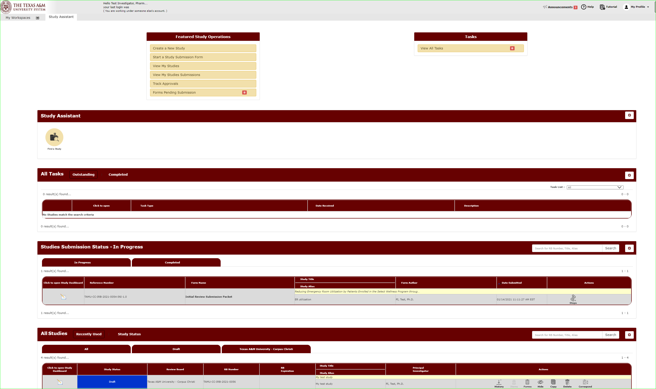
You will manage all your studies through the Study Assistant Workspace.
You will be taken to the Study Assistant Workspace once you login.

Slide 11
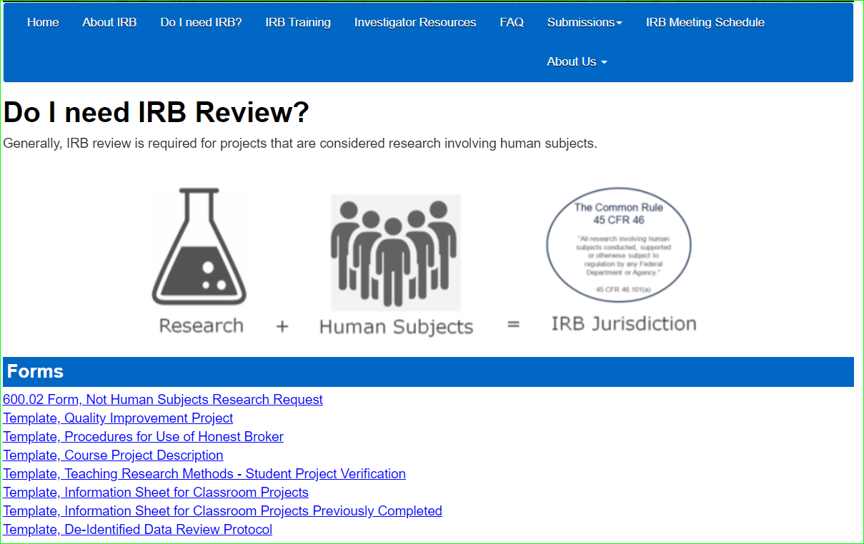
Submission Packet
The completed submission packet, and ultimately our approved protocol, consists of several parts:
The Study Application
Supporting Documents
Project protocols
Information sheet for class projects
You can find templates for supporting documents on the IRB website.

Slide 12
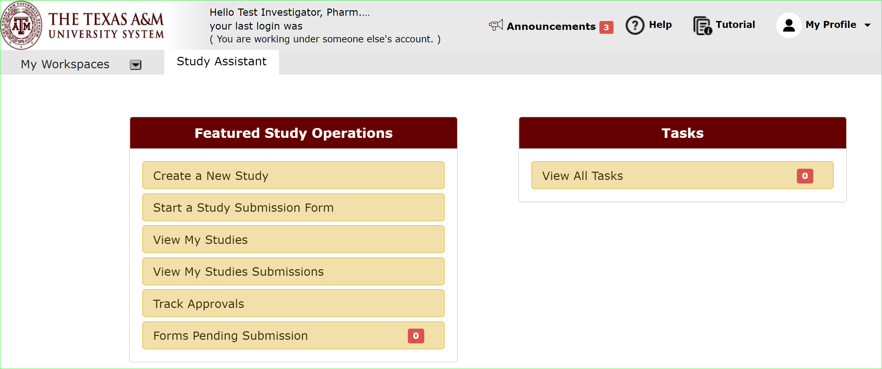
Let’s begin a new submission.
On the Study Assistant Workspace, Click “Create a New Study” to open the Study Application form.

Slide 13
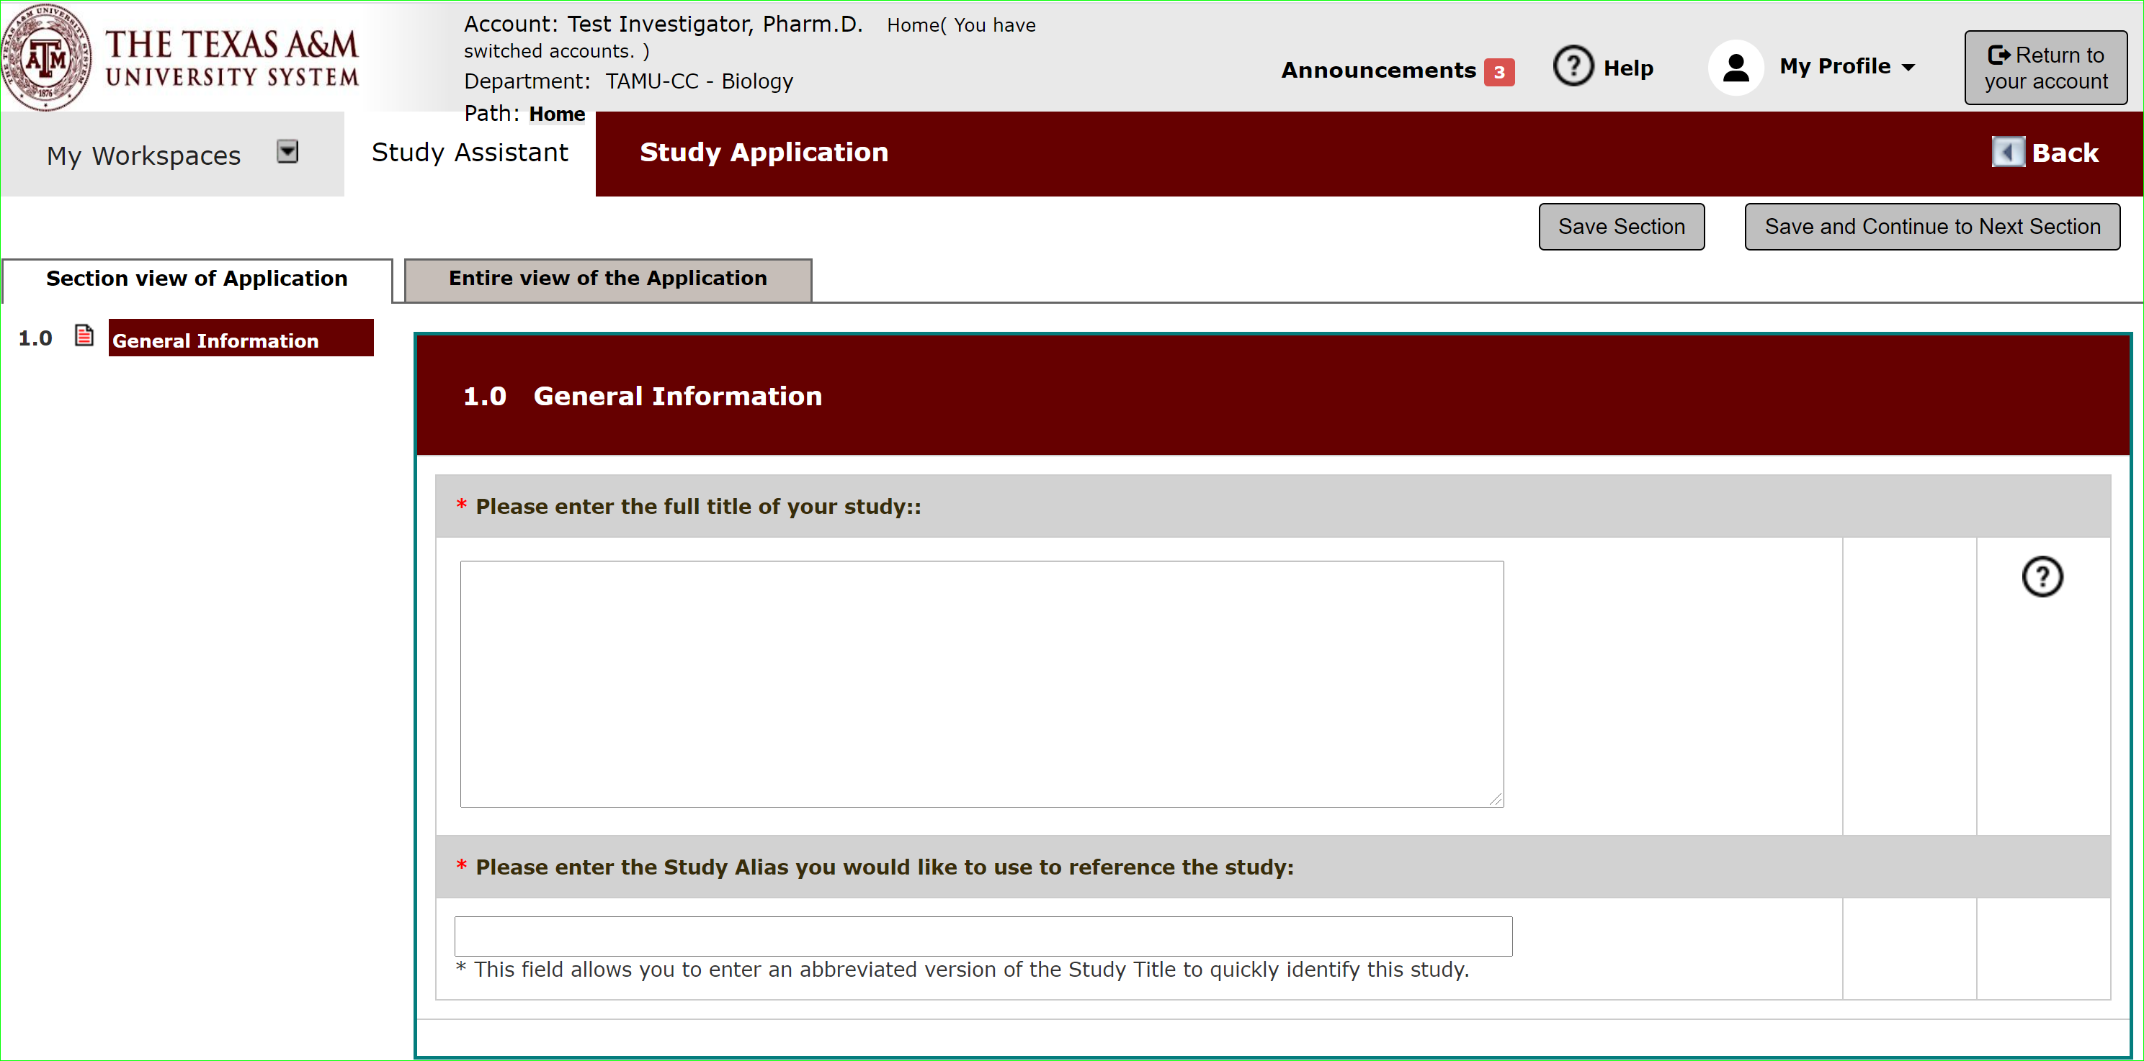
Begin filling out the form.
Hit save and continue to the next section to proceed through the form.

Slide 14
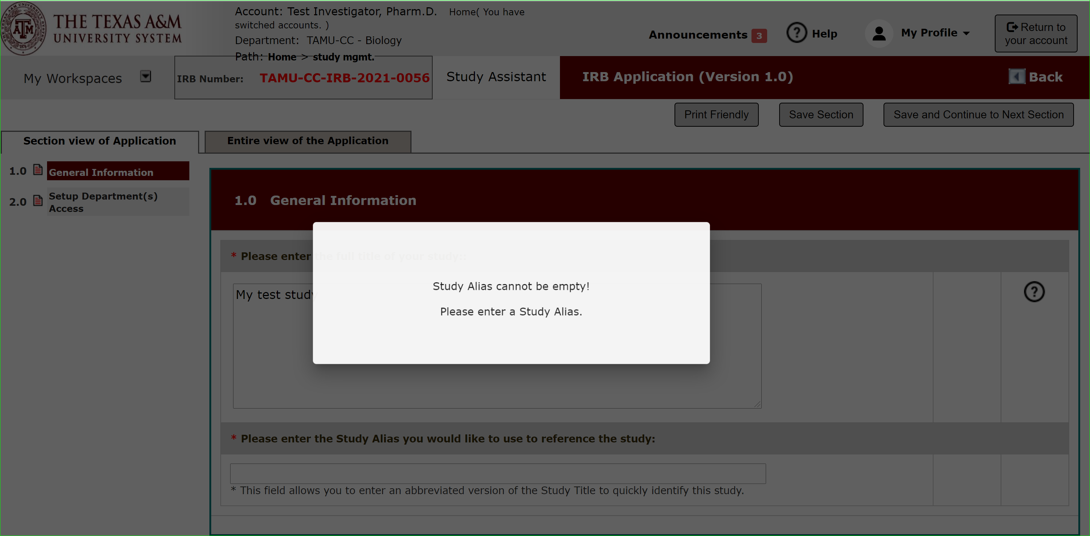
Begin filling out the form.
Fields with an asterisk are required fields.
An error message will appear if left blank.

Slide 15
Section 2.0: Department Access
This section associates your study with your department.
This allows departments to run reports on studies within their area.
The department listed on the author’s profile will be added as a default department.
But the default can be changed, or additional departments added.

Slide 16
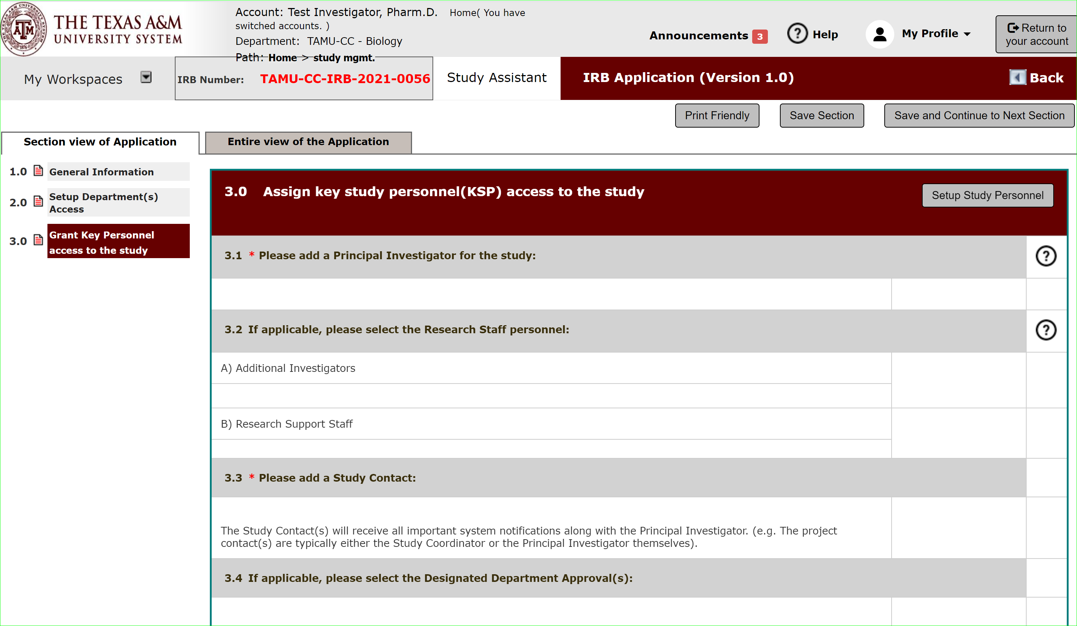
Section 3.0: Grant Key Personnel access
This section allows you to list personnel and indicate what level of access you want them to have on your application.

Slide 17
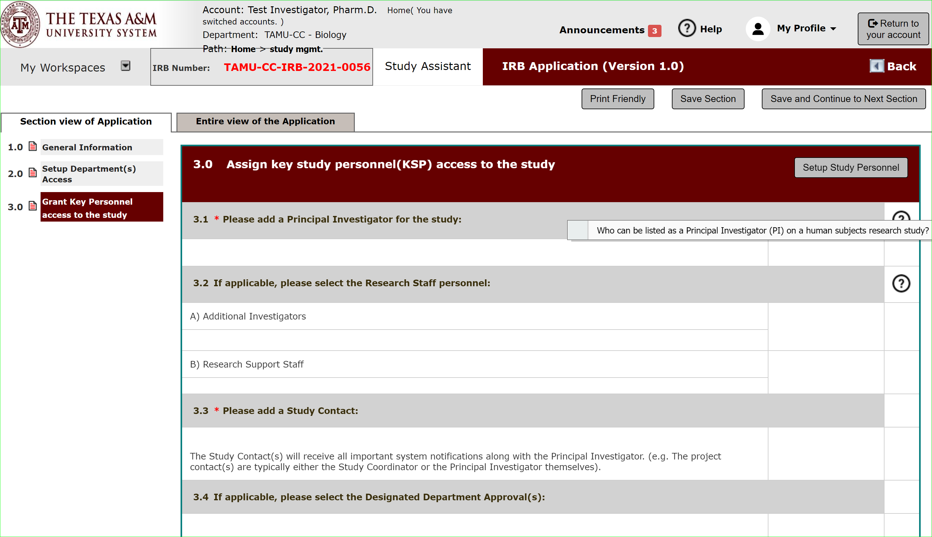
System Feature: Help Text
The application will feature help text to assist you in filling out the application form.
Click the ? Icon to open.

Slide 18
Section 3.0: Grant Key Personnel access
Click “Setup Study Personnel” to be able to add personnel to your application.

Slide 19
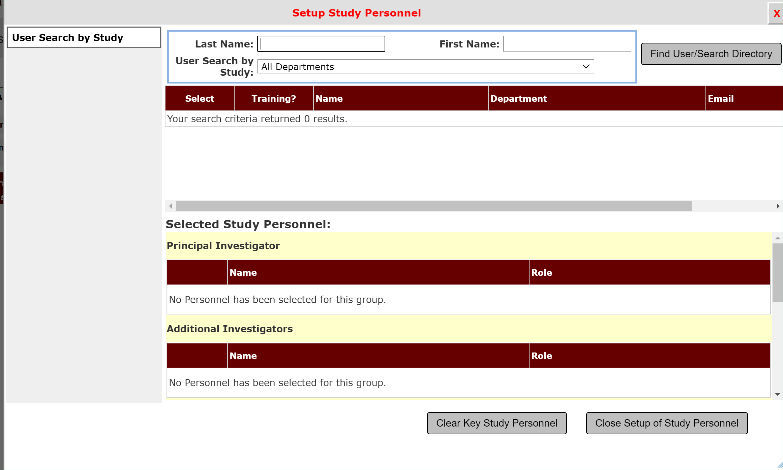
Section 3.0: Setup Study Personnel
Use the search feature to find personnel to add to your study.

Slide 20
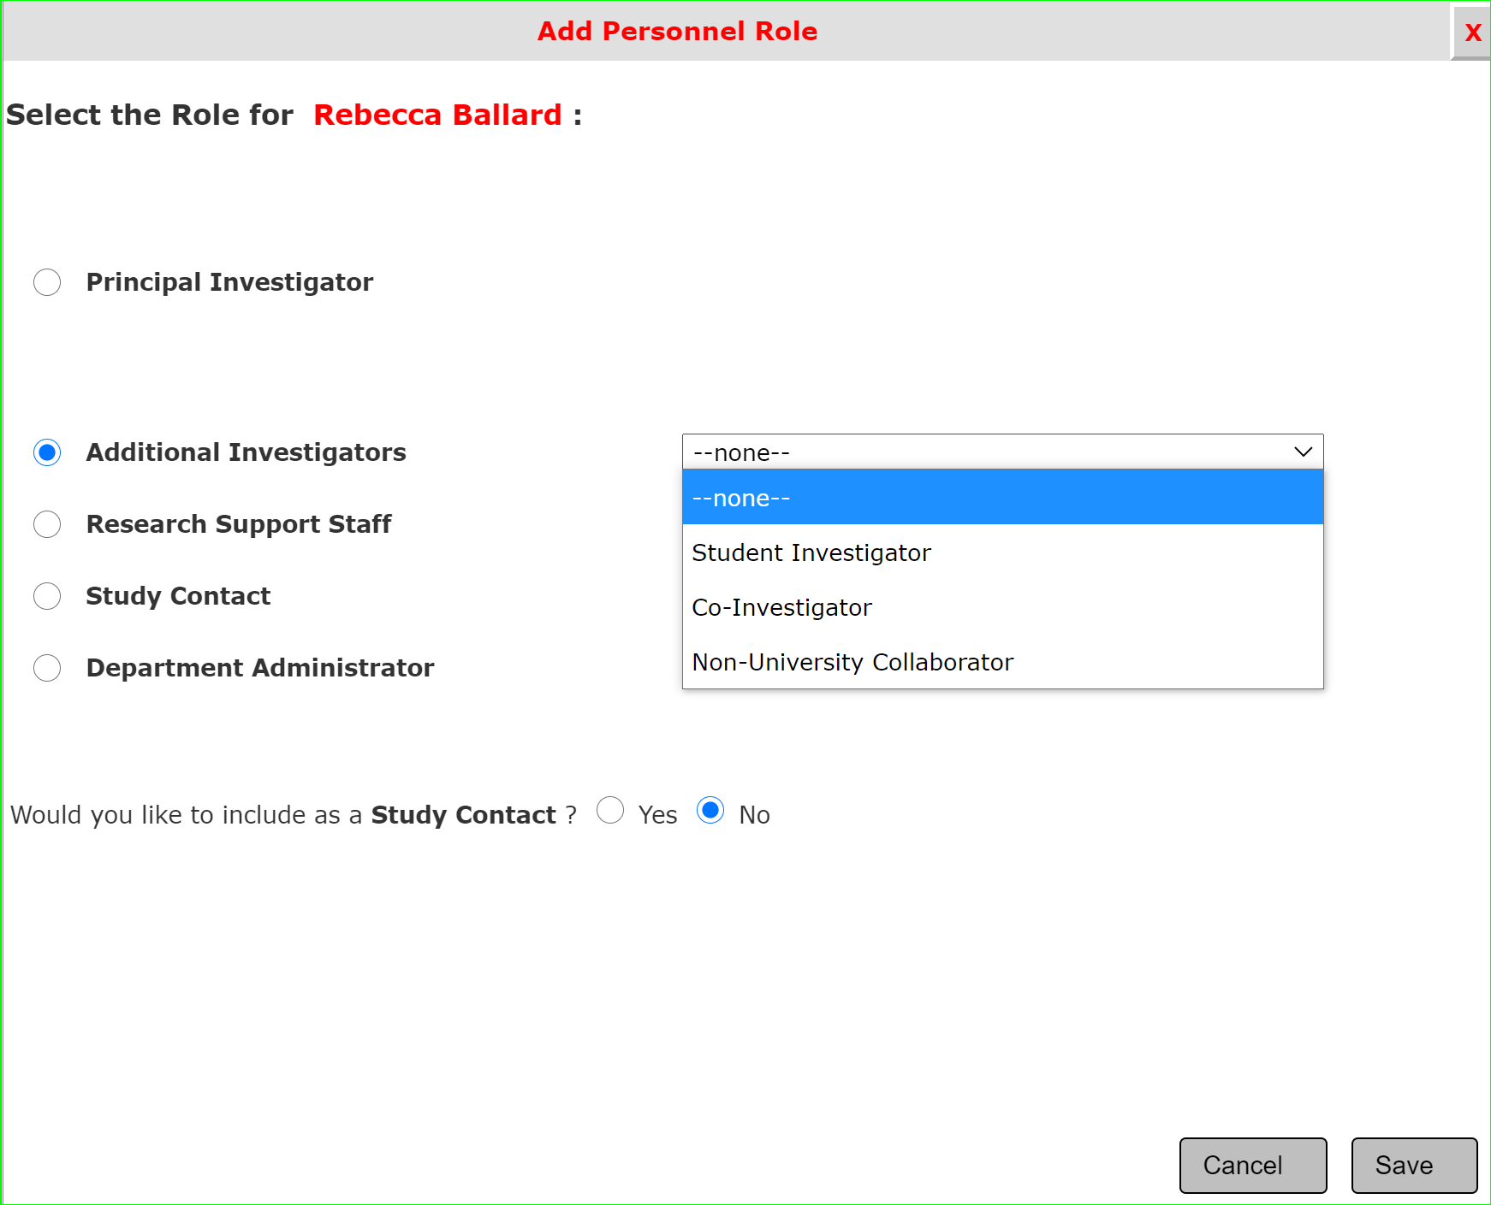
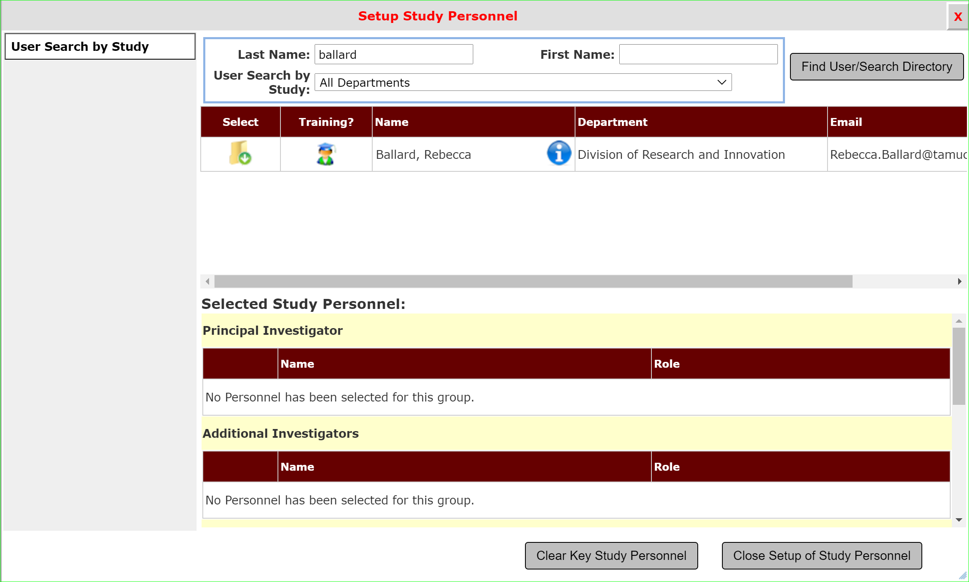
Section 3.0: Setup Study Personnel
Click “Select” to open the window to indicate the role of the individual.

Slide 21
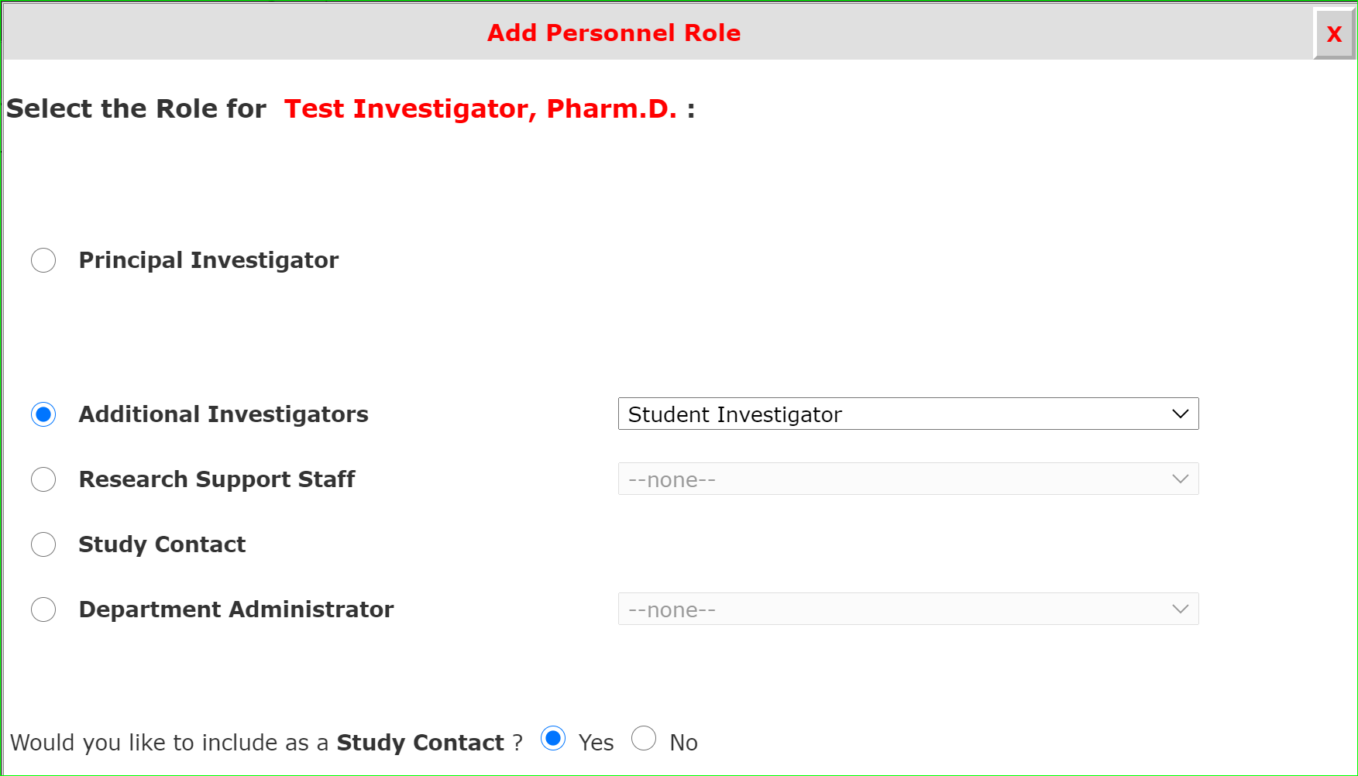
System Feature: Who Receives Notifications?
Who receives notifications is in your control.
Study contacts will receive all notifications just like the PI.
If you want the person to receive notifications select “Yes” here.

Slide 22
What if I can’t find the person in the search directory?
To be in the directory the individual must have an iRIS account and profile.
How do I get an iRIS account?
Login to iRIS through SSO.
Go to: https://research.tamucc.edu/compliance/home/index.html to access the iRIS login page.

Slide 23
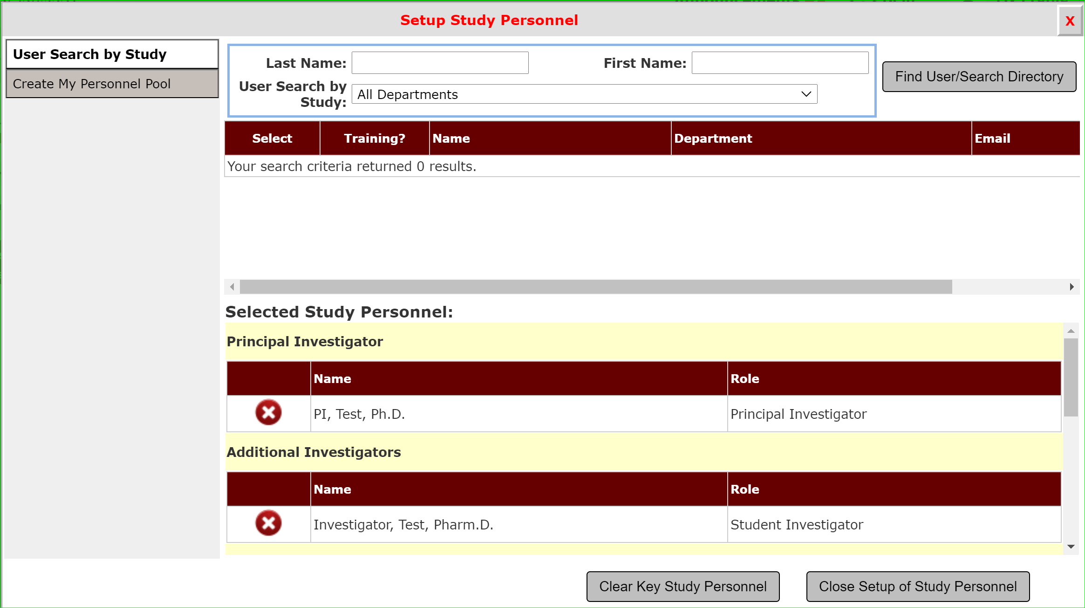
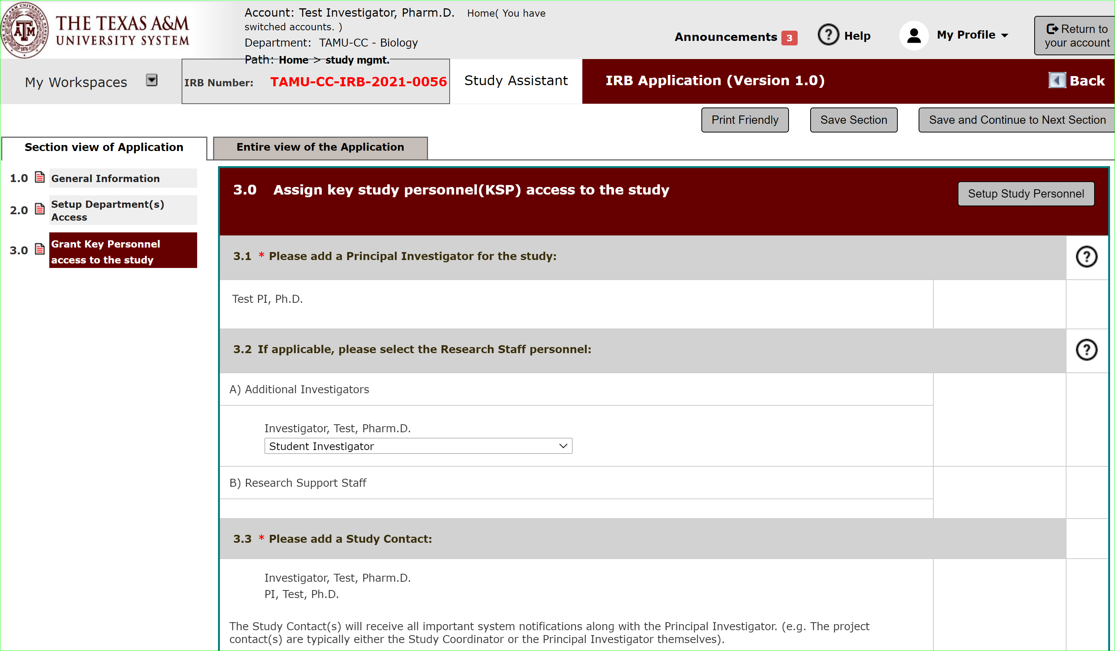
Section 3.0: Setup Study Personnel Completed
Once all individuals are set up as study personnel, select “Close setup of Study Personnel” to return to the application.

Slide 24
Section 4: Submission Type
Section 4.0 is a major branching point in the application.
For a determination as to whether your project requires IRB review, select submission type “Human Research Determination”.

Slide 25
The Human Research Determination Submission Type determine if your projects fit here in the schematic of IRB review levels.
Not Human Subjects Determination
Exempt
More extensive the review process
Limited IRB Review
(2018 Requirement)
Expedited
Full Committee

Slide 26
Remaining Application Sections
Continue through the application until all sections are completed.
The study application is composed of several sections.
iRIS uses smart form logic.
Questions with “branching” logic will trigger the hide/show feature that will hide or show additional questions or sections based on your answers.
Questions marked with an asterisk (*) must be answered. If they are not answered, you will receive an error message.
Help Text: Questions with an icon on the right have help text available to provide definitions of key terms, additional explanation on the question topic, suggestions or examples to assist you in responding to the questions.

Slide 27
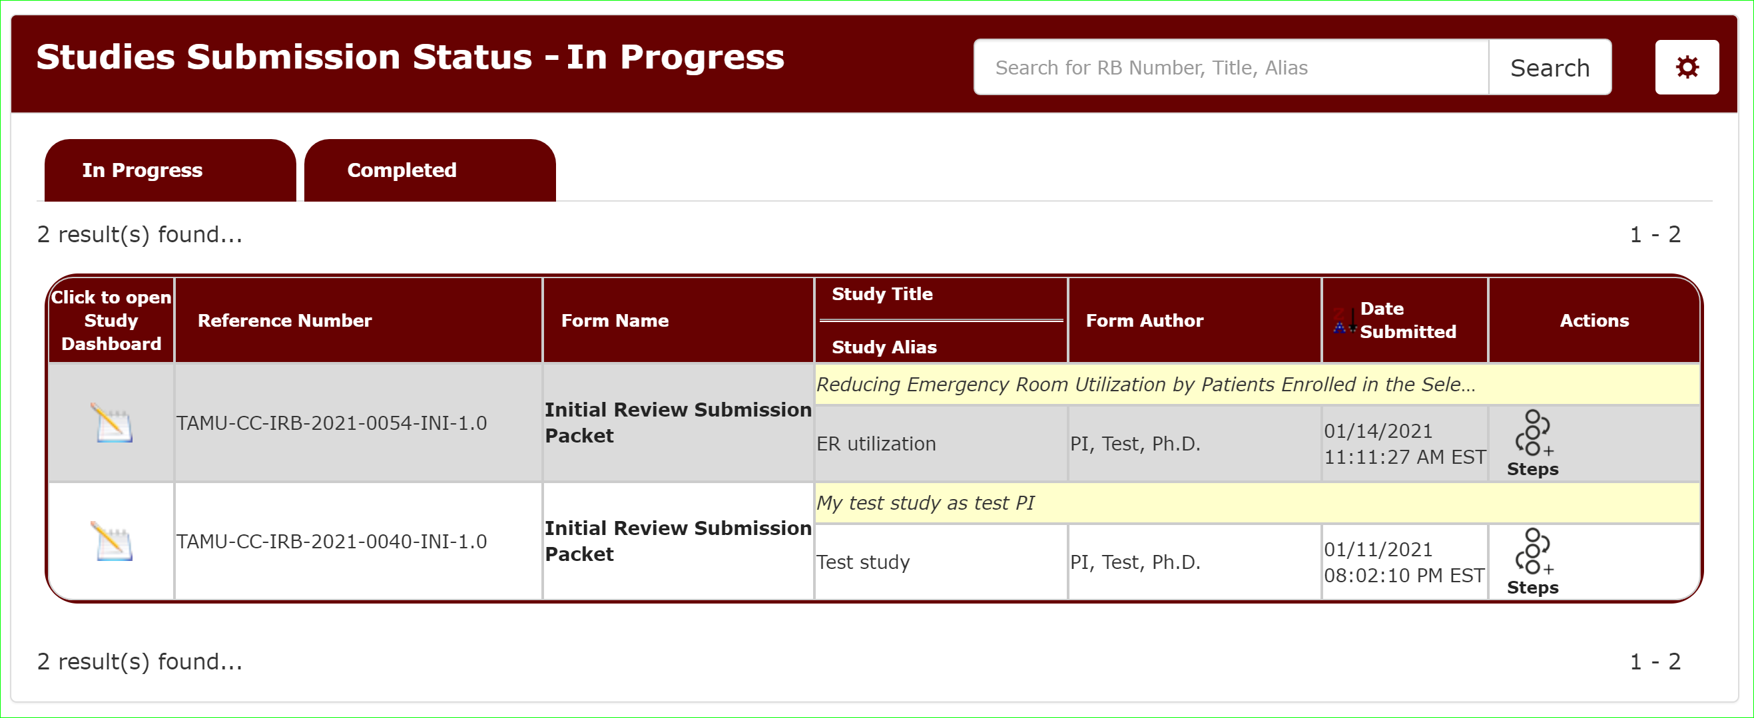
What if I need to finish my application later?
You can view your submissions in progress from the Study Assistant Dashboard.
Click the paper/pencil icon to open the study submission.

Slide 28
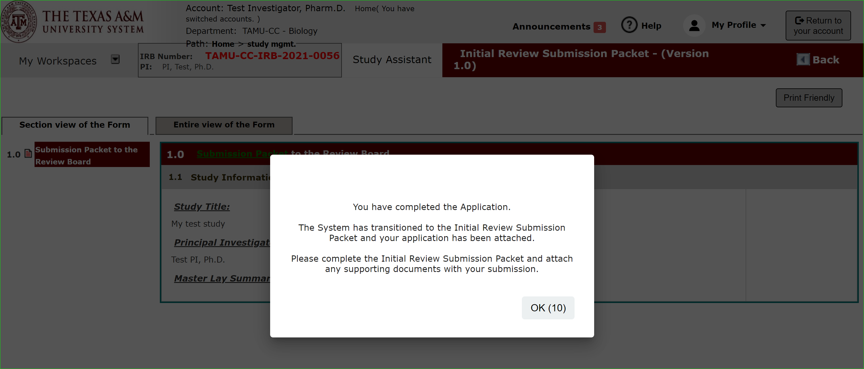
Application Complete
Once you have completed the application portion of the submission packet, you will see this message.

Slide 29
Submission Packet
You will automatically be taken to the submission packet to upload documents related to your application.
The Initial Review Submission Packet “packages” the Application and documents together for submission.

Slide 30
Submission Packet: Study Application
Section 2.0 Displays the Application form you just filled out.
You can view/edit the IRB Application form.
Or hit save and continue to the next section to upload your supporting documents.

Slide 31
Add Documents
Upload supporting documents in Other Attachments.

Slide 32
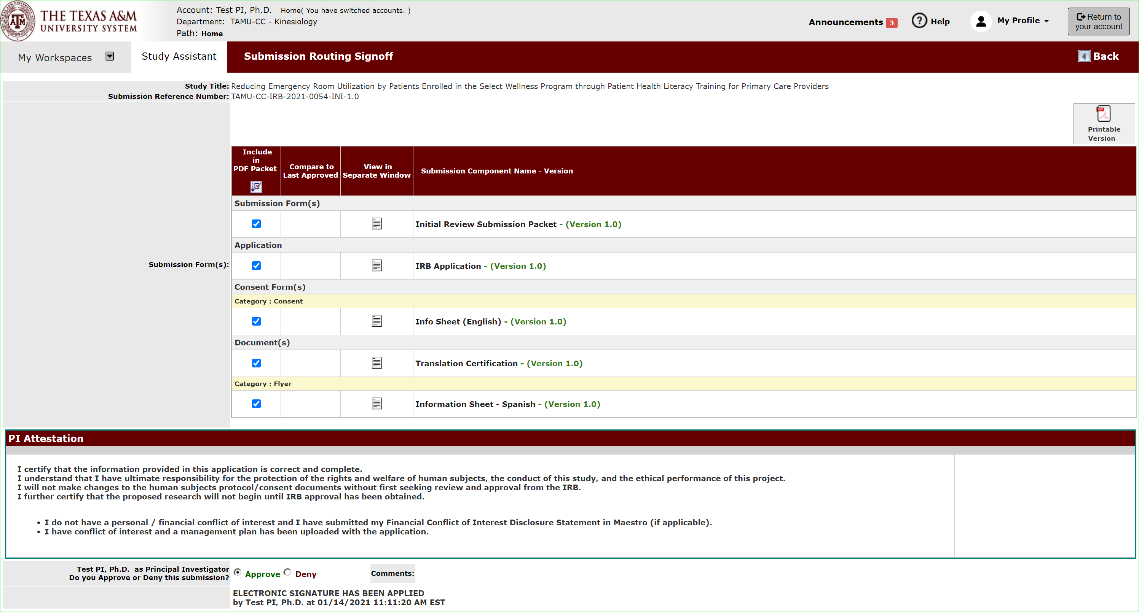
PI Sign-off and Submit
Once complete the PI will click “sign-off” and be presented with the attestation page for sign-off.

Slide 33
PI Sign-off and Submit
Only the Principal Investigator can execute the sign-off and submit action.
If you are not the PI, then select “notify PI to Signoff” once completed and ready for submission.

Slide 34
What happens if my project requires IRB Review?
The IRB staff will review the application.
If they have questions they will contact you or send the application back to you with those questions for you to respond.
If after the questions are answered the determination is your project requires IRB review you will be notified in iRIS.

Slide 35
At this point you will return to the application and select IRB Application as the study type.

Slide 36
Changing your answer in Section 4.0, Submission Type will route you through the IRB Application form to consider whether the submission is exempt.
Not Human Subjects Determination
Exempt
More extensive the review process
Limited IRB Review
(2018 Requirement)
Expedited
Full Committee

Slide 37
What happens if my project does NOT IRB Review?
You will get an outcome letter sent to you from iRIS informing you that your project does NOT require IRB review.
You may then proceed to conduct your project as described.

Slide 38
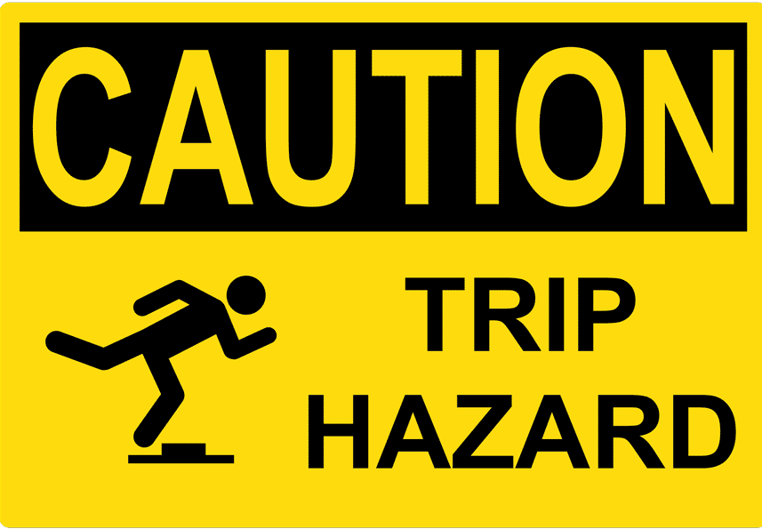
Not Human Subjects Determination
Some Limitations to this Determination to be Aware of
Exempt
Limited IRB Review
Expedited
Full Committee
Remember the limits of this determination to avoid any issue with non-compliance. The decision made was that your project was outside the scope of the regulations requiring IRB review.
For this reason:
The project may NOT be referred to as human subjects research (because it is not).
And cannot be referred to as “IRB Approved” (because it wasn’t).

Slide 39
Course Objectives:
Conclusion
Understanding when IRB Review is Required
How to submit a request to determine if your project needs IRB review via iRIS.

