Slide 1
Quality Improvement v. Research
Defining when IRB review is required
Rebecca Ballard, JD, MA, CIP June 10, 2019
Director, Research Compliance

Slide 2
Welcome!
I’ll be guiding you through today’s course objectives.
Defining Research
Understanding the distinction between Quality Improvement and Research

Slide 3
Federal regulations gives us various levels of IRB review.
Labels are used to describe the review process the study will undergo.
Not Human Subjects Determination
Exempt
More extensive the review process
Limited IRB Review
(2018 Requirement)
Expedited
Full Committee

Slide 4
The further down the triangle, the greater the review required.
Not Human Subjects Determination
Can be reviewed by non-voting member
Exempt
More extensive the review process
Limited IRB Review
(2018 Requirement)
Reviewed by an experienced voting member
Expedited
Must be reviewed at a meeting with a majority of members
Full Committee

Slide 5
Not Human Subject Determinations
The Common rule applies to research involving human subjects.
Projects not fitting within this definition do not require IRB review.
Not Human Subjects Determination
Exempt
Limited IRB Review
Expedited
Full Committee
Not Human Subjects Determination
Projects not involving research
Projects not involving human subjects
The Common Rule
45 CFR 46
“All research involving human subjects conducted, supported or otherwise subject to regulation by any Federal Department or Agency.”
45 CFR 46.101(a)

Slide 6
Not Human Subject Determinations
To require IRB review, the project most both be research and involve human subjects.
Not Human Subjects Determination
Exempt
Limited IRB Review
Expedited
Full Committee
The Common Rule
45 CFR 46
“All research involving human subjects conducted, supported or otherwise subject to regulation by any Federal Department or Agency.”
45 CFR 46.101(a)
Research
+
Human Subjects
=
IRB Jurisdiction

Slide 7
Not Human Subject Determinations
If the project does not fit the definition of research,
IRB review is not required.
Not Human Subjects Determination
Exempt
Limited IRB Review
Expedited
Full Committee
The Common Rule
45 CFR 46
“All research involving human subjects conducted, supported or otherwise subject to regulation by any Federal Department or Agency.”
45 CFR 46.101(a)
Research
+
Human Subjects
=
IRB Jurisdiction

Slide 8
Not Human Subject Determinations
Likewise, if the project does not involve human subjects, IRB review is not required.
Not Human Subjects Determination
Exempt
Limited IRB Review
Expedited
Full Committee
The Common Rule
45 CFR 46
“All research involving human subjects conducted, supported or otherwise subject to regulation by any Federal Department or Agency.”
45 CFR 46.101(a)
Research
+
Human Subjects
=
IRB Jurisdiction

Slide 9
Defining Research
While FDA and DHHS define clinical trials differently, both agree clinical trials are considered research.
FDA | DHHS
FDA has defined "clinical investigation" to be synonymous with "research". "Clinical investigation" means any experiment that involves a test article and one or more human subjects, and that either must meet the requirements for prior submission to the FDA...or the results of which are intended to be later submitted to, or held for inspection by, the FDA as part of an application for a research or marketing permit. 21 CFR 56.102; 21 CFR 50.2 | Clinical trial means a research study in which one or more human subjects are prospectively assigned to one or more interventions (which may include placebo or other control) to evaluate the effects of the interventions on biomedical or behavioral health-related outcomes. 45 CFR 45.102(b)(1/19/2017)

Slide 10
Defining Research for Non-Clinical Trials
Research means
A systematic investigation, including research development, testing and evaluation, designed to develop or contribute to generalizable knowledge.
45 CFR 46.102(d)(pre-2018)/45 CFR 46.102(l)(1/19/2017)

Slide 11
Defining Quality Improvement
Quality Improvement Projects
Systematic, data-guided activities designed to bring about immediate improvements in health delivery in particular settings."
Working group from the Hastings Center

Slide 12
Quality Improvement v. Research
Quality improvement and research share many features.
Systematic evaluation
Data-driven
Involves human participants
Uses data to answer questions
Societal benefit
May share results
Use data collection tools like surveys

Slide 13
Quality Improvement Projects are Often Determined Not to be Research
Quality improvement projects are focused on monitoring a process/policy in place to determine if it reaching a target or measurable goal.
Select why quality Improvement projects not considered research?
1
A QI project does not contribute to generalizable knowledge.
2
A QI project is not a systematic investigation.
3
A QI project does not involve testing.

Slide 14
Quality Improvement Projects are Often Determined Not to be Research
Quality improvement projects are focused on monitoring a process/policy in place to determine if it reaching a target or measurable goal.
QI projects are aimed at promoting adherence to or implementing a best practice.
That’s right!
QI projects are internally focused and may not be transferrable knowledge outside the local setting.
This does not satisfy the ”contributing to generalizable knowledge” criteria.
Publishing one’s experience in promoting a best practice alone does not necessarily make a QI project research, requiring IRB review.
Select why quality Improvement projects not considered research?
1
A QI project does not contribute to generalizable knowledge.
2
A QI project is not a systematic investigation.
3
A QI project does not involve testing.
Next >

Slide 15
Quality Improvement Projects
A key distinction is that the QI process involves evaluating and learning from one’s experience.
The project is internally focused.

Slide 16
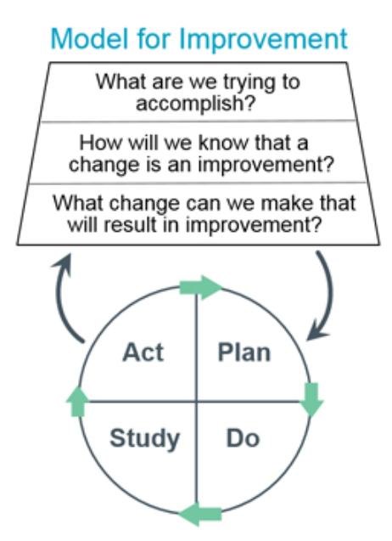
Quality Improvement Projects
Another key distinction is the activities are continuous in nature. Data collected is fed directly back into the process to drive change.
http://www.ihi.org/resources/Pages/HowtoImprove/default.aspx

Slide 17
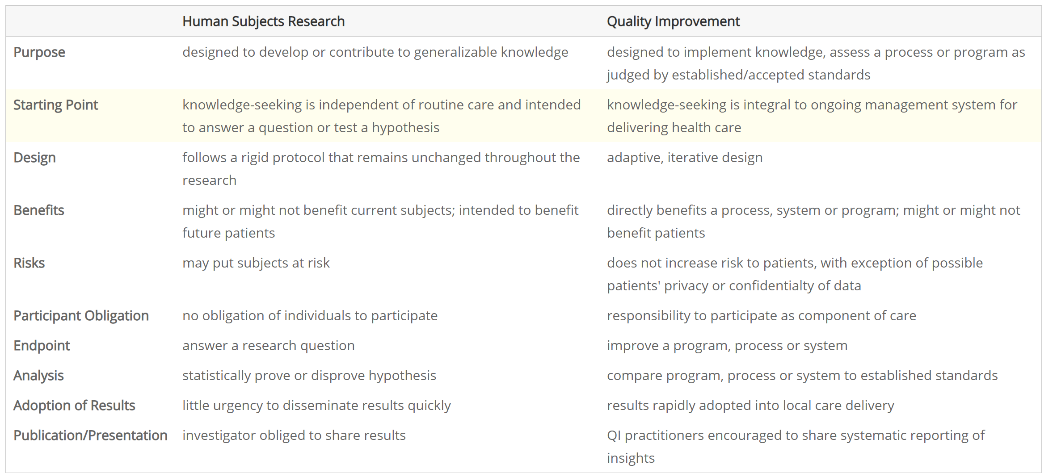
How does QI differ from research?
https://irb.research.chop.edu/quality-improvement-vs-research

Slide 18
When is IRB approval needed for QI activities?
IRB approval would be required when the QI project includes research elements.
If the project seeks to develop new knowledge or validate new treatments rather than to assess current practice, then IRB review is required.

Slide 19
Qualities of a Quality Improvement Project
To be a quality improvement project, activities must be limited to:
Assessing and ensuring compliance with standard or regulation
Monitoring a process that is in place to see if it is reaching a measurable goal
Implementing a practice to improve quality of care
Collecting patient or provider data for clinical, practical, or administrative uses.

Slide 20
Read the description below. Click “thumbs up” if the project is a Quality Improvement Project. Click “thumbs down” if research.
Quality Improvement or Research?
Is this quality improvement?
The emergency department (ED) is a highly complex environment with frequent interruptions. While some of these interruptions are time-critical communication events others are non-critical communication events such as a diet order for a patient. There is currently no other means to communicate these non-critical events.
We will develop and test a new tool for interruption management in the ED. The purpose of the project is to evaluate the usability and effectiveness of the interruption management prototype tool of non-critical physician tasks. Feedback from the usability testing will be analyzed and enhancements will be made to the interruption management prototype tool.

Slide 21
Read the description below. Click “thumbs up” if the project is a Quality Improvement Project. Click “thumbs down” if research.
Quality Improvement or Research?
That’s right!
This is research.
Some key clues is that this is a “new tool” and there are no current standards. The intent here is to gather data to validate the new tool.
Is this quality improvement?
The emergency department (ED) is a highly complex environment with frequent interruptions. While some of these interruptions are time-critical communication events others are non-critical communication events such as a diet order for a patient. There is currently no other means to communicate these non-critical events.
We will develop and test a new tool for interruption management in the ED. The purpose of the project is to evaluate the usability and effectiveness of the interruption management prototype tool of non-critical physician tasks. Feedback from the usability testing will be analyzed and enhancements will be made to the interruption management prototype tool.
Next >

Slide 22
Read the description below. Click “thumbs up” if the project is a Quality Improvement Project. Click “thumbs down” if research.
Quality Improvement or Research?
Is this quality improvement?
SCRCSP is a preventive screening program. In 2016, The Center for Disease Control (CDC) and the New Hampshire Colorectal Cancer Screening Program (NHCRCSP) developed a Patient Navigation (PN) Model for Increasing Colonoscopy Quality and Completion: A Replication Manual. The manual provides replicable evidence based tools and specific information on implementing a patient navigation program to improve CRC screening.
The goal of this project is to implement and evaluate the SCRCSP and nurse navigation services. The project will measure the number of patients who complete CRC screening and utilize nurse navigation services in overcoming barriers to care. Primary outcomes are to improve screening rates after the SCRCSP intervention, increase access to CRC preventive screening and risk assessment, and increase the number of patients who complete CRC screening and utilize nurse navigation services in overcoming barriers to care.

Slide 23
Read the description below. Click “thumbs up” if the project is a Quality Improvement Project. Click “thumbs down” if research.
Quality Improvement or Research?
That’s right!
This is quality improvement.
The outcomes are focused on implementing and measuring the success of an already proven method. Unlike the previous example, they are not trying to establish the efficacy of this tool.
Is this quality improvement?
SCRCSP is a preventive screening program. In 2016, The Center for Disease Control (CDC) and the New Hampshire Colorectal Cancer Screening Program (NHCRCSP) developed a Patient Navigation (PN) Model for Increasing Colonoscopy Quality and Completion: A Replication Manual. The manual provides replicable evidence based tools and specific information on implementing a patient navigation program to improve CRC screening.
The goal of this project is to implement and evaluate the SCRCSP and nurse navigation services. The project will measure the number of patients who complete CRC screening and utilize nurse navigation services in overcoming barriers to care. Primary outcomes are to improve screening rates after the SCRCSP intervention, increase access to CRC preventive screening and risk assessment, and increase the number of patients who complete CRC screening and utilize nurse navigation services in overcoming barriers to care.
Next >

Slide 24
The Publication Myth
Publication does not make a project research, requiring IRB review.
“Intent to publish is an insufficient criterion for determining whether a quality improvement activity involves research.
The regulatory definition under 45 CFR 46.102(d) is “Research means a systematic investigation, including research development, testing and evaluation, designed to develop or contribute to generalizable knowledge.”
Planning to publish an account of a quality improvement project does not necessarily mean that the project fits the definition of research; people seek to publish descriptions of non-research activities for a variety of reasons, if they believe others may be interested in learning about those activities.
Conversely, a quality improvement project may involve research even if there is no intent to publish the results.
OHRP, FAQ, http://www.hhs.gov/ohrp/qualityfaq.html

Slide 25
The Publication Myth
There is much to be learned from a shared experience. QI projects can be published without prior IRB review.
Referring to the Project as Research
QI Projects cannot be represented as “research”.
No use of the word “research” is allowed since labeling a project conducted under these parameters as “research” is inaccurate and misleading.

Slide 26
Publication Reference
If the project was not submitted to the IRB for determination, the following statement may be included in the manuscript: “This project was undertaken as a Quality Improvement Initiative and as such does not constitute human subjects research.”
If the project was reviewed by the IRB and was determined not to be human subjects research, the following statement can be included in the manuscript: “This Quality Improvement Initiative was reviewed and determined to not meet the criteria for human subjects research by the TAMU-CC Institutional Review Board.”

Slide 27
Course Objectives:
Conclusion
Defining Research
Understanding the distinction between Quality Improvement and Research

