Slide 1
How to perform a study closure in iRIS
Rebecca Ballard, JD, MA, CIP March 13, 2023
Director, Research Compliance

Slide 2
Welcome!
I’ll be guiding you through today’s course objectives.
For this session we will focus on:
How to complete a study closure request in iRIS.

Slide 3
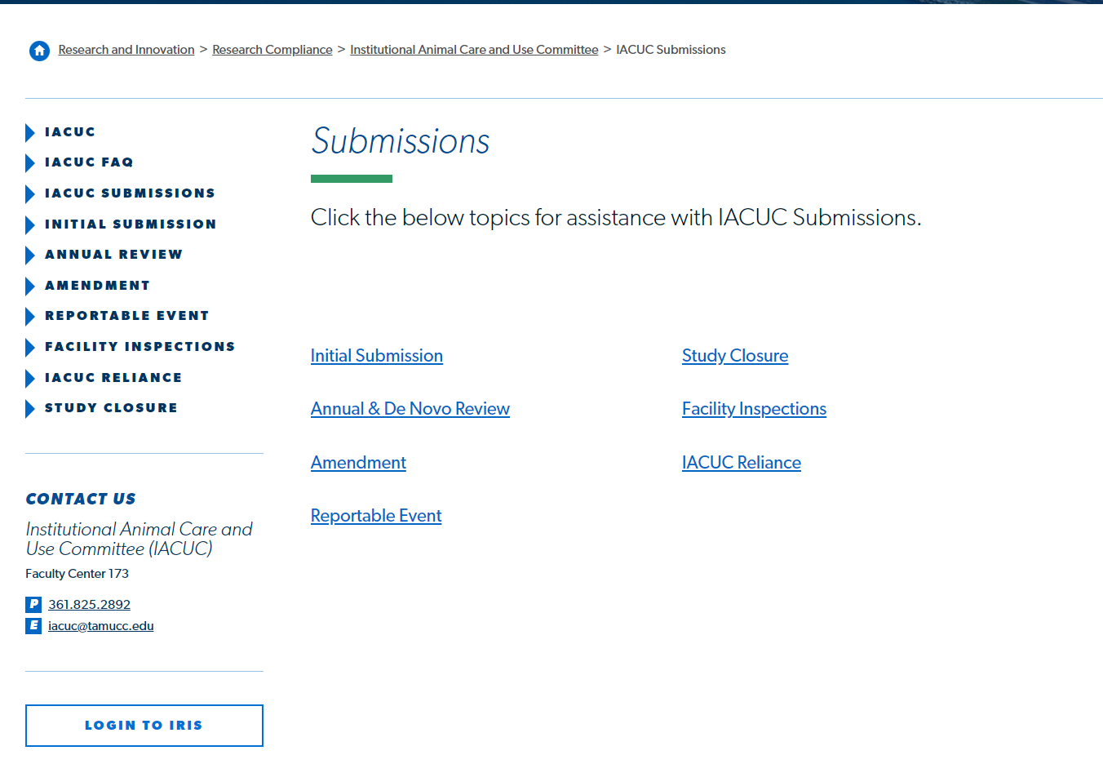
Login to iRIS
Click on the link on our website to open iRIS.

Slide 4
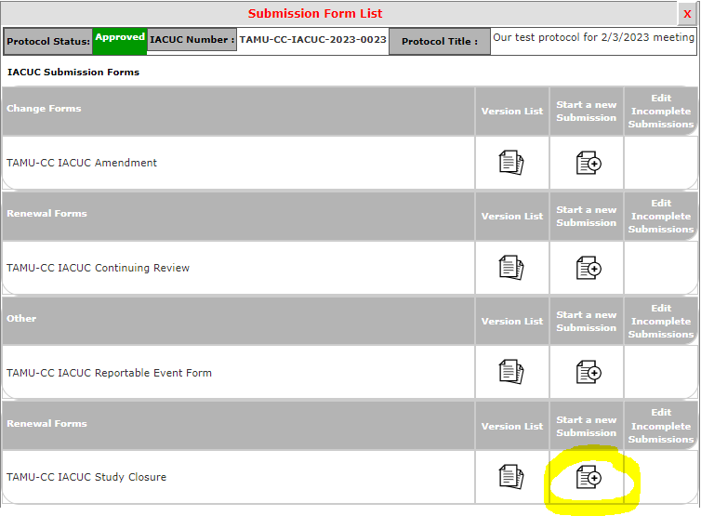
Open the study closure form
Under Actions, select Forms.
Then select the icon under Start a New Submission for IACUC Study Closure Form.

Slide 5
Study Closure Form
Complete the study closure form. Hit Save and continue to progress through the form until you reach the sign-off and submit form.

Slide 6
Let's see this in action.

