Slide 1
How to start a protocol in iRIS
Rebecca Ballard, JD, MA, CIP February 2, 2023
Director, Research Compliance

Slide 2
Welcome!
I’ll be guiding you through today’s course objectives.
For this session we will focus on:
How to start an Animal Use Permit (AUP)

Slide 3
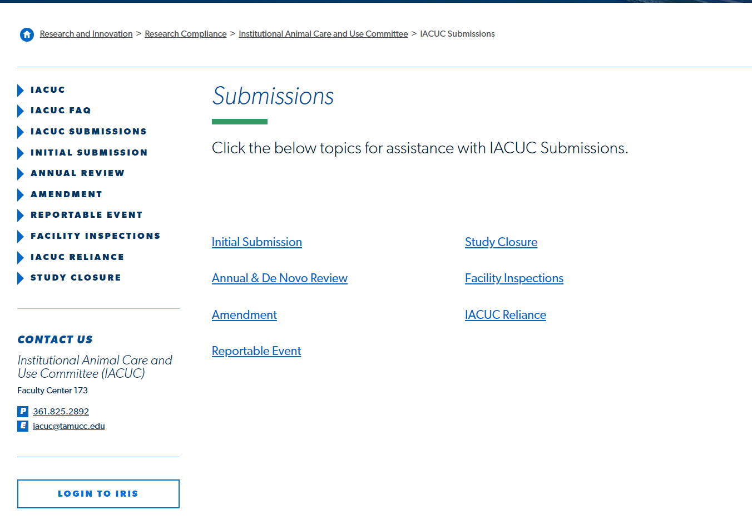
Login to iRIS
Click on the link on our website to open iRIS.

Slide 4
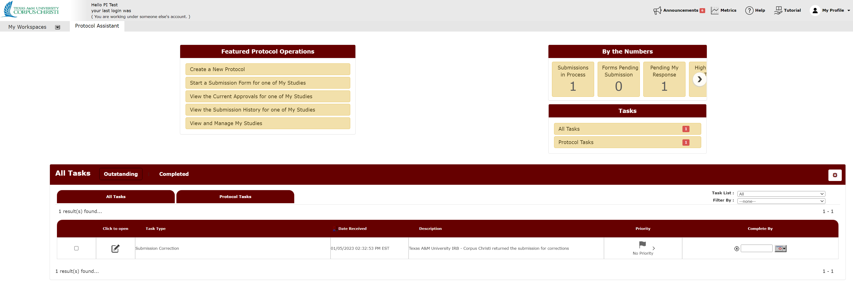
Create a New Protocol
To open the application form, click “Create a New Protocol.”

Slide 5
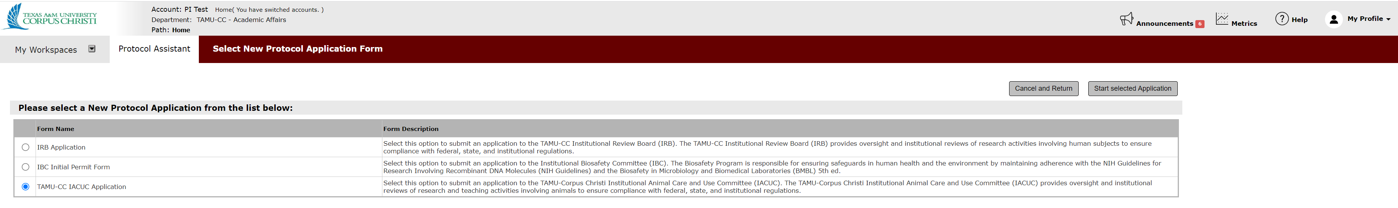
Select the TAMU-CC IACUC Application
Select “TAMU-CC IACUC Application” to submit to the IACUC.

Slide 6
Select the TAMU-CC IACUC Application
Select “Start Selected Application” to open and begin the application form.

Slide 7
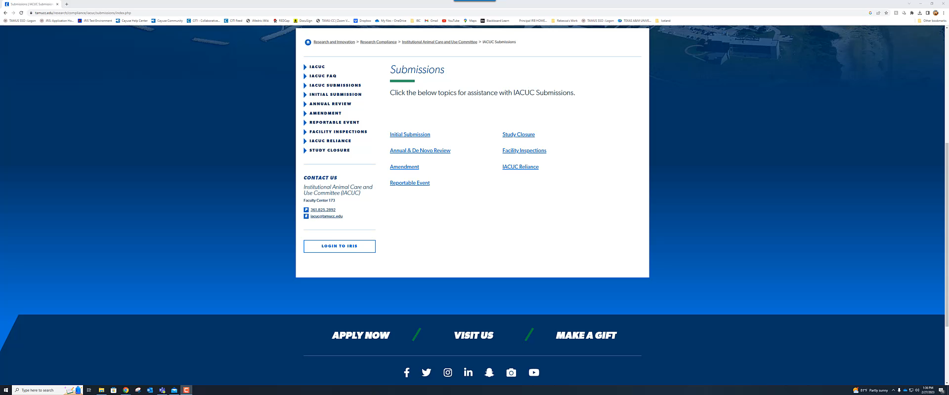
Let's see this in action.

