Slide 1
How to start an amendment in iRIS
Rebecca Ballard, JD, MA, CIP March 13, 2023
Director, Research Compliance

Slide 2
Welcome!
I’ll be guiding you through today’s course objectives.
For this session we will focus on:
How to start an amendment to an approved protocol in iRIS.

Slide 3
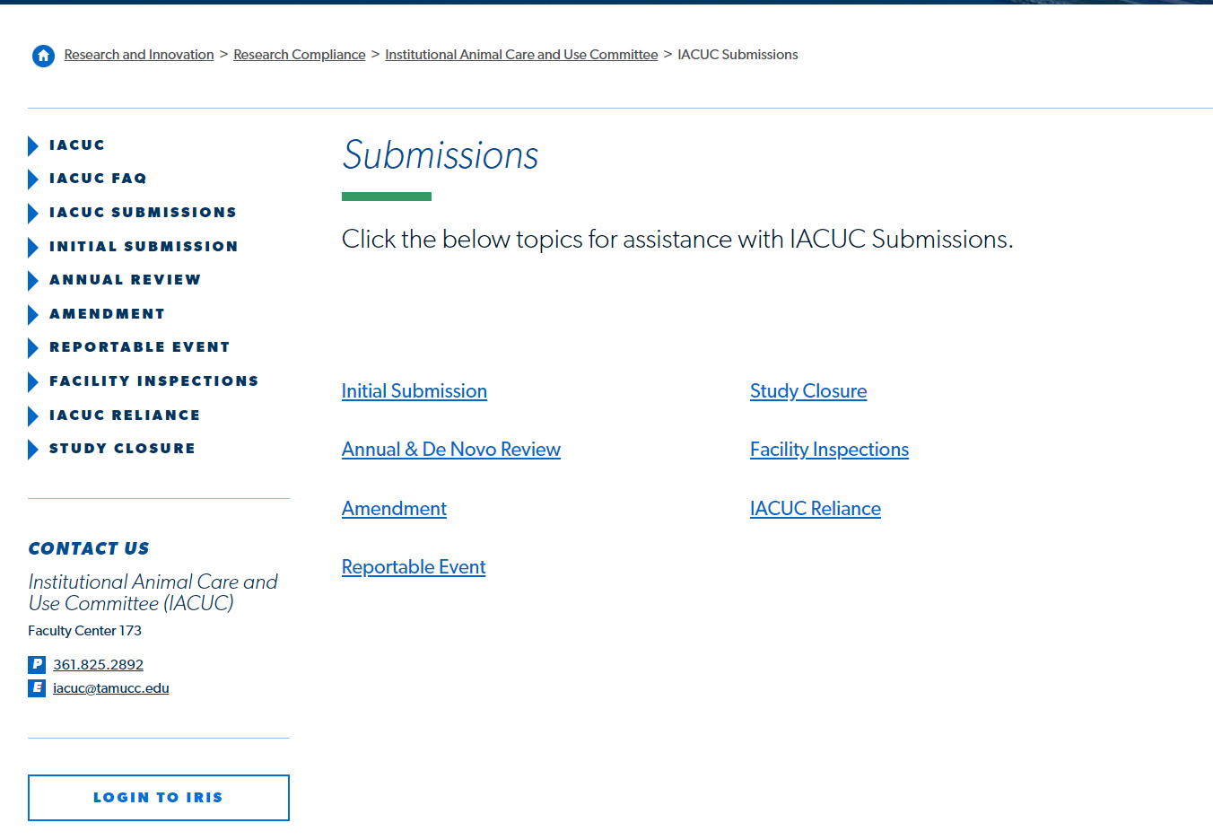
Login to iRIS
Click on the link on our website to open iRIS.

Slide 4
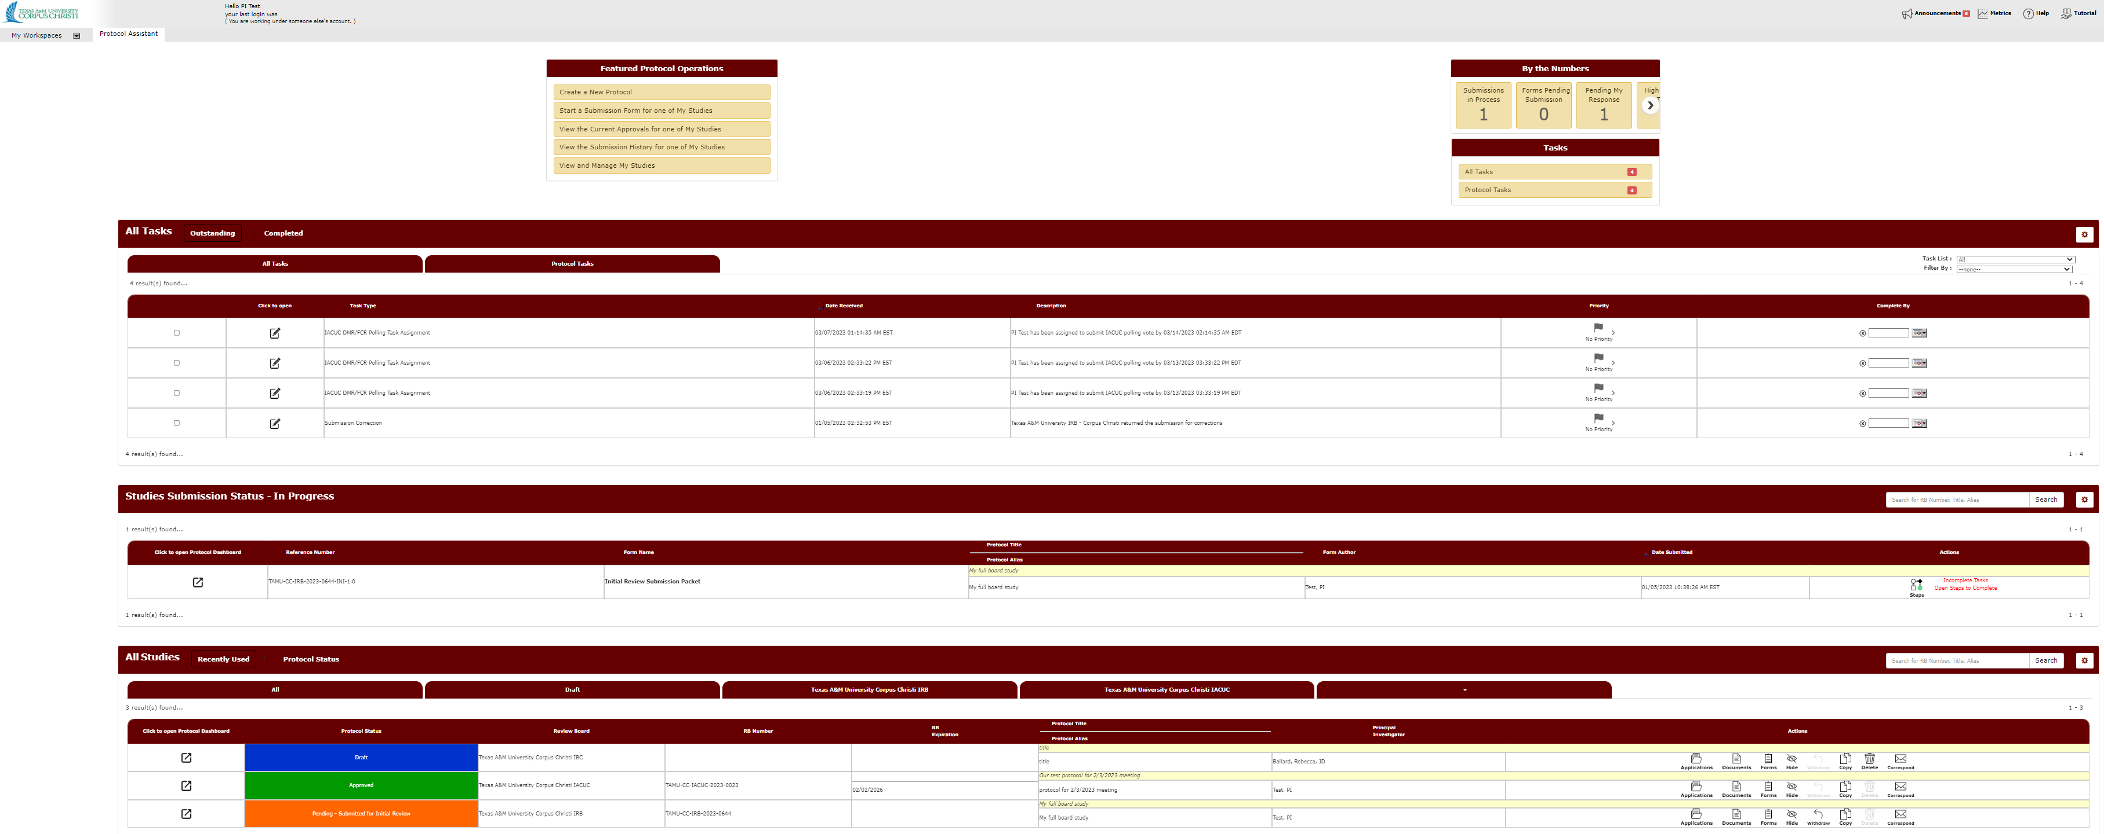
Locate the approved protocol requiring change
Amendments can only be submitted on approved protocols. Scroll down to All Studies to locate your approved protocols.

Slide 5
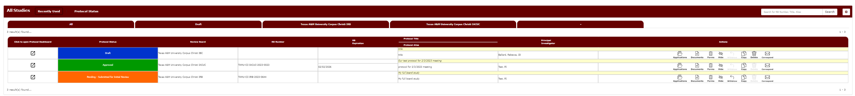
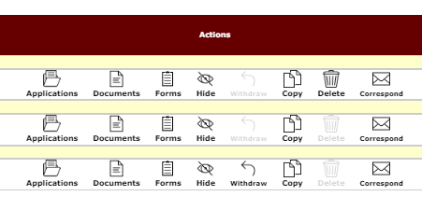
Action: Forms
Under Actions. Click Forms.

Slide 6
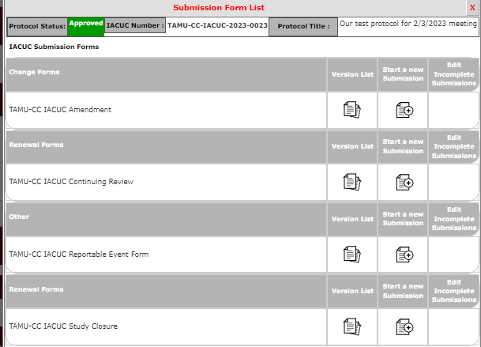
Action: Forms
Clicking on forms opens the submission forms. Click the icon under “start a new submission” for TAMU-CC IACUC amendment.

Slide 7
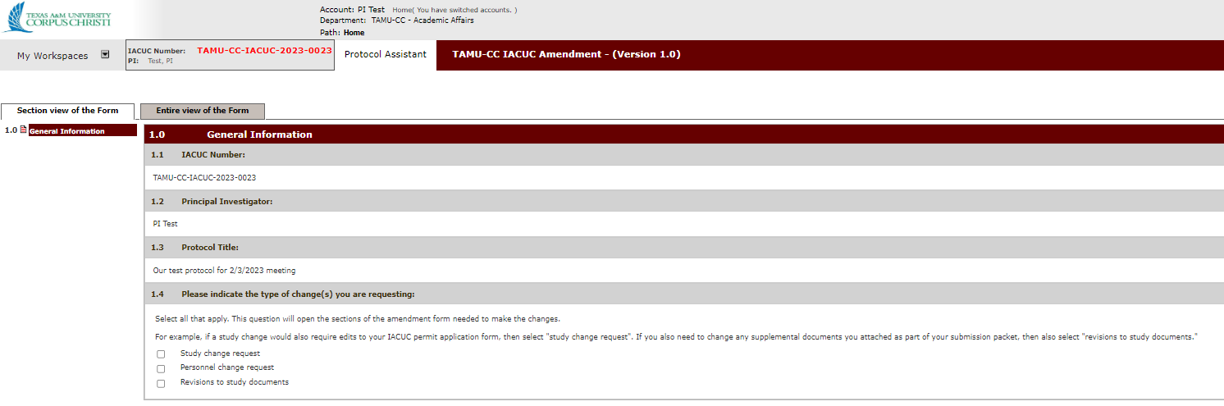
Opened amendment form.
Clicking on icon under “start a new submission” opens the IACUC amendment.

Slide 8
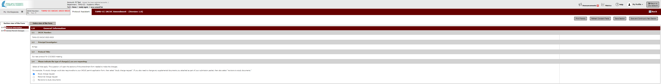
Complete the Amendment form.
Answer the questions in the amendment form. Hit “Save and Continue to Next Section” to progress through the form until you reach the PI sign-off page.

Slide 9
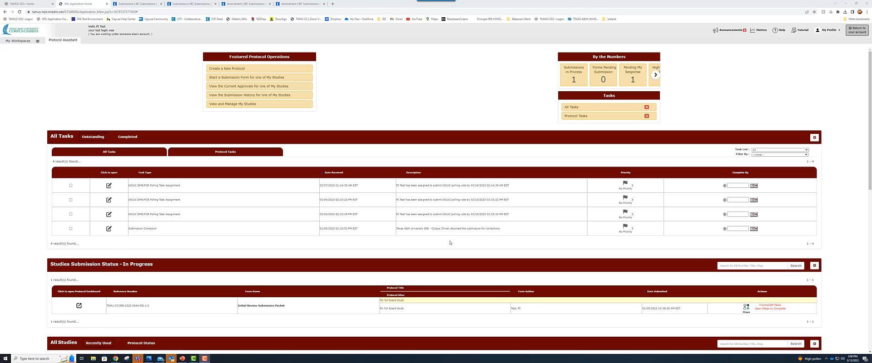
Let's see this in action.

