Slide 1
How to perform an amendment in iRIS
Rebecca Ballard, JD, MA, CIP March 13, 2023
Director, Research Compliance

Slide 2
Welcome!
I’ll be guiding you through today’s course objectives.
For this session we will focus on:
How to complete a study change request in iRIS.

Slide 3
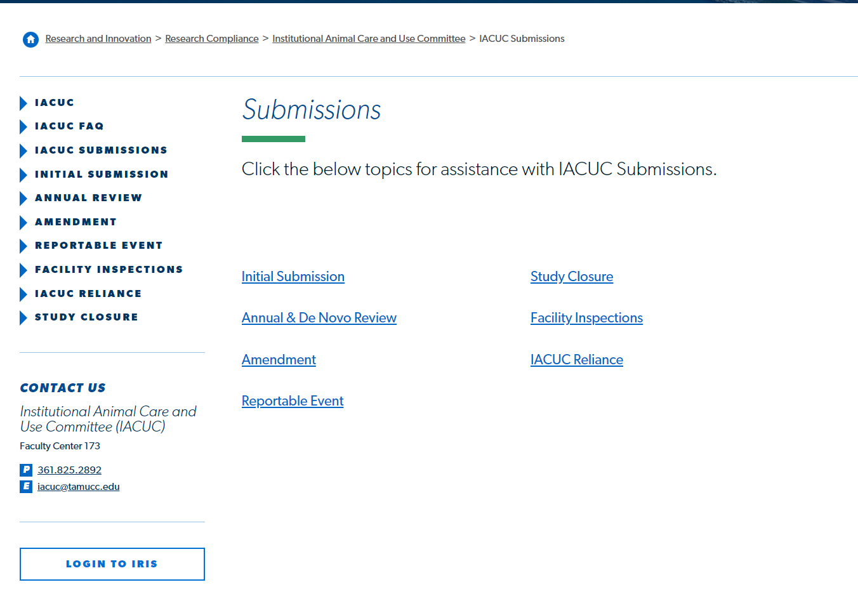
Login to iRIS
Click on the link on our website to open iRIS.

Slide 4
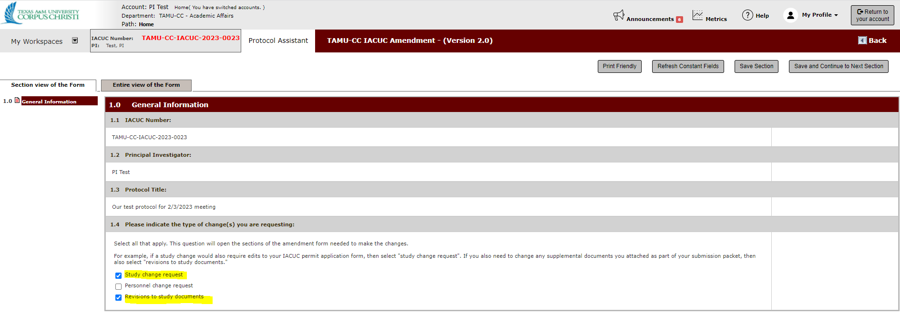
Amendment type
Once the amendment form is opened, select as your amendment type “study change request.”
If you need to change study documents also select “revisions to study documents”.

Slide 5
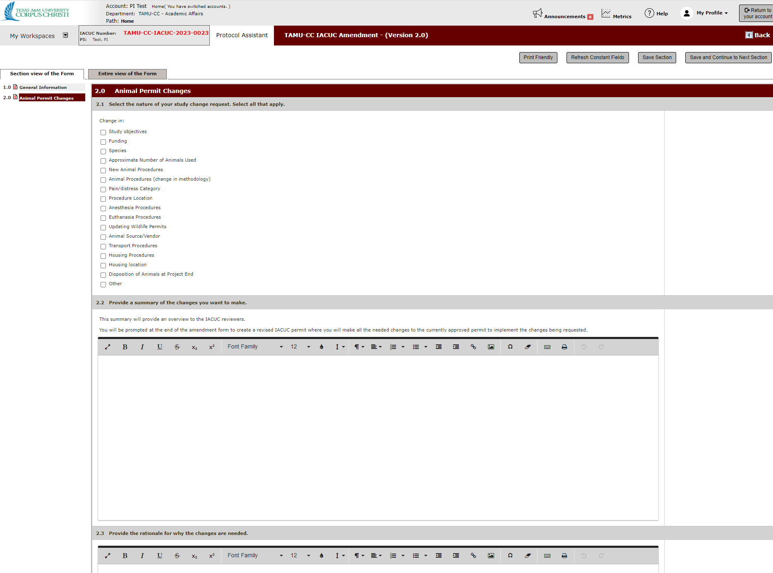
Animal Permit Changes
In the Animal Permit change section, describe the changes you are making.
Select all that apply.

Slide 6
Attachments: Edit the Animal Use Permit
Click the button “Click her to attach the application.” This create a new version of your Animal Use Permit to make your changes needed.

Slide 7
Attachments: Add new study documents
Click “Add a New Document” to add a new document not previously submitted.

Slide 8
Attachments: Revise an existing study document
Click “Select or Revise Existing” to update an existing document.

Slide 9
Attachments: Revise an existing study document
Click “Create Revision” to create a revised version to the existing document.

Slide 10
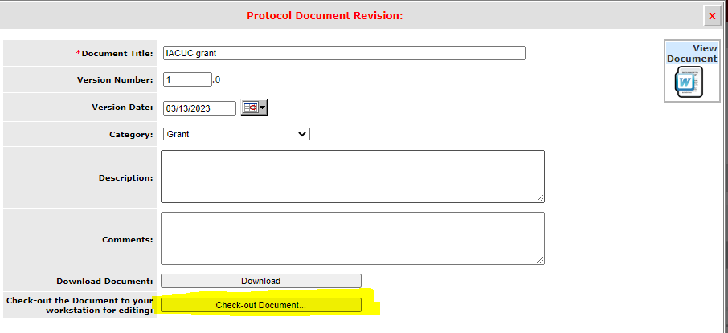
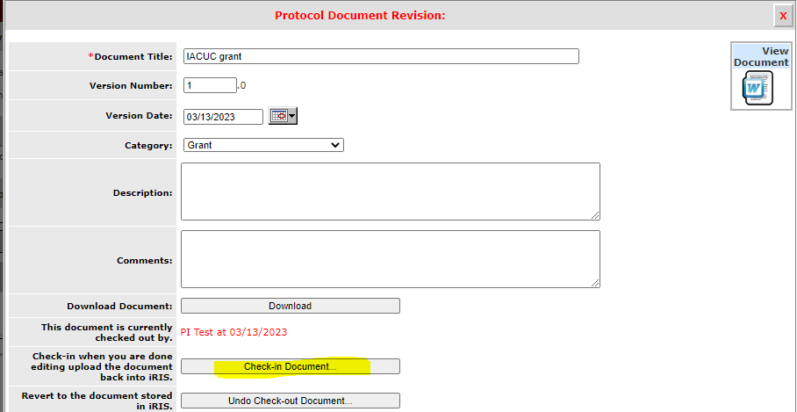
Attachments: Revise an existing study document
Check out the document to download onto your dashboard. Make the edits. Then check-in the revised document into iRIS.

Slide 11
Let's see this in action.

