Slide 1
How to perform a personnel change in iRIS
Rebecca Ballard, JD, MA, CIP March 13, 2023
Director, Research Compliance

Slide 2
Welcome!
I’ll be guiding you through today’s course objectives.
For this session we will focus on:
How to complete a personnel change request in iRIS.

Slide 3
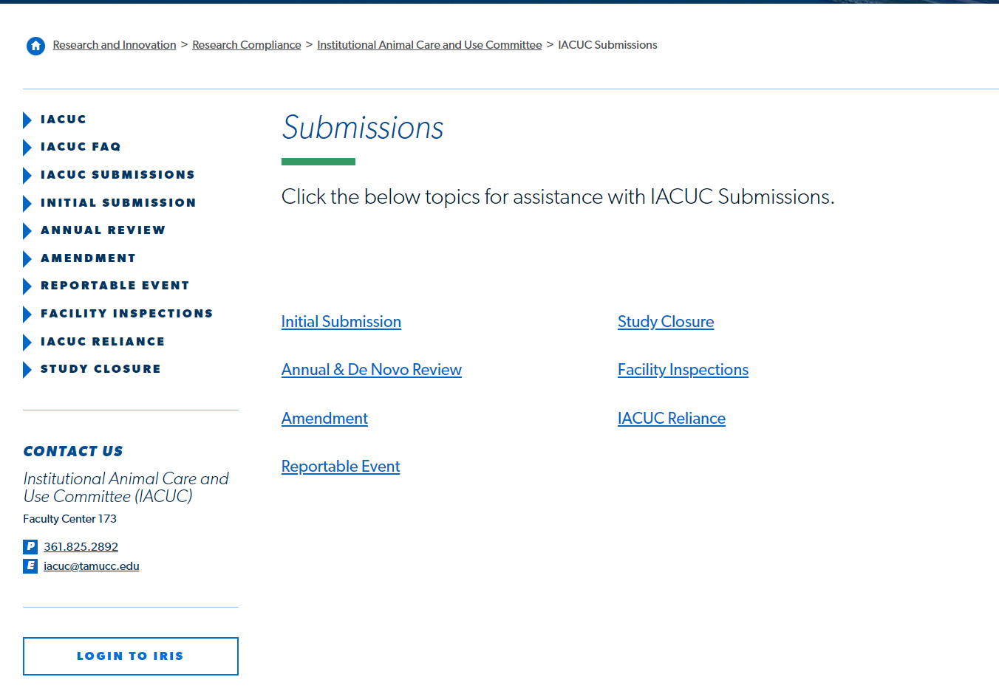
Login to iRIS
Click on the link on our website to open iRIS.

Slide 4
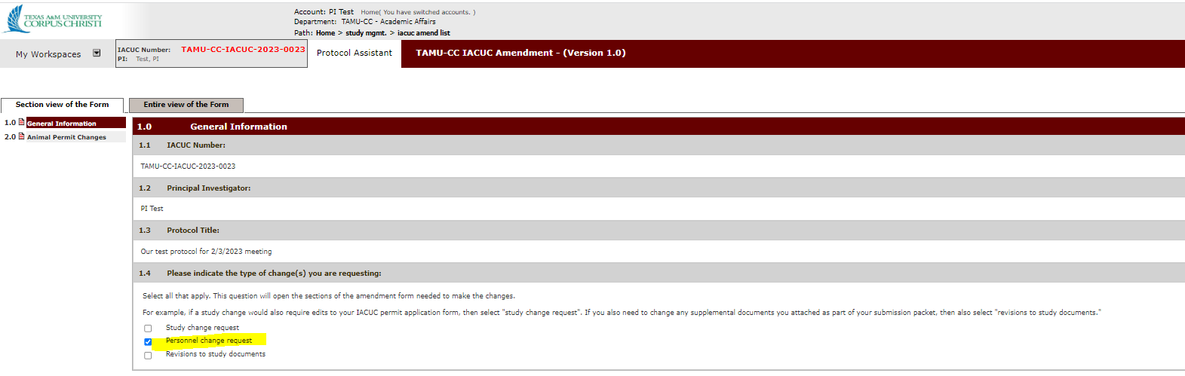
Amendment type
Once the amendment form is opened, select as your amendment type “Personnel change request.”

Slide 5
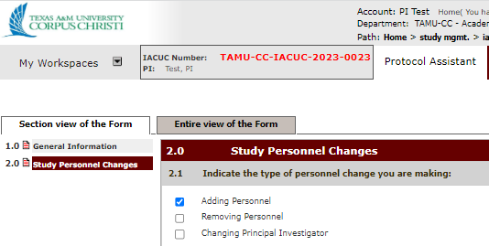
Study Personnel Changes Section
The next section that displays will be “Study Personnel Changes.”
Select the type of personnel change in Question 1.
This will open/close questions based on the selection.
Select all that apply.

Slide 6
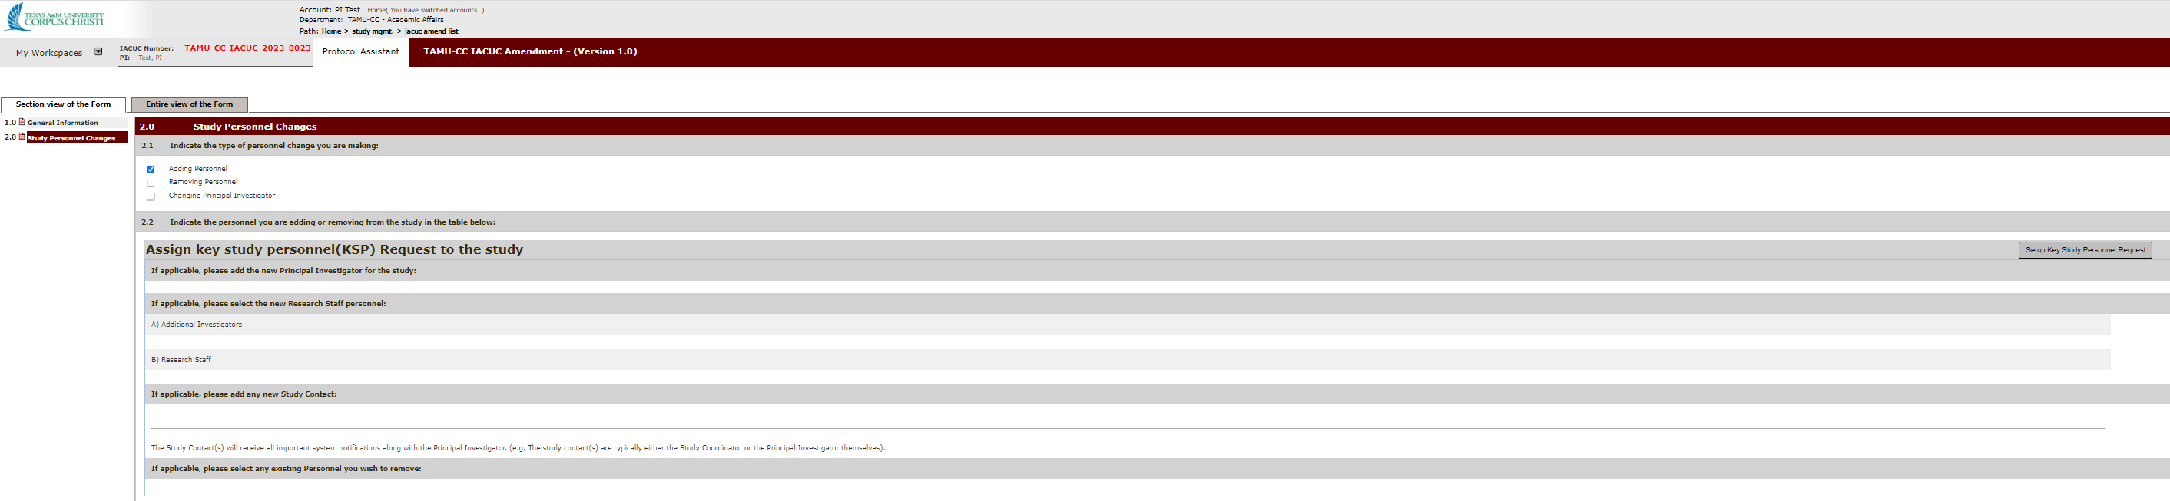
Key study personnel
Click “Setup Key Personnel Request” to open the directory finder.

Slide 7
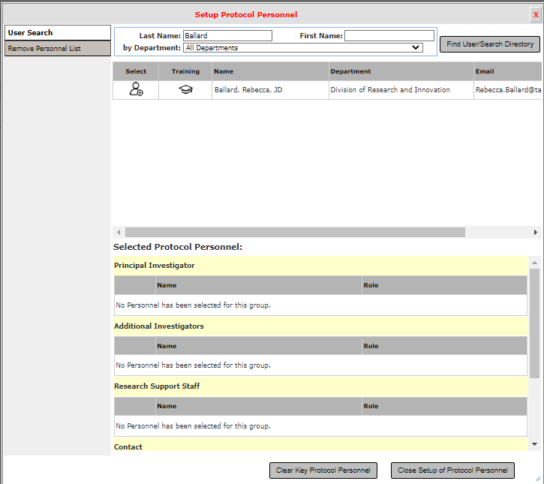
Key study personnel: adding personnel
For added personnel, search for their name and click the icon under “Select” to add them.

Slide 8
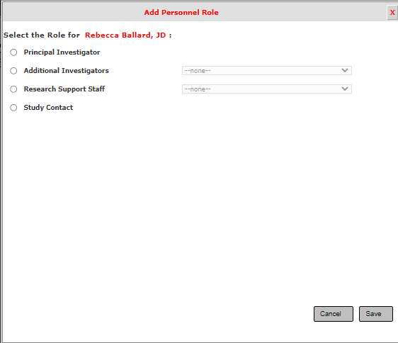
Key study personnel: adding personnel
For added personnel, select their study role. Hit save to close the window.

Slide 9
Key study personnel: deleting personnel
Click “Setup Key Personnel Request” to open the directory finder.

Slide 10
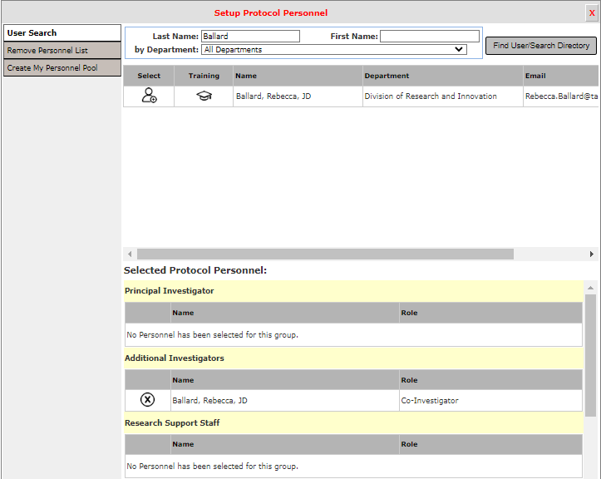
Key study personnel: deleting personnel
This page displays currently listed personnel. Click the X by the person you want to remove from the approved study personnel list.

Slide 11
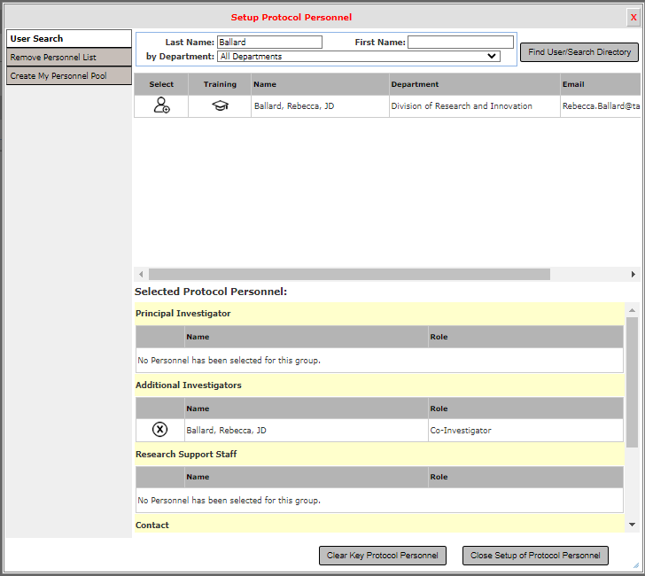
Key study personnel: close Key Personnel Page
Once you have made the changes to the key personnel list, click “close setup of protocol personnel” to return back to the amendment form.

Slide 12
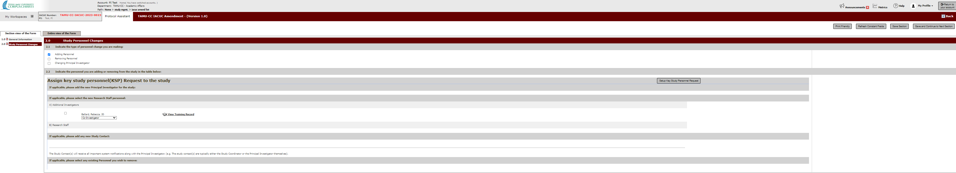
Key study personnel: continue completing amendment form
Hit “Save and Continue to Next Section” until you reach the end of the amendment form. Apply the PI sign-off and submit.

Slide 13
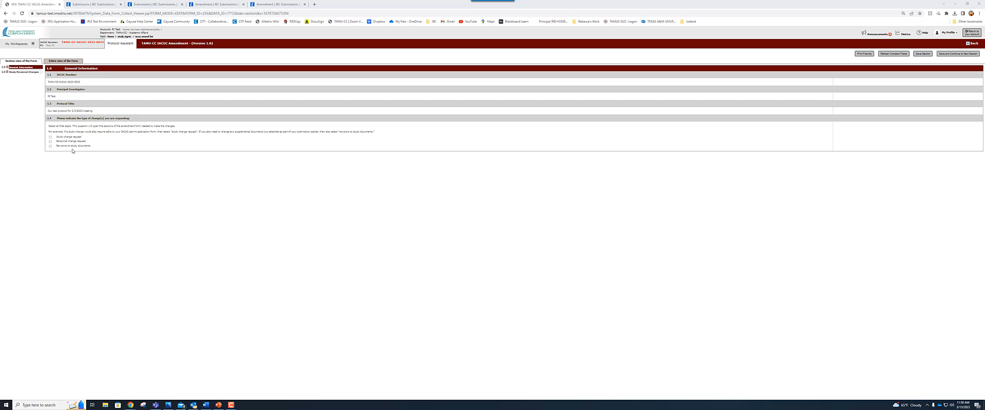
Let's see this in action.

