Slide 1
Rinki Suryavanshi, Ph.D. Digital Learning and Academic Innovations
You & I With AI
Notes:
Artificial Intelligence (AI) is revolutionizing education at an exponential rate. In this session we will look at what is AI and how we can utilize it for our benefit.

Slide 2
Provide an overview of AI.
Discuss optimization of prompts.
Discuss the privacy and ethical considerations of AI.
Objectives
Notes:
Artificial Intelligence (AI) is revolutionizing education at an exponential rate. In this session we will look at what is AI and how we can utilize it for our benefit.

Slide 3
Please download and install the Slido app on all computers you use
What comes to your mind when you hear about AI?
3967065
https://app.sli.do/event/m9wE6SnpvQ2zGqGFYp9FdH
ⓘ Start presenting to display the poll results on this slide.

Slide 4
Generative AI
What Is Generative AI?
Creates new content such as Text, Images, Music, Or Videos based on the patterns learned from existing data.
How Does It Work?
Trained on large datasets to recognize patterns and then generate similar, original content.
Key Examples:
Text Generation
Image Generation
Notes:
Slide Title: **Introduction to Generative AI**
**What is Generative AI?**
- **Generative AI** is a type of artificial intelligence that can **create new content** such as text, images, music, or videos based on the patterns it has learned from existing data.
**How does it work?**
- It uses models like **neural networks** that are trained on large datasets to recognize patterns and then generate similar, original content.
**Key Examples:**
- **Text Generation:** AI that writes articles or completes sentences.
- **Image Generation:** AI that creates realistic pictures from descriptions.
**Why is it Important?**
- It helps automate creative tasks, saving time and effort, and can be used in industries like **marketing, entertainment, and design**.
(Support with visuals: text-to-image AI, examples of generated text or images.)

Slide 5
The AI Toolbox
Notes:
Explain when you will be engaging with these AI tools. How it can be useful for our work.

Slide 6
How can AI help you in your work?
ⓘ Start presenting to display the poll results on this slide.

Slide 7
Create A Free ChatGPT Account (Optional)
Go to https://chat.openai.com in your web browser.
On the homepage, click the “Sign Up” button.
Input your email address and click “Continue”.
Choose a secure password, then click “Continue”.
1. Verify your email
2. Agree to terms (enter personal information )
3. Verify your phone number
4. Start using chatgpt!
After completing these steps, you can now start interacting with chatgpt for free!
Notes:
### Slide Title: **Steps to Create a Free ChatGPT Account**
**1. Visit the OpenAI Website**
- Go to [https://chat.openai.com](https://chat.openai.com) in your web browser.
**2. Click "Sign Up"**
- On the homepage, click the **Sign Up** button.
**3. Enter Your Email Address**
- Input your email address and click **Continue**.
*(You can also sign up using a Google or Microsoft account for quick access.)*
**4. Create a Password**
- Choose a secure password, then click **Continue**.
**5. Verify Your Email**
- Open your email inbox, find the verification email from OpenAI, and click the link to verify your account.
**6. Enter Personal Information**
- Provide basic details like your name and agree to OpenAI’s terms and conditions.
**7. Verify Your Phone Number**
- OpenAI will ask for a phone number to verify your account. Enter your phone number and input the verification code sent to you.
**8. Start Using ChatGPT**
- After completing these steps, you can now start interacting with ChatGPT for free!

Slide 8
Some settings are surprising, let’s walk through them together!
Notes:
Security - Turn off “improve model for everyone”
Personalize your prompts. Edit your custom instructions!
Next screen, Check out the “Thought starters”
Show the exact things what needs to be done when creating the account.

Slide 9
So - What Is Prompt Engineering?
Why is it important?
The quality of the AI’s response depends on how well the prompt is crafted. A clear, detailed prompt can lead to better, more relevant answers.
Why learn prompt engineering?
It helps you maximize AI’s potential, making it easier to get exactly what you need for tasks like writing, coding, or creative projects.
The process of designing and refining questions or instructions (called prompts) that you give to an AI system to get accurate and useful responses.
Notes:
A clear, detailed prompt can lead to better, more relevant answers - Garbage in garbage out!

Slide 10
Write Clear Instructions – Framework For Prompt Engineering
Use precise, unambiguous language to guide the AI in generating the right response.
Avoid vague terms; instead, define exactly what you need.
Example: Instead of “Define communication,” try “Define communication for college students taking an introductory communication course.”
Step 1
Step 2
Step 3
Step 4
Notes:
Writing prompts is a delicate art! You want to be clear enough that the model understands want you are expecting, but succinct enough that the prompt doesn’t ramble or become irrelevant to what you are really asking.

Slide 11
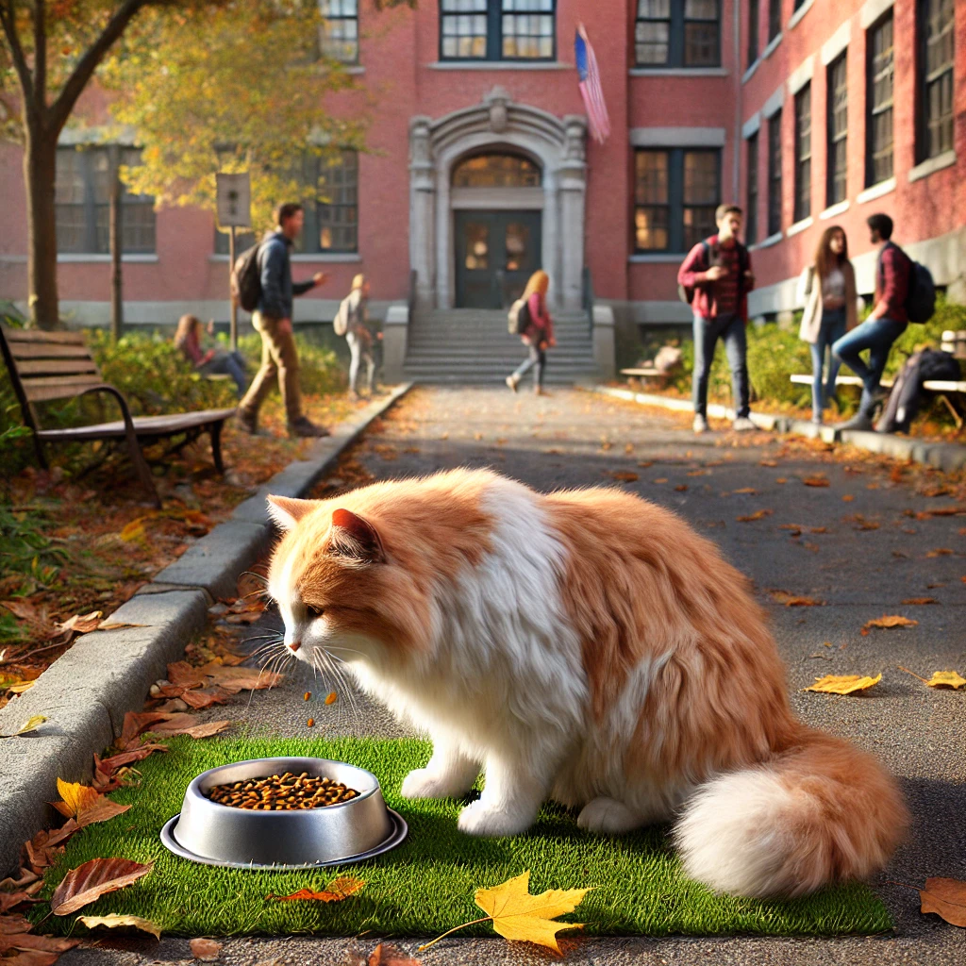
Anatomy of a Prompt – Let’s try it!
“Create an image of a cat eating food at a school's campus.”
Original
Response
Is it clear?
Step 1 - Write Clear Instructions: Is the language used precise and unambiguous? Does it define exactly what you need?
Notes:
It gave me the first image, with the prompt.
When I asked to make it look more natural, it provided me the second image, along with the note that it looks like I am looking for a photograph, rather than a digitally generated image, I can provide you photorealistic styled image. So it is making me learn its capabilities.

Slide 12
Provide a Reference Task– Framework For Prompt Engineering
Offer examples or context to help the AI understand the desired output.
Reference previous tasks or models of what a good response looks like.
Example: “Summarize [this article] in 200 words, similar to the way a journal abstract summarizes key points.”
Step 1
Step 2
Step 3
Step 4
Notes:
Writing prompts is a delicate art! You want to be clear enough that the model understands want you are expecting, but succinct enough that the prompt doesn’t ramble or become irrelevant to what you are really asking.
You may have to tweak your prompt many times – called Iterative refinement.

Slide 13
Anatomy of a Prompt – Let’s try it!
“I am representing my office to attend the conference hosted by X company. Your email has mentioned to reach out to the you directly, do you have any information about it, I can see the agenda but would like to know more about hotel recommendations etc. ”
Original
I hope this message finds you well. I am representing my office at University and will be attending the conference. I received this information via the email sent through Campus announcement, which mentioned reaching out to you directly for more details. While I can see the agenda for the event, I would appreciate any additional information you could provide—particularly around hotel recommendations or any other logistics that might be helpful.
Response
Does it provide a reference task?
Step 2 - Provide a Reference Task: Is an example or context provided to help the AI know how to write the response?
Notes:
I provided it with the reference task to refining the message and it gave me the following message.

Slide 14
Split Complex Tasks into Simple Subtasks– Framework For Prompt Engineering
Break down large or complex requests into manageable steps.
Guide the ai through each step to avoid confusion or incomplete answers.
Example: Instead of “Write about [a research question],” use: “First, summarize [the research question]. Then, provide three key findings, followed by a conclusion.”
Step 1
Step 2
Step 3
Step 4
Notes:
Writing prompts is a delicate art! You want to be clear enough that the model understands want you are expecting, but succinct enough that the prompt doesn’t ramble or become irrelevant to what you are really asking.
You may have to tweak your prompt many times – called Iterative refinement.

Slide 15
Anatomy of a Prompt – Let’s try it!
“Provide some ideas for student activities to enhance student interactions at the university campus.”
Original
1. Cross-campus conversations
2. Culture & cuisine
3. Peer mentorship mixer
4. Creative collaboration nights
5. Skills share night
Response
Is the prompt too complex?
Step 3 – Split Complex Tasks: Is this prompt too complex? Should it be split into multiple, manageable steps?
Notes:
It provided the list, and then you can split the task and ask it to explore the cross-campus conversation, provide details for its implementation.

Slide 16
Allow Time for Models to Reason– Framework For Prompt Engineering
Give the AI time to generate more thoughtful responses by requesting reflection or reasoning steps.
Use prompts like “think step-by-step” or “analyze before answering” to encourage deeper reasoning.
Example: “Before providing a recommendation, list the pros and cons of each option.”
Step 1
Step 2
Step 3
Step 4
Notes:
Writing prompts is a delicate art! You want to be clear enough that the model understands want you are expecting, but succinct enough that the prompt doesn’t ramble or become irrelevant to what you are really asking.
You may have to tweak your prompt many times – called Iterative refinement.

Slide 17
Anatomy of a Prompt – Let’s try it!
“Provide interview questions for admin assistant, think before you provide the answer, it is important for me.”
Original
1. Describe a time when you had to manage multiple tasks with tight deadlines. How did you prioritize, and what tools or strategies did you use to stay organized?
2. As an administrative assistant, you'll often be the first point of contact for faculty, students, and external parties. Can you describe a time when you had to communicate an important message clearly and professionally.
Response
More time to process?
Step 4 – Allow Time for Models to Reason: Should the AI be prompted to take its time generating a thoughtful response?
Notes:
With this prompt, the AI provided some possible questions that can be used for interview. When it was asked to take time to think, it responded that after careful consideration, the interview questions are the following.

Slide 18
Further prompt modifications
Audience Persona: Act as Person X
Flipped Interaction: I would like you to ask me questions to achieve X
Question Refinement: Suggest a better version of the question to use
Notes:
Audience Persona: To use this pattern, your prompt should make the following fundamental contextual statements:
Act as Persona X
Perform task Y
Example: Act as a computer that has been the victim of a cyber attack. Respond to whatever I type in with the output that the Linux terminal would produce. Ask me for the first command.
Flipped Interaction Pattern: To use this pattern, your prompt should make the following fundamental contextual statements:
I would like you to ask me questions to achieve X
You should ask questions until condition Y is met or to achieve this goal (alternatively, forever)
(Optional) ask me the questions one at a time, two at a time, ask me the first question, etc.
Potential audience participation -
Example: I would like you to ask me questions to help me create variations of my marketing materials. You should ask questions until you have sufficient information about my current draft messages, audience, and goals. Ask me the first question.

Slide 19
Ethical Challenges and Concerns
Privacy and Security
Bias
Academic Integrity
Student Learning
Responsible Use
Incorrect or made-up information
Notes:
### Slide Title: **Challenges and Concerns of Generative AI in Higher Education**
**1. Privacy and Security**
- **Data Privacy:** Risk of sensitive data being used without proper consent.
- **Security Breaches:** AI models can be vulnerable to malicious attacks (e.g., data poisoning, misuse).
**2. Bias**
- **Bias in AI Models:** AI systems may perpetuate biases present in the data they were trained on.
**3. Academic Integrity**
- **Plagiarism Risks:** AI-generated content makes it difficult to distinguish between student work and machine output.
- **Undermining Originality:** AI could discourage students from engaging deeply with learning material.
**4. Impact on Student Learning**
- **Over-reliance on AI:** May lead to a decline in critical thinking, problem-solving, and writing skills.
- **Misuse of AI Tools:** Students may use AI to bypass learning, affecting mastery of subjects.
**5. Responsible Use**
- **Ethical Dilemmas:** Balancing the benefits of AI with responsible usage (e.g., preventing misuse in assessments).
- **Lack of Guidelines:** Inconsistent policies across institutions on how to properly use AI tools.
Incorrect or made-up information
In the context of generative AI, a hallucination occurs when the AI provides information that is inaccurate, made-up, or misleading, even though it sounds confident and plausible.
Why It’s Important:
Understanding hallucination helps us recognize that while AI is a powerful tool, it isn’t always accurate. It’s important to fact-check AI-generated content, especially in academic and professional settings.
Paradigm Shift in Education**
- **Changing Roles:** AI could shift the role of educators from knowledge transmitters to facilitators of learning.
- **Curriculum Adaptation:** Need for continuous updating of curricula to include AI literacy and ethical considerations.
(Consider including icons or visuals representing each challenge for engagement.)

Slide 20
Please download and install the Slido app on all computers you use
How confident do you feel in using AI for your work?
ⓘ Start presenting to display the poll results on this slide.

Slide 21
Let’s Try Chatgpt!!
CHATGPT

Slide 22
Conclusion
Chatgpt is a tool that would help you become more engaged with the learning process .
By adhering to best practices and addressing challenges, we can unlock the full potential of AI through well-crafted prompts.
Notes:
Thank you for your attention. Let's continue to innovate and refine prompt engineering for a better AI future.

Slide 23
Sources
https://www.tamucc.edu/library/dlai/faculty/teaching-with-ai.php
https://platform.openai.com/docs/guides/prompt-engineering
https://www.ibm.com/think/topics/shedding-light-on-ai-bias-with-real-world-examples

