Slide 1
Why Don't They Teach That In School?
Jacqueline Hamilton, EdD

Slide 2
Nutrition
Exercise
Sleep
Basic Healthcare
Personal Finance
Mental Health Thriving
Coping Skills
Time Management
Soft Skills
What else?

Slide 5
Students seek our advice.
Be a good steward for the students.
Start with yourself (airplane example) - learn available resources.
Model behavior.
Learn resources available to students.

Slide 6
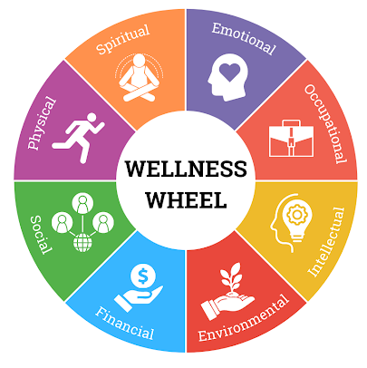
Notes:
Wellness wheel, but also adulting. Self advocacy and self efficacy.

Slide 7
Nutrition
Exercise
Sleep
Basic Healthcare
Personal Finance
Mental Health Thriving
Coping Skills
Time Management
Soft Skills
What else?

Slide 8
Campus Resources
Students​
Health + (vetted off campus) ​
Academic Blue Health Insurance​
Counseling ​
Gym​
Izzy's Pantry​
IGrad
LinkedIn Learning​
Career & Professional Development​
Campus Organizations
Faculty/Staff​
Human Resources​
Employee Assistance Program​
Health Insurance + Programs​
Employee Wellness​
Gym​
LinkedIn Learning
Notes:
Wellness wheel, but also adulting. Self advocacy and self efficacy.

Slide 9
Off Campus
Overwhelming – word of mouth!​
Convention and Visitor's Bureau​
City of Corpus Christi​
Credit Union/Bank - financial classes​
Organizations by Interest​
Faith-based​
Sport​
Social
Notes:
Wellness wheel, but also adulting. Self advocacy and self efficacy.

Slide 10
Do no harm​
Know your scope​
First time for everything (again)​
Explore resources together​
Build community, ask​
Communicate
Notes:
Wellness wheel, but also adulting. Self advocacy and self efficacy.

Slide 11
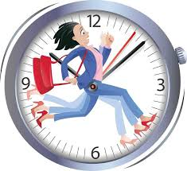
Time Management
Notes:
Making a schedule, prioritizing, motivating, not procrastinating. Know your limits.

Slide 12
Lifelong Learning
Awareness of ourselves as resources.​
Needs (of students) change with the times.​
College mindset always changing.​
Salience changes with situations.​
Resources change to meet needs.​
Responsibility of being a resource.​
Adulting.
Notes:
Wellness wheel, but also adulting. Self advocacy and self efficacy.

