Slide 1
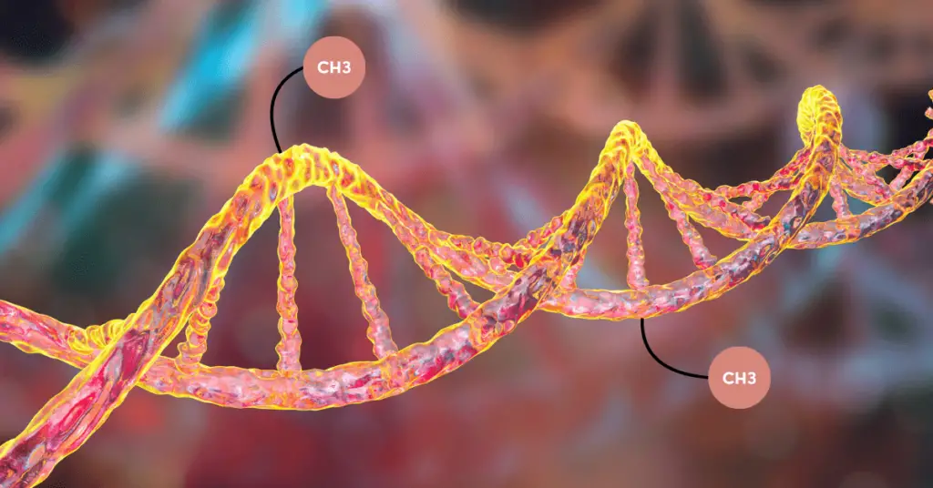
The Association of Childhood Allergic Diseases with Prenatal Pollen Exposure Through At-Birth DNA Methylation
Dr. Rajesh Melaram
11/14/24

Slide 2
Outline
Background
Purpose
Study Design
Methods
Results
Discussion
Conclusions

Slide 3
Background
Childhood allergic diseases, such as asthma and allergic rhinitis, are increasing in prevalence on a global scale.
The impacts of childhood allergic diseases are profound, affecting families, parents, and schoolchildren.
There are limited epidemiological data on environmental risk factors in early life for asthma and allergy in children.

Slide 4
Background - Continued
Pollen is a recognized environmental risk factor for asthma and allergy in childhood.
Some studies associated pollen season of birth with risk of asthma and allergic rhinitis.
Other studies indicated a high risk of allergic sensitization or asthma hospitalization from high pollen exposure during pregnancy.
None of these studies have explored the role of DNA methylation (DNAm) on the association of pollen exposure in early life and incidence of childhood allergic diseases.

Slide 5
Purpose
The purpose of the study was to examine the potential connection of at-birth DNAm between prenatal pollen exposure and childhood asthma and rhinitis in a longitudinal birth cohort of the U.K.

Slide 6
Isle of Wight, U.K.

Slide 7
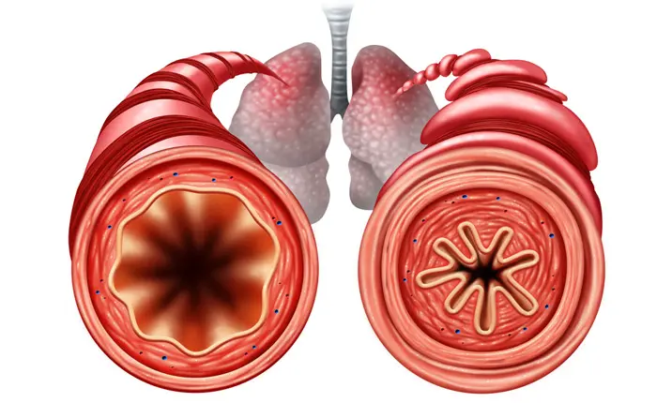
Study Design
A time-lagged design was utilized in the study:
Pollen exposure (pregnancy)
DNAm (at birth)
Asthma and allergic rhinitis (age 6 years)

Slide 8
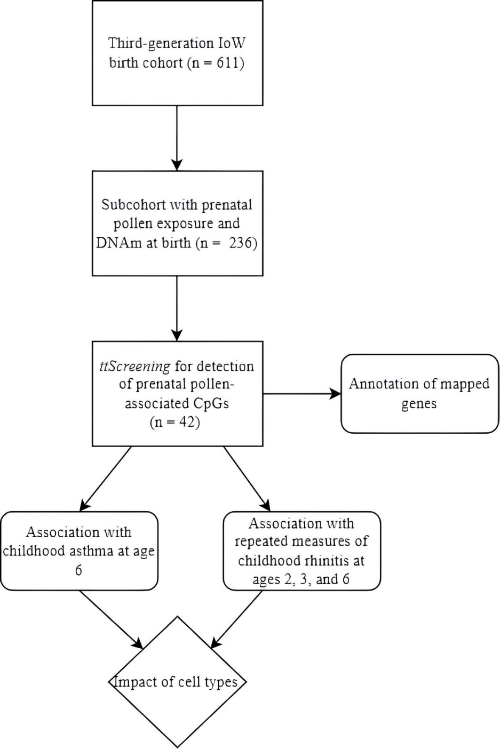
Notes:
Analytic process of epigenome wide study on pollen exposure and childhood asthma and rhinitis.

Slide 9
Methods – Isle of Wight birth cohort (IOWBC)
The Isle of Wight birth cohort (IOWBC) is a longitudinal cohort spanning three generations (F0, F1, and F2) on the Isle of Wight, U.K.
This study was based off the third-generation (F2), children born between 2010 and 2022.
F2 children are followed at ages 3 and 6 months and 1, 2, 3, and 6 years.
Standardized questionnaires were used to collection information on demographics, clinical outcomes, and related risk factors.

Slide 10
Methods – Variables
Exposure
Sum of pollen counts during pregnancy
Health outcomes
Childhood asthma status at age 6 years
Rhinitis status at ages 2, 3, and 6 years
Mediator
DNAm expressed as M-values in cord blood or blood spots on Guthrie cards
Covariates
Maternal risk factors (i.e., smoking, asthma status or wheeze, rhinitis), socioeconomic status (SES), passive smoke exposure in first year of life, and sex of offspring

Slide 11
Methods – Screening
Screening of cytosine-phosphate-guanine (CpG) sites
Using the R package, ttScreening, a total of 551,710 sites were screened at the genome scale to detect potentially informative CpGs associated with prenatal pollen exposure.
No covariates were included in this step.

Slide 12
Methods – First Arm of Study
Association of prenatal pollen exposure and DNAm at birth
Linear regressions using the SAS procedure PROC GLM were applied with DNAm at birth as the dependent variable.
Notes:
Potential confounders: maternal smoking, maternal asthma or wheeze, maternal rhinitis, socioeconomic status, and sex

Slide 13
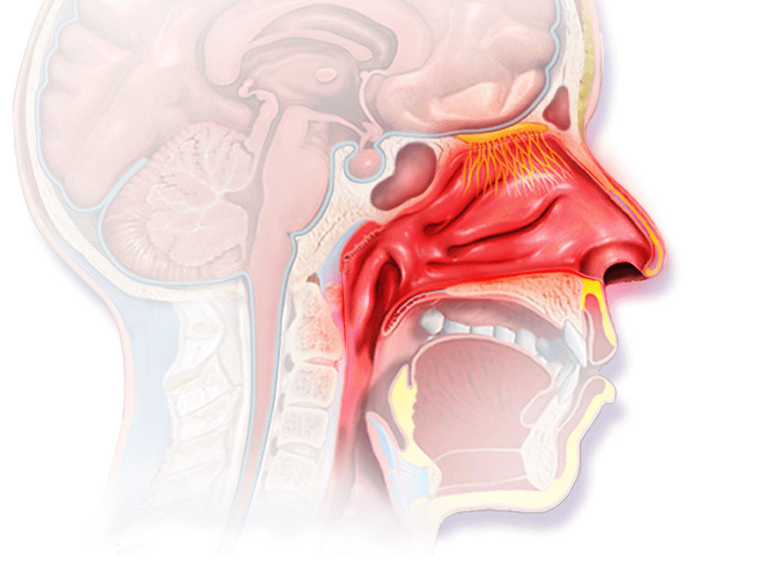
Methods – Second Arm of Study
Association of prenatal-pollen exposure-related DNAm at birth and childhood allergic diseases (asthma and rhinitis)

Slide 14
Methods – Second Arm of Study
Logistic regression using the SAS procedure PROC LOGISTIC were applied with childhood asthma at age 6 years as the dependent variable with no asthma as the reference group.
Generalized linear regressions with repeated measures using the SAS procedure PROC GENMOD were applied with rhinitis at each age (2, 3, and 6 years) with no rhinitis as the reference group.
Regression coefficients or odds ratios (OR) were estimated for each independent variable and 95% confidence intervals were calculated.

Slide 15
Summation of Pollen Exposure
For study subjects with DNAm at birth, the average level of prenatal pollen exposure was 12489.36 grains/m³ compared to 10780.29 grains/m³ among the complete cohort (p < 0.05).

Slide 16
Variables | Descriptor | Complete cohort n (%) | Subcohort n (%) | p-value*
Risk Factors
Maternal smoking | Yes No | 178 (31.79) 382 (68.21) | 75 (32.75) 154 (67.25) | 0.7548
Maternal asthma or wheeze | Yes No | 79 (16.12) 411 (83.88) | 33 (16.02) 173 (83.98) | 0.9687
Maternal rhinitis | Yes No | 217 (44.11) 275 (55.89) | 97 (42.73) 130 (57.27) | 0.6757
SES | 1 (lowest) 2 3 4 5 (highest) | 77 (19.25) 97 (24.25) 114 (28.50) 61 (15.25) 51 (12.75) | 30 (12.93) 67 (28.88) 72 (31.03) 40 (17.24) 23 (9.91) | 0.0507
Sex | Male Female | 336 (56.00) 264 (44.00) | 122 (51.69) 114 (48.31) | 0.1827
Passive smoke in the first year | Yes No | 58 (16.38) 296 (83.62) | 24 (14.37) 143 (85.63) | 0.4830
Health Outcomes
Childhood asthma status at age 6 | Yes No | 44 (7.20) 567 (92.80) | 32 (13.56) 204 (86.44) | 0.0002
Childhood rhinitis
Age 2 | Yes No | 42 (14.63) 245 (85.37) | 24 (15.79) 128 (84.21) | 0.6859
Age 3 | Yes No | 40 (14.76) 231 (85.24) | 24 (14.72) 139 (85.28) | 0.9896
Age 6 | Yes No | 38 (20.99) 143 (79.01) | 24 (19.51) 99 (80.49) | 0.6873
Notes:
Table 1. Comparison of complete cohort (n=611) and subcohort of study subjects (n=236) on potential risk factors and childhood asthma and rhinitis status.

Slide 17
Results – Screening
The screening process identified a total of 42 CpGs potentially associated with pollen exposure in pregnancy, based on data in the IOWBC.
Based on selection frequency of each CpG site, the topmost CpG site was cg01375976.
Located at TSS1500 of gene ZNF3
Biological functions?
How did we maximize the informativity of the 42 screened CpGs?

Slide 18
 | Estimate/p-value | Gene | Gene Location | Biological Functions
cg01375976 | 0.0392 (<0.0001) | ZNF3 | TSS1500 | Negative regulation of transcription Nucleic acid binding Identical protein binding
cg22609722 | -0.0425 (<0.0001) | LTBP4 | Body | Regulator of transforming growth factor beta Calcium ion binding Glycosaminoglycan binding
cg07046197 | -0.0294 (0.0002) | CDC27 | TSS1500 | Controls progression through mitosis Protein phosphatase binding
cg10571824 | 0.0442 (0.0003) | MAD1L1 | Body | Cell cycle control and tumor suppression
cg11676546 | 0.0493 (0.0003) | CHD7 | Exon31 | Chromatin binding Helicase activity
cg26525457 | 0.0433 (0.0005) | CYTH1 | Body | Lipid binding Guanyl-nucleotide exchange factor activity Membrane trafficking
cg15790214* | -0.0307 (0.0006) | HCG11 | Body | Differentiation Proliferation
cg15794640 | -0.0224 (0.0007) | MAN2C1 | TSS1500 | Oligosaccharide catabolism Carbohydrate binding and alpha-mannosidase activity
cg04365180 | -0.0196 (0.0008) | MAD1L1 | Body | Cell cycle control and tumor suppression
cg09356014 | -0.0253 (0.0008) | SH3PXD2A | Body | Superoxide metabolism Phosphatidylinositol binding
Notes:
Table 2. List of top 10 CpGs showing association with pollen exposure in terms of statistical significance.
*cg15790214 encodes a long-coding RNA molecule

Slide 19
Results – Association of prenatal pollen-associated CpGs with childhood asthma
Of the 41 prenatal pollen-associated CpGs, DNAm at cg12318501 (ZNF99) and cg00929606 (ADM2), showed statistically significant associations with decreased odds of asthma, adjusting for covariates and cell types.
cg12318501: OR = 0.23, 95% CI 0.07-0.081, p = 0.022
cg00929606: OR = 0.11, 95% CI 0.02-0.53, p = 0.006

Slide 20
Results – Association of prenatal pollen-associated CpGs with childhood rhinitis
Of the 41 prenatal pollen-associated CpGs, DNAm at cg15790214 (HCG11) significant associated with a decreased odds of rhinitis (OR = 0.22, 95% CI 0.07-0.72, p = 0.01).

Slide 21
Discussion
Two prenatal pollen-associated CpGs, cg12318501 and cg00929606, were associated with decreased odds of asthma incidence at age 6 years.
One prenatal pollen associated CpG, cg15790214, was associated with decreased odds of repeated measures of rhinitis.
Strengths
First epigenetic study on pollen and childhood allergic diseases
Screening of CpGs for biomarker detection
Longitudinal cohort
Time-lagged modeling
Limitations
Methylation sites sourced from two distinct platforms, Illumina Infinium Human Methylation450 BeadChip and Illumina Infinium MethylationEPIC BeadChip
DNAm measured in blood instead of nasal epithelia
Lack of replication

Slide 22
Conclusions
DNAm in newborns may play an important role on the connection between pollen exposure in pregnancy and childhood allergic diseases.
These findings could help in understanding the molecular pathways and processes of asthma and rhinitis in addition to improved prognosis of such diseases.

Slide 23
Acknowledgments
Dr. Hongmei Zhang
Professor of Biostatistics
University of Memphis
Dr. Hasan Arshad
Professor of Allergy and Clinical Immunology
University of Southampton

Slide 24
Texas A&M University-Corpus Christi The Island University

