Slide 1
Licensing & Trademarks
Lacey Loomis, Licensing & Trademark Coordinator

Slide 2
Agenda
Required Promotional Item Ordering Procedure
Key Considerations for Approval
Licensing Guidelines
Be an Advocate
Questions?

Slide 3
Promotional Item Ordering Procedure
Approval Form:
To begin the process, you must first submit a Laserfiche approval form. This form gathers information regarding your order request, and automatically routes it to your division’s designated approver for review.
Once submitted and reviewed, you will receive an email from your designated approver confirming the decision status.
If denied, your approver will explain why, outlining if any changes need to be made, or if an alternate request should be submitted.
If approved, you may proceed with the promotional item ordering procedure.
Notes:
Most asked question here on campus.

Slide 4
2. AgoraCX:
Receive Bids from Multiple Vendors
After receiving approval from your department’s designated approver, the next step is to obtain bids for your promotional item purchase through AgoraCX.
AgoraCX allows you to request bids from multiple licensed vendors in one place, helping you select the vendor that best meets your needs and budget.
Vendor Selection Process
Include All Available Vendors: Be sure to invite all relevant vendors to bid. 1 HUB vendor must be included.
Allow at Least 3 Days: Vendors need time to submit their quotes, so allow a minimum of 3 days for bidding.
Notes:
After receiving approval from your departments designated approver, you may move forward with obtaining bids for your promotional item purchase through our campus bid acquisition platform, AgoraCX.
AgoraCX allows you to receive bids from multiple licensed vendors in one place and select the vendor that best meets your needs and budget. We suggest you include all available vendors, and allow at least 3 days for vendors to bid on your project.
Please note that AgoraCX is a bid acquisition platform only. After reviewing bids and selecting a vendor’s quote, you will need to close the project and contact the vendor directly to place your order and arrange payment via a Purchase Order or P-card following university purchasing guidelines. Note - production for your order will not begin until you have coordinated payment with your selected vendor.

Slide 5
2. AgoraCX:
Next Steps After Bidding
Review Bids & Select a Vendor: Once you’ve reviewed all bids, choose the best option for your order.
Close the Project & Contact Vendor: AgoraCX is only a platform for acquiring bids. You must contact the vendor directly to place the order and arrange payment.
Payment Method: Payment must be made through a Purchase Order or P-card, following university purchasing guidelines.
Note: Production will not begin until payment has been coordinated with the vendor.
Notes:
After receiving approval from your departments designated approver, you may move forward with obtaining bids for your promotional item purchase through our campus bid acquisition platform, AgoraCX.
AgoraCX allows you to receive bids from multiple licensed vendors in one place and select the vendor that best meets your needs and budget. We suggest you include all available vendors, and allow at least 3 days for vendors to bid on your project.
Please note that AgoraCX is a bid acquisition platform only. After reviewing bids and selecting a vendor’s quote, you will need to close the project and contact the vendor directly to place your order and arrange payment via a Purchase Order or P-card following university purchasing guidelines. Note - production for your order will not begin until you have coordinated payment with your selected vendor.

Slide 6
3. Artwork Review
As a heads up, all promotional item orders are monitored by Marketing & Communications. The licensing team reviews every order request, and checks to ensure the artwork for each request is within university guidelines.
In the case that the artwork requested for use on your promotional items is disapproved, you will receive notice of what needs to be updated. To avoid order delays, utilize the Texas A&M University-Corpus Christi Brand and Style Guide when creating an initial design.
If you have any questions related to your artwork, please contact licensing@tamucc.edu.
Notes:
Most asked question here on campus.

Slide 7
Key Considerations for Purchasing Approval
Do the items prioritize university branding? Items should align with the university's brand identity.
Are the items for student recruitment/retention? Branded items should engage students and promote campus life. Will it resonate with past, present, or prospective students?
Are you requesting items for employees? Clear business justification is required for purchases intended for employee use.
Are you requesting employee volunteer shirts? Marcom provides one volunteer shirt per employee annually. This volunteer shirt should be worn at all events. Direct requests to licensing@tamucc.edu.
Can the department afford it? Ensure the purchase fits within the department’s budget and resources.
Is it tied to a grant? Verify compliance with the grant's requirements and budget.

Slide 8
Licensing Guidelines
The promotional item procedure is a requirement, and is the only approved way to place orders that are:
Purchased using university funding, and/or
Contain product bearing university branding.
Note: Vendors who make product bearing TAMU-CC branding are required to be licensed through the Collegiate Licensing Company (CLC). TAMU-CC offers 3 license types: Retail, Internal, and Crafters. If you or someone you know is interested in holding a license to sell TAMU-CC product (whether a small crafter or a large promotional item company), please contact licensing@tamucc.edu.

Slide 9
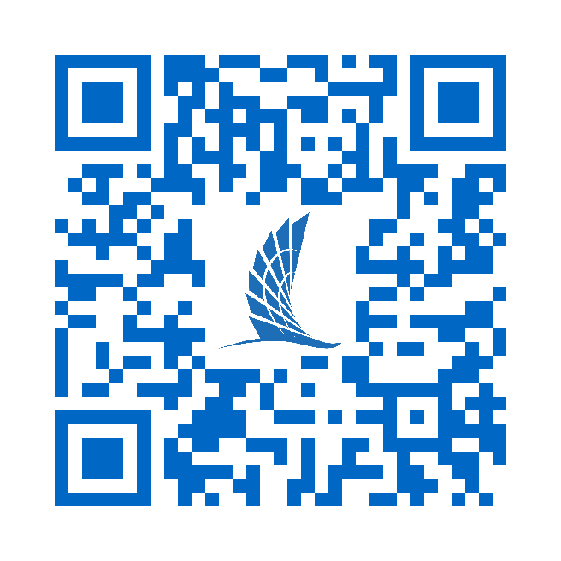
Be an Advocate
In order to maintain a cohesive and welcoming brand image, it is crucial that we protect the usage of our university name and marks.
Be an advocate by:
Following the required promotional item procedure.
Reporting inappropriate, incorrect, and unapproved usage of our marks to Marketing & Communications.
Keeping refreshed on our branding guidelines per the Texas A&M University-Corpus Christi Brand and Style Guide (scan the QR code).

Slide 10
Q&A
Questions?
Contact licensing@tamucc.edu or 361.825.3058 with any additional questions.

