Slide 1
building for success
John C.B. LaRue
EPIC 2024

Slide 2
Agenda
About Me
Building Relationships
Building a Team
Building on Failure
Building on Knowledge
Final Takeaways

Slide 3
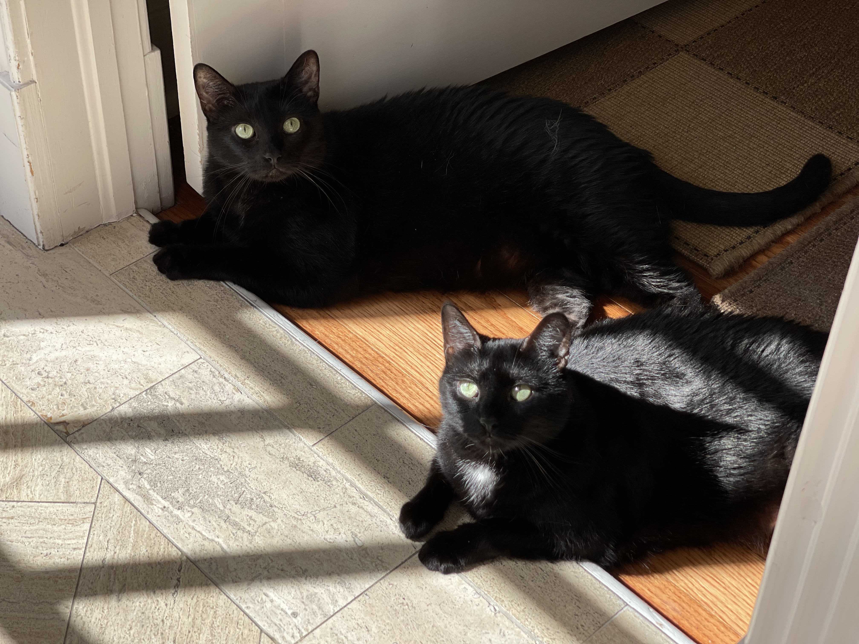
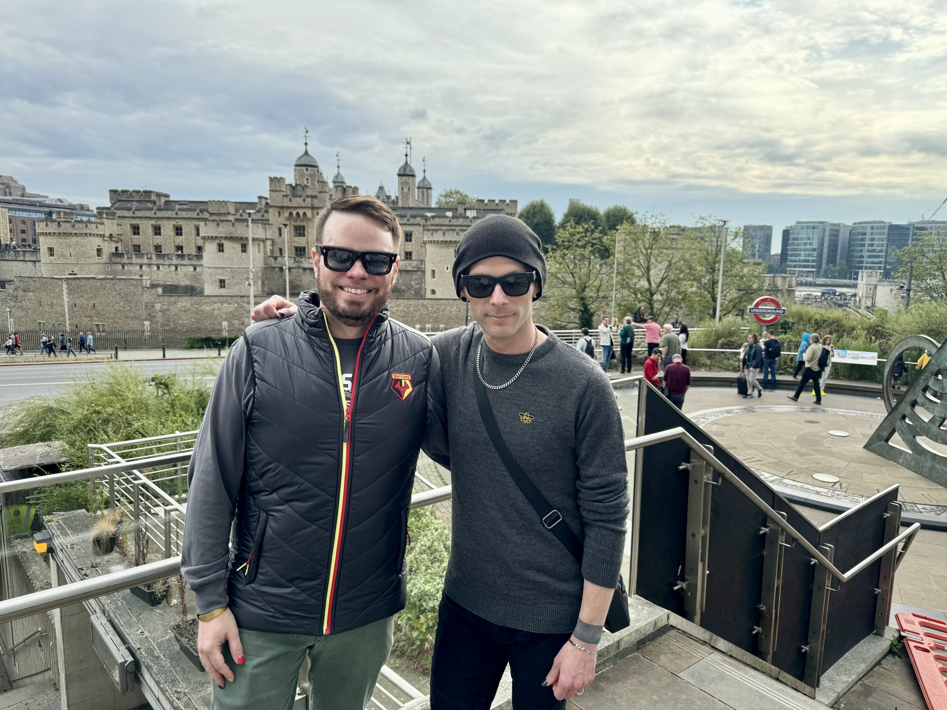
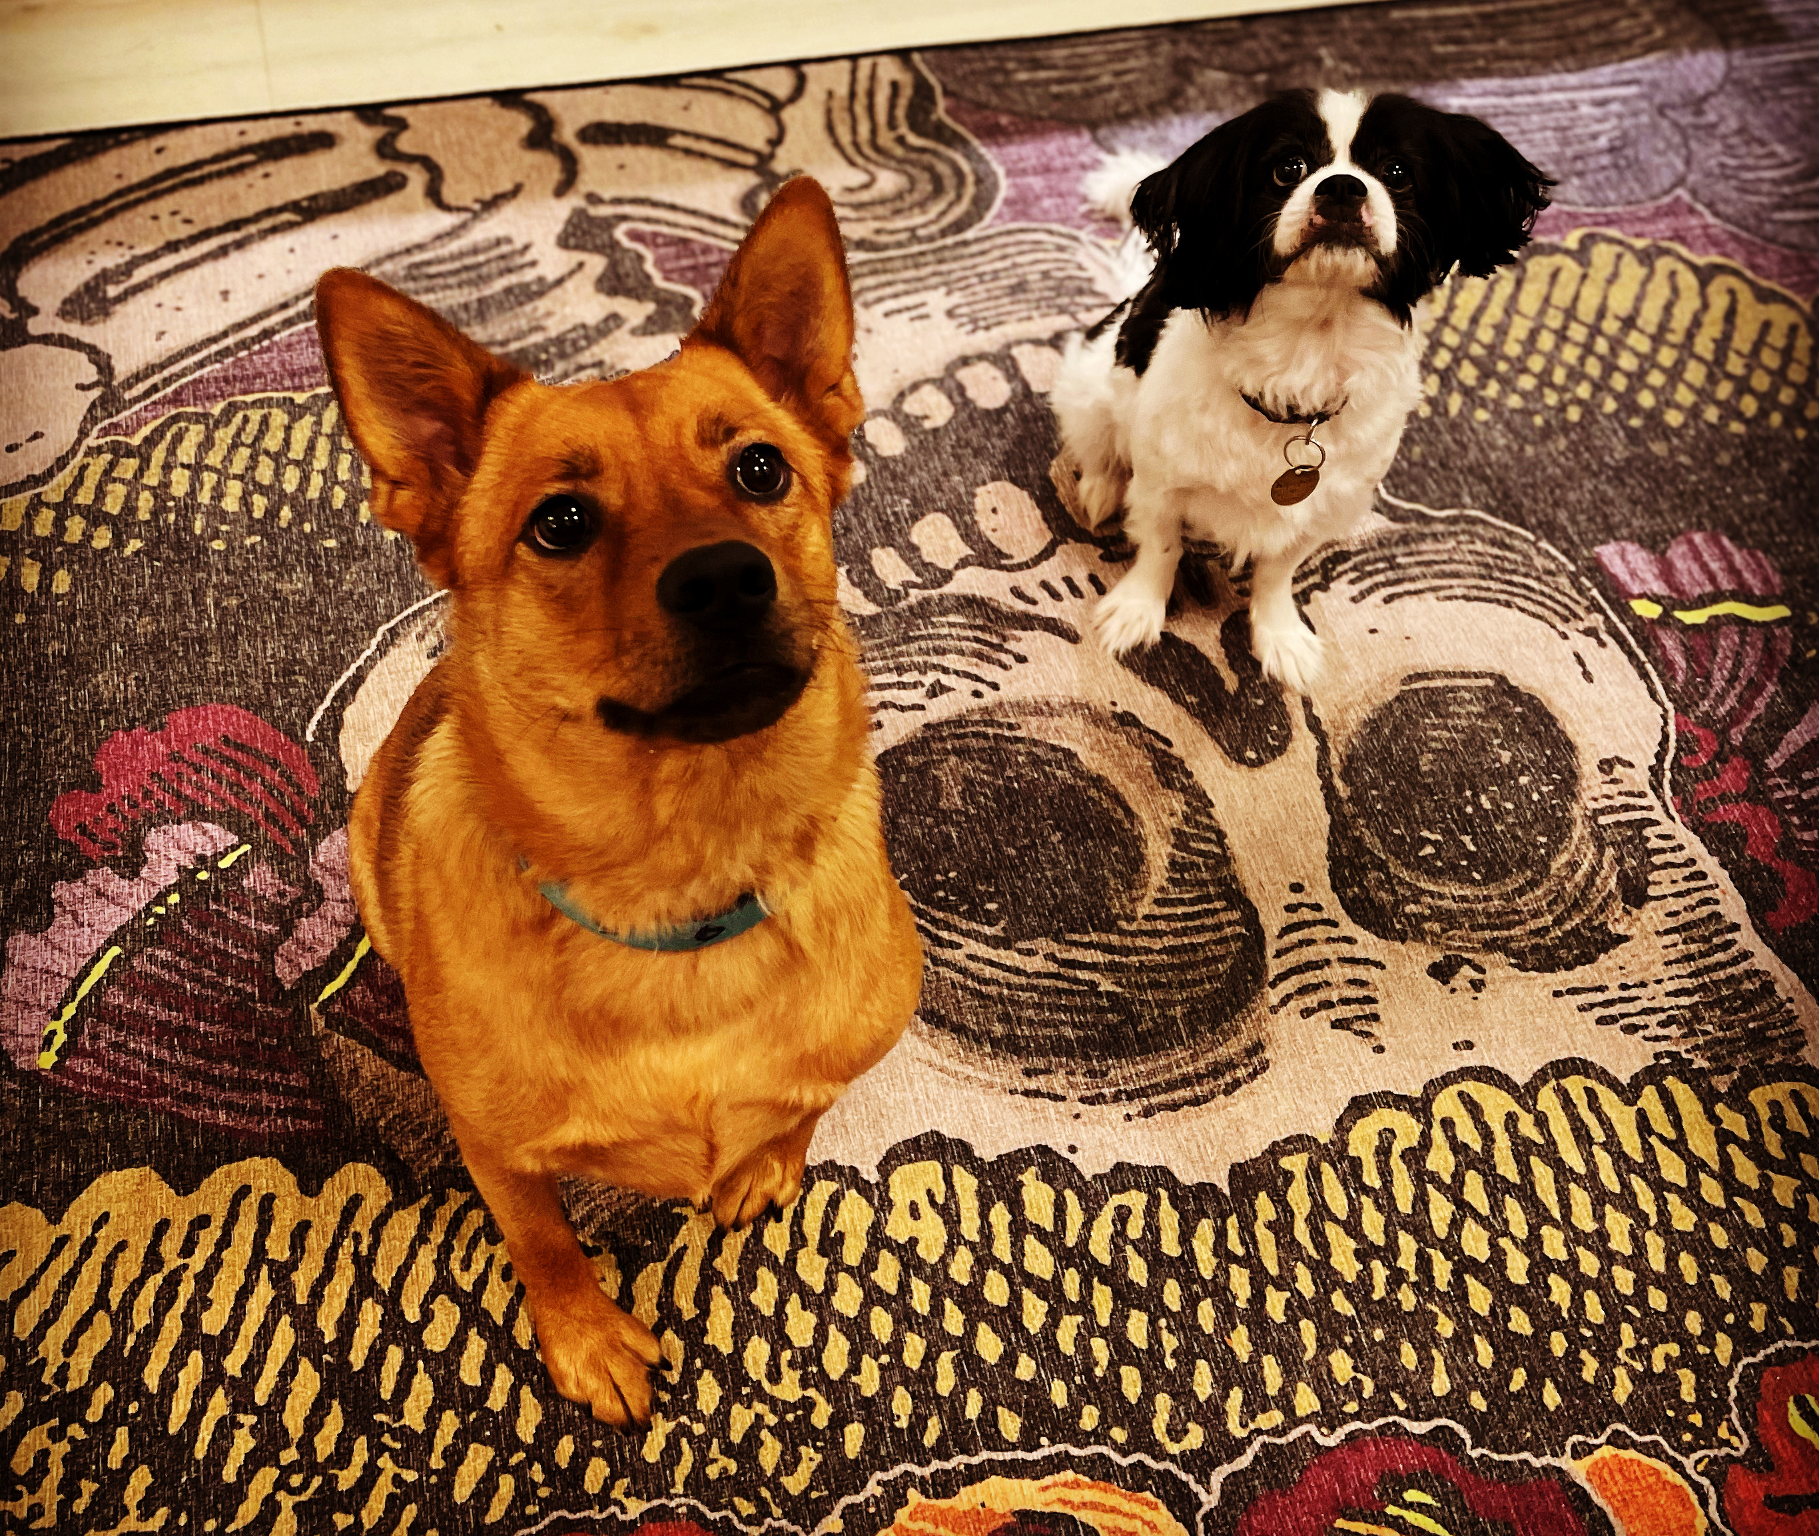
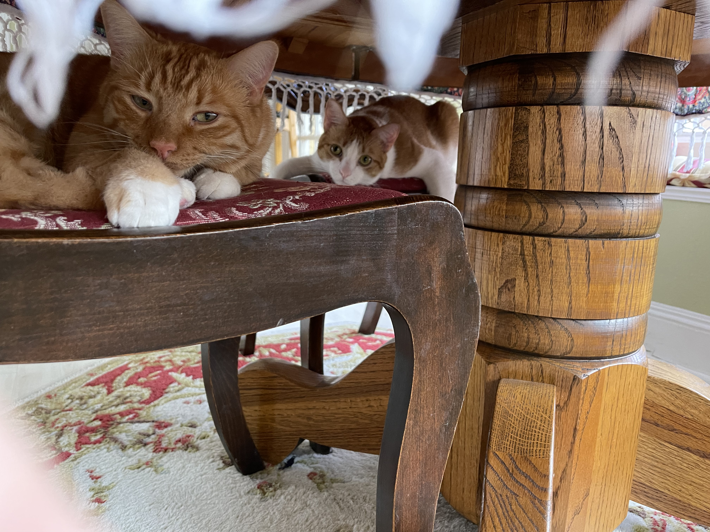
About me

Slide 4
Building relationships

Slide 5
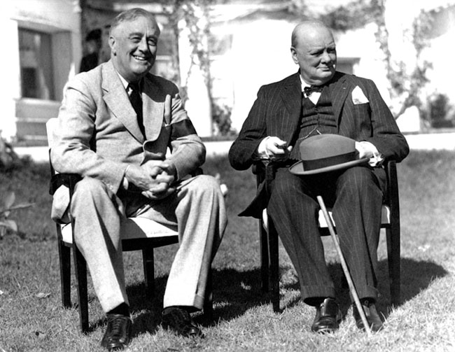
Fdr & Churchill
Relationship has been described as one of the most significant friendships of the 20th century
Met in person for a total of 113 days, but only once prior to the start of WWII
Over the course of the war, Churchill sent 1,161 messages to FDR, FDR sent 788 of his own
Key to success were candor, cordiality, commonalities, and informal approaches
Relationship wasn’t perfect

Slide 7
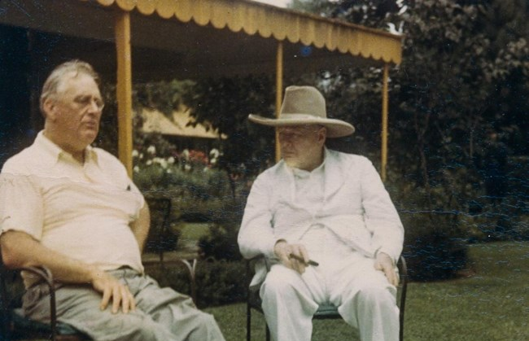
Fdr & Churchill: lessons learned
Relationships matter.
Relationships take time & patience.
Relationships aren’t built solely on a transactional basis.
Compliant fun can be helpful.
Finding commonalities is important when possible.
You have to be able to disagree and be able maintain a relationship.

Slide 8
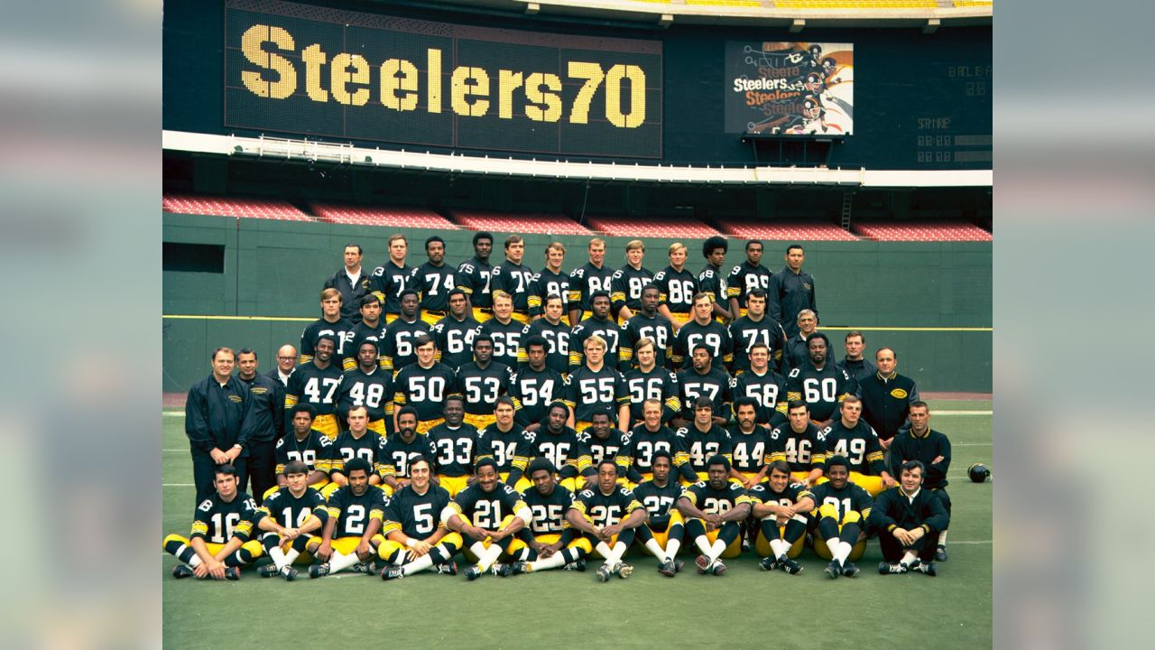
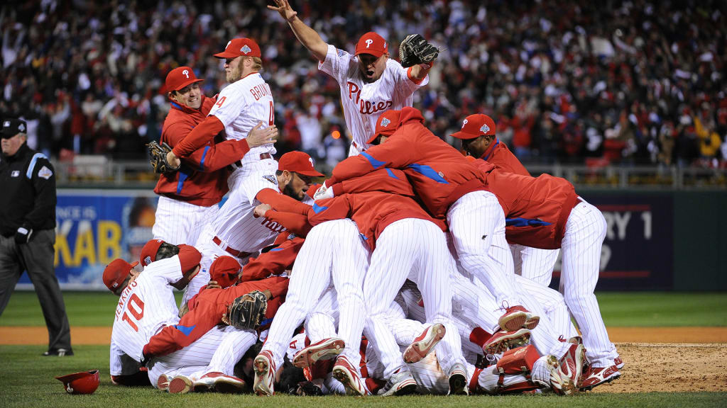
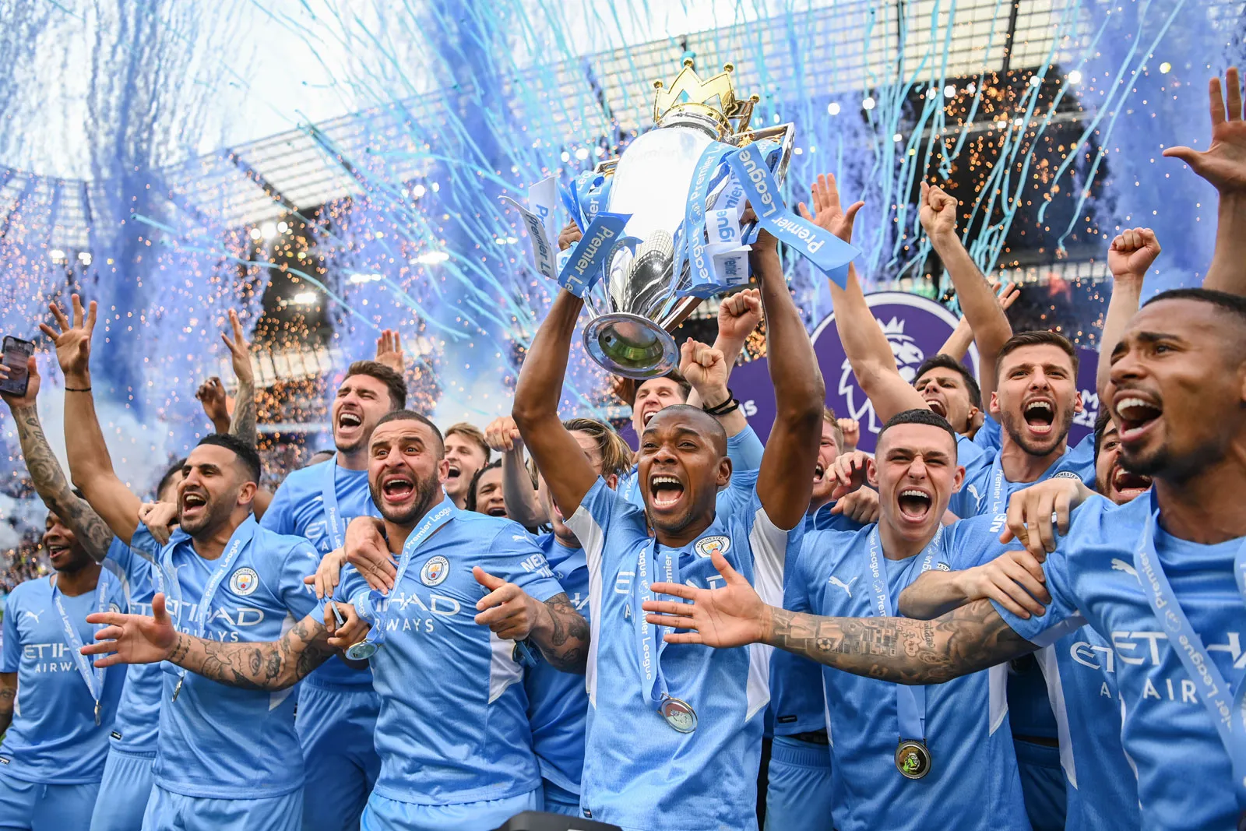
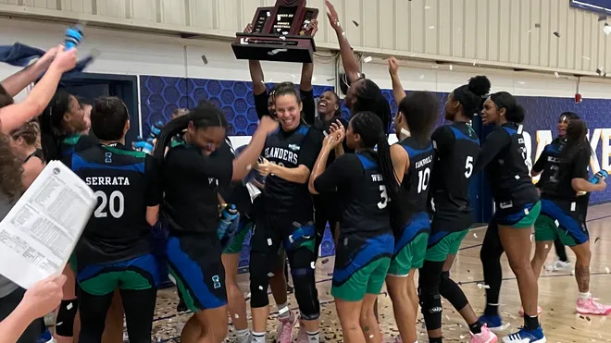
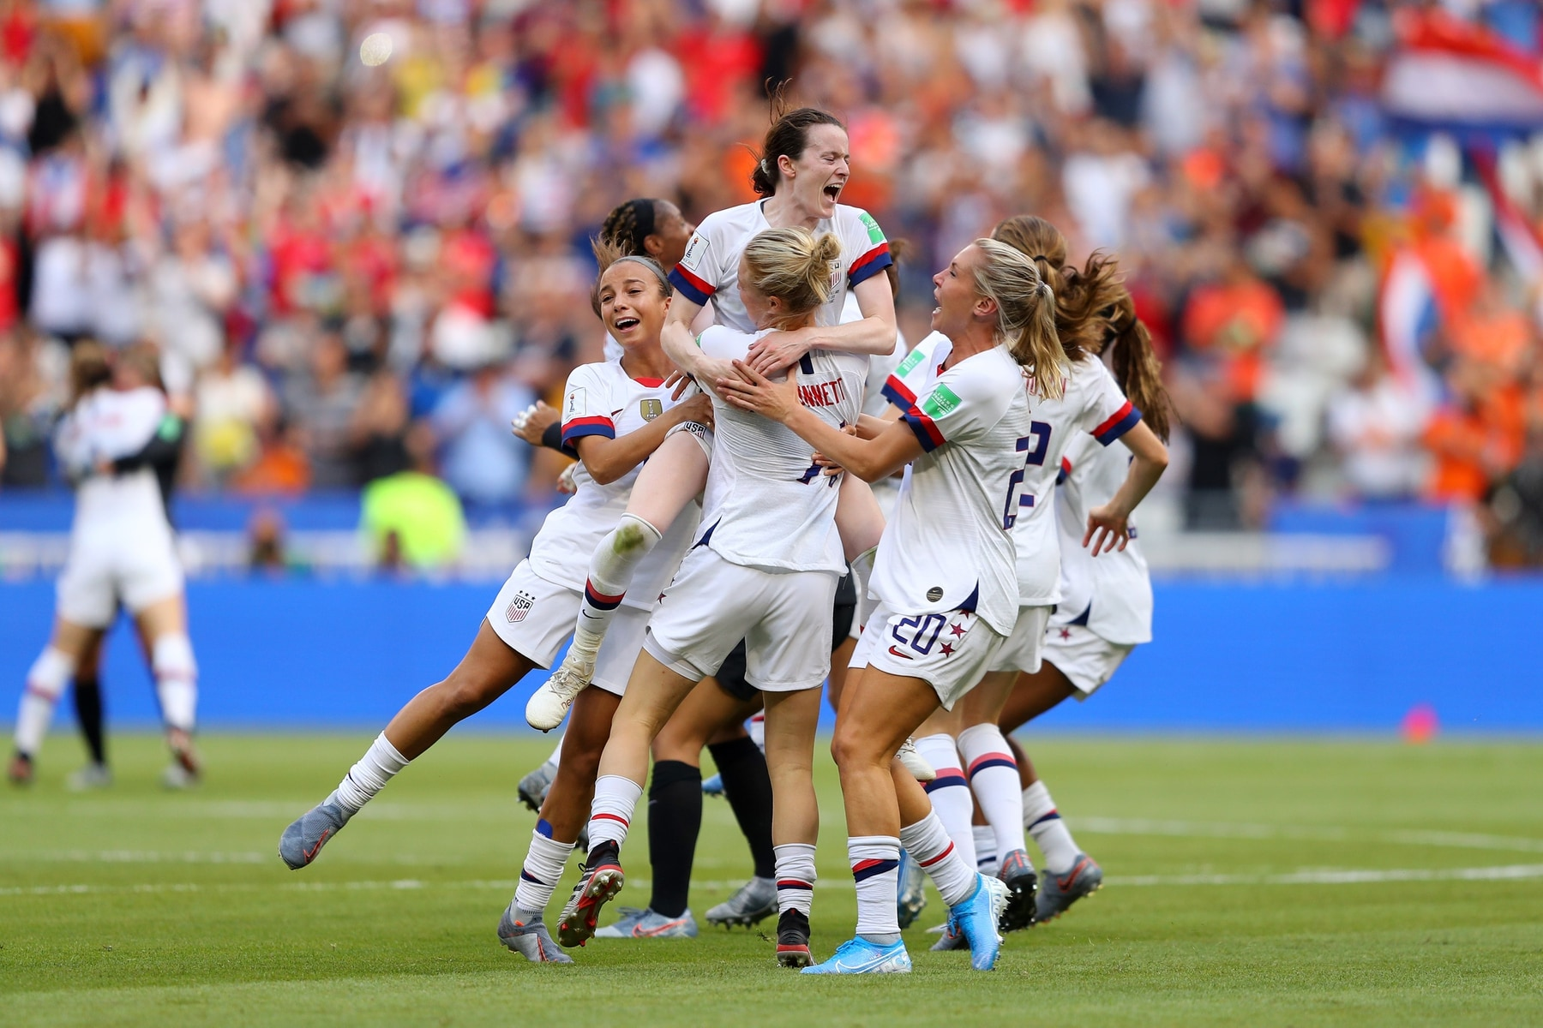
Building a team

Slide 9
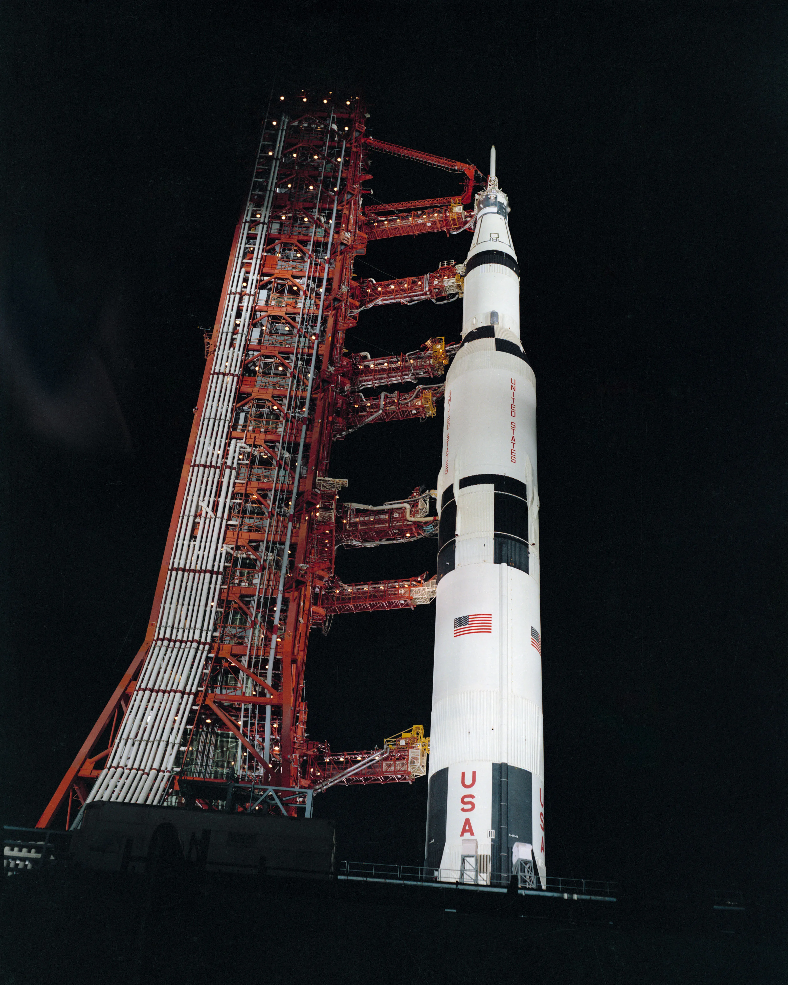
Apollo 13
Intended as third mission to land on the moon and launched from Kennedy Space Center on April 11, 1970
Astronauts Jim Lovell, Fred Haise, and Jack Swigert
Oxygen tank explosion resulted in losses of oxygen, water, electricity, and light
Crew more than 200k miles away
Mission Control team in Houston solution(s)

Slide 11
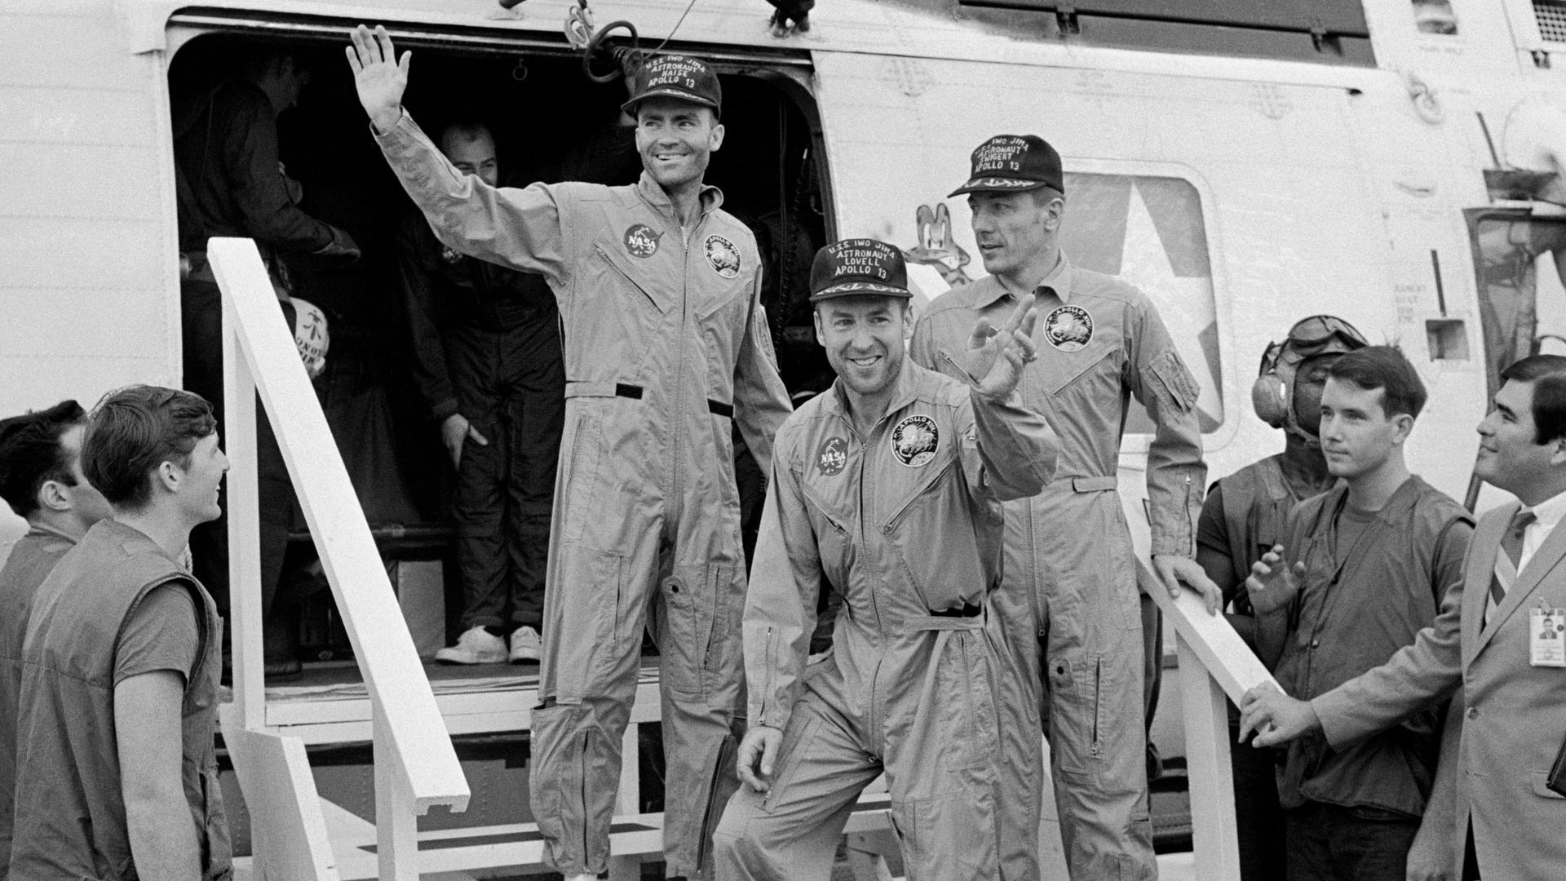
The successful failure
Solution made from a plastic bag, spacesuit hose, cardstock, and duct tape
87 hours around the clock
Touchdown in the Pacific on April 17
Subsequent redesign of Apollo equipment
Calm leadership
Constant and thoughtful communication

Slide 12
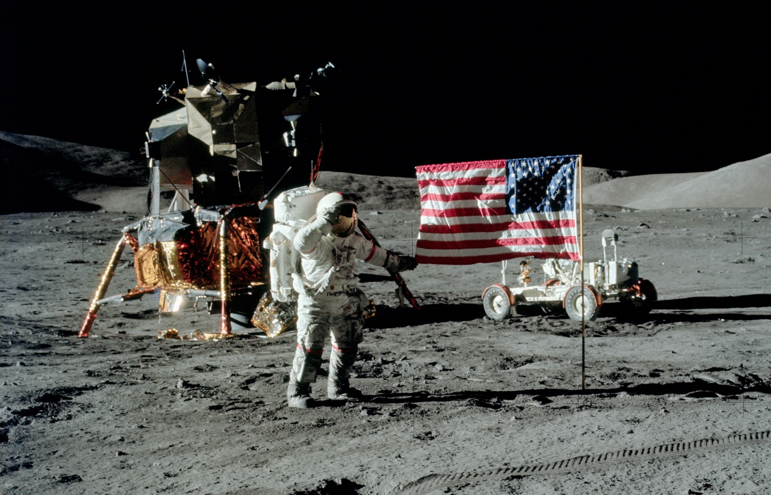
Apollo 13: lessons learned
Good communication is paramount.
Training was also important.
“Your team” may not just be “your team.”
Make sure your team is prepared properly and then let them do their job.
When something goes wrong, fix it.

Slide 13
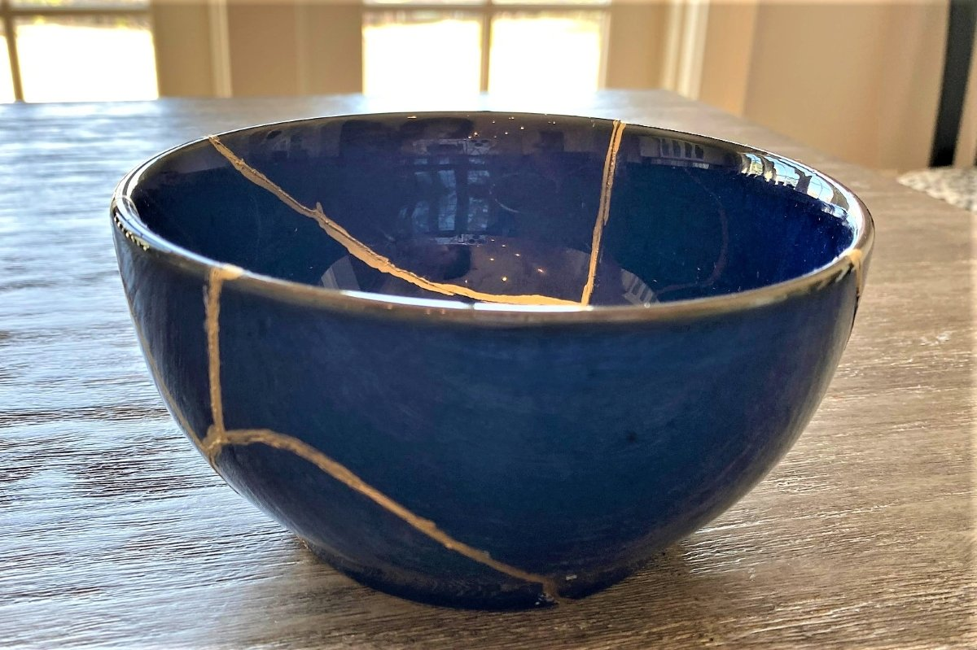
Building on failure

Slide 14
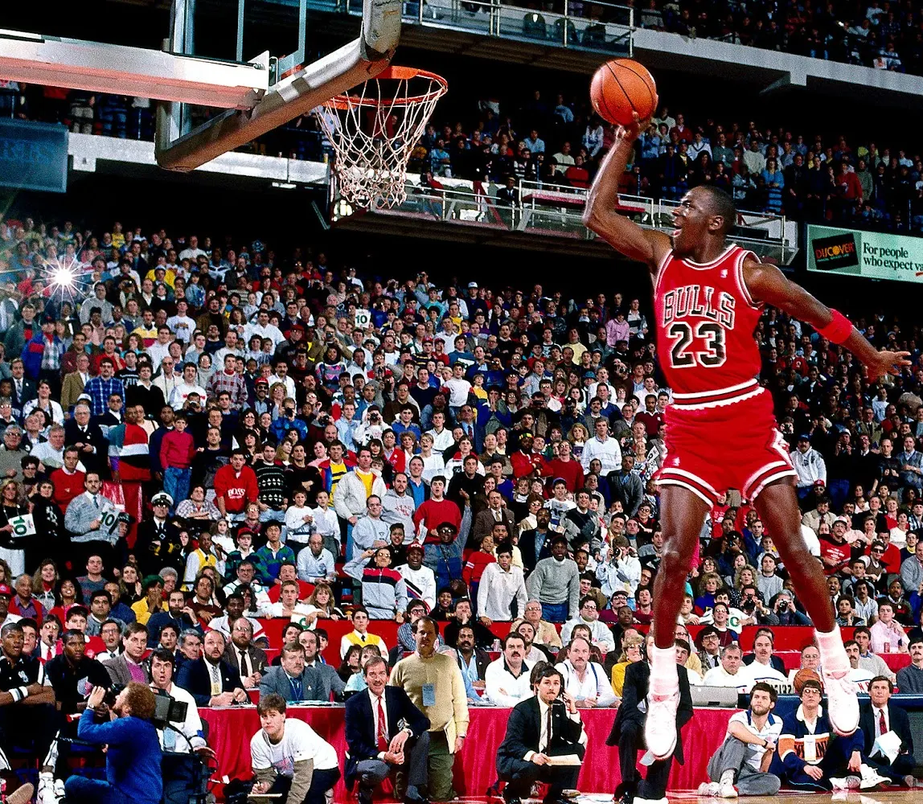
Michael jordan
One of the greatest basketball players of all time
Didn’t make varsity
Used failure as fuel
UNC and winning shot in NCAA championship game
Air Jordans

Slide 16
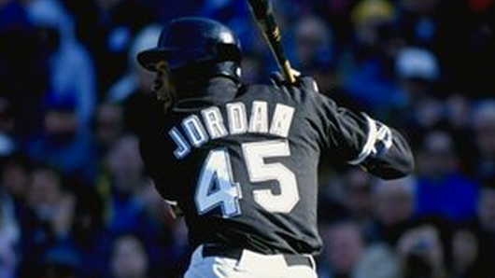
Michael jordan
Failures mentioned happened on the national stage
Fear of failure = fear of what people will think
Switch to baseball
Return to the Bulls in 1995
Expect Failure
Final game in 2003

Slide 17
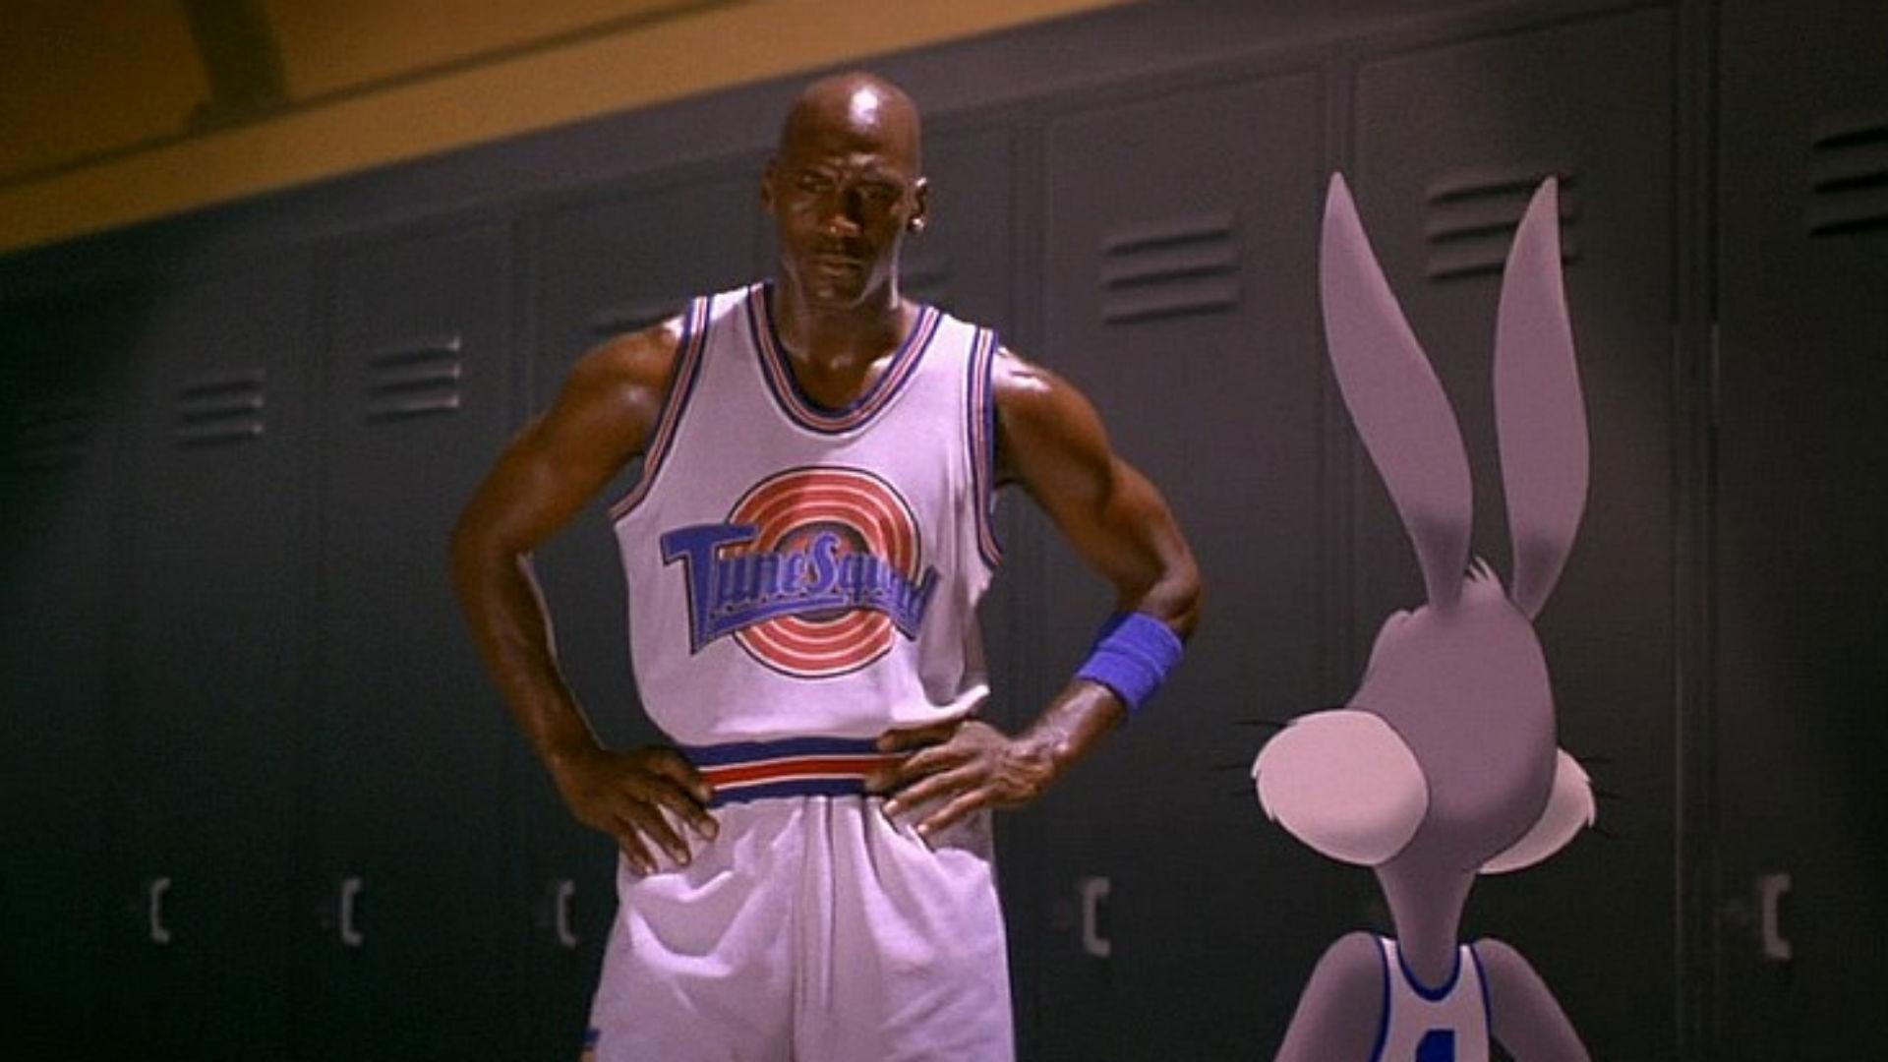
Michael jordan: lessons learned
Failure will happen; don’t be afraid of it, acknowledge it, pick yourself up, and keep going.
You gotta try.
People are going to know you failed.
Know your strengths and areas for improvement.

Slide 18
Building on knowledge

Slide 19
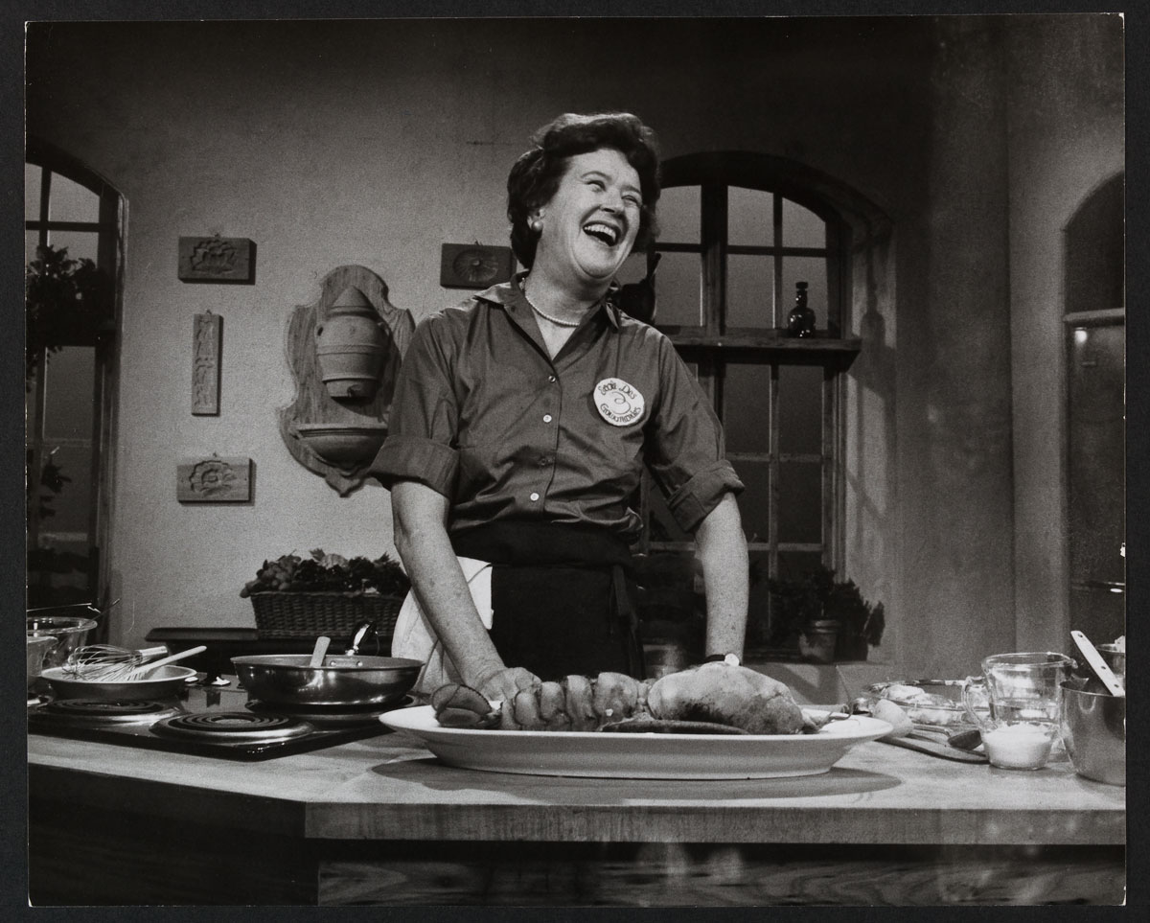
Julia child
Early career in the OSS & CIA
Graduated from Le Cordon Bleu at age 39
Cookbook at age 49
TV career started at age 50
National Book Award at age 68
Work on children’s health and food education
Animated film at age 81
Last book was posthumous

Slide 21
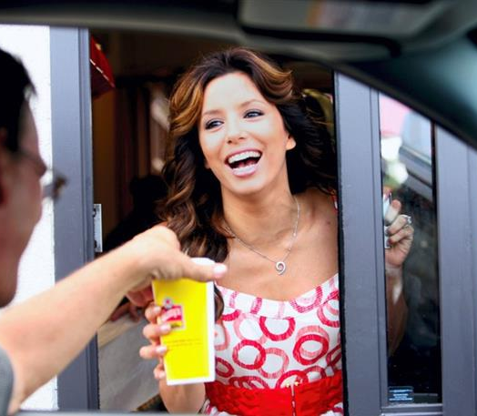
Eva longoria
Grew up in CCTX
Started acting shortly after graduation
Three ALMA Awards, 2 People’s Choice Awards
Went back for a second degree in mid 30s
Graduated with a degree in Chicano Studies
“You’re never too old or too busy to continue your education.”

Slide 22
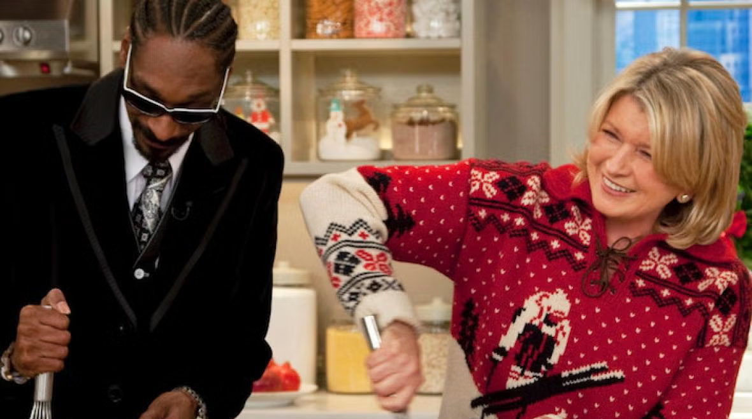
Martha stewart
Modeling career
Attended Barnard College but changed majors (like, a lot)
Second career as a stockbroker
10 years later, launched catering company at age 35
First cookbook at age 41
Started Martha Stewart Living magazine at age 49
Martha Stewart Living TV show at age 52

Slide 24
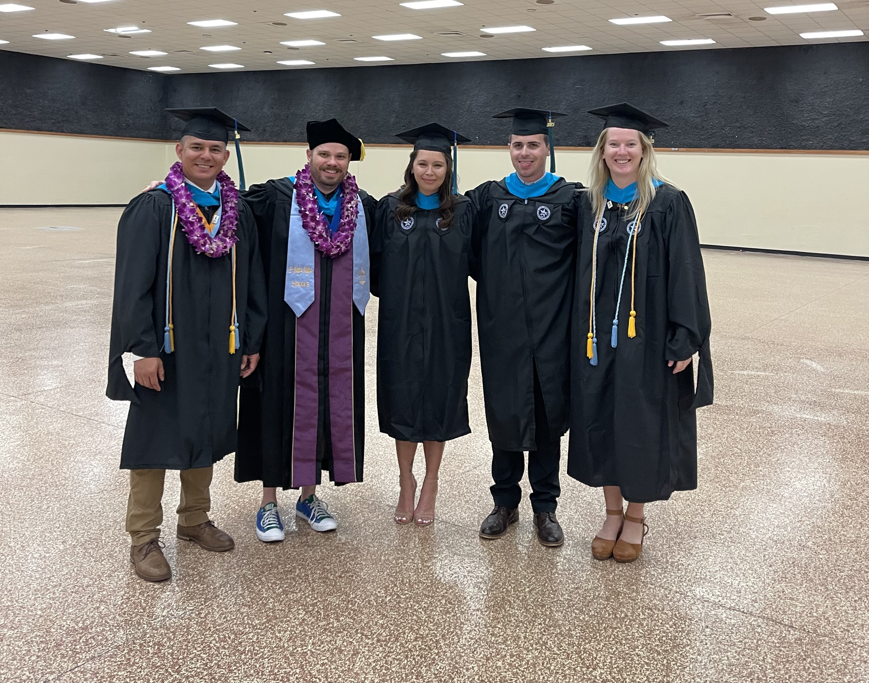
Lifelong learning: lessons learned
Sometimes learning involves formal education and sometimes it involves learning as you go from new experiences.
Once again, you can’t be afraid of failure.
Additional learning isn’t always a choice you make.
Opportunities to learn are everywhere.
Try something new!

Slide 25
Key takeaways
Relationships aren’t built solely on a transactional basis.
You have to disagree and be able maintain a relationship.
Failure will happen; don’t be afraid of it, acknowledge it, pick yourself up, and keep going.
Know your strengths and areas for improvement.
Sometimes learning involves formal education and sometimes it involves learning as you go from new experiences.
Try something new!

Slide 27
Thank you
John C.B. LaRue
x2636
john.larue@tamucc.edu

