Slide 1
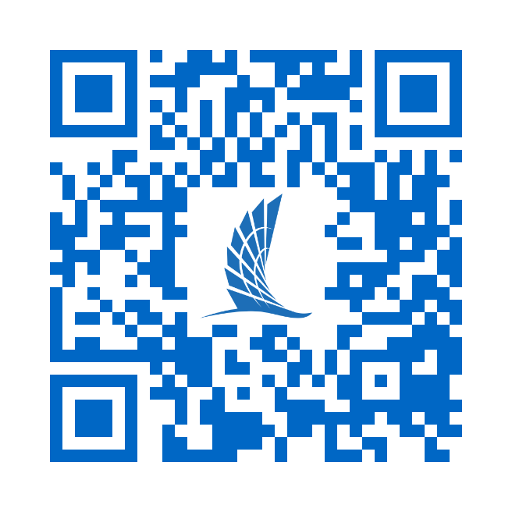
For Questions, Scan the QR Code and Join our Slido using Code #1265827

Slide 2
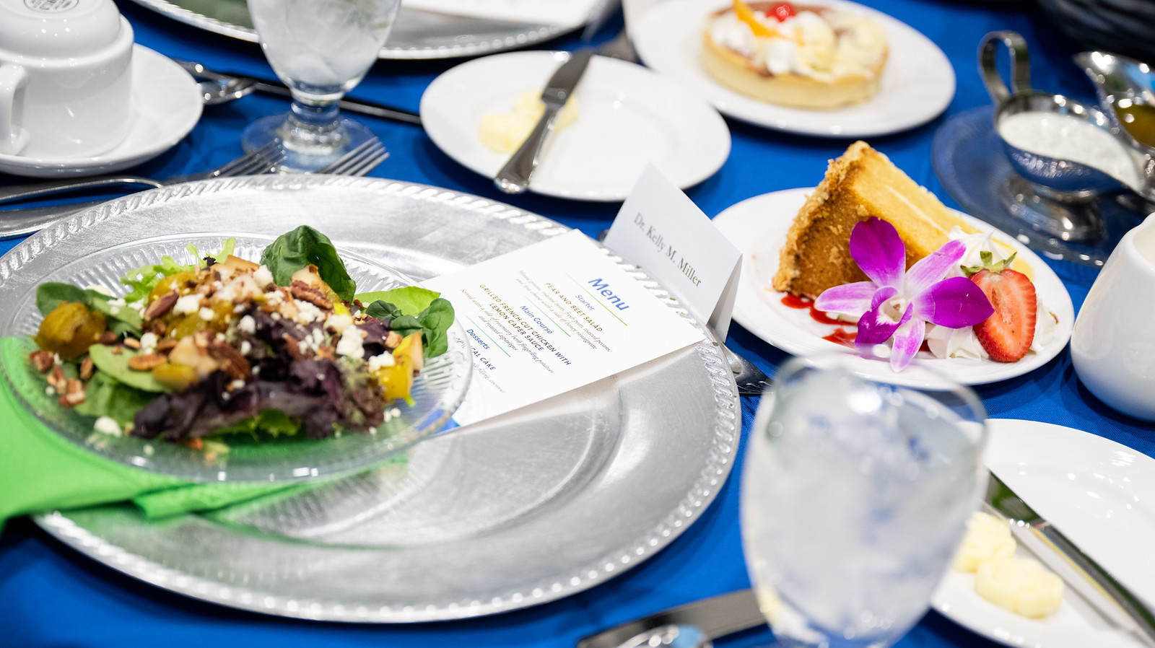
Institutional Advancement
Event Planning 101

Slide 3
institutional Advancement Events team
Carrie Coursey
Event Services Manager
carrie.coursey@tamucc.edu
O 361.825.2989 | C 361.249.6035
Linda Copado Rincón
Events Coordinator
linda.rincon@tamucc.edu
O 361.825.2763 | C 361.947.1475
Sarina Garcia
Assistant Director of Donor Engagement
sarina.garcia@tamucc.edu
O: 361.825.3641
Ricardo Urdinaran
Event Services Assistant
ricardo.urdinaran@tamucc.edu
O: 361.825.3825 | C: 609.385.6684

Slide 4
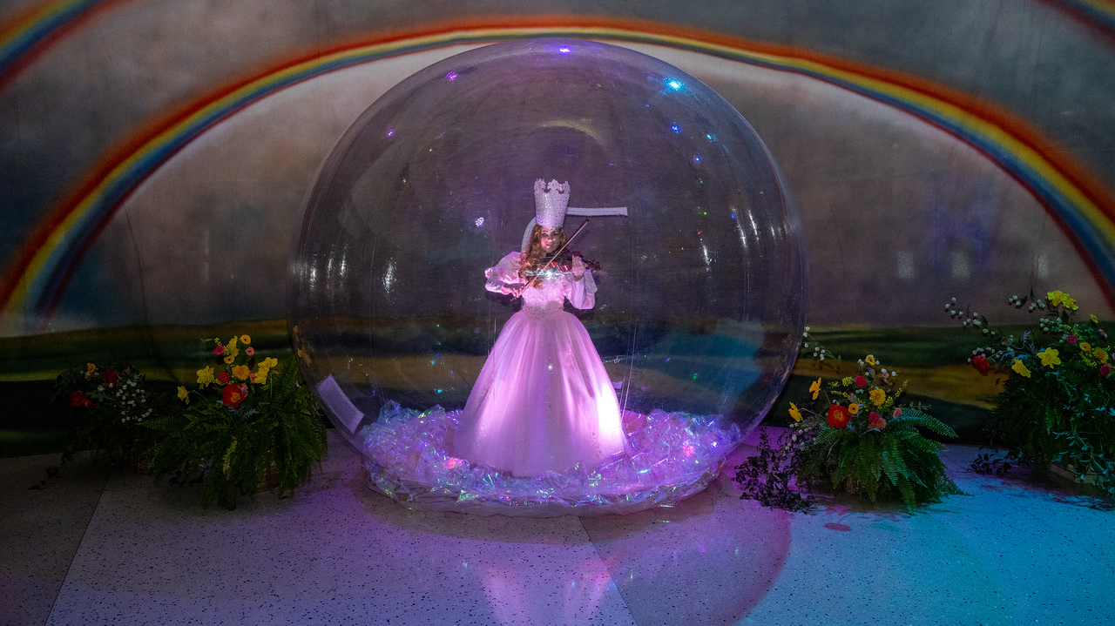
Signature IA Events
External Events
Internal Events

Slide 5
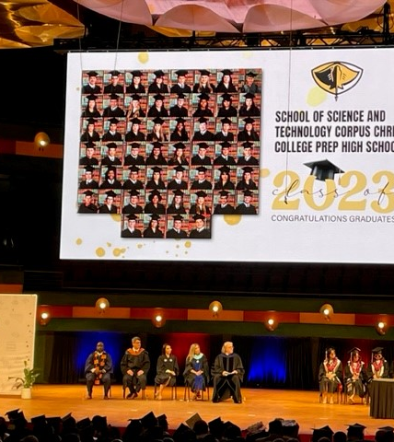
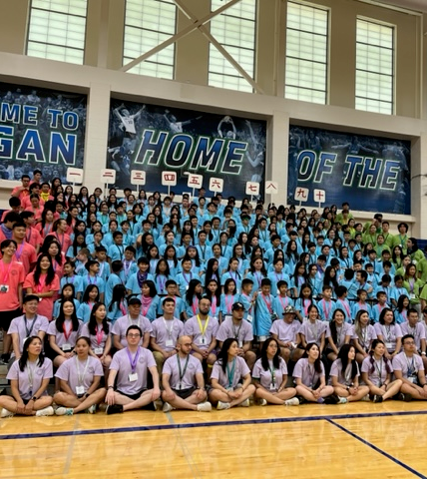
External events
External Event Clients
Non-University Group
Any group or individual that is not formally recognized or affiliated with the university.
Individuals
For-profit groups
Non-profit groups
Includes professional organizations, societies, other universities, governmental agencies, and political groups. These groups may include university personnel, alumni, and students acting as private citizens and not in collaboration with a recognized student organization.

Slide 6
External events
External Clients
Initial client inquiry
Request for Proposal (RFP)
Planning and communication
Post event

Slide 7
Internal events
Internal Clients
Institutional Event Notification Form (IEN)
TAMU-CC departments and organizations must fill out IEN when planning an event where external guests will be in attendance.
Please submit the form at least two weeks prior to event.
IEN List
List is shared with the President’s Cabinet and Campus Partners.
Sent out weekly on Thursdays.

Slide 8
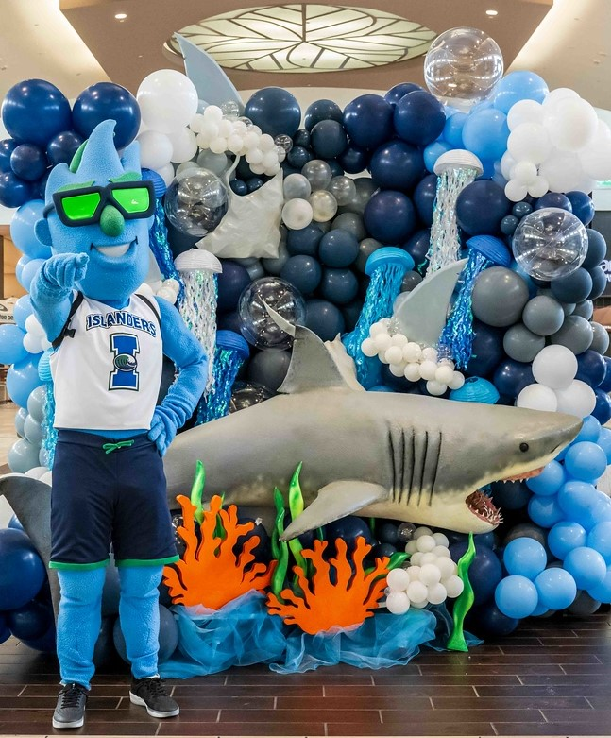
Event services support
Event Consultation
Planning Resources
Event Management
Policies and Procedures
Connections

Slide 9
What does it take to plan an event like this?

Slide 10
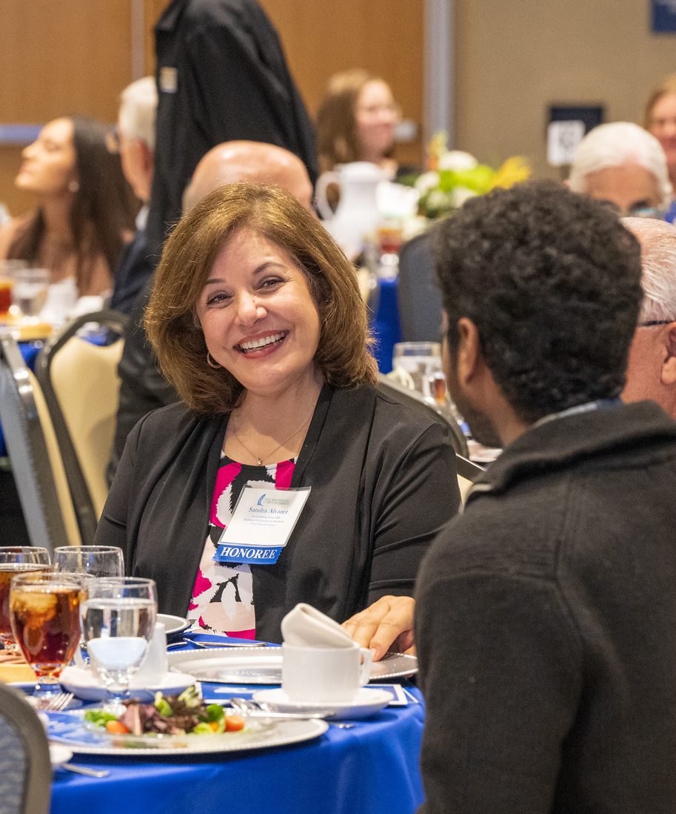
Steps to Planning a successful event
Plan Early
Purpose of Event
Date and Venue Selection
Budget/Funding
Checklist and Timeline
Printed Materials
Run of Show
Walkthrough
Staffing
Catering
Vendors
Seating
Name Badges
Program Rehearsal
Day of Event
Event Follow-up

Slide 11
Events Data
GUEST CONTACT INFORMATION
IA Data Request Form
TAMU-CC departments and organizations may request contact information for external guests (community, alumni, campus, etc.) for use .
Please submit the form at least twenty days prior to need.
Registration
Microsoft Forms
Share latest contact info collected by your area with IAHelpDesk@tamucc.edu.

Slide 12
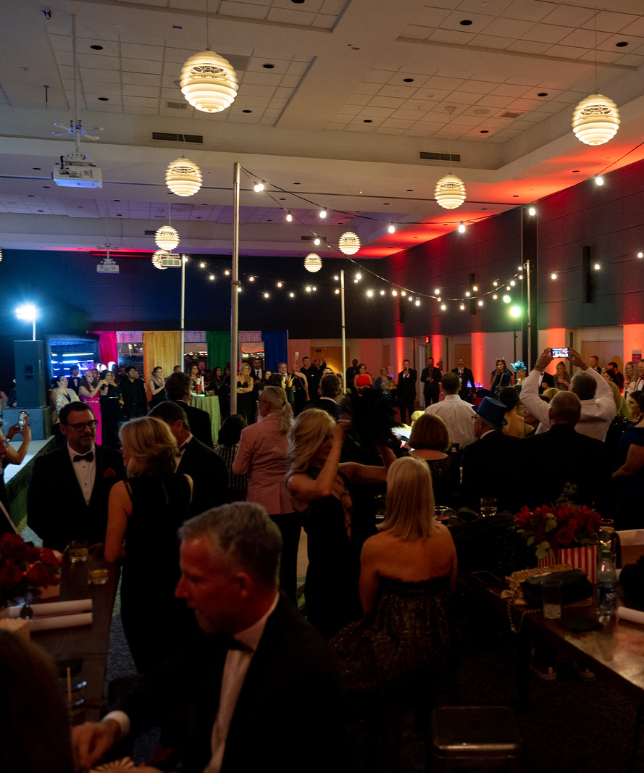
Communication
Pre-Event
Invitations & Reminders
"Day of" Information (check-in, parking, etc.)
Post-Event
Thank You Message
Photos & Other Materials
Survey

Slide 13
institutional Advancement Events team
Carrie Coursey
Event Services Manager
carrie.coursey@tamucc.edu
O 361.825.2989 | C 361.249.6035
Linda Copado Rincón
Events Coordinator
linda.rincon@tamucc.edu
O 361.825.2763 | C 361.947.1475
Sarina Garcia
Assistant Director of Donor Engagement
sarina.garcia@tamucc.edu
O: 361.825.3641
Ricardo Urdinaran
Event Services Assistant
ricardo.urdinaran@tamucc.edu
O: 361.825.3825 | C: 609.385.6684

Slide 14
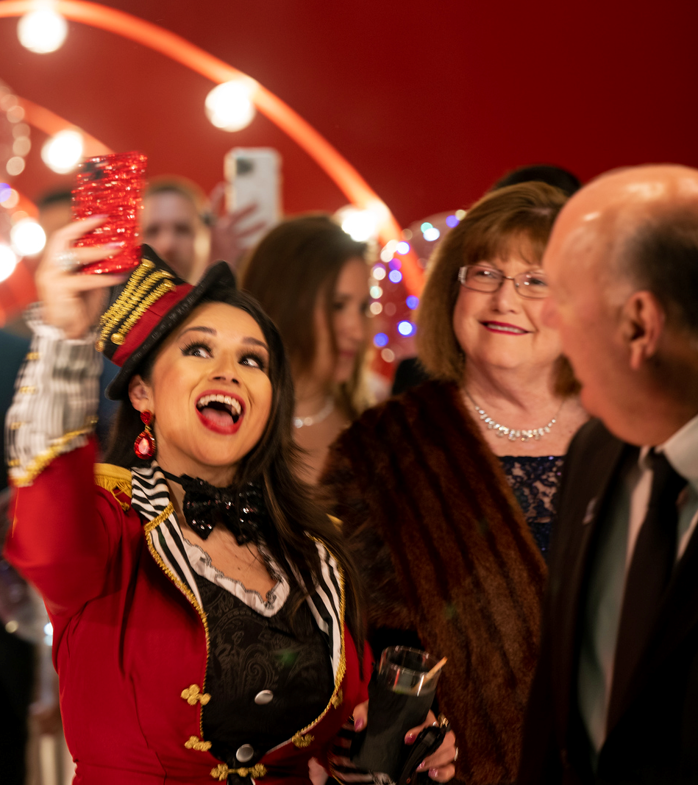
“An event is not over until everyone is tired of talking about it.” Mason Cooley
IA Event Services
event.services@tamucc.edu
361.825.EVNT (3868)

Slide 15
Questions

