Slide 1
Building Blocks for New Professionals
By Devon Wilde and Laura Glasgow

Slide 2
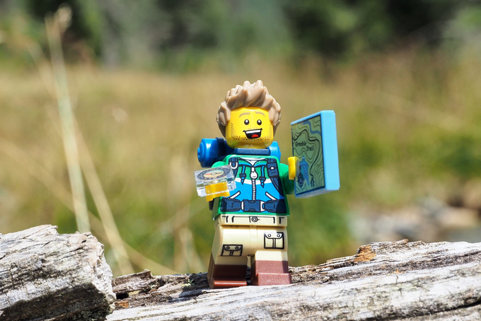
Agenda
Learning Outcomes
Presenter Bios
Who is Here?
Circle of Influence
Mentorship
Next Steps Up
Team Management
Know Your Benefits...And Use Them
Professional Development Opportunities
Questions

Slide 3
Learning Outcomes
By attending this session, new professionals will learn how to set boundaries with those around them.
By attending this session, new professionals will learn what resources are available to them at TAMU-CC and outside.
We hope you meet someone in this session that you didn't know before

Slide 4
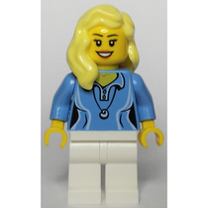
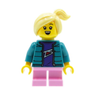
Devon Wilde
Laura Glasgow
Devon Wilde, ABD, is the Associate Athletics Director for Student-Athlete Development. Devon has worked for TAMU-CC in various roles since June 2017, working with many students and new professionals.
Laura Glasgow, M.Ed (she/her/hers), is the Associate Director of Residence Life with Islander Housing. She has worked at TAMU-CC since July of 2023 when the university took over the operation of Islander Housing. Throughout the years, Laura has supervised many new professionals and development numerous new professional development plans to help her new staff be successful within their new roles.

Slide 5
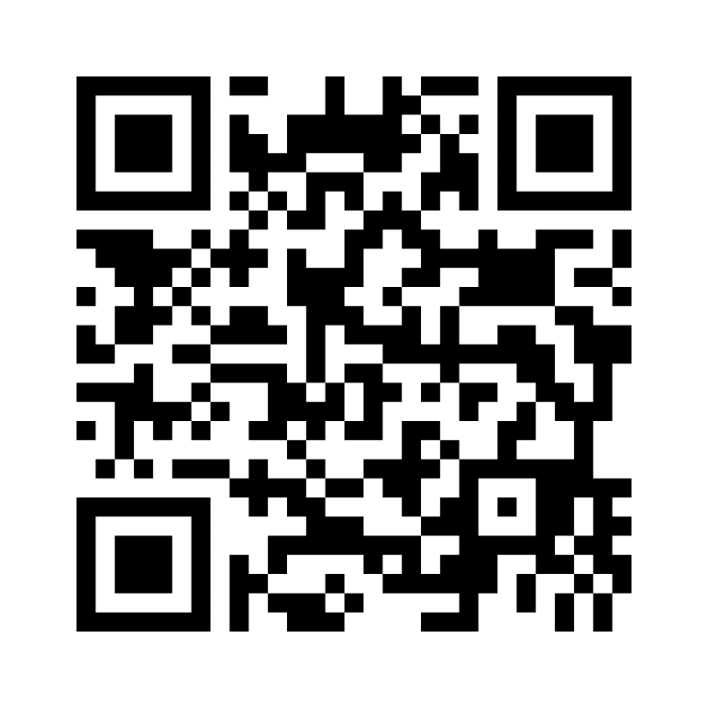
Who is Here?
Menti Meter

Slide 6
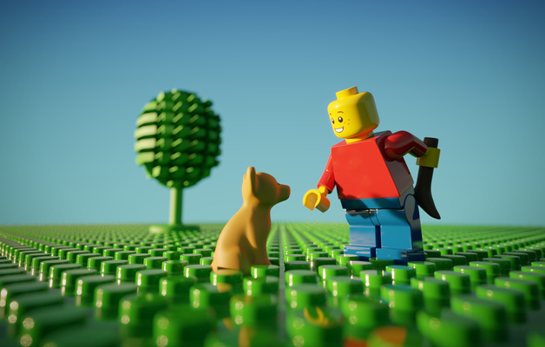
Circle of Influence
Special People to Observe
Building relationships
Attending university events
Joining organizations/committees
Know What You’re Stepping Into
Meeting - check the details
Know who is attending
Check the weather
Prepare your content
Know what role you play in that meeting

Slide 7
Circle of Influence Cont.
Leadership above you
Professional and personal fish bowls
Widening your circle
Committees
Partnerships
Mutual attendance

Slide 8
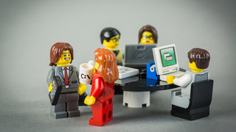
Mentorship
What does mentorship look like?
Why should you have a mentor
How do you find a mentor

Slide 9
Next Steps Up
Stay current with industry trends
Google is a great tool!
AI is a great tool...
Know your tools
Social media
Appropriate journals, online courses, engage with professional committees
Be adaptable
Higher Education is ever changing
Stay flexible, learn new technology and software
Be open to new ideas and strategies especially with turnover

Slide 10
Team Management
Students
Supervisors
Professional team
Establishing boundaries with supervisors
Understanding boundaries

Slide 11
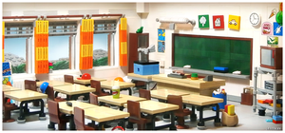
Know Your Benefits... And Use Them...
Employee Betterment Program
TAMUS Doctoral Tuition Program
Employee Assistance Program (EAP)
Retirement and Financial Programs
Wellness Benefits
Free Fridays
Islander Health Initiative
Insurance Wellness Programs

Slide 12
Professional Development
Departmental Opportunities
Institutional Opportunities
Regional Opportunities
Inter/national Opportunities

Slide 13
Institutional Opportunities
Career and Professional Development Center
I-Engage
Workday
TrainTraq
LinkedIn Learning
Library resources
Volunteer opportunities
Tamalada
Islander Lights
Paws on the Islander
Epic Professional Development Conference
Continued education with Employee Betterment Program

Slide 14
Regional Opportunities
Regional Conferences
Regional Symposiums
Regional Drive-in conferences
Reach out to A & M System partners
Find others in similar positions at other A & M schools for support

Slide 15
Inter/national Opportunities
National Conferences
International Conferences
Virtual Conferences through International Organizations

Slide 16
Questions
Back to MentiMeter!

