Slide 1

Request External Evaluations

Slide 2
Request External Evaluations
Administrators, Case Managers, and Committee Managers can add or request evaluations from scholars who are external to the committee (or even the institution) to help them evaluate a candidate.
There are two ways to add external evaluations. An Administrator, Case Manager, or Committee Manager can upload an evaluation they have on their computer to the candidate's case, or can request evaluations from one or more external evaluators by email through RPT.
If requesting an evaluation from an outside scholar by email, the evaluator will receive an email with instructions for submitting the document and can upload it directly to Interfolio without having an Interfolio account.
Note that it is possible to request evaluations from multiple potential evaluators at the same time. (So you only have to type one email message for all requests.)

Slide 3
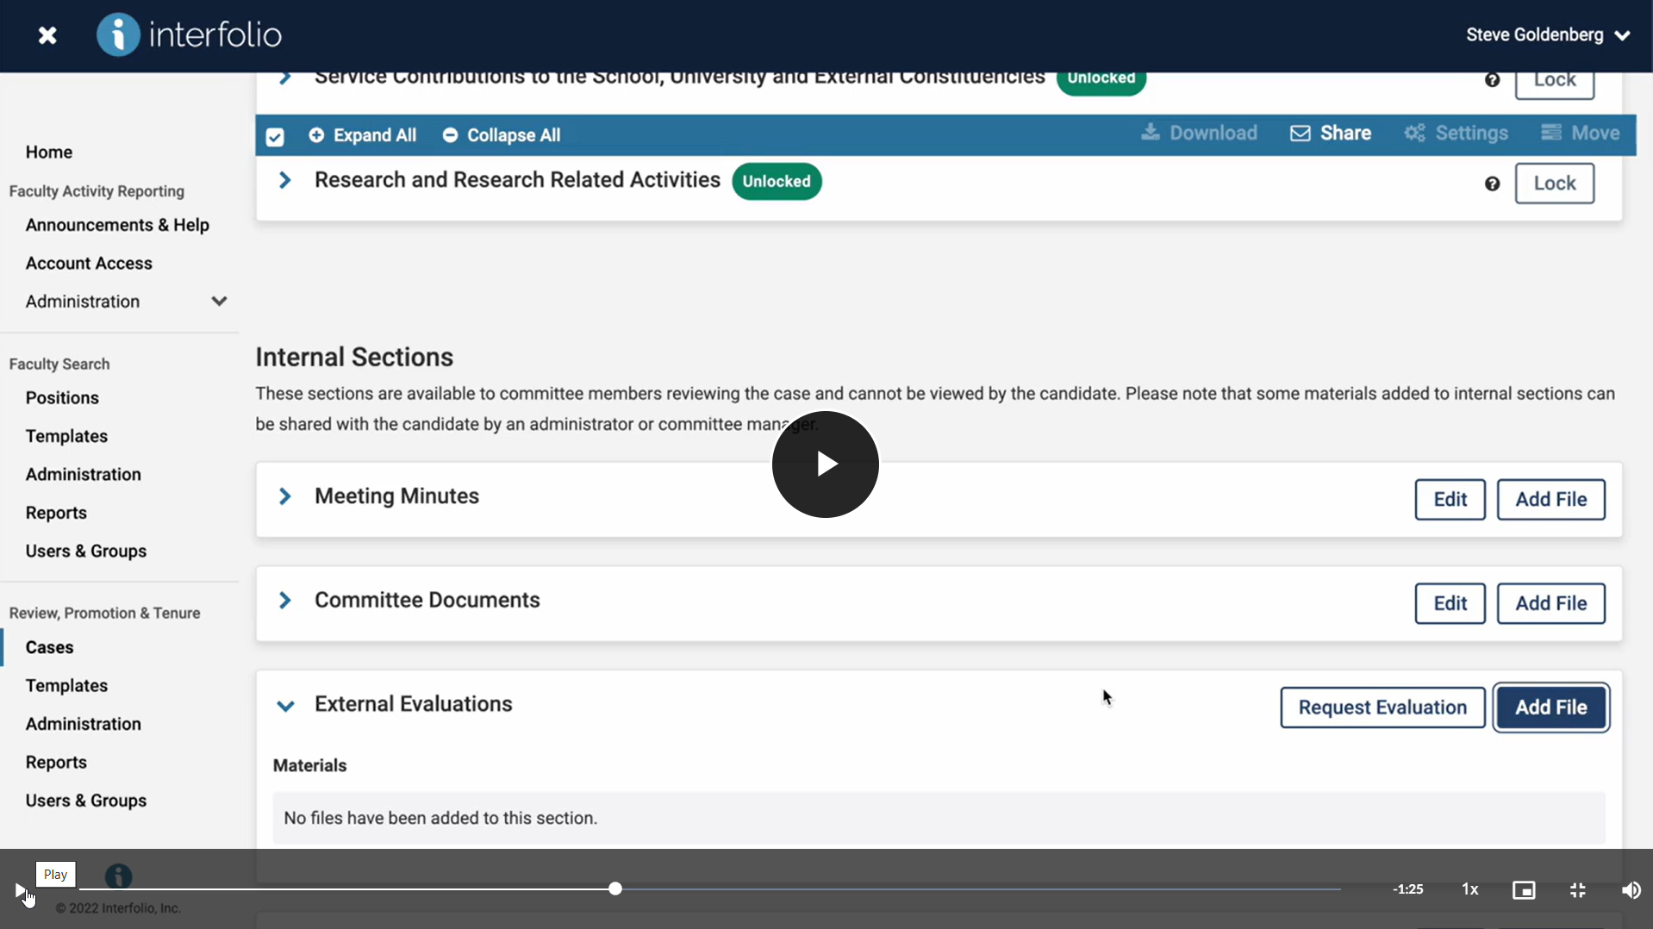
Request External Evaluations

